Slide 1

SNS COLLEGE OF TECHNOLOGY
Kurumbapalayam (Po), Coimbatore – 641 107
An Autonomous Institution
Accredited by NBA – AICTE and Accredited by NAAC – UGC with ‘A’ Grade
Approved by AICTE, New Delhi & Affiliated to Anna University, Chennai
DEPARTMENT OF ARTIFICIAL INTELLIGENCE AND DATA SCIENCE
COURSE NAME : 23EET103- ELECTRIC CIRCUITS AND ELECTRON DEVICES
I YEAR /II SEMESTER
Unit-5 - RECTIFIERS AND POWER SUPPLIES
Topic : Thermal Management

Slide 2
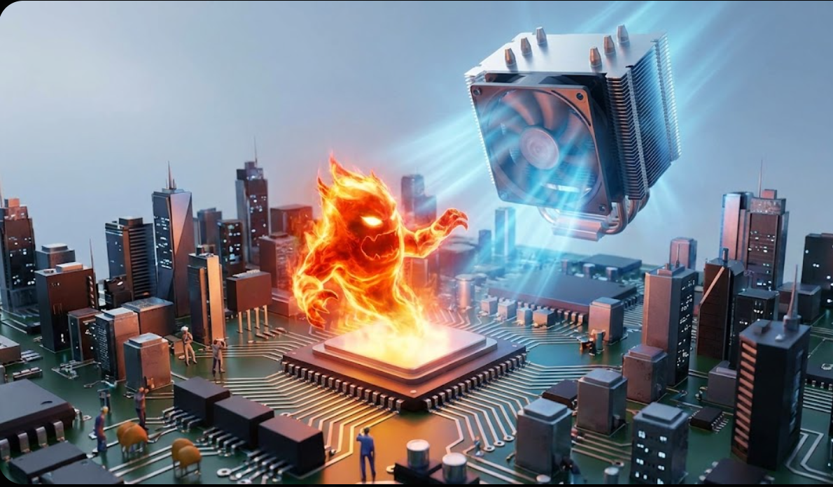
Story Telling

Slide 3
Content
Need for Thermal Management
What is Thermal Management.
Why Thermal Management.
Thermal Management Fundamentals.
Thermal Management of IC and PWB Packages

Slide 4
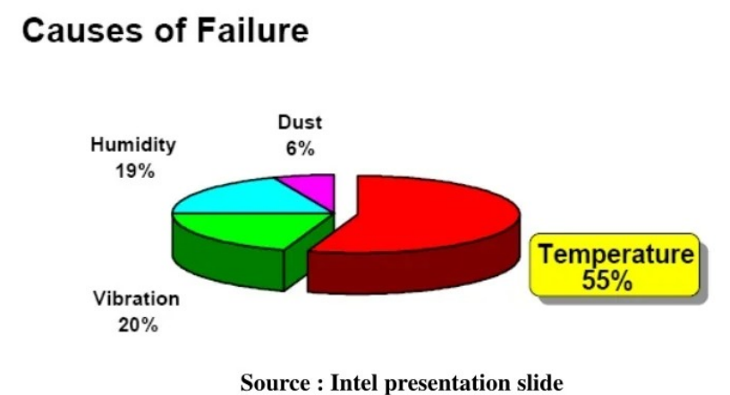
Need for Thermal Management
Ensure Long Term Reliability
Guarantee Performance and Functionality
DT-Empathize

Slide 5
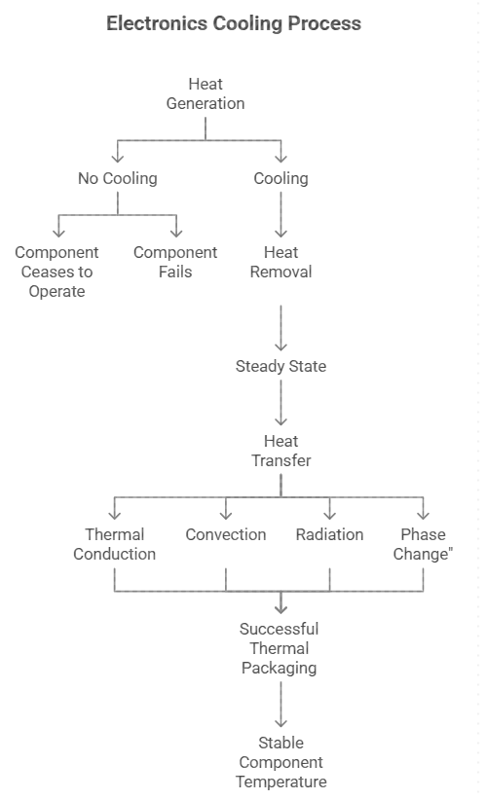
DT-DEFINE
What is Thermal Management
Heat is generated by the electrical resistance of leads, poly-silicon and transistors
The absence of cooling will result in constant rate increase in temperature until the component ceases (terhenti) to operate or until it fails
Placing the device in contact with components at lower temperatures (solid fluid), facilitates the removal of heat flow away from the components.
Presence of cooling, the temperature rise is moderated as it approaches an acceptable steady state value.
At steady state, all heat generated by the component is transferred to the surrounding structure and/or fluid.

Slide 6
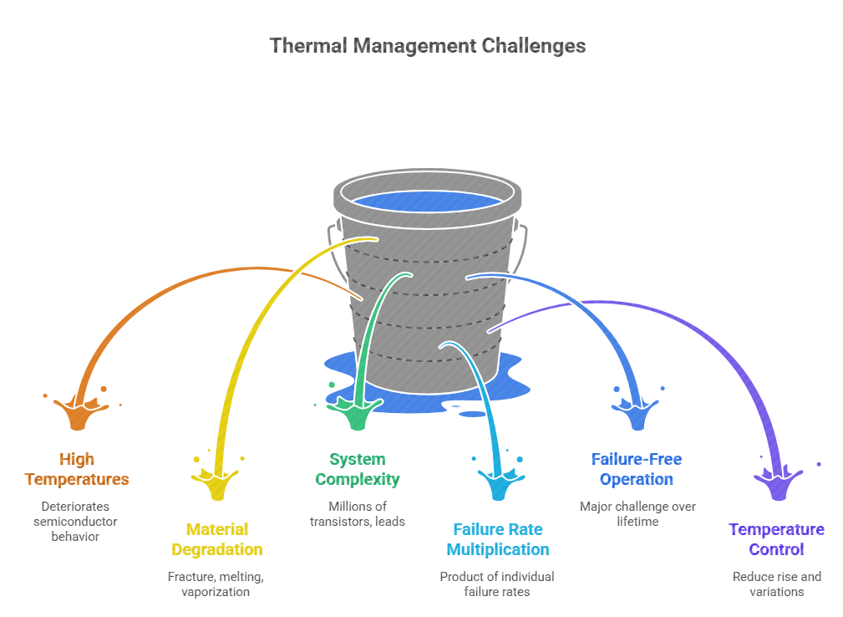
DT-DEFINE
Why Thermal Management

Slide 7
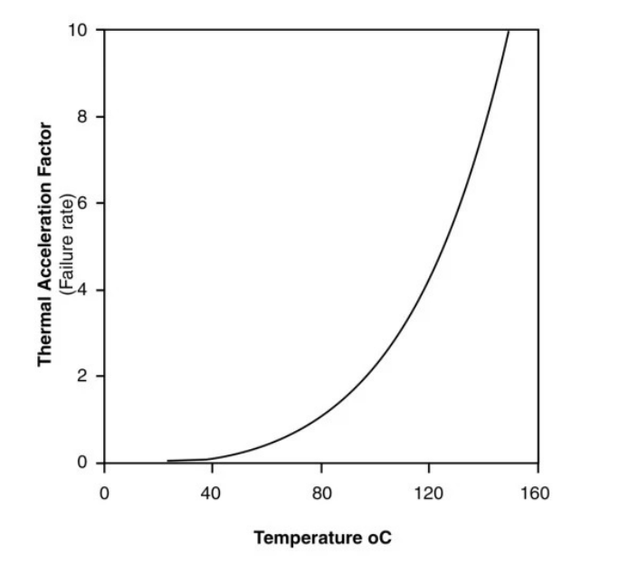
Effect of Temperature on Failure Rate

Slide 8
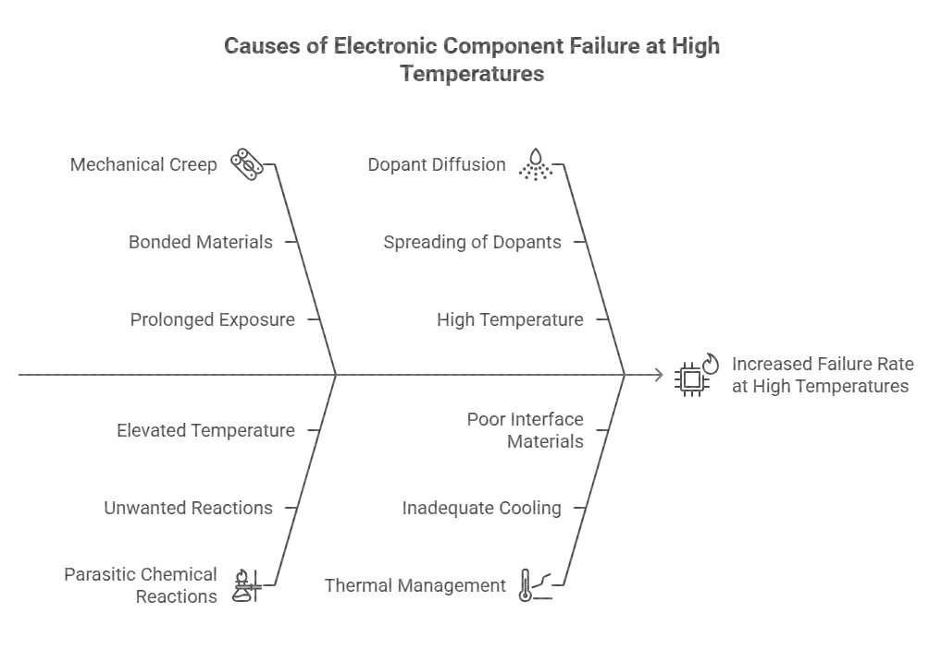
Failure Rate Increase with Temperature
DT-DEFINE

Slide 9
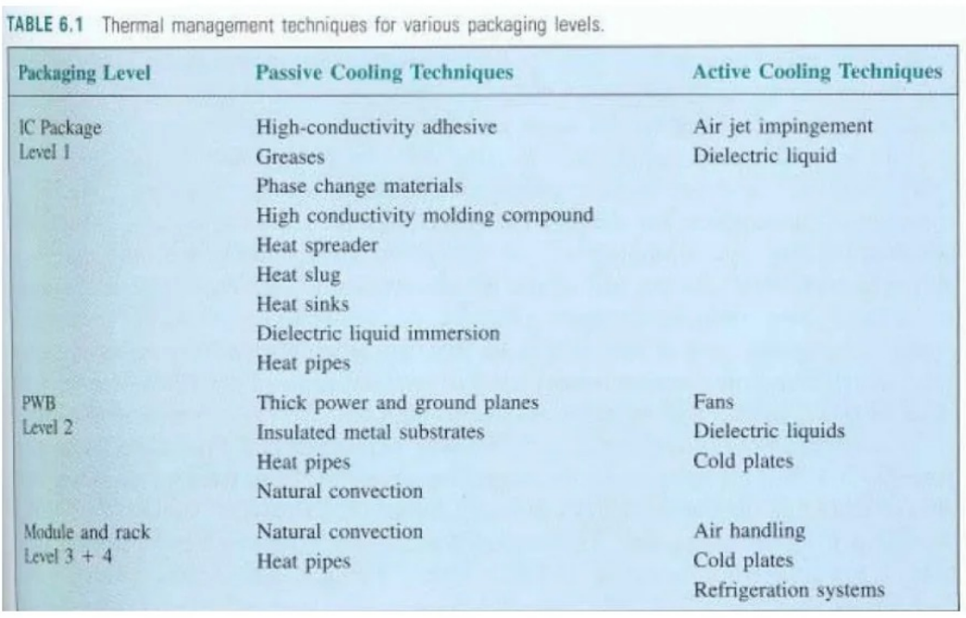
Packaging Levels and Heat Removal
DT-IDEATE

Slide 10
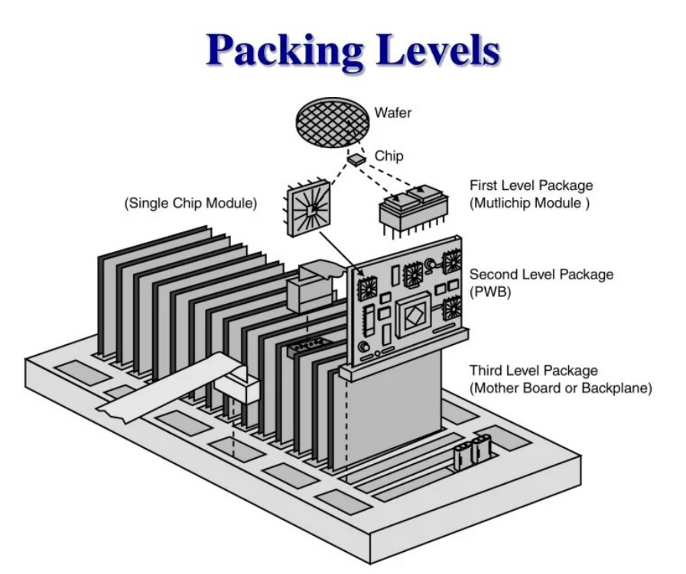
DT-IDEATE

Slide 11
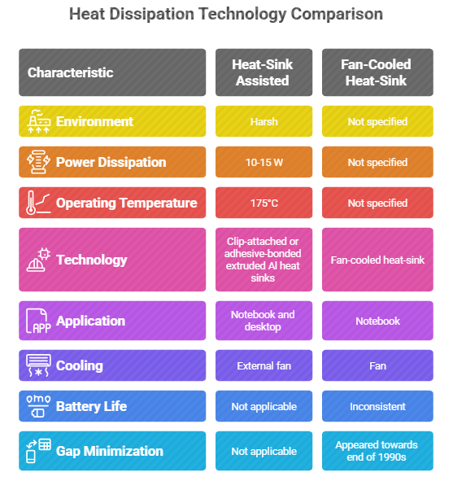
DT-IDEATE

Slide 12
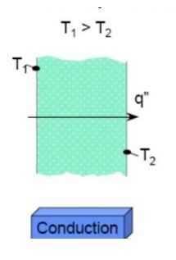
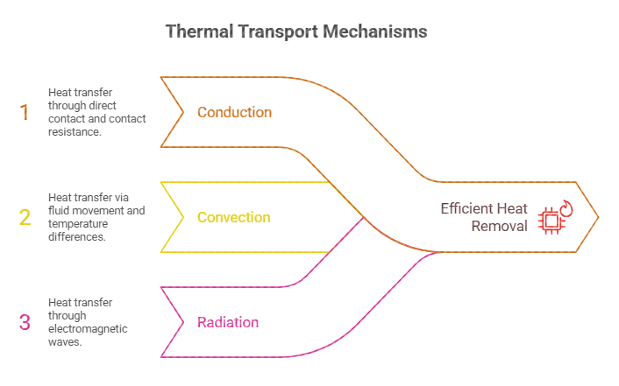
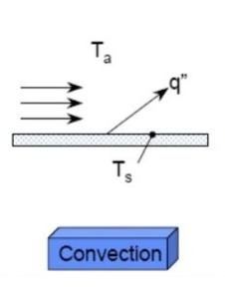
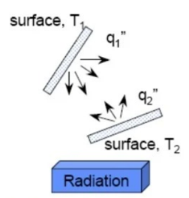
Thermal Management Fundamentals
DT-IDEATE

Slide 13
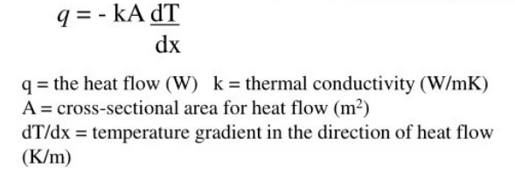
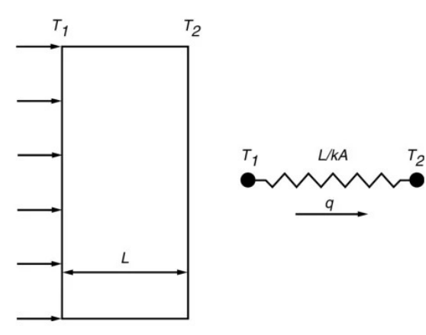
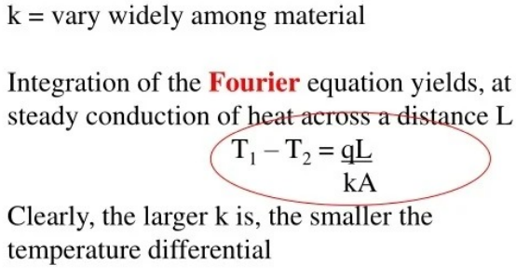
DT-IDEATE
One-Dimensional Conduction
Conduction heat transfer - The flow of heat from a region of higher temperature to a region of lower temperature within a solid, stationary liquid, or static gaseous medium.
It occurs as a result of direct energy exchange among molecule. Conduction is governed by the Fourier equation, which is one-dimensional form.
q

Slide 14
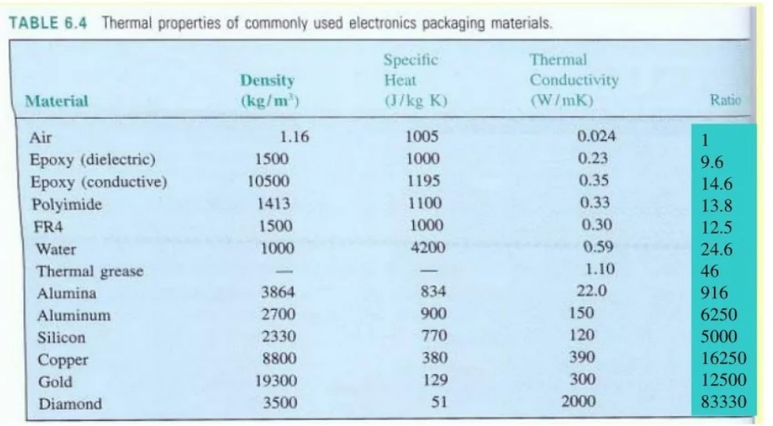
DT-IDEATE
One Dimension Conduction

Slide 15
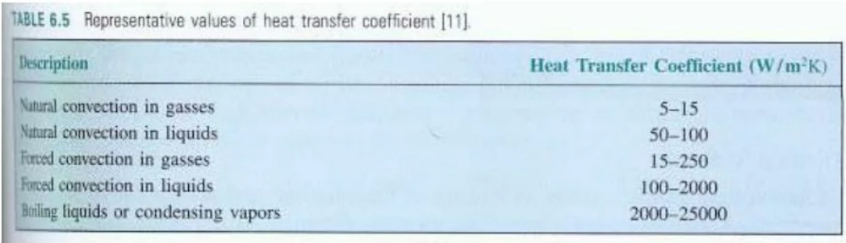
DT-IDEATE
Thermal Convection
The heat transfer coefficients h, reflect the rapidly, slowly circulation fluid and variations in the convective transport properties.
The range of about 104 as we move from natural convection of gases to boiling liquids

Slide 16
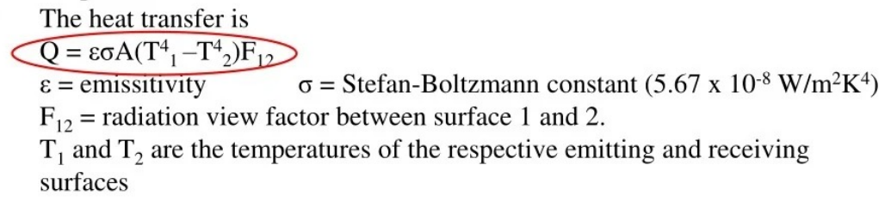
DT-IDEATE
Thermal Radiation
Radiation occurs as a results of the emission and absorption of energy contained in electromagnetic radiation waves or photons.
Thermal radiation can occur across a vacuum, or any medium that is transparent to infrared wavelengths (typically larger that 1 µm)
Unlike conduction and convection, the heat transfer is not dependant on the temperature differences.
If the surfaces are highly emitting/absorbing and close together, F12 is nearly unity
F12 also approaches unity for heat flow from small, highly emitting surface to a large, highly absorbing surface which surrounds it on all sides.

Slide 17
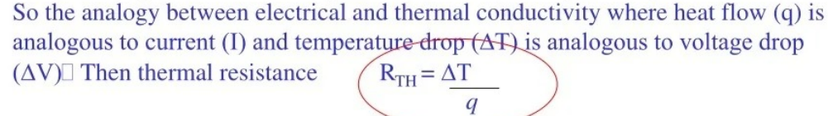
Thermal Resistance
Fourier's Law suggests analogy between heat transfer and the flow of an electric current through conductor as expressed in Ohm's Law (AV = RI)
Analogy strictly applies only to thermal conduction, but possible to generalize this definition to cover all form of thermal transport.
RTH can be determined:
Experimentally - based on measure value of heat flow and temperature differences.
2. Analytically - based on theoritical expressions or on correlation.

Slide 18
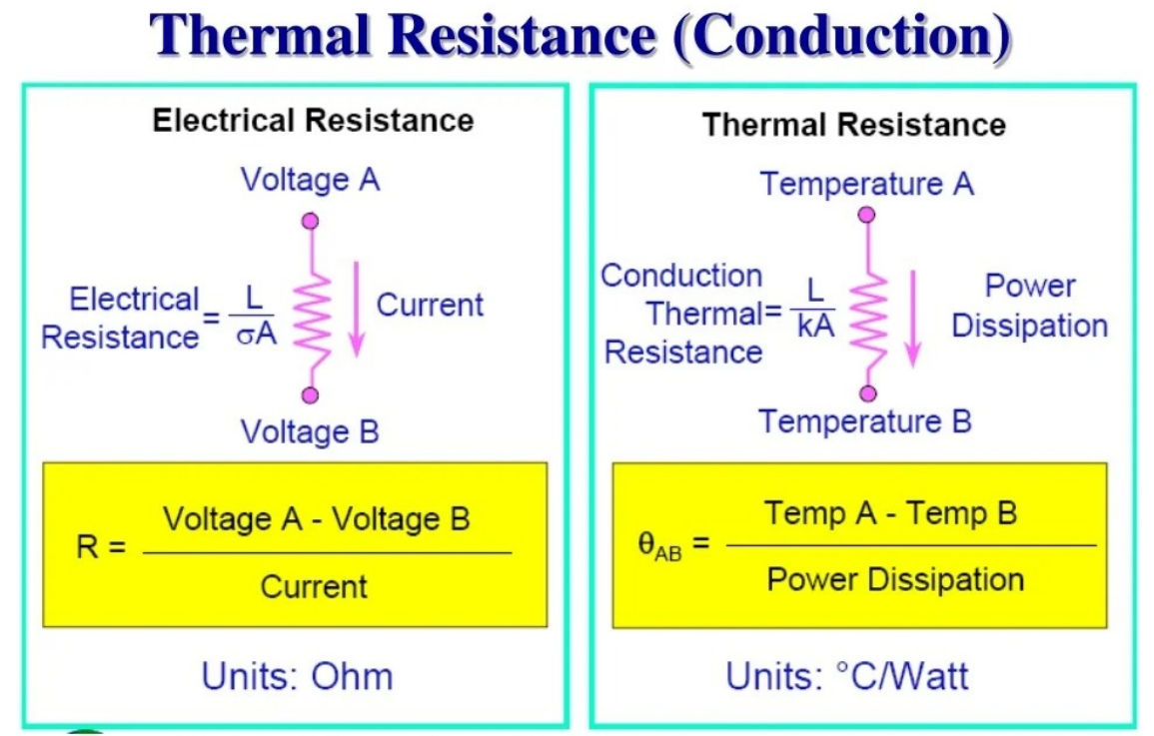
DT-IDEATE

Slide 19
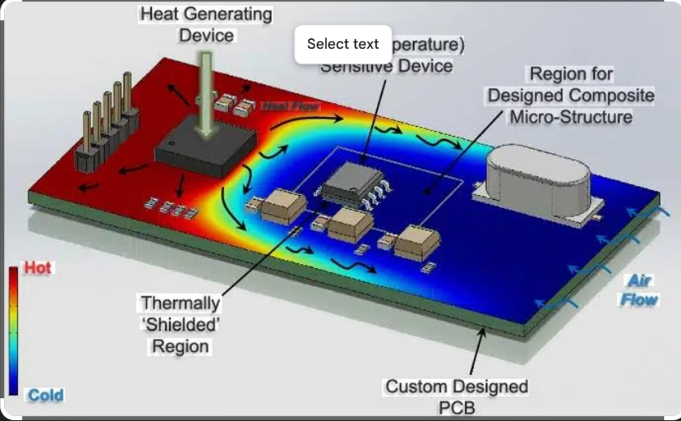
DT- Prototype

Slide 20
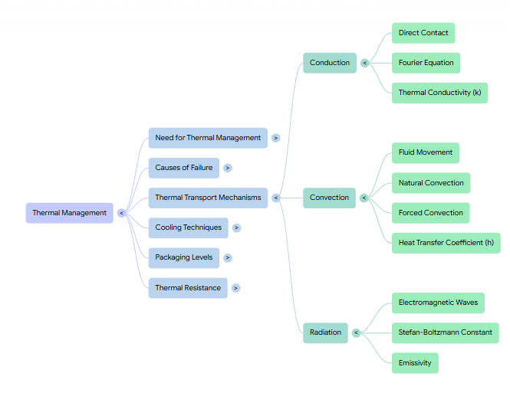
Summary

Slide 21
Quiz: The main purpose of a heat sink is: A) Store heat B) Dissipate heat C) Convert heat to electricity D) Block airflow (Correct: B)
Scenario: Your LMPS regulator is getting very hot. Suggest two methods to manage the heat without reducing efficiency.
Real-time: A 5W linear regulator dissipates heat. Suggest a suitable heat sink with approximate thermal resistance to maintain junction temperature below 125°C if ambient is 35°C.

Slide 22

References
Muthusubramanian R, Salivahanan S, “Basic Electrical and Electronics Engineering”, TataMcGrawHillPublishers,2014.
Kothari DP and I.J Nagrath, “Basic Electrical and Electronics Engineering”, Second Edition, McGraw Hill Education, 2020.
Thank you

