Slide 1


Dr.SNS COLLEGE OF EDUCATION CHILD RIGHTS AND PROTECTION
HISTORY OF CHILD RIGHTS IN TAMIL NADU

Slide 2

Empathy
Can a child speak for their rights?

Slide 3
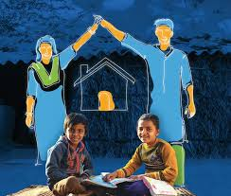
Define
What are Child Rights in Infancy?

Slide 4
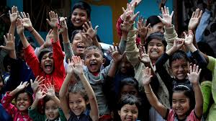
Ideate
How did Tamil Nadu respond?

Slide 5

Prototype Stage
Government Initiatives

Slide 6
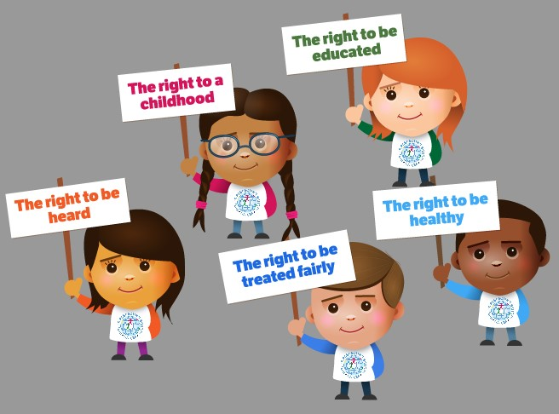
Test
Are Child Rights Achieved?

Slide 7
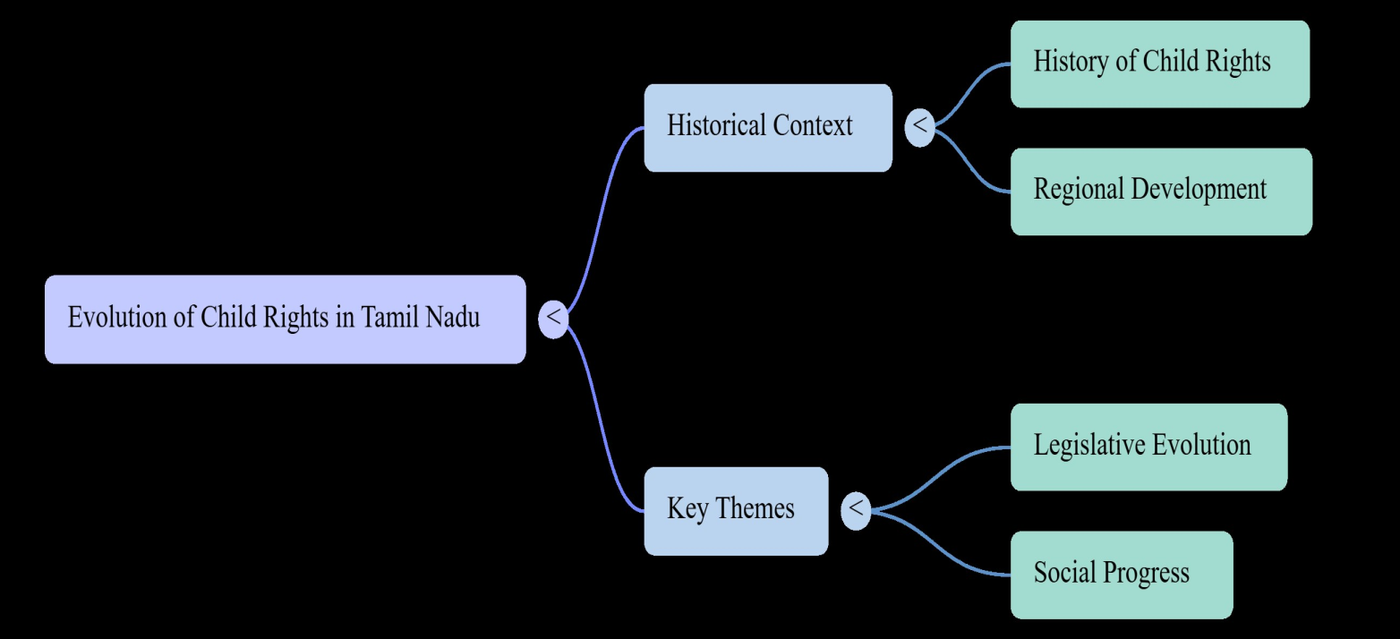
MIND MAP

Slide 8
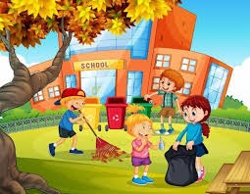
Assignment
Draw a picture showing a healthy child environment

Slide 9
Puzzle
Title: Find the Missing Word
Content:
Right to ______
ICDS provides ______ and health services
Infancy stage is from ___ to ___ years
(Answers: life, nutrition, 0–2)

Slide 10
THANK YOU

