Slide 1

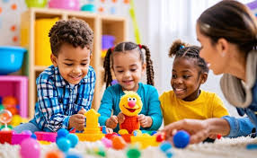
Dr.SNS COLLEGE OF EDUCATION CHILD RIGHTS AND PROTECTION CONCEPT AND DEFINITION OF CHILD AND CHILD RIGHTS
Mrs .V Rani
Asst.Prof.,
Dr.SNSCE

Slide 2
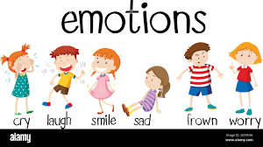
Empathy
How would you feel if you were denied education, safety, or the freedom to express your thoughts?”

Slide 3

Define
Who is a Child? What are Child Rights?

Slide 4
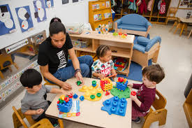
Ideate
What Rights Should Every Child Have?
Right to Education
Right to Protection
Right to Participation
Right to Survival and Development

Slide 5
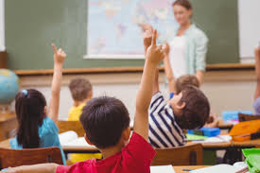
Prototype
Transforming Ideas into Action

Slide 6
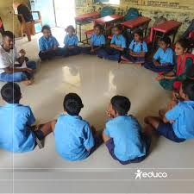
Test Are Child Rights Being Realized?

Slide 7
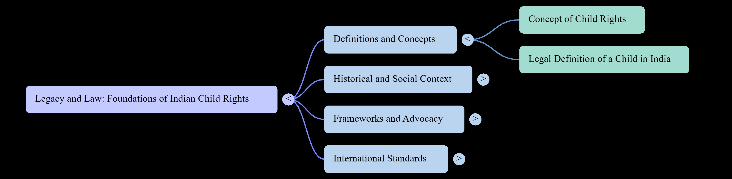
MIND MAP

Slide 8

Assignment
Reflect and Respond

Slide 9
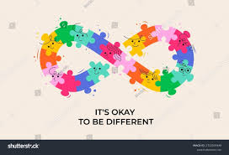
Puzzle Guess the Right!

Slide 10
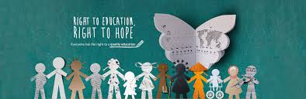
Case Study Ensuring Child Rights

Slide 11
THANK YOU

