Slide 1


Dr.SNS COLLEGE OF EDUCATION
CHILD RIGHTS AND PROTECTION
United Nations Convention on the Rights of the Child (UNCRC)
Mrs.V Rani
Asst.Prof.,
Dr.SNSCE

Slide 2
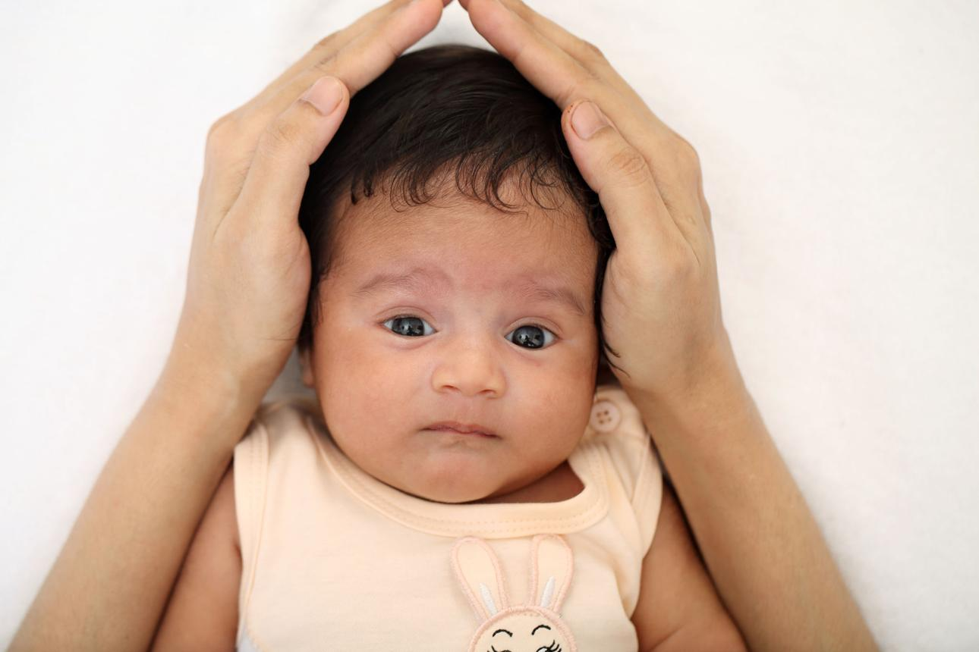
THINK!!!
Do all infants receive proper love, care, and protection?

Slide 3
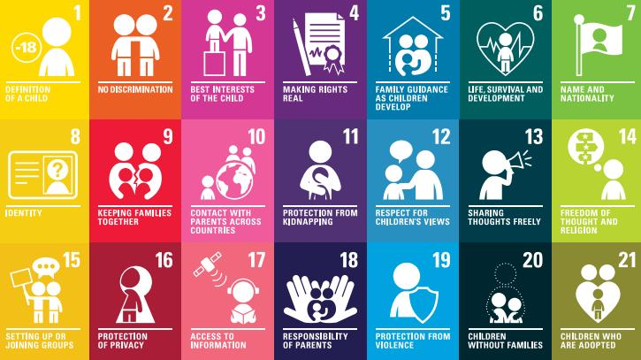
Define – Identifying the Core Problem
United Nations Convention on the Rights of the Child (UNCRC) is an international agreement that protects children’s rights.

Slide 4
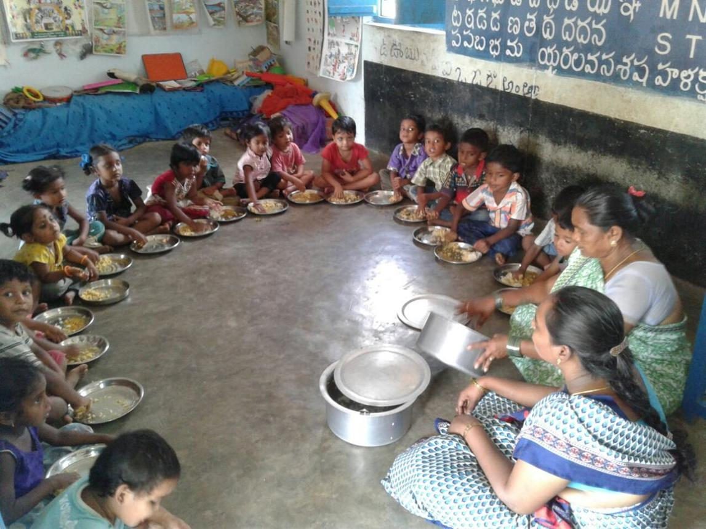
Ideate – Generating Solutions

Slide 5
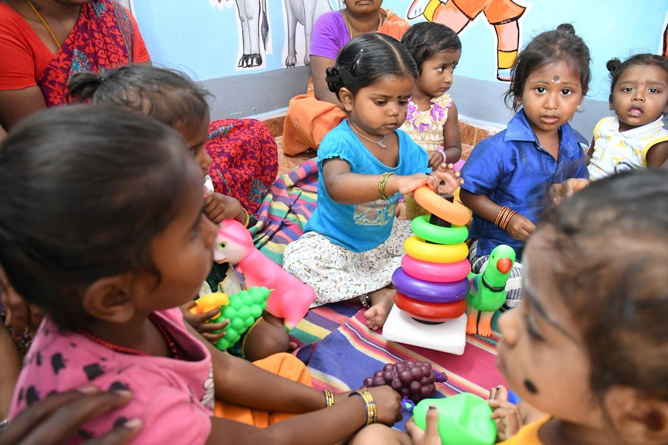
Designing a Teaching Strategy
.
Action Plan
Strengthen Anganwadi services
Conduct health camps for infants
Train parents on child care
Government + NGO collaboration

Slide 6
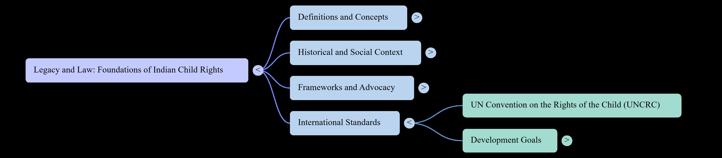
Mind Map

Slide 7
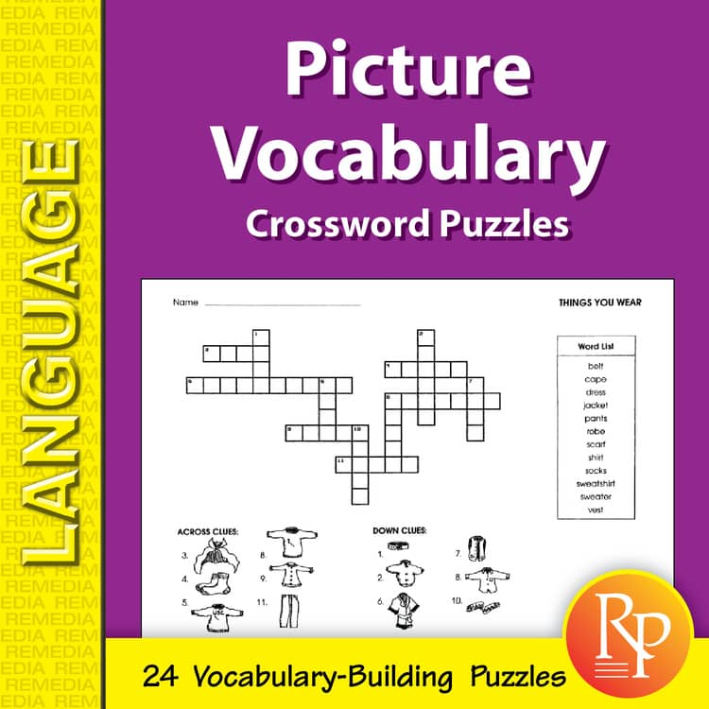
Puzzle
Match:
Health → Hospital
Protection → Safety
Nutrition → Food

Slide 8
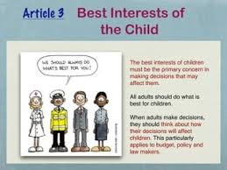

Assignment

Slide 9

Case study

Slide 10


