Slide 1


Dr.SNS COLLEGE OF EDUCATION CHILD RIGHTS AND PROTECTION Discrimination
Mrs.V RANI
Asst.Prof.,
Dr.SNSCE

Slide 2
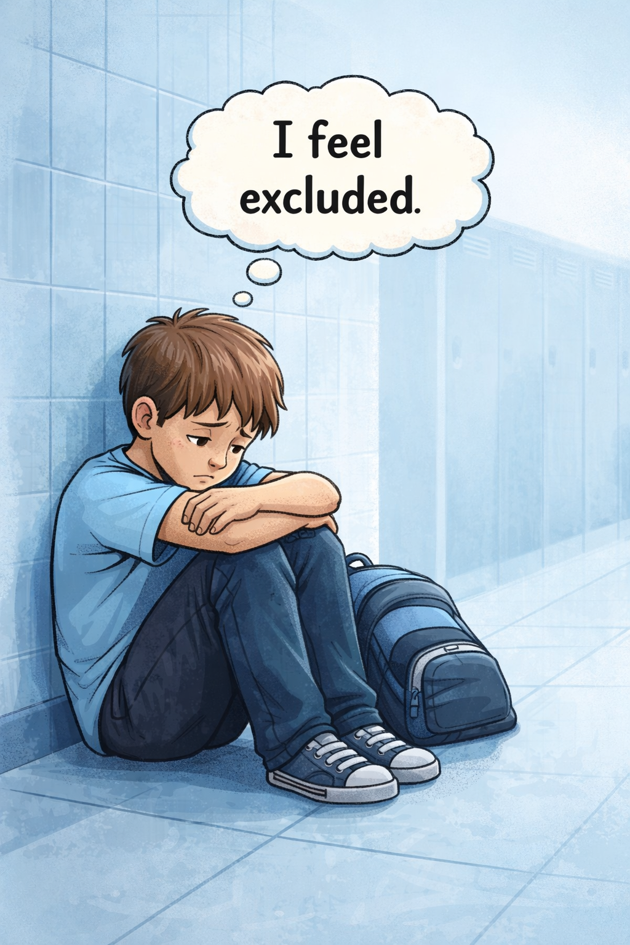
EMPATHIZE
Sad/isolated student image
Thought bubble: “I feel excluded”

Slide 3
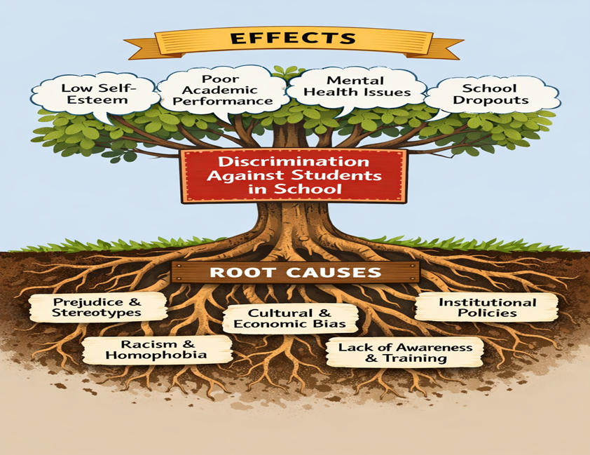
Define
Identify core problem
Example: “Students face discrimination in school”

Slide 4
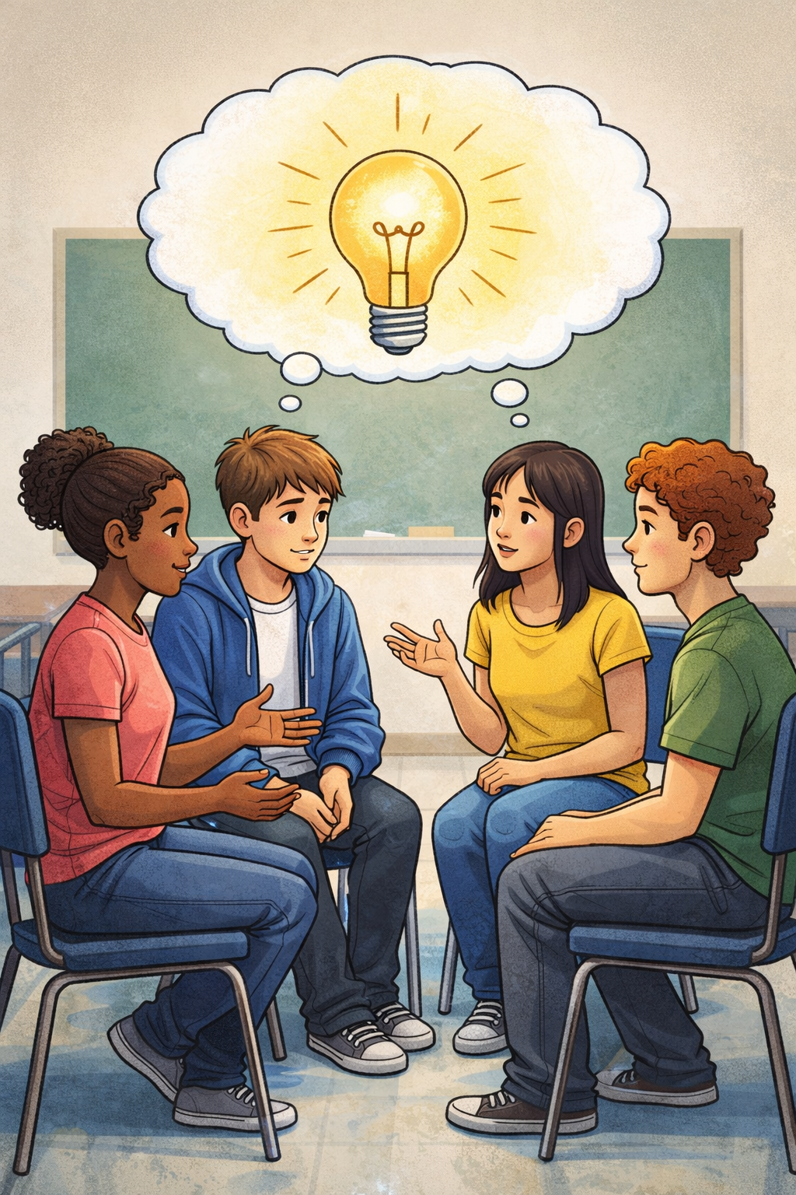
IDEATE
Brainstorm solutions
Awareness programs
Inclusive policies

Slide 5
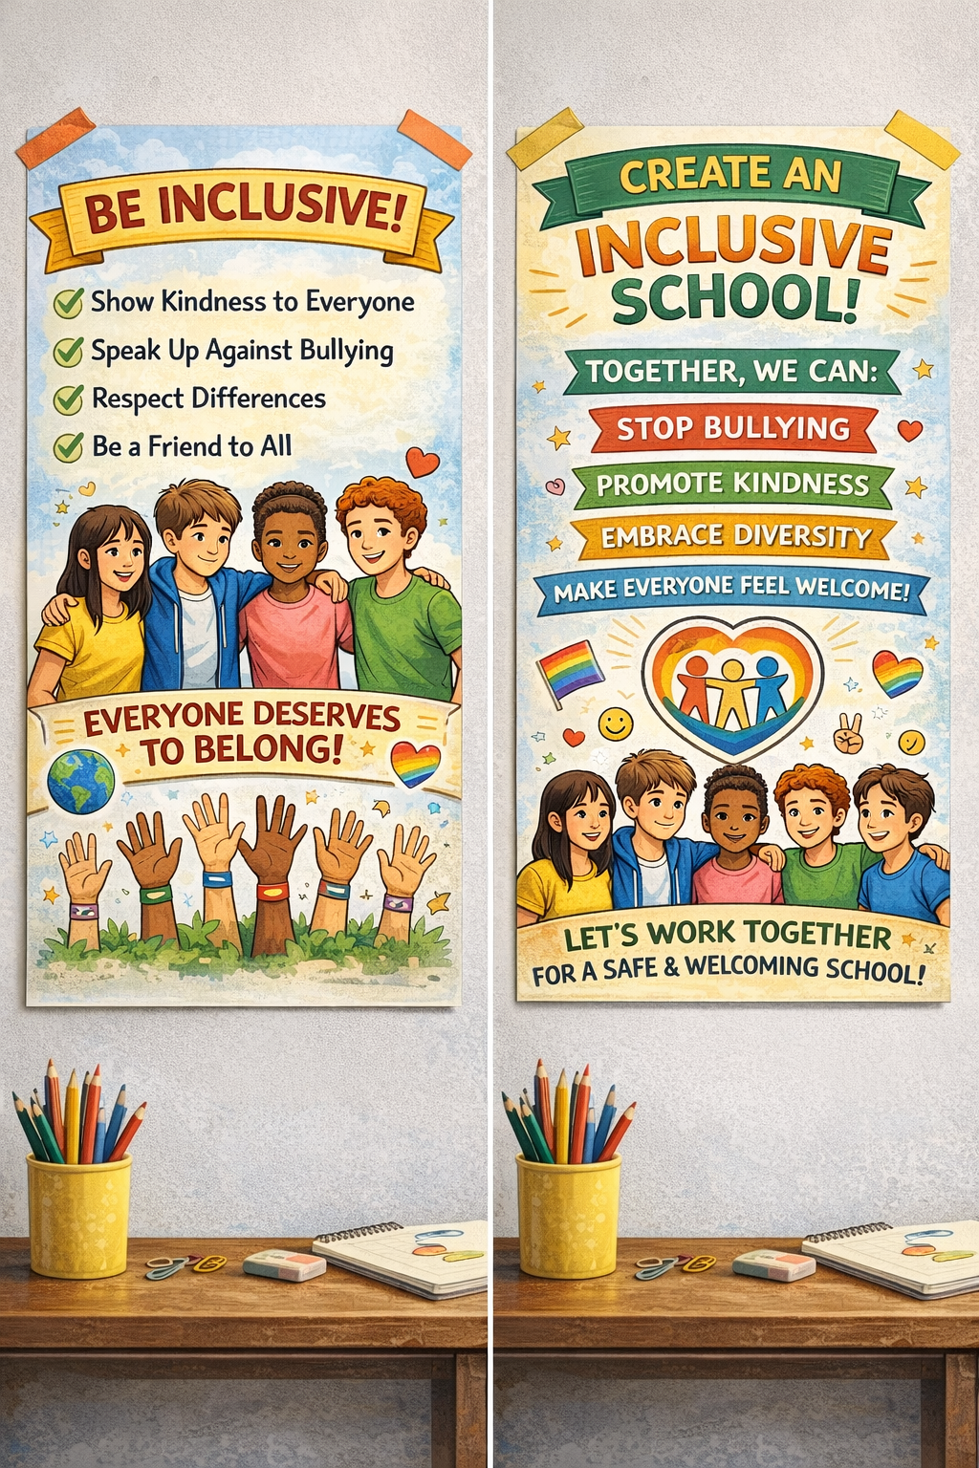
PROTOTYPE
Create solutions:
Posters
Campaigns
School policies

Slide 6
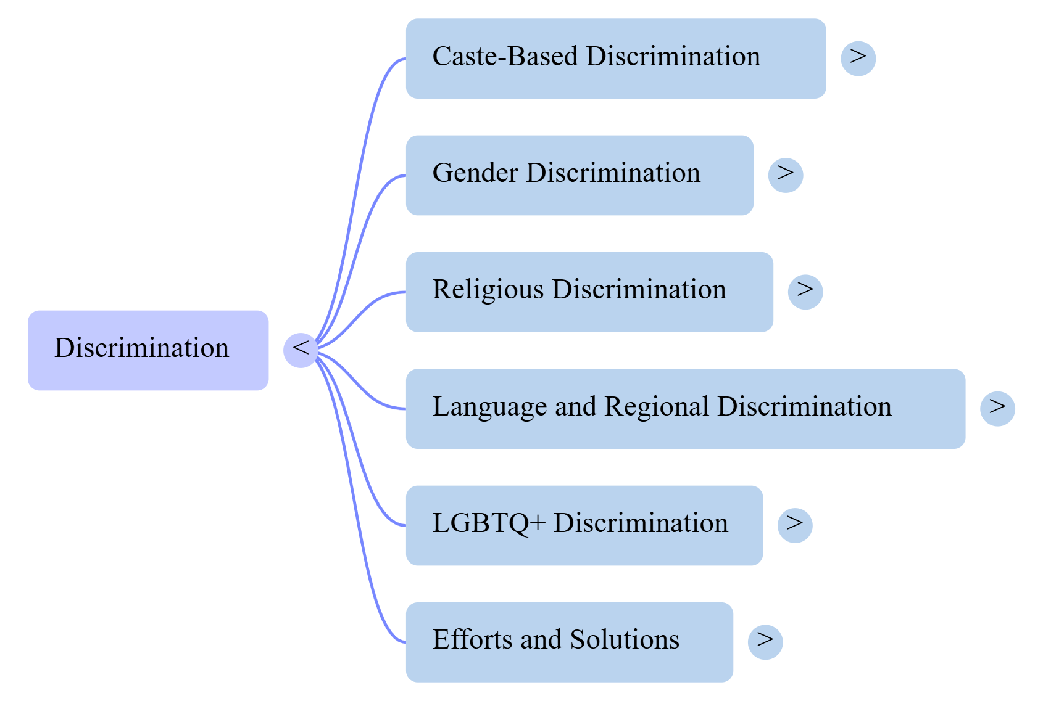
Mind Map

Slide 7
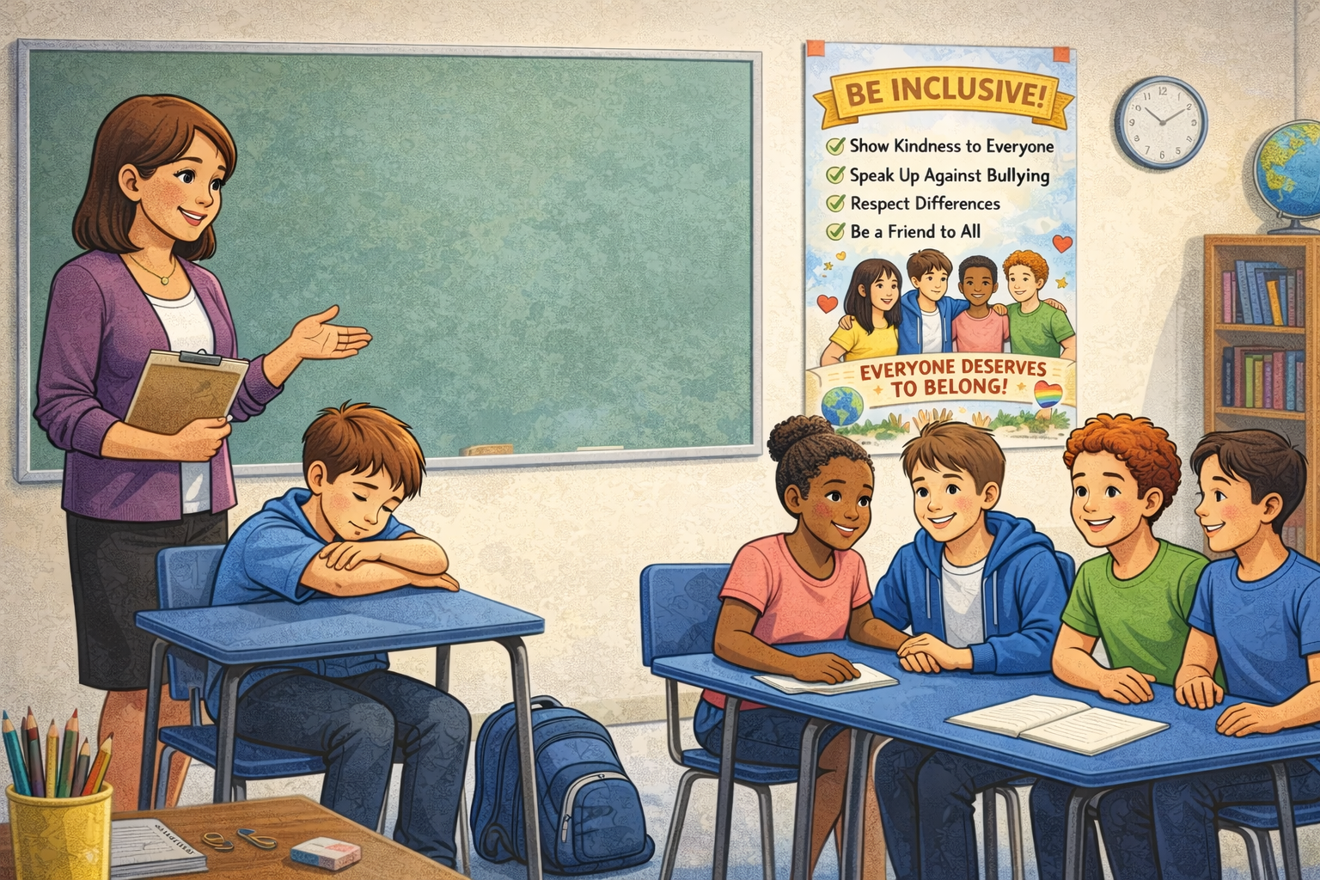
: Case Study Discussion
“A student is excluded due to caste/gender. What will you do?”

Slide 8
Assignment
Create a Problem Tree Diagram:
Roots: Causes (bias, stereotypes, social inequality)
Trunk: Problem (e.g., discrimination in school)
Branches: Effects (low self-esteem, dropout, exclusion)

Slide 9
THANK YOU

