Slide 1

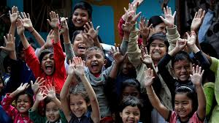
Dr.SNS COLLEGE OF EDUCATION CHILD RIGHTS AND PROTECTION
Factors Leading to Vulnerability of Children in Tamil Nadu
Mrs.V RANI
Asst.Prof.,
Dr.SNSCE

Slide 2
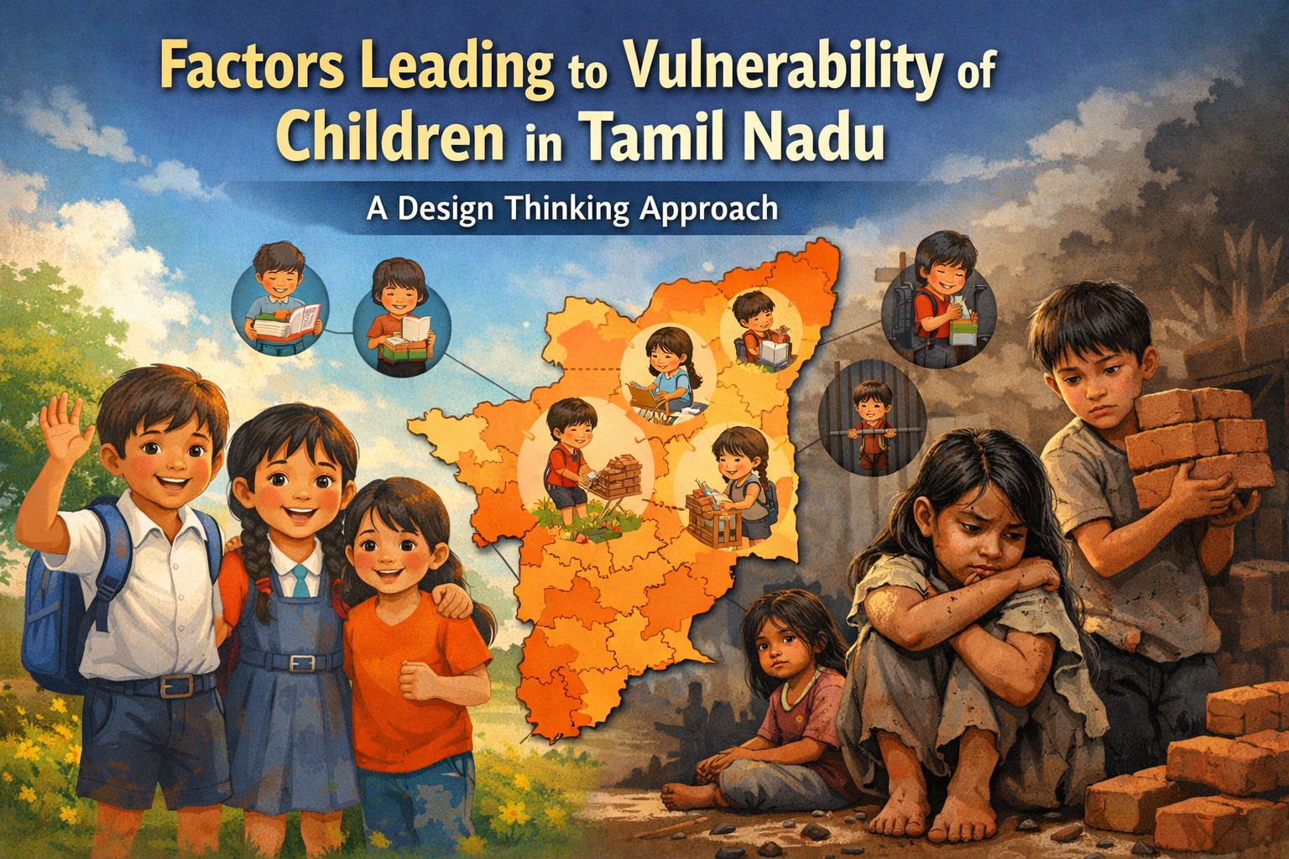
Factors Leading to Vulnerability of Children in Tamil Nadu

Slide 3
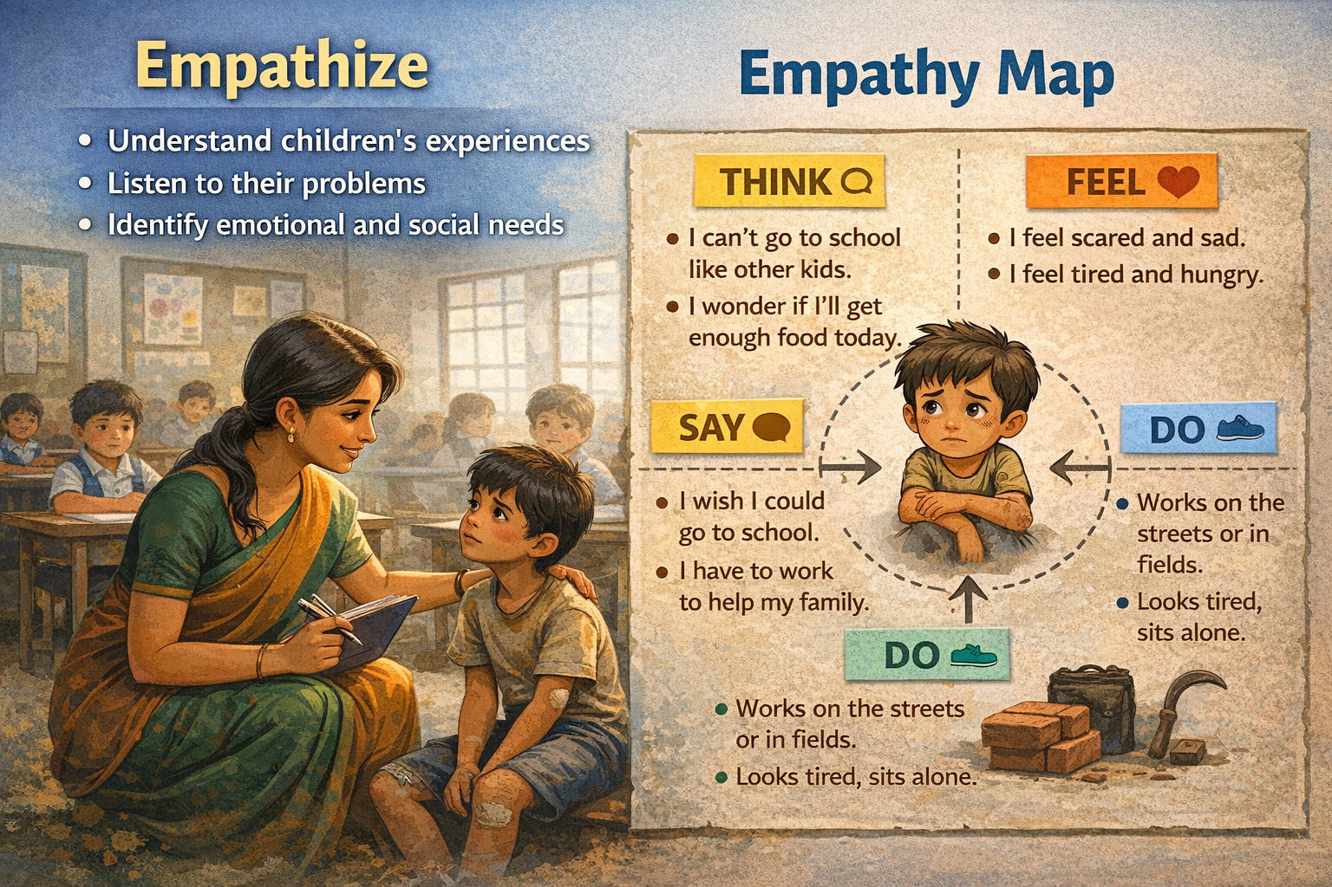
Empathize
Understand children's experiences
Listen to their problems
Identify emotional and social needs

Slide 4
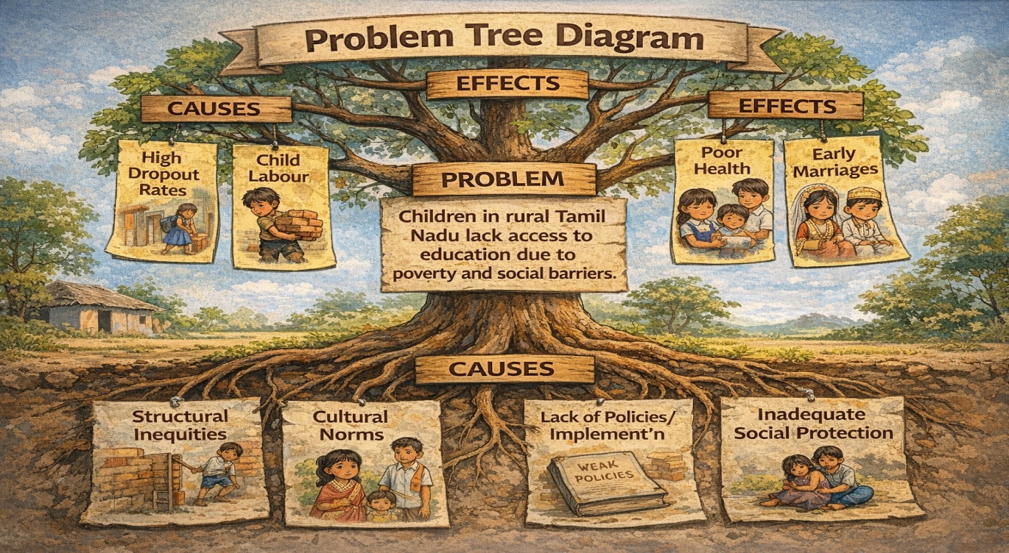
Define
Example Problem Statement: “Children in rural Tamil Nadu lack access to education due to poverty and social barriers.”

Slide 5
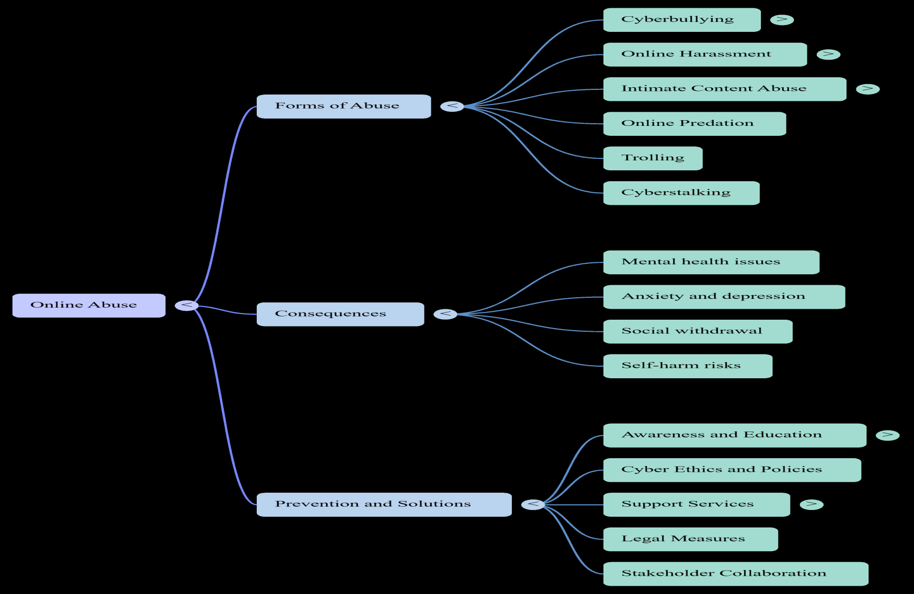
Mind Map

Slide 6
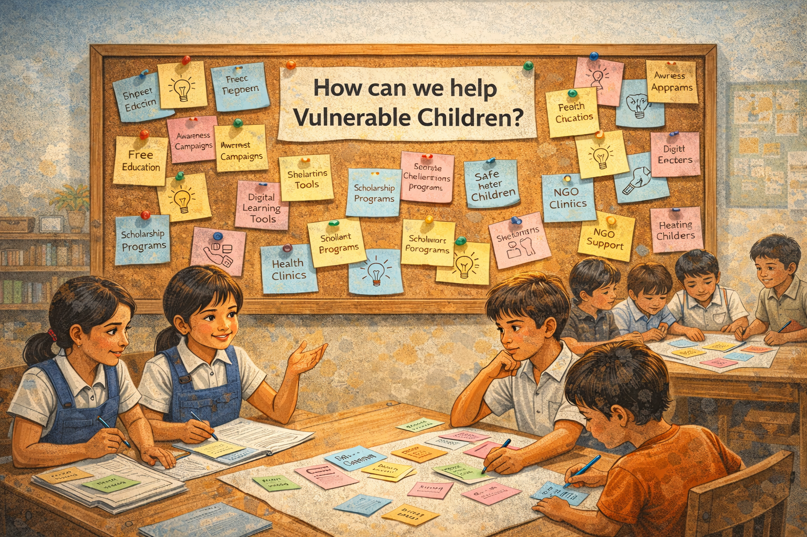
Ideation
Brainstorm solutions
Think creatively
No idea is wrong

Slide 7
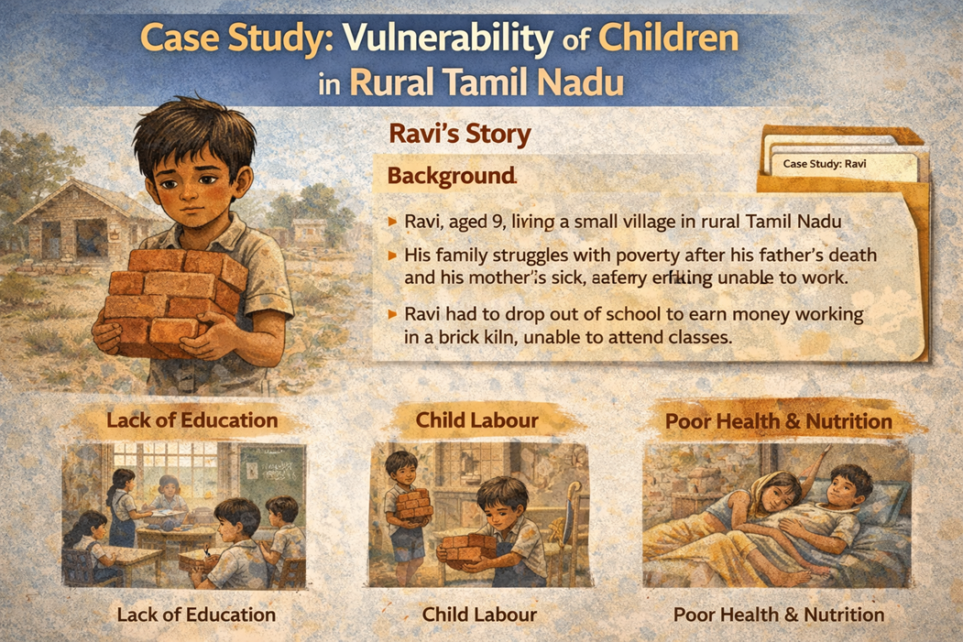
Case Study
Give the best solution for this case study picture

Slide 8
Assignment
1.As a future teacher, how will you identify vulnerable children in your classroom?
2.What steps will you take to create an inclusive and safe learning environment?
3.Design an awareness poster or campaign on child protection

Slide 9
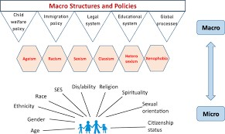
PUZZLES

Slide 10
THANK YOU

