Slide 1


Dr.SNS COLLEGE OF EDUCATION CHILD RIGHTS AND PROTECTION
Non-Governmental Organizations (NGO) working for child rights in Tamil Nadu and India
Mrs .V Rani
Asst.Prof.,
Dr.SNSCE

Slide 2

THINK!!!
Do all infants receive proper care and protection?

Slide 3

Define – Identifying the Core Problem
NGOs (Non-Governmental Organizations) are voluntary groups working for social welfare without government control

Slide 4
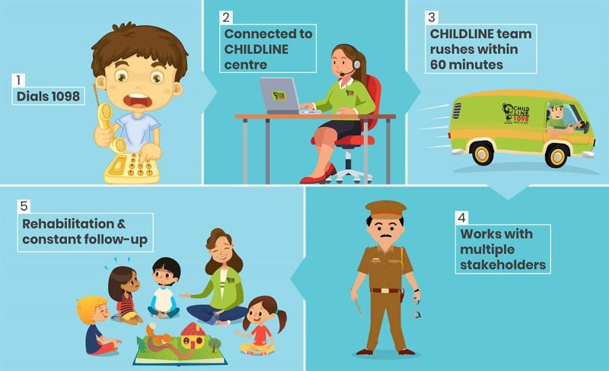
Ideate – Generating Solutions
.
Solutions by NGOs
Provide nutrition programs
Ensure vaccination & health care
Rescue abandoned infants
Spread awareness to parents

Slide 5
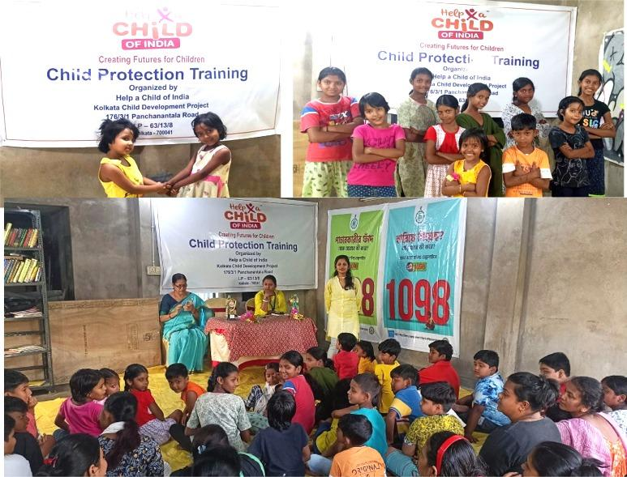
Designing a Teaching Strategy
Implementation
Organize health camps for infants
Support Anganwadi centers
Create awareness programs for mothers
Collaborate with schools & communities

Slide 6
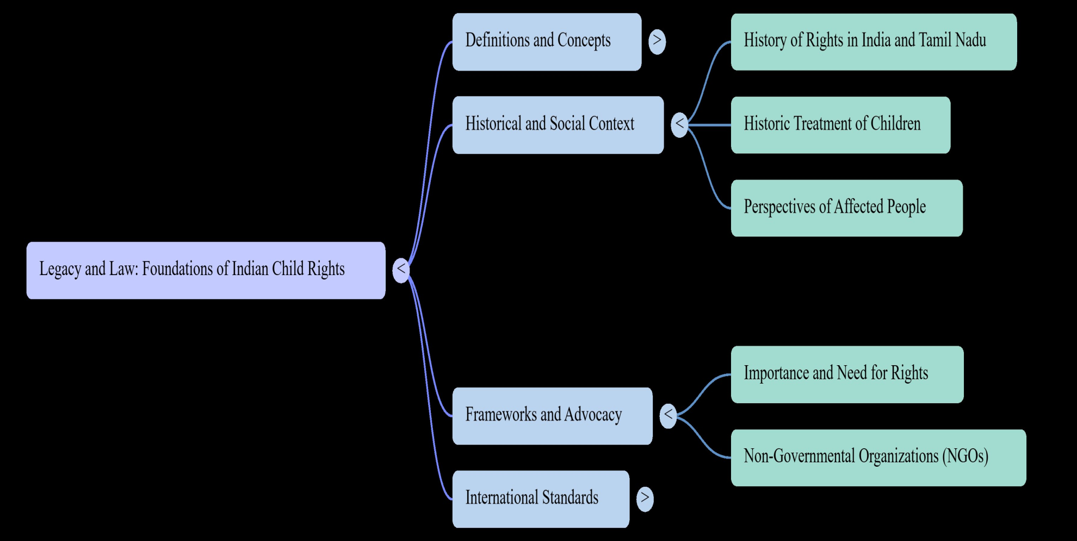
Mind Map

Slide 7

Puzzle
Match NGO with its function (Example: Childline → Emergency help 📞)

Slide 8
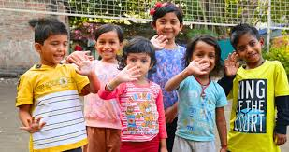
Assignment
Write about any one NGO working for child rights

Slide 9
Case study
Situation
A newborn baby is found abandoned.
Questions
Which NGO can help?
What actions should be taken?
Answer Idea
Inform Childline 1098
Provide immediate care & protection

Slide 10


