Slide 1


Dr.SNS COLLEGE OF EDUCATION
CHILD RIGHTS AND PROTECTION
Violence Against Children
Mrs.V RANI
Asst.Prof.,
Dr.SNSCE

Slide 2
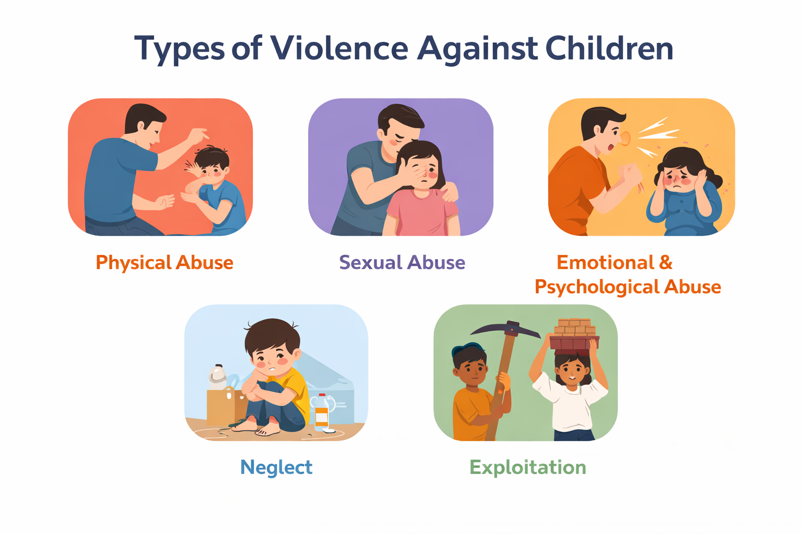
Introduction
VAC includes abuse, neglect, exploitation
Affects children under 18

Slide 3
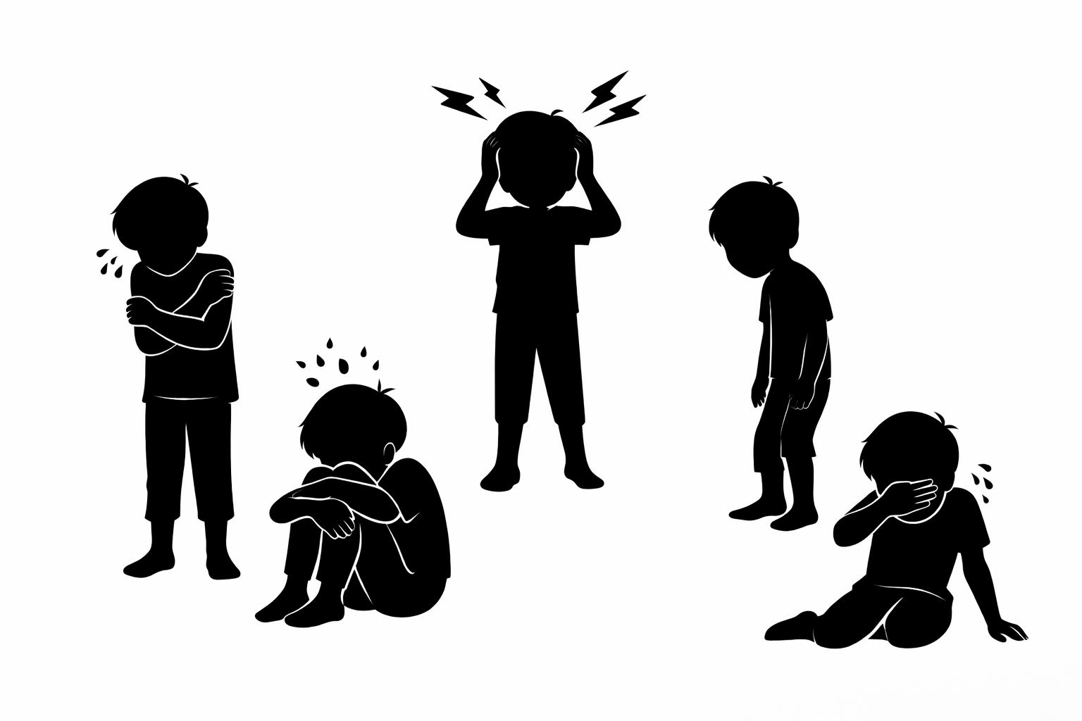
Empathize
Understand children’s experiences
Identify vulnerable groups

Slide 4
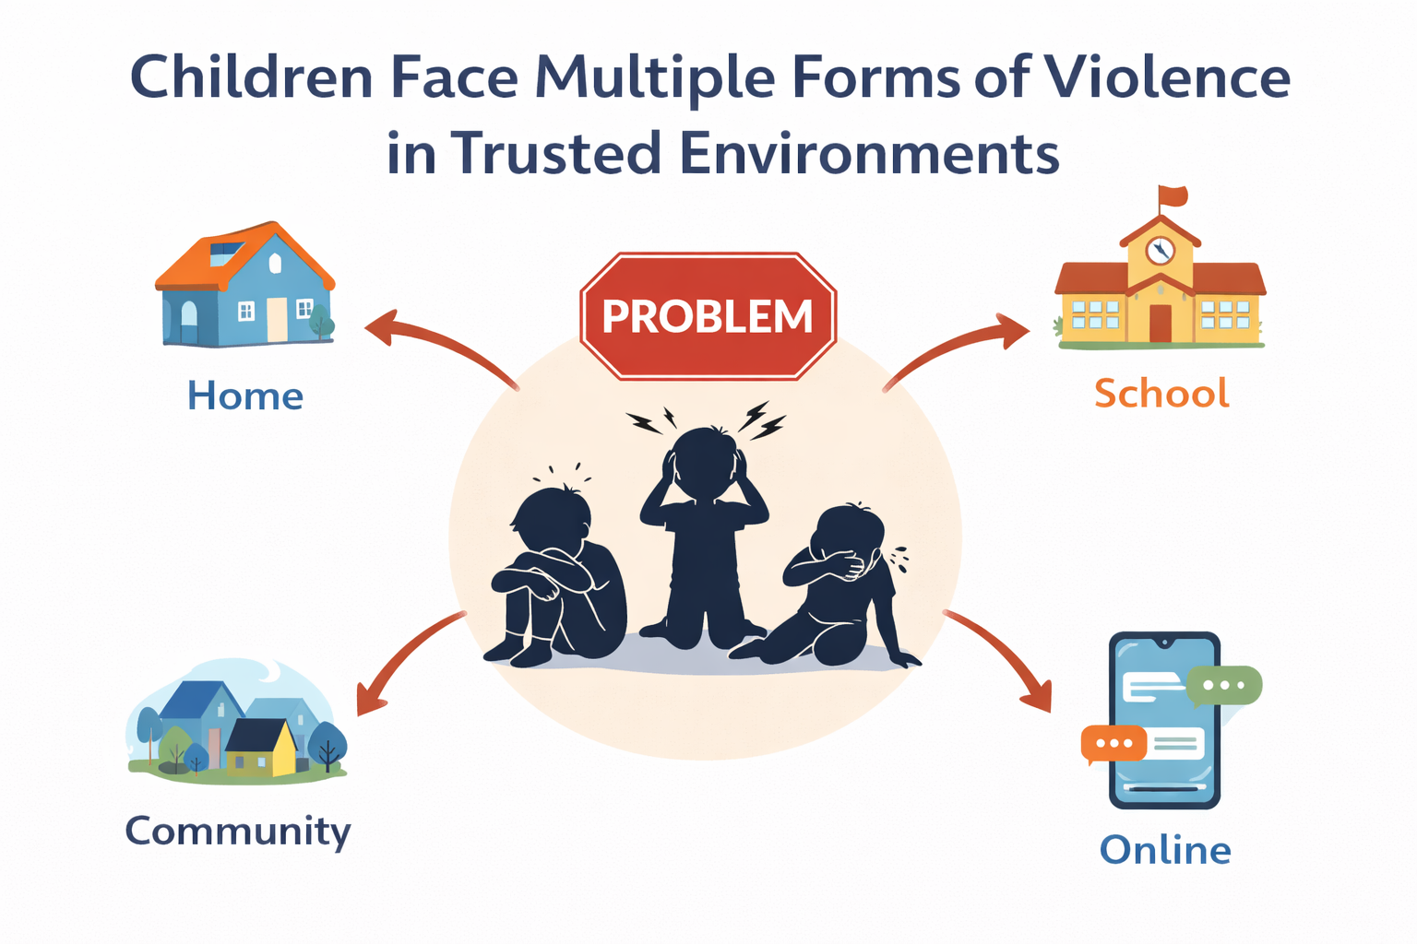
Define Problem
Children face violence in trusted environments

Slide 5

Ideate
Generate solutions for protection

Slide 6
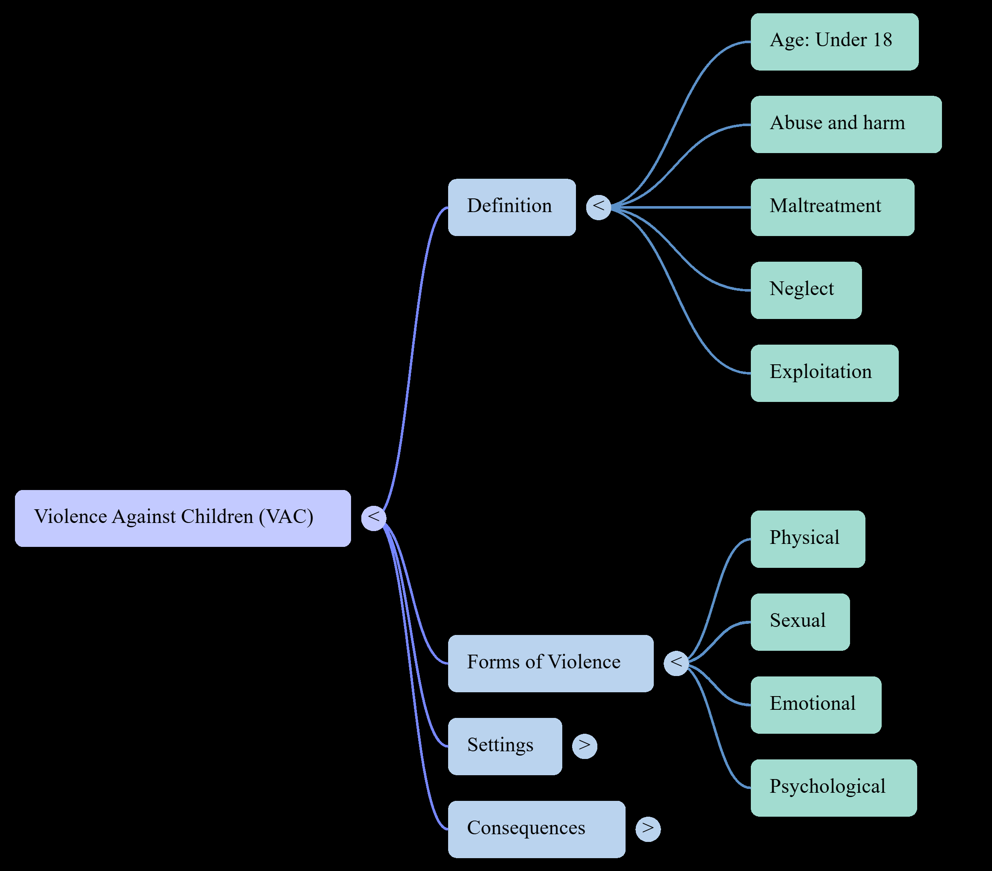
Mind Map

Slide 7
Case Study
Case Scenario:
Riya, a 13-year-old student, has recently shown a decline in academic performance and irregular attendance. She appears withdrawn and anxious in class. Her teacher notices bruises on her arm and signs of emotional distress. At home, she is under the care of a relative who mistreats her, and she is also engaged in part-time work under unsafe conditions.
1. As a Teacher , how would you identify early wrning signs in such cases?
2. What Steps Should be taken by School to ensure the Child Safety ?

Slide 8
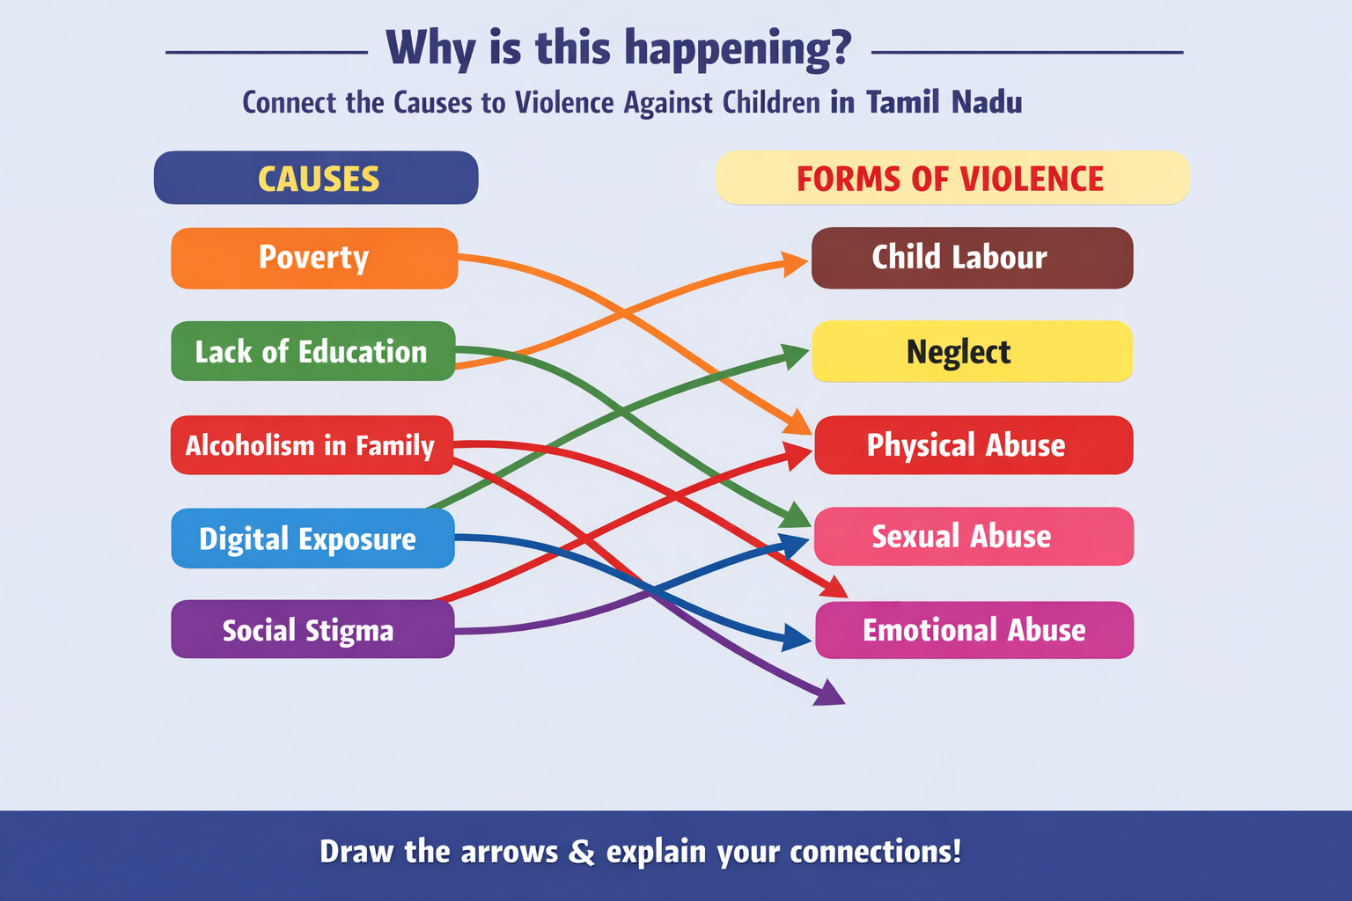
Quiz

Slide 9
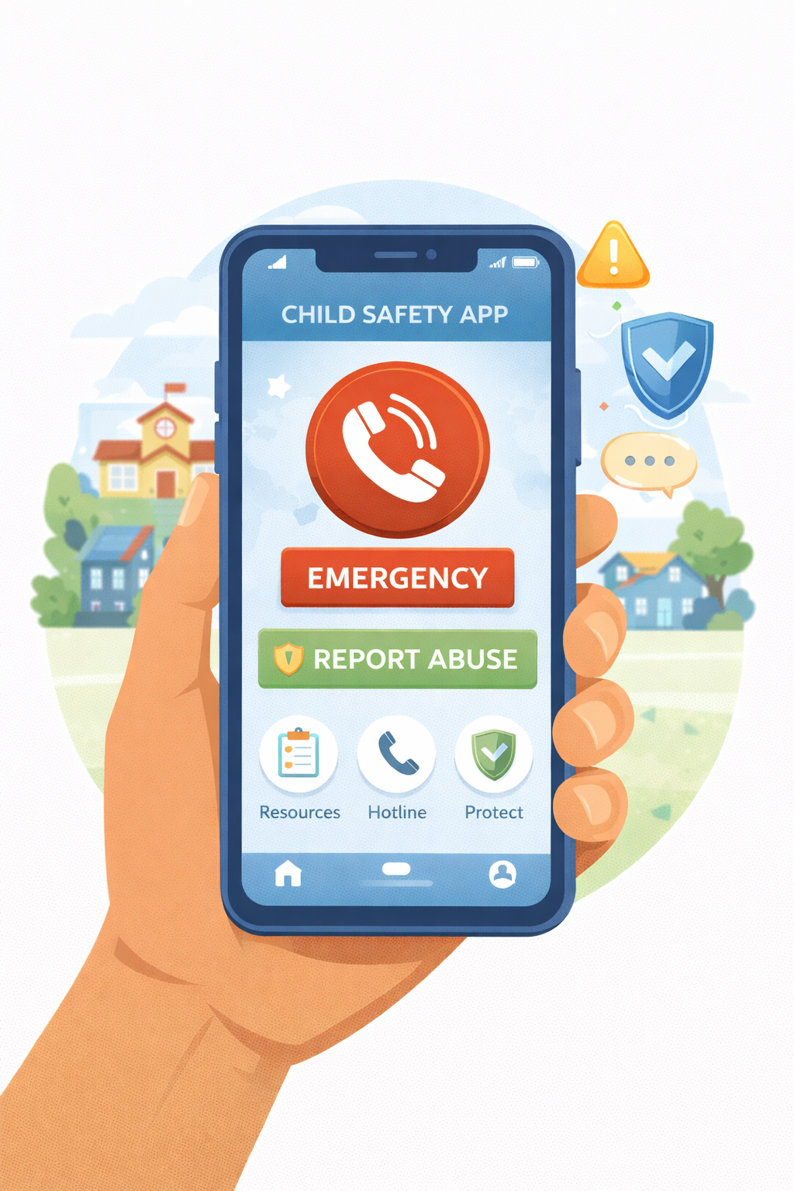
Test
Evaluate effectiveness

Slide 10
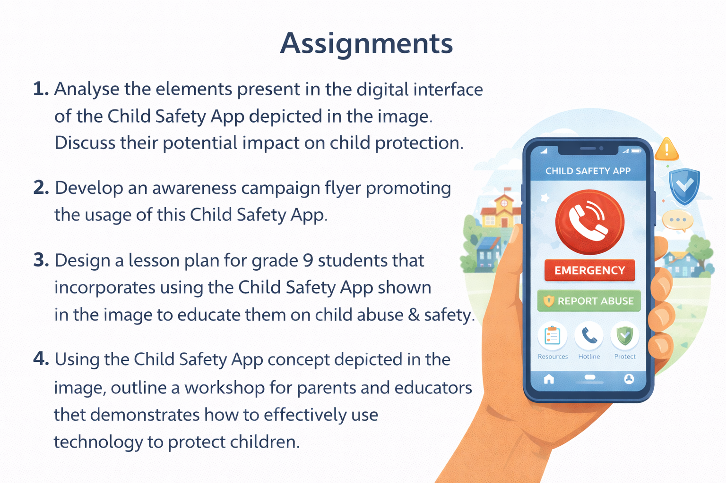

Slide 11
Thank You

