Slide 1

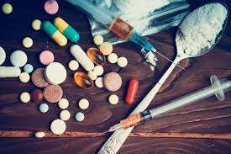
Dr.SNS COLLEGE OF EDUCATION CHILD RIGHTS AND PROTECTION
Drug Dependency Among Children
Mrs.V RANI
Asst.Prof.,
Dr.SNSCE

Slide 2
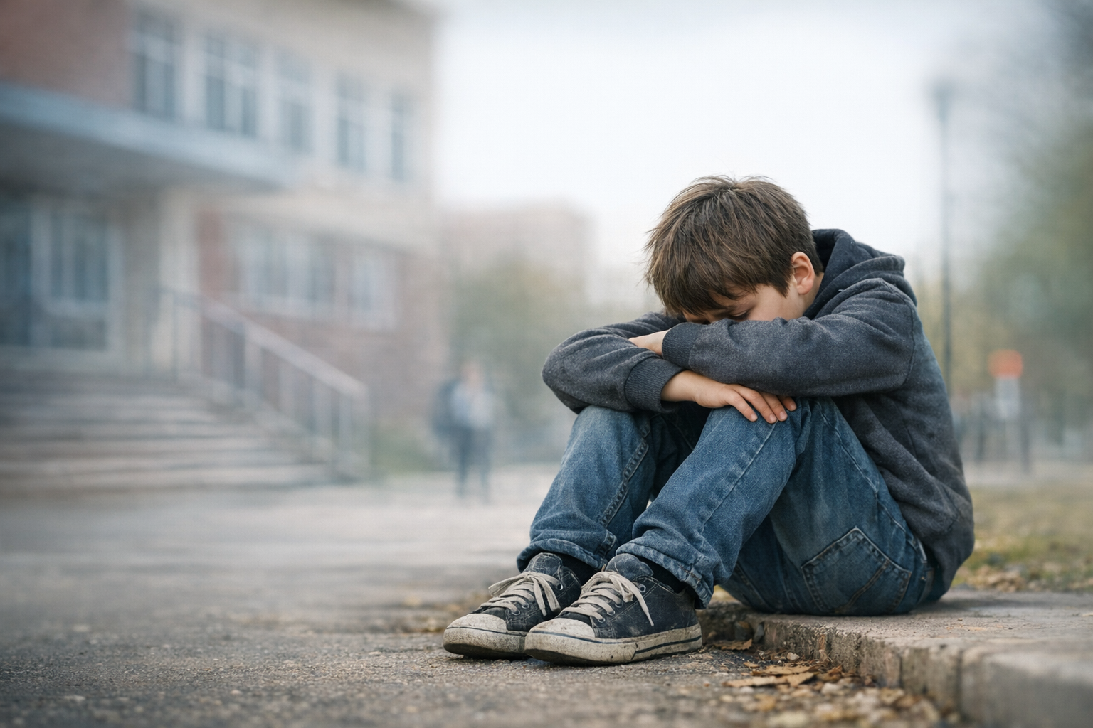
Drug Dependency Among Children

Slide 3

EMPATHIZE
Understand child’s feelings:
Loneliness
Fear
Low self-esteem Reasons:
Peer pressure
Family issues
Trauma

Slide 4
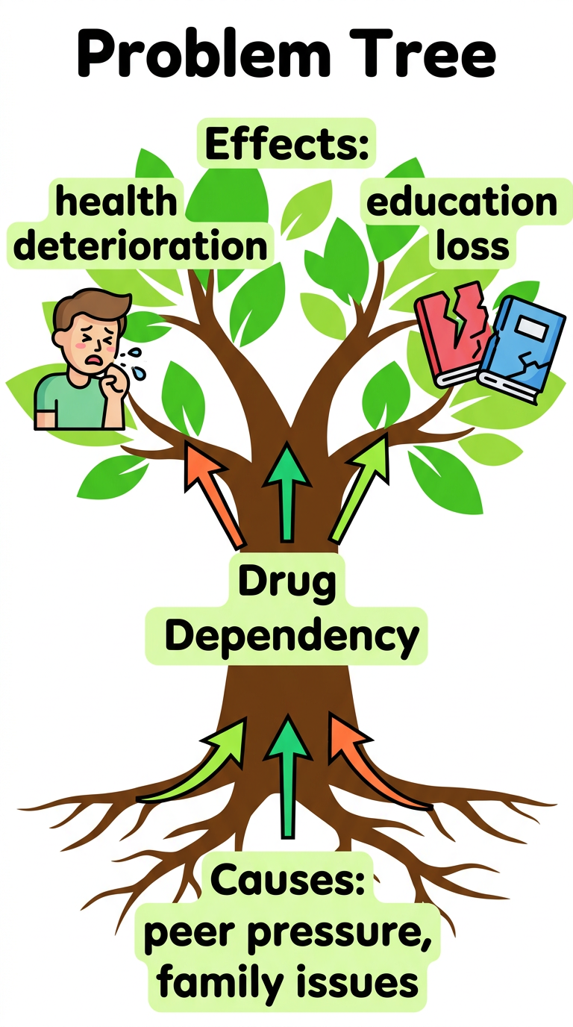
DEFINE
Problem Statement: “Children are engaging in drug use due to lack of emotional support, awareness, and safe environments

Slide 5

IDEATE
Brainstorm solutions:
Awareness programs
Counselling support
Peer mentoring
Parent education

Slide 6
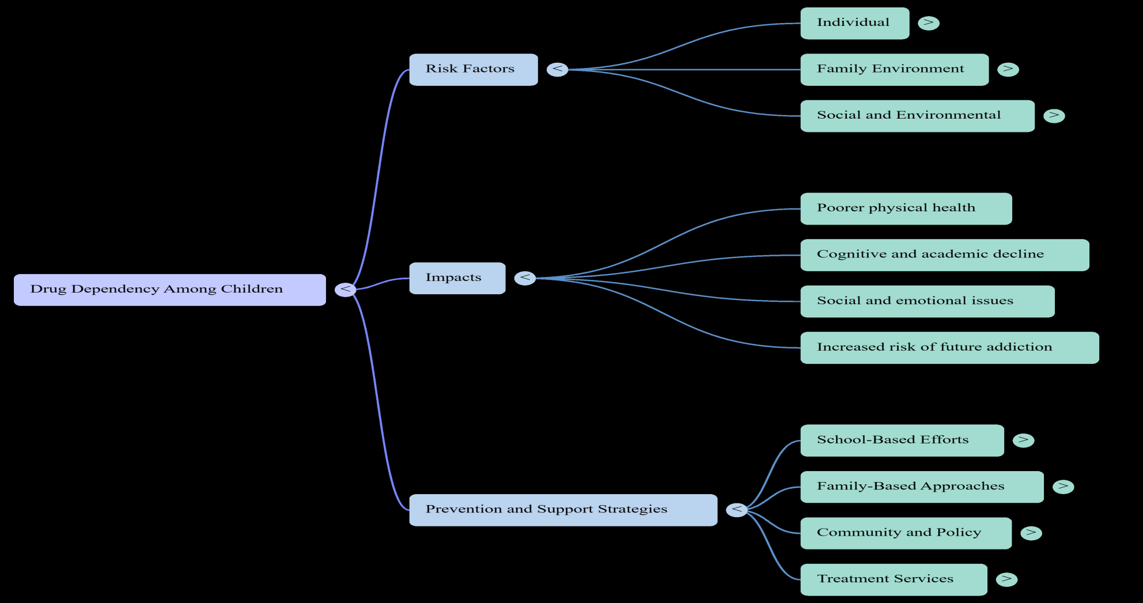
Mind map

Slide 7
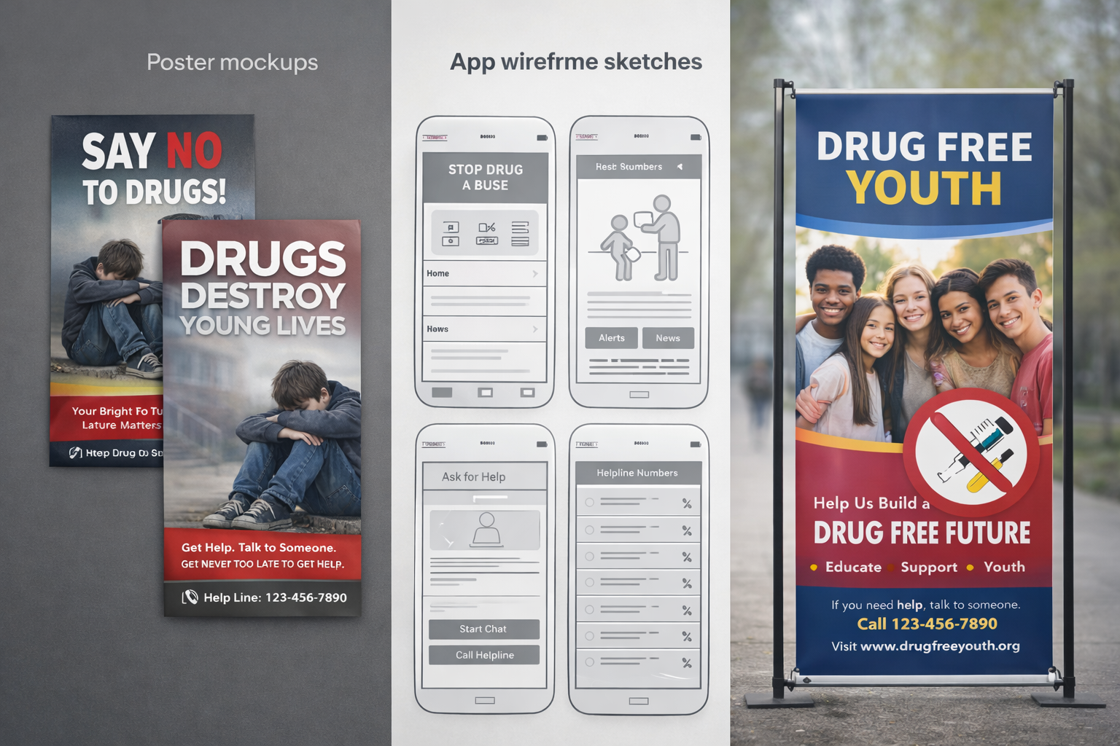
PROTOTYPE
Posters
Awareness campaigns
Mobile app ideas
School counselling model

Slide 8
Assignments
How can teachers prevent drug dependency?
What will you implement in your future classroom?

Slide 9

PUZZLES

Slide 10
THANK YOU

