Slide 1

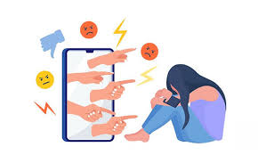
Dr.SNS COLLEGE OF EDUCATION CHILD RIGHTS AND PROTECTION
Online Abuse
Mrs.V RANI
Asst.Prof.,
Dr.SNSCE

Slide 2
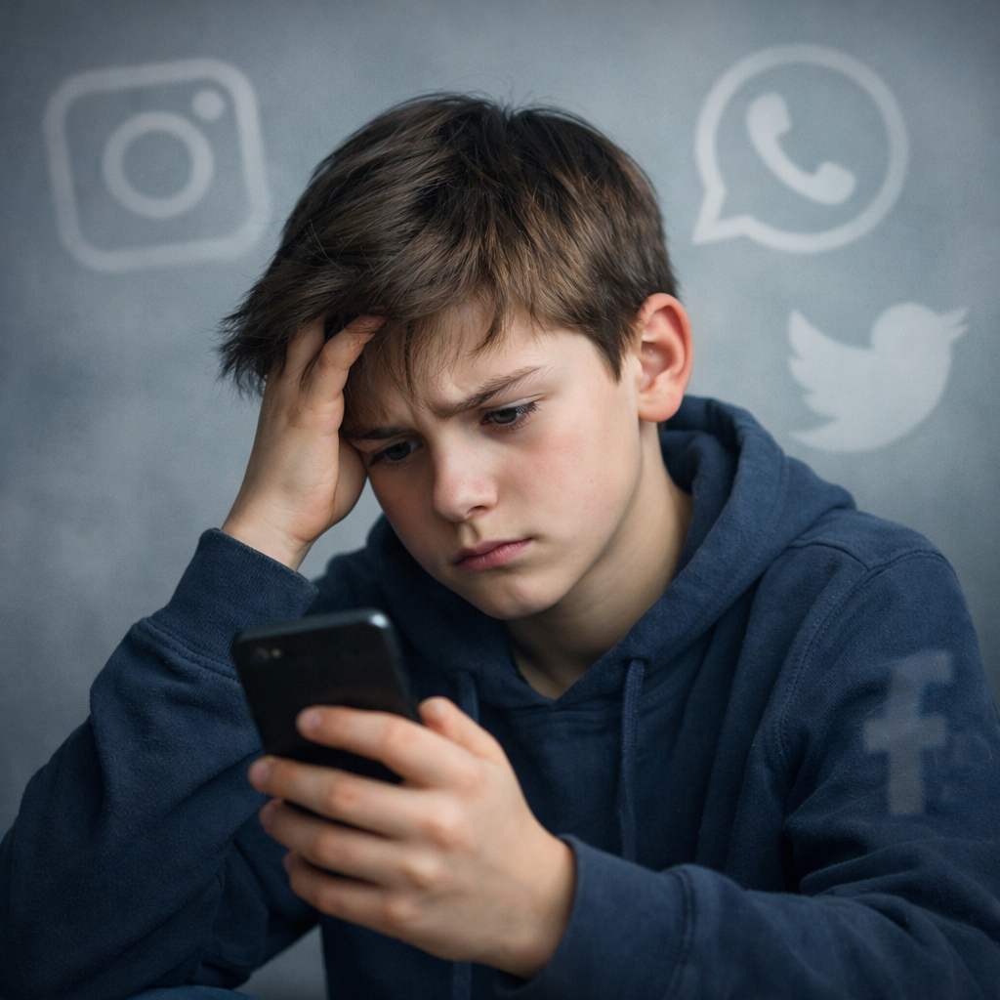
Online Abuse

Slide 3
EMPATHIZE
Understand victim’s feelings
Listen without judging
Identify real-life experiences
Activity
Ask: “How would you feel if someone trolls you online?”

Slide 4
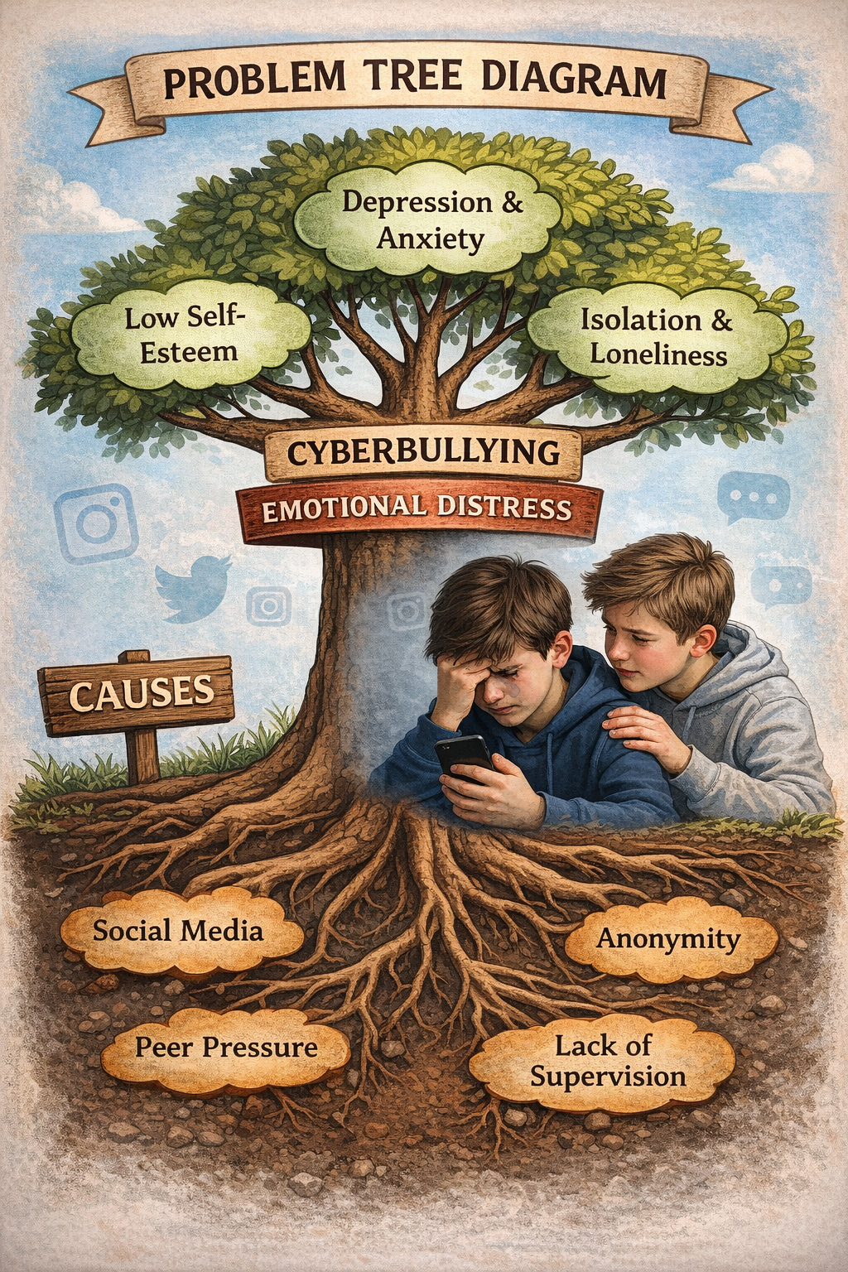
DEFINE
Identify the core problem
Example: “Students face cyberbullying causing emotional distress”

Slide 5
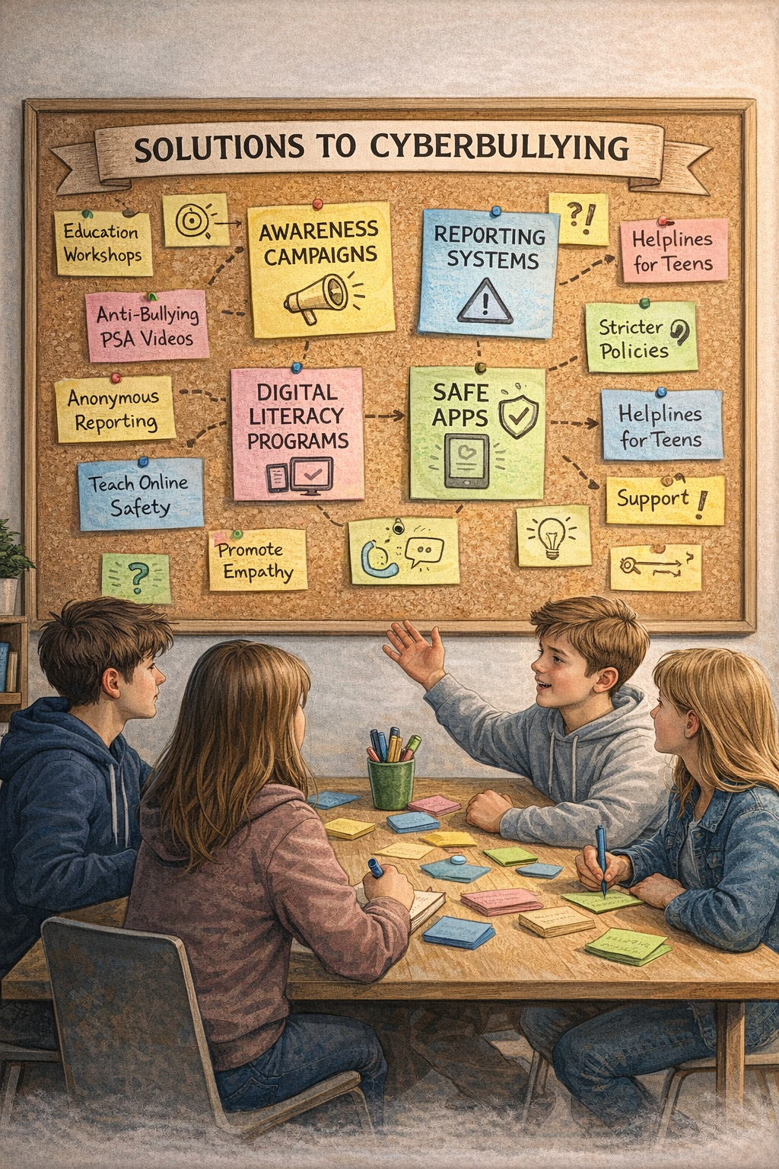
IDEATE
Brainstorm solutions:
Awareness campaigns
Reporting systems
Digital literacy programs
Safe apps
Activity
Group brainstorming session

Slide 6
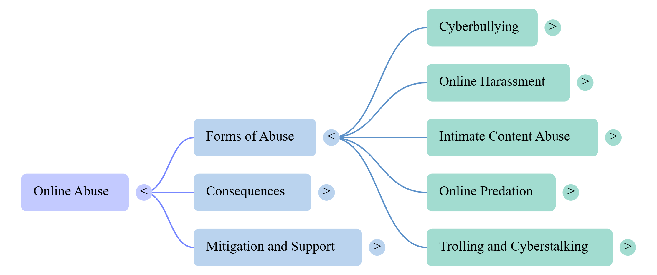
Mind Map

Slide 7
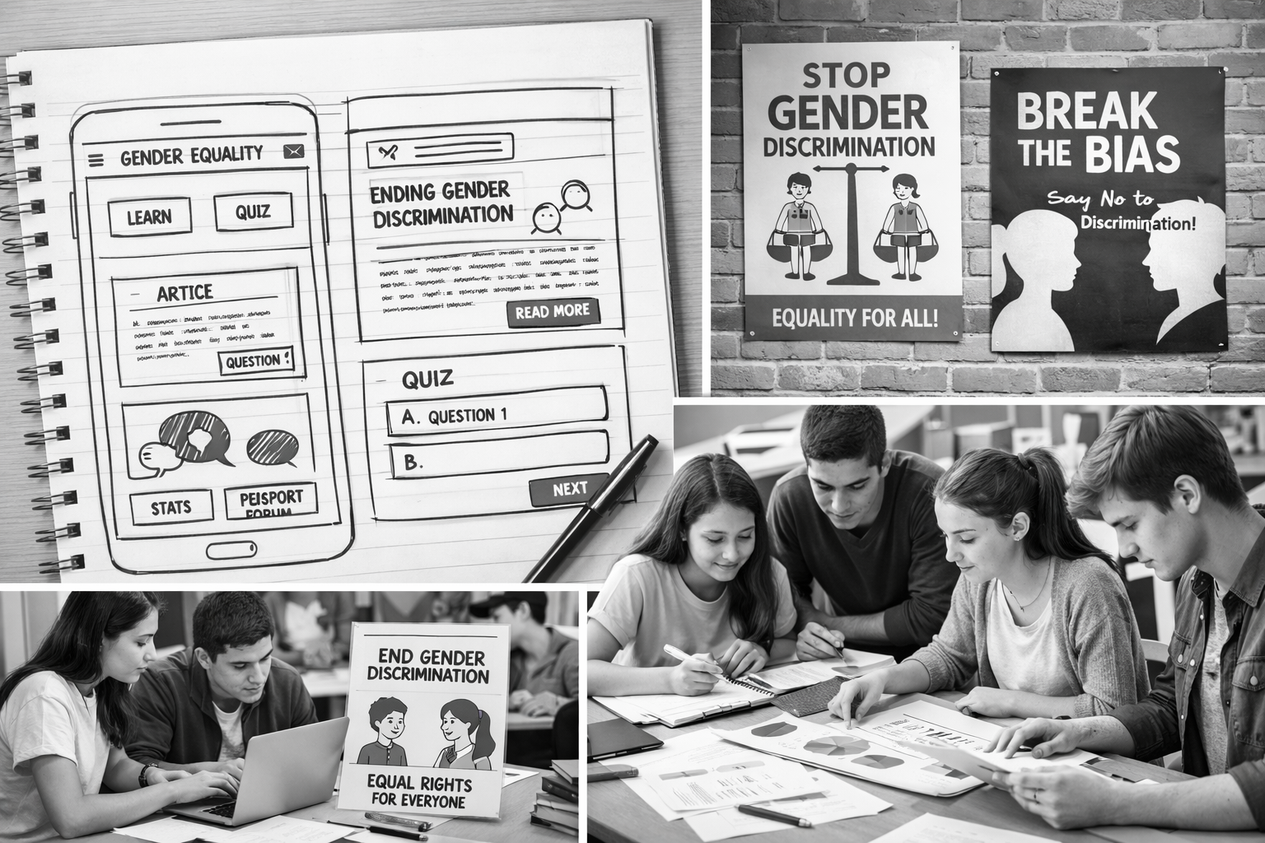
PROTOTYPE
Create solutions:
Poster
Mobile app idea
Awareness campaign
School policy draft

Slide 8
Case study
Scenario: A student receives abusive messages and fake rumours are spread online.
Questions:
What is the problem?
How will you help?
What solution will you design?

Slide 9
Assignment
Create a poster on cyber safety
Design a mobile app idea

Slide 10
THANK YOU

