Slide 1


Dr.SNS COLLEGE OF EDUCATION CHILD RIGHTS AND PROTECTION Abuse of Trust Against Children
Mrs.V RANI
Asst.Prof.,
Dr.SNSCE

Slide 2
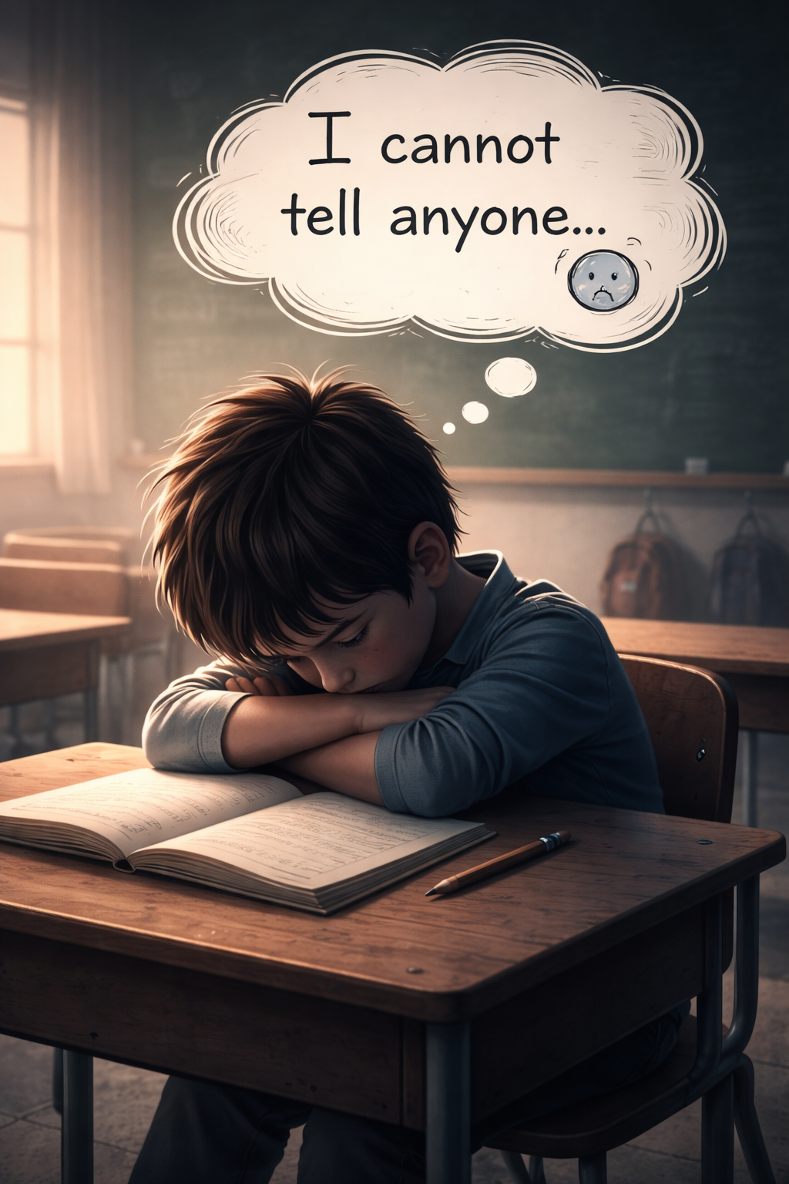
EMPATHIZE
CHILD’S PERSPECTIVE
Children trust adults blindly
Fear, confusion, silence
Long-term emotional trauma

Slide 3
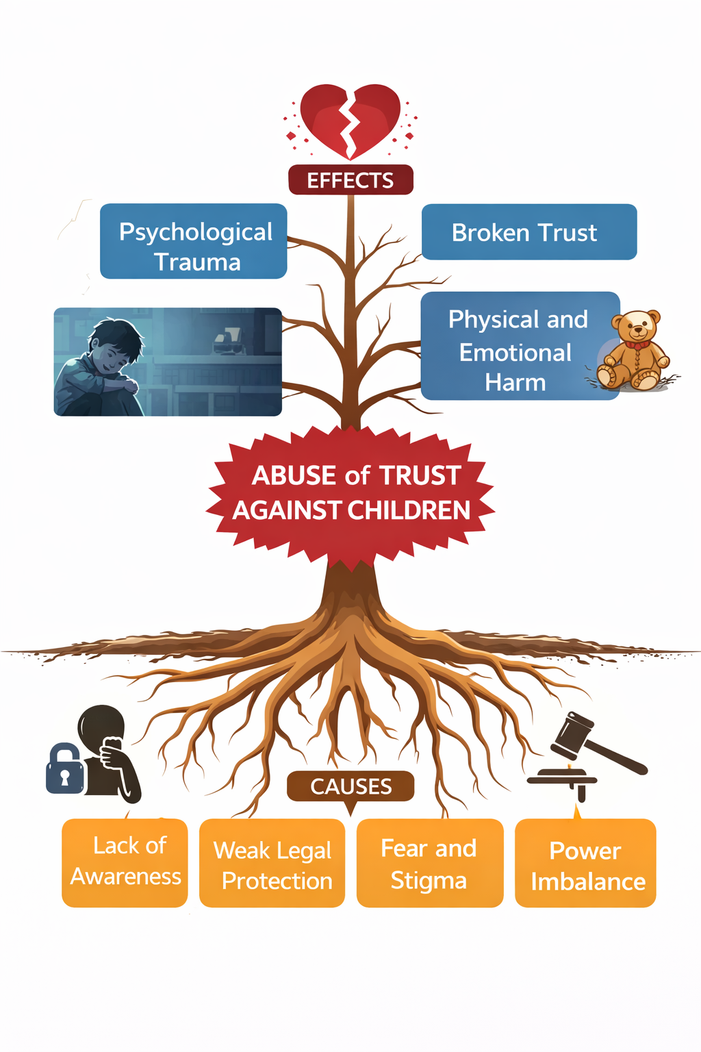
DEFINE
Children are exploited by trusted individuals

Slide 4
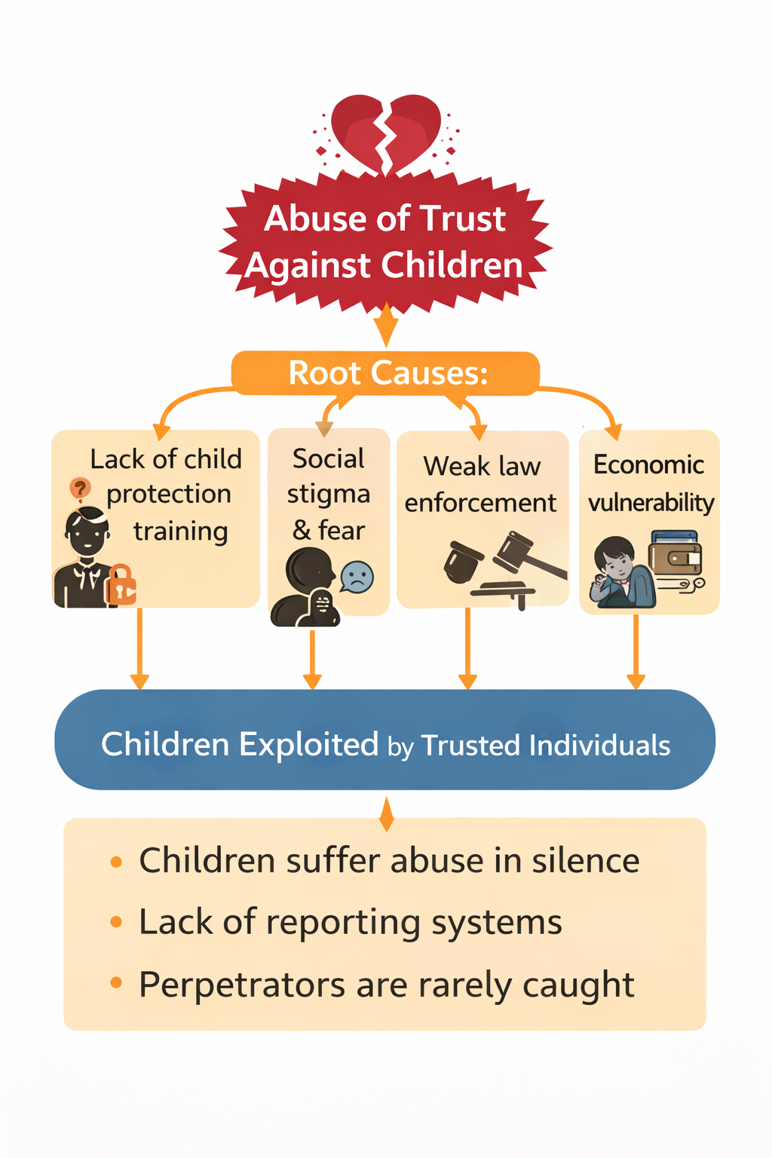
WHY DOES IT HAPPEN?

Slide 5
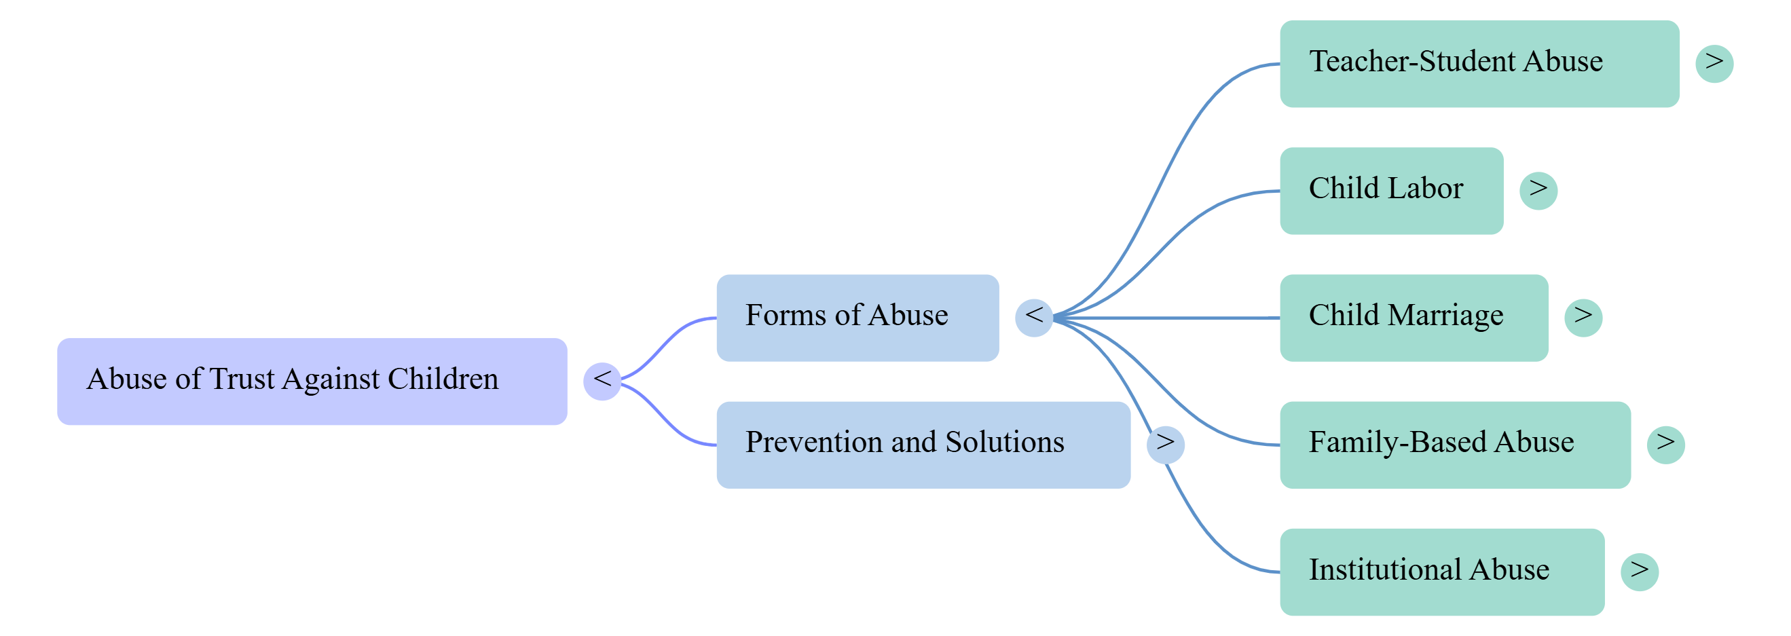
Mind Map

Slide 6
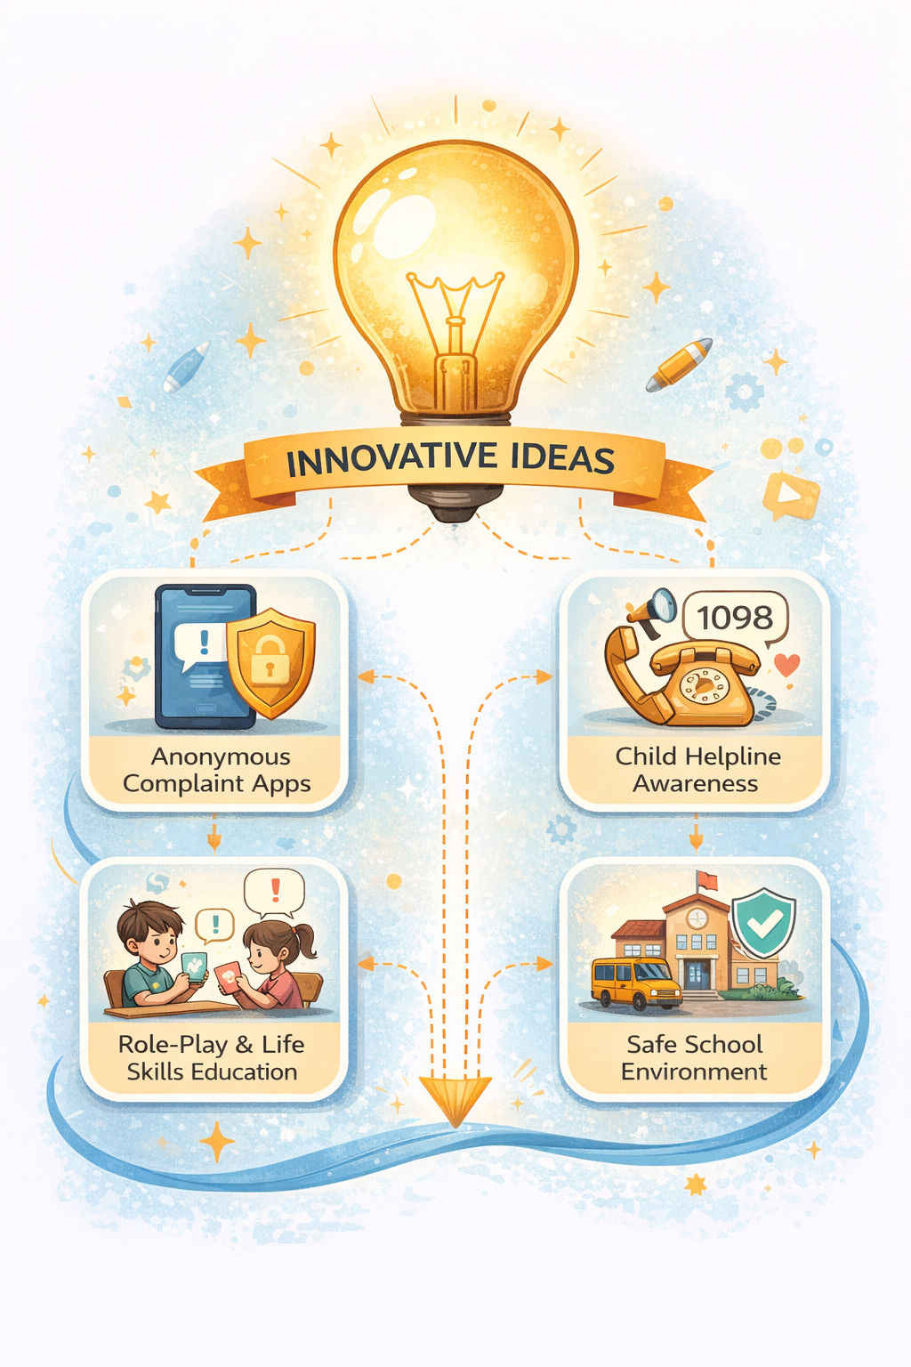
Innovative Ideas

Slide 7

Case Study
Case study discussion
Role play: “What would you do?”

Slide 8
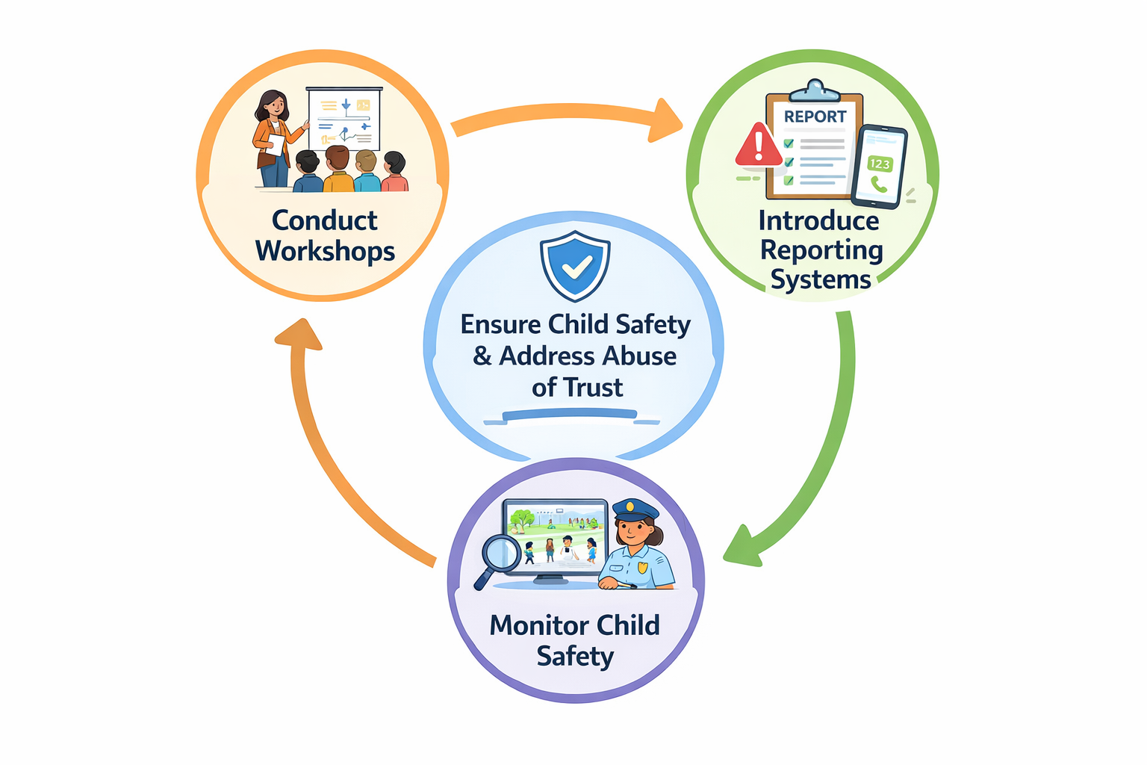
As a future teacher, how will you prevent abuse of trust in your classroom?

Slide 9
Assignment
Create an Awareness poster
Conduct workshops
Introduce reporting systems
Monitor child safety

Slide 10
THANK YOU

