Slide 1


Dr.SNS COLLEGE OF EDUCATION
BD4GS : CREATING AN INCLUSIVE SCHOOL
TOPIC :VARIOUS EDUCATION PROGRAMMES FOR CWSN: INTEGRATED EDUCATION
R.AMUTHA
ASSISTANT PROFESSOR
Dr.SNSCE

Slide 2
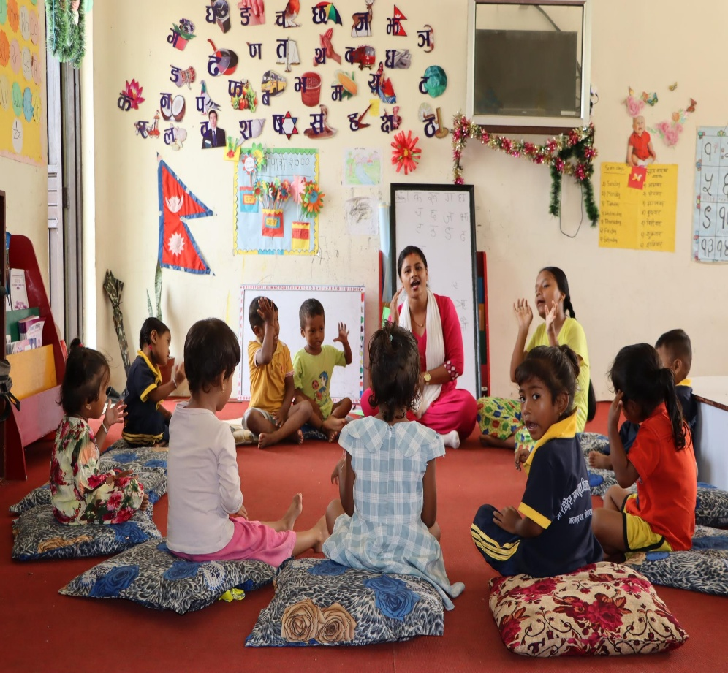
EMPATHY
Think & Feel:
How can we understand the challenges faced by CWSN when they learn alongside regular students in an integrated classroom?
10/24/2025
2/12

Slide 3

DEFINE
CWSN in integrated classrooms face difficulty in participation, learning pace, and social interaction due to lack of adapted teaching methods and support systems.

Slide 4

IDEATE
Use differentiated instruction
Provide assistive devices and learning materials
Encourage peer tutoring and group learning

Slide 5

PROTOTYPE
Teacher implements small interventions:
Conduct group-based inclusive activities
Use simplified worksheets and visual aids
Provide extra time for tasks

Slide 6

REAL TIME SITUTATION
A teacher identifies that a child with a learning disability struggles to read.

Slide 7

TEST
Observe improvement in participation
Compare academic performance
Gather feedback from students

Slide 8
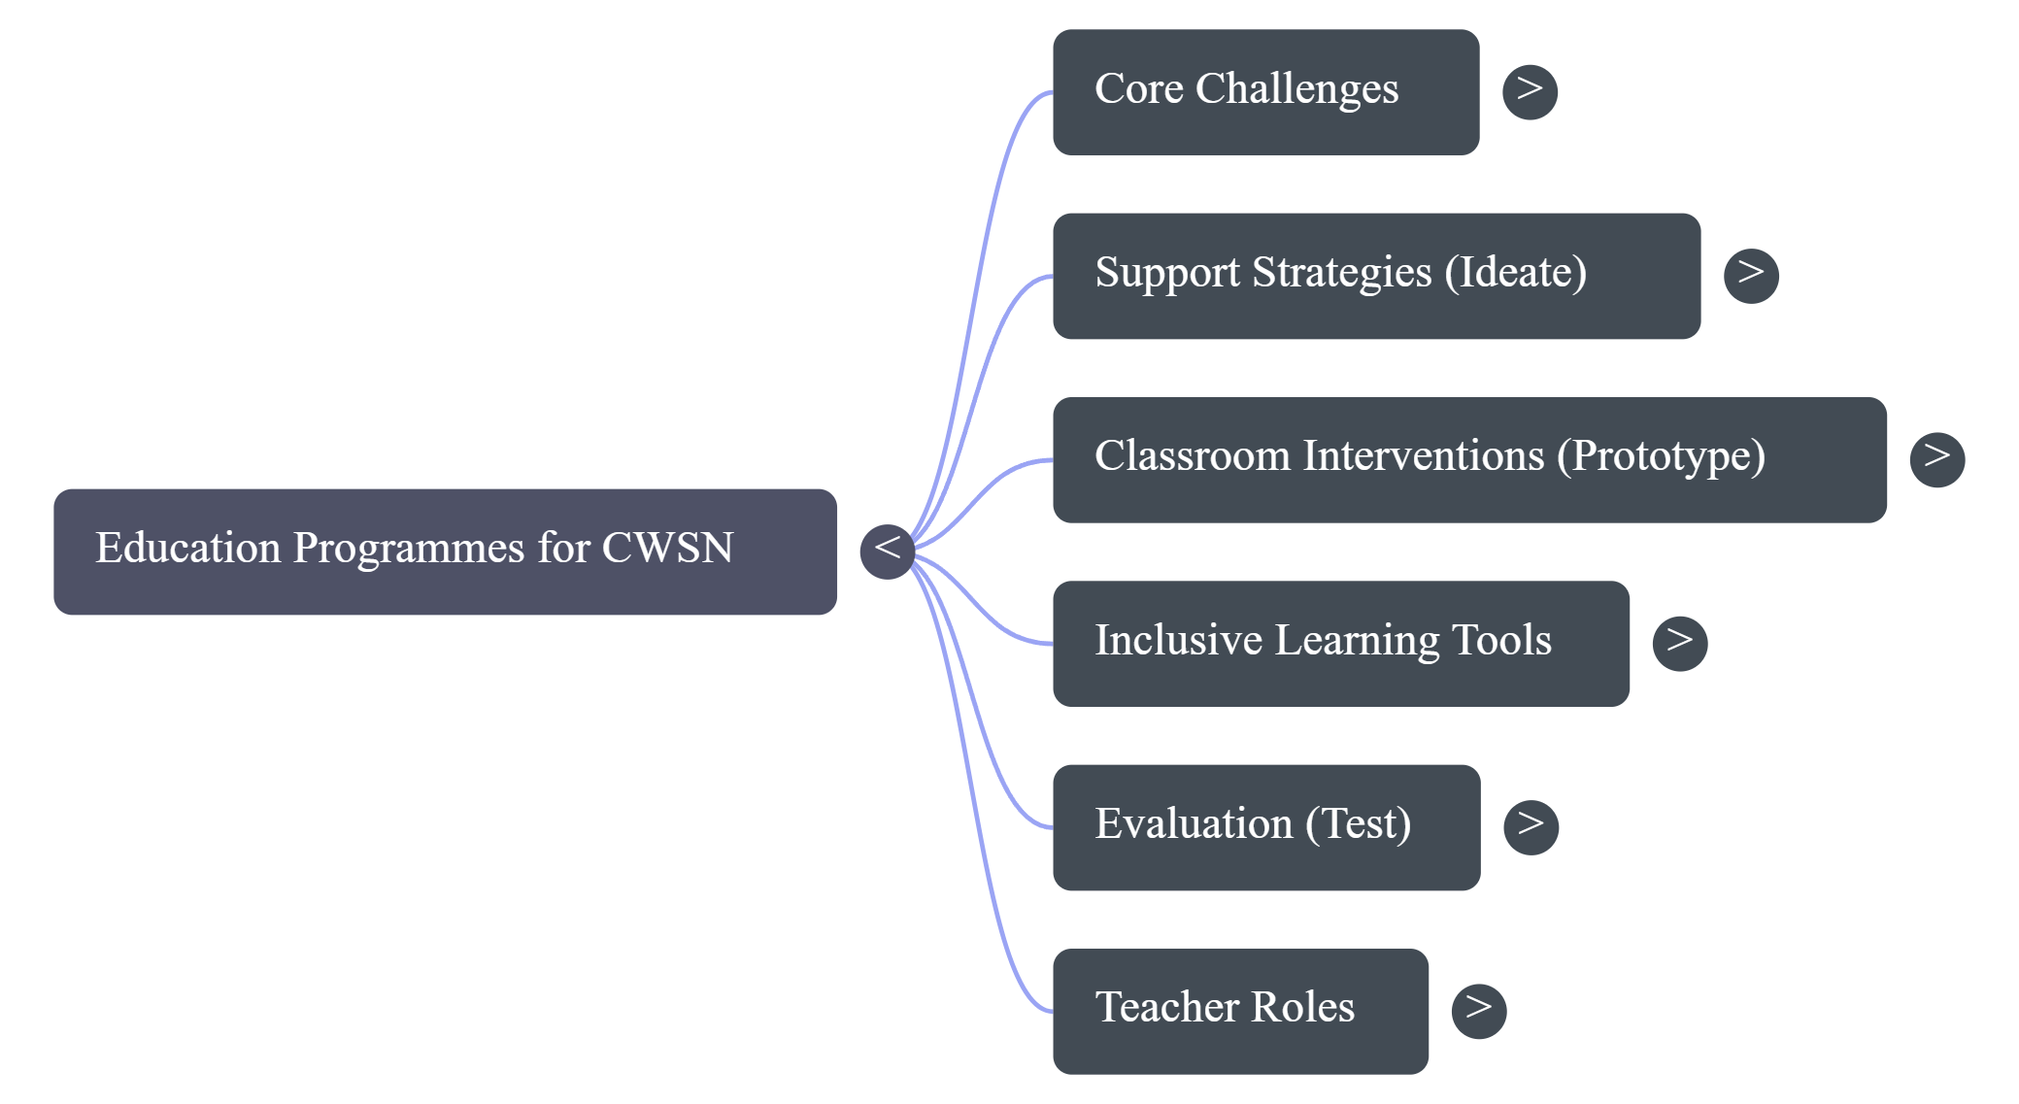
MINDMAP

Slide 9

CASE STUDY
Case Study:
A child with hearing impairment in a regular classroom struggles to follow instructions and avoids participation.
Task:
How will you identify the problem?
What strategies will you apply?
How will you improve inclusion and communication?

Slide 10
PUZZLE
Puzzle: “Integration Recall Challenge”
Words: Classroom, Inclusion, Peer, Support, Equality, Access, Teacher, Learning,
Participation, Confidence
Task: Recall as many words as possible after 20 seconds. 👉 Which words were easy and why? Suggest one memory strategy.

Slide 11

ASSIGNMENT
List any three strategies used in integrated classrooms
Describe importance of integrated education

Slide 12


