Slide 1


Dr.SNS COLLEGE OF EDUCATION
BD4GS : CREATING AN INCLUSIVE SCHOOL
TOPIC :VARIOUS EDUCATION PROGRAMMES FOR CWSN: SPECIAL EDUCATION
R.AMUTHA
ASSISTANT PROFESSOR
Dr.SNSCE

Slide 2

EMPATHY
Think & Feel:
“How can we understand the emotional, learning, and social challenges faced by Children With Special Needs (CWSN) in inclusive classrooms?”
10/24/2025

Slide 3

DEFINE
CWSN are unable to fully participate and achieve learning outcomes due to lack of appropriate support, teaching strategies, and inclusive environment.

Slide 4

IDEATE
Use Individualized Education Plans (IEP)
Apply multisensory teaching methods
Introduce assistive technologies

Slide 5

PROTOTYPE
Teacher designs small classroom interventions:
Conduct activity-based learning sessions
Use flashcards, audio-visual tools
Create flexible seating arrangements

Slide 6

REAL TIME SITUTATION
A teacher identifies that a child with a learning disability struggles to read.

Slide 7

TEST
Compare performance before and after strategies
Collect feedback from students and parents

Slide 8
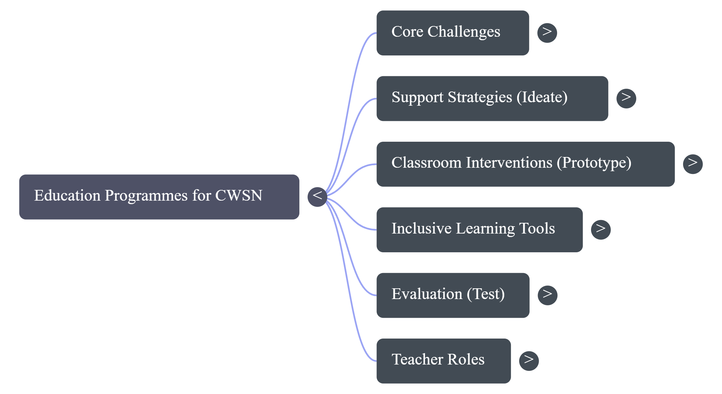
MINDMAP

Slide 9

CASE STUDY
A child with a learning disability in Class VI avoids group activities and struggles to complete tasks.
Task:
How will you observe and understand the child?
What strategies will you use to support learning?
How will you improve participation and confidence?

Slide 10

PUZZLE
Puzzle: “Inclusive Learning Challenge”
List 10 support strategies:
Braille
Audio books
Wheelchair access
Peer tutoring
IEP
Assistive technology
Therapy
Inclusive games
Task: Recall as many as possible after 20 seconds. 👉 Which strategies were easiest to remember and why?

Slide 11

ASSIGNMENT
Describe the role of teacher in inclusive classrooms
Suggest two innovative teaching strategies for CWSN

Slide 12


