Slide 1

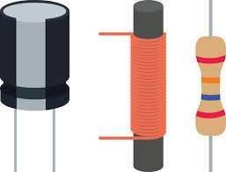

SNS COLLEGE OF TECHNOLOGY
An Autonomous Institution
Coimbatore-35
Department of Artificial Intelligence and Machine Learning
23EET103-Electric Circuits and Electron Devices
I B.Tech. AIML / II SEMESTER
UNIT I : DC CIRCUITS
Topic 6 : Ideal and Practical Sources

Slide 2
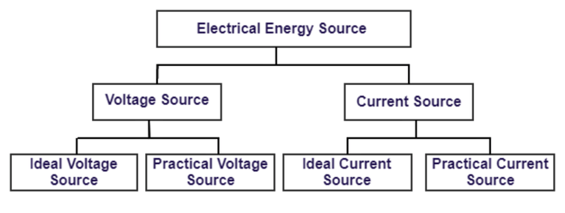
DT Empathy
22/01/2026
IDEAL AND PRACTICAL SOURCES / 23EET103-ELECTRIC CIRCUITS AND ELECTRON DEVICES /Dr Indu Nair. V / ASP / AIDS / SNSCT
2/14

Slide 3
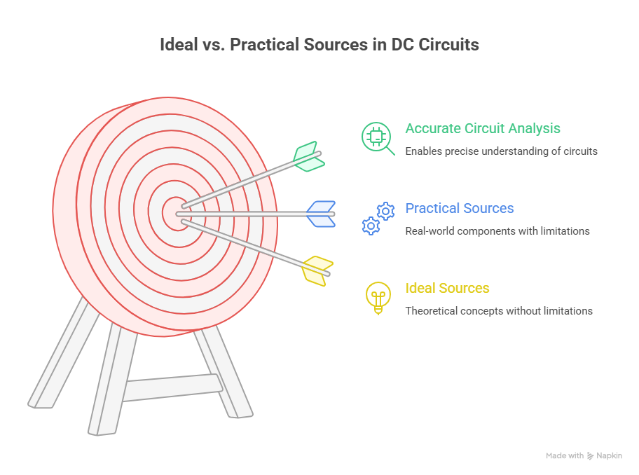
DT Empathy
IDEAL AND PRACTICAL SOURCES / 23EET103-ELECTRIC CIRCUITS AND ELECTRON DEVICES /Dr INDU NAIR. V / ASP / AIDS / SNSCT
3/14
22/01/2026

Slide 4
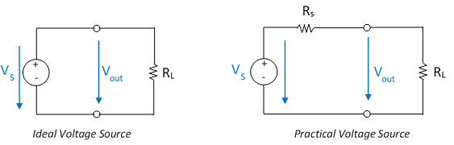
DT Define
Voltage sources
An ideal voltage source provides constant voltage at its terminal to the circuit regardless of the load current.
Practical voltage sources are real and used in daily life. A practical voltage source has internal resistance that causes a drop in terminal voltage due to the current flow.
22/01/2026
IDEAL AND PRACTICAL SOURCES / 23EET103-ELECTRIC CIRCUITS AND ELECTRON DEVICES /Dr INDU NAIR. V / ASP / AIDS / SNSCT
4/14

Slide 5
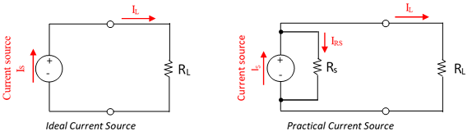
DT Define
Current Sources
Ideal current sources are providing the exact same current to any resistance connected to it.
Where practical current sources may vary current resistance.
IDEAL AND PRACTICAL SOURCES / 23EET103-ELECTRIC CIRCUITS AND ELECTRON DEVICES /Dr INDU NAIR. V / ASP / AIDS / SNSCT
5/14
22/01/2026

Slide 6
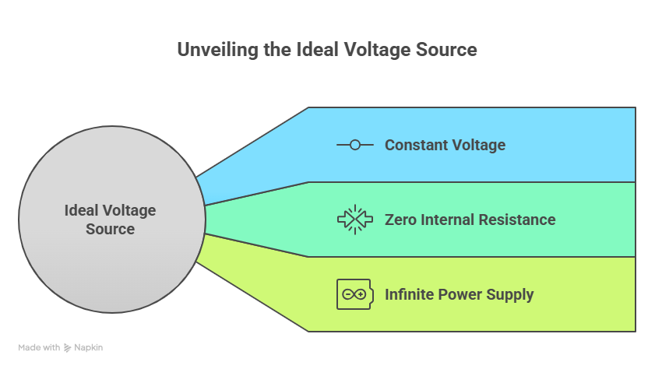
Ideal Voltage Source
Provides a constant voltage across its terminals, regardless of the current drawn from it.
22/01/2026
IDEAL AND PRACTICAL SOURCES / 23EET103-ELECTRIC CIRCUITS AND ELECTRON DEVICES /Dr INDU NAIR. V / ASP / AIDS / SNSCT
6/14

Slide 7
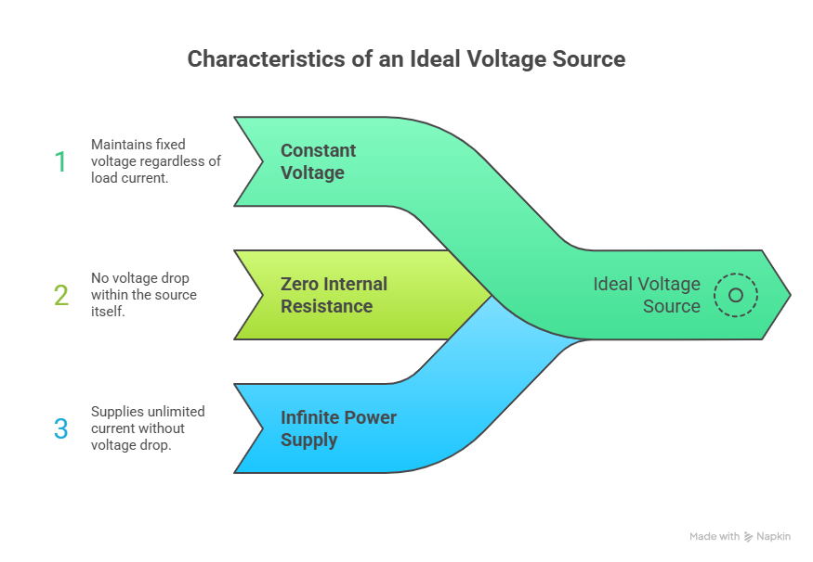
Characteristics of an Ideal Voltage Source:
            Constant Voltage
          Zero Internal Resistance
          Infinite Power Supply
22/01/2026
IDEAL AND PRACTICAL SOURCES / 23EET103-ELECTRIC CIRCUITS AND ELECTRON DEVICES /Dr INDU NAIR. V / ASP / AIDS / SNSCT
7/14

Slide 8
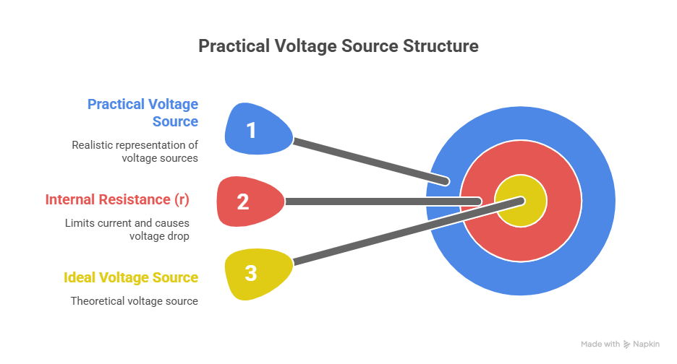
Practical Voltage Source
consists of an ideal voltage source in series with an internal resistance (r).
22/01/2026
IDEAL AND PRACTICAL SOURCES / 23EET103-ELECTRIC CIRCUITS AND ELECTRON DEVICES /Dr INDU NAIR. V / ASP / AIDS / SNSCT
8/14

Slide 9
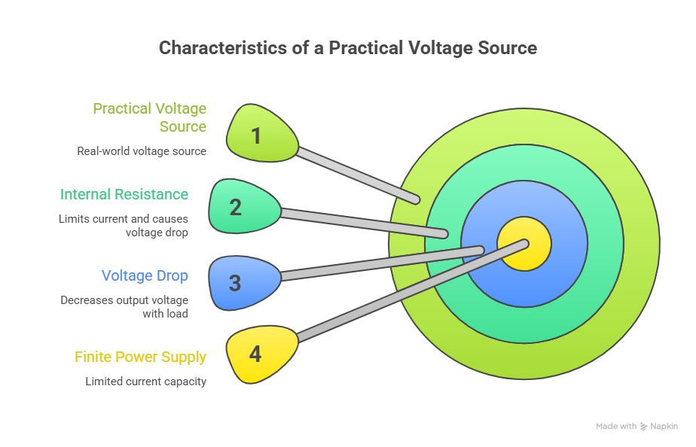
Characteristics of a Practical Voltage Source:
Voltage Drop
Internal Resistance
Finite Power Supply.
22/01/2026
IDEAL AND PRACTICAL SOURCES / 23EET103-ELECTRIC CIRCUITS AND ELECTRON DEVICES /Dr INDU NAIR. V / ASP / AIDS / SNSCT
9/14

Slide 10
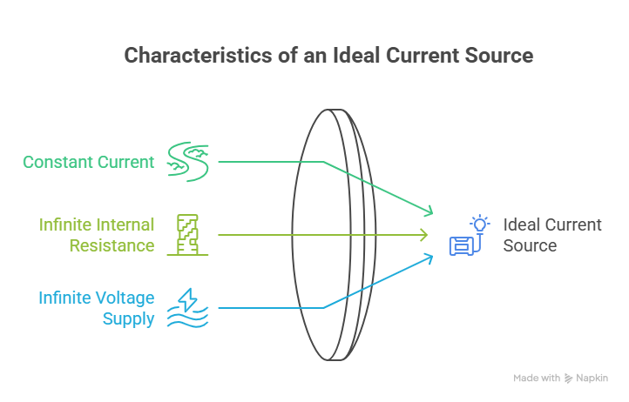
Ideal Current Source
Provides a constant current, regardless of the voltage across its terminals.
Characteristics of an Ideal Current Source:
Constant Current
Infinite Internal Resistance
Infinite Voltage Supply
22/01/2026
IDEAL AND PRACTICAL SOURCES / 23EET103-ELECTRIC CIRCUITS AND ELECTRON DEVICES /Dr INDU NAIR. V / ASP / AIDS / SNSCT
10/14

Slide 11
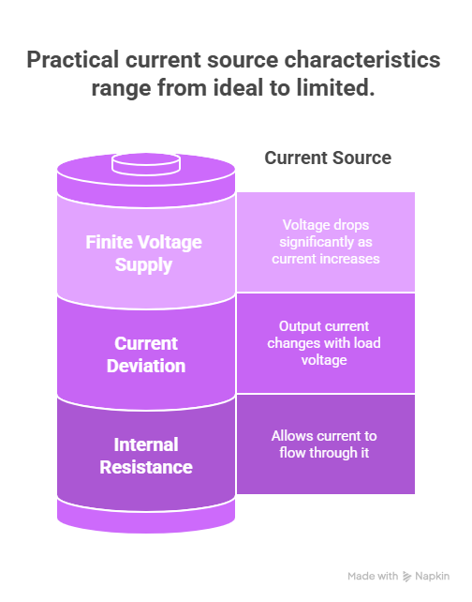
Practical Current Source
Consists of an ideal current source in parallel with an internal resistance (R).
Characteristics of a Practical Current Source:
Current Deviation
Internal Resistance
Finite Voltage Supply
22/01/2026
IDEAL AND PRACTICAL SOURCES / 23EET103-ELECTRIC CIRCUITS AND ELECTRON DEVICES /Dr INDU NAIR. V / ASP / AIDS / SNSCT
11/14

Slide 12
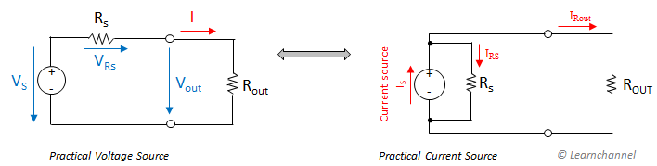
Source transformation - Voltage Source to Current Source or Current Source to Voltage Source
An electrical source transformation is a method for simplifying circuits by replacing a voltage source with its equivalent current source, or vice versa.
Source transformation - Voltage Source to Current Source or Current Source to Voltage Source
22/01/2026
IDEAL AND PRACTICAL SOURCES / 23EET103-ELECTRIC CIRCUITS AND ELECTRON DEVICES /Dr INDU NAIR. V / ASP / AIDS / SNSCT
12/14

Slide 13
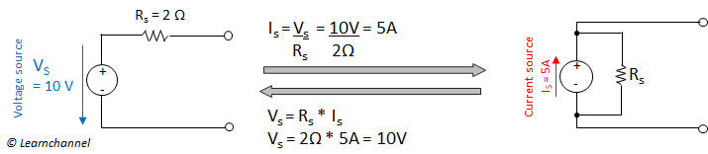
Example: Source transformation - Voltage Source to Current Source and vice versa
Source transformation example - Voltage Source to Current Source and vice versa
22/01/2026
IDEAL AND PRACTICAL SOURCES / 23EET103-ELECTRIC CIRCUITS AND ELECTRON DEVICES /Dr INDU NAIR. V / ASP / AIDS / SNSCT
13/14

Slide 14


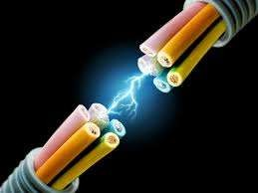
…THANK YOU

