Slide 1

SNS COLLEGE OF TECHNOLOGY
Kurumbapalayam (Po), Coimbatore – 641 107
An Autonomous Institution
Accredited by NBA – AICTE and Accredited by NAAC – UGC with ‘A’ Grade
Approved by AICTE, New Delhi & Affiliated to Anna University, Chennai
DEPARTMENT OF COMPUTER SCIENCE AND DESIGN
COURSE NAME : 23EET103- ELECTRIC CIRCUITS AND ELECTRON DEVICES
I YEAR /II SEMESTER
Unit-5 - RECTIFIERS AND POWER SUPPLIES
Topic : UPS & Battery Charger

Slide 2
Uninterruptible Power Supply
Key learnings:
UPS Definition: A UPS (Uninterruptible Power Supply) is defined as a device that provides immediate power during a main power failure.
Energy Storage: UPS systems use batteries, flywheels, or supercapacitors to store energy for use during power interruptions.
Types of UPS: There are three main types of UPS: Off-line UPS, On-line UPS, and Line-interactive UPS.
Off-line UPS Explanation: This UPS type switches to battery power when a power failure is detected, providing basic features and surge protection.
On-line UPS Block Diagram: The on-line UPS uses a double conversion method to continuously provide power without transfer time, ensuring constant power supply.

Slide 3
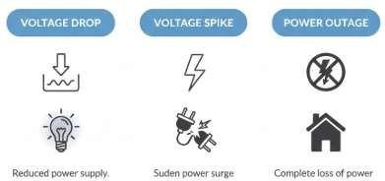
DT-Empathize

Slide 4
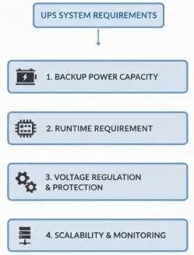
DT-DEFINE
What is a UPS (Uninterruptible Power Supply)?
An Uninterruptible Power Supply (UPS) is defined as a piece of electrical equipment which can be used as an immediate power source to the connected load when there is a failure in the main input power source.
In a UPS, the energy is generally stored in flywheels, batteries, or super capacitors. When compared to other immediate power supply system, UPS have the advantage of immediate protection against the input power interruptions.
UPS can be used as a protective device for some hardware which can cause serious damage or loss with a sudden power disruption.

Slide 5
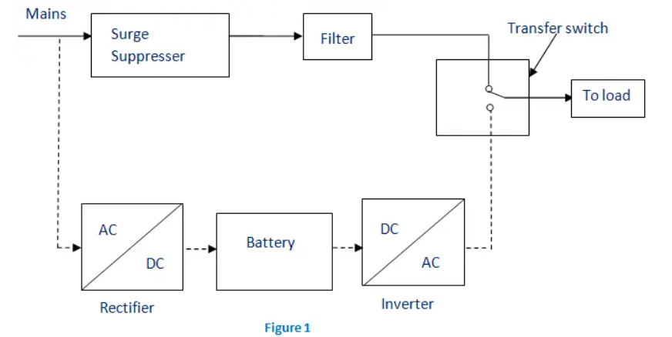
Types of UPS
Generally, the UPS system is categorized into On-line UPS, Off- line UPS and Line interactive UPS. Other designs include Standby on-line hybrid, Standby-Ferro, Delta conversion On-Line.
Off-line UPS

Slide 6
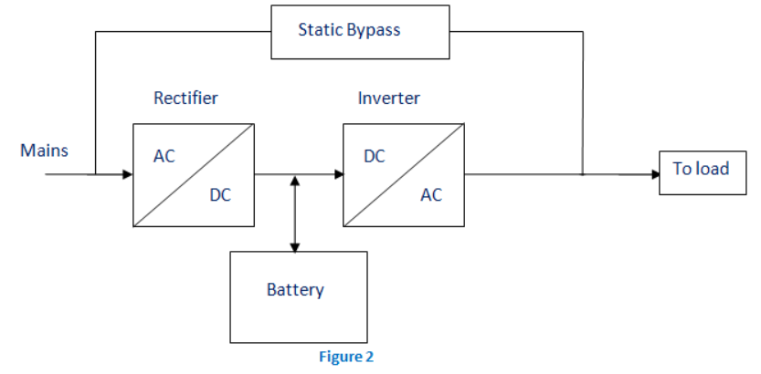
On-line UPS

Slide 7
Ideate: Online versus Offline UPS
DT-IDEATE
Feature | Online UPS | Offline UPS
Power Flow | Always powers load through inverter | Load normally powered by mains
Transfer Time | Zero ms (no interruption) | 4–10 ms delay during switching
Power Quality | Excellent — no noise or fluctuation | Depends on mains supply quality
Protection Level | High (ideal for sensitive equipment) | Moderate (basic protection)
Cost | Higher | Lower
Efficiency | Slightly lower (double conversion) | Higher (direct mains supply)
Heat Generation | More heat due to continuous conversion | Less heat
Best Use Cases | Data centers, medical devices, servers | Home PCs, small offices

Slide 8
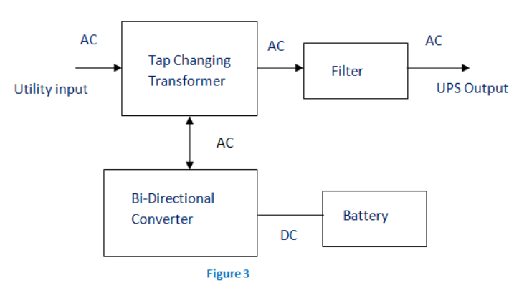
Line Interactive UPS
Line-interactive UPS is used for small businesses and departmental servers. It is similar to Off-line UPS but includes a tap-changing transformer for voltage regulation.
The difference is the addition of tap changing transformer. Voltage regulation is done by this tap-changing transformer by changing the tap depending on input voltage. Additional filtering is provided in this UPS result in lower transient loss. The block diagram is shown below.

Slide 9
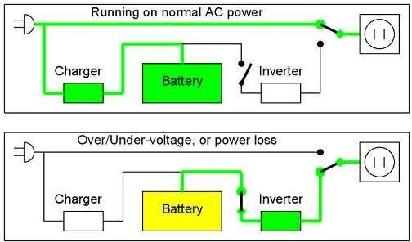
DT-IDEATE
Major Roles of a UPS
When the main power fails, the UPS supplies power for a short time. This is its primary role. Additionally, UPS can correct power problems like voltage spikes, noise, and frequency instability.
The problems that can be corrected are voltage spike (sustained over voltage), Noise, Quick reduction in input voltage, Harmonic distortion and the instability of frequency in mains.

Slide 10
UPS Applications
Applications of a UPS include:
Data Centers
Industries
Telecommunications
Hospitals
Banks and insurance
Some special projects (events)

Slide 11
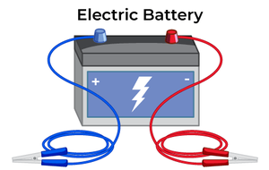
Electric Battery
An electric battery is a source that stores electrical power energy in chemical form and it releases electrical power when required. It consists of one or more electrochemical cells. An electric battery is used for supplying the power, then its positive terminal acts as a cathode, and its negative terminal acts as an anode.

Slide 12
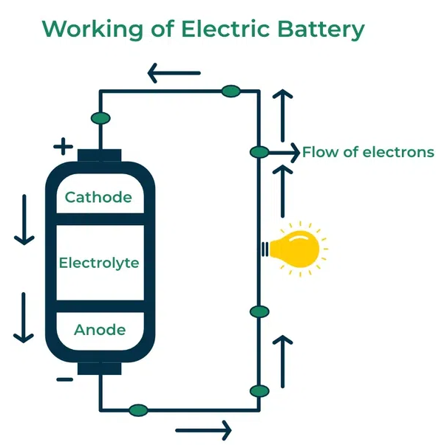
Working Principle of Electric Battery
Electric battery is a source that stores electrical power energy in chemical form and it releases electrical power when we required.
Electric battery consists of one or more electrochemical cells.
An electric battery is used for supplying the power, then its positive terminal acts as cathode and its negative terminal acts as an anode.
Each Electric battery consists of three essential components in it:
An anode which acts an electrode.
An Cathode which acts another electrode.
An Electrolyte.

Slide 13
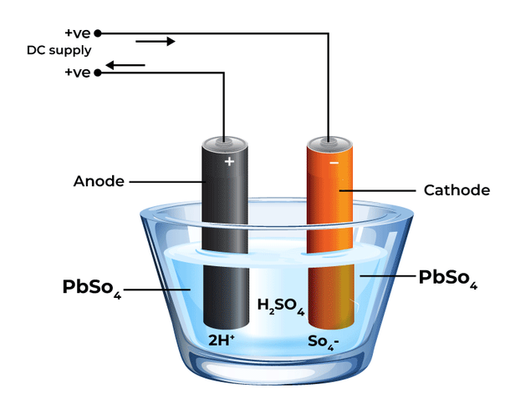
Types of Electric Battery
There are different types of electric battery:
Lead-Acid Battery.
Lithium-Ion Battery.
Nickel-Cadmium Battery.
Nickel-Metal Hydride Battery.
Lead-Acid Battery

Slide 14
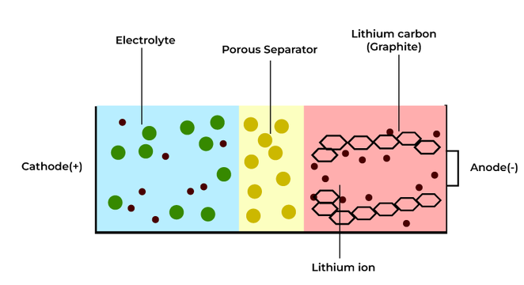
Lithium-Ion Battery

Slide 15
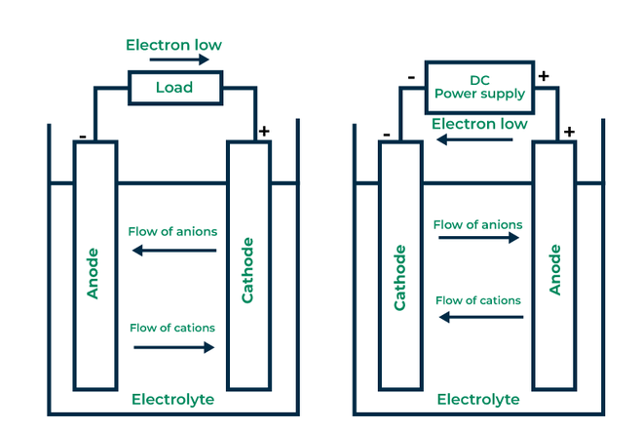
Nickel Cadmium Battery(NiCad )

Slide 16
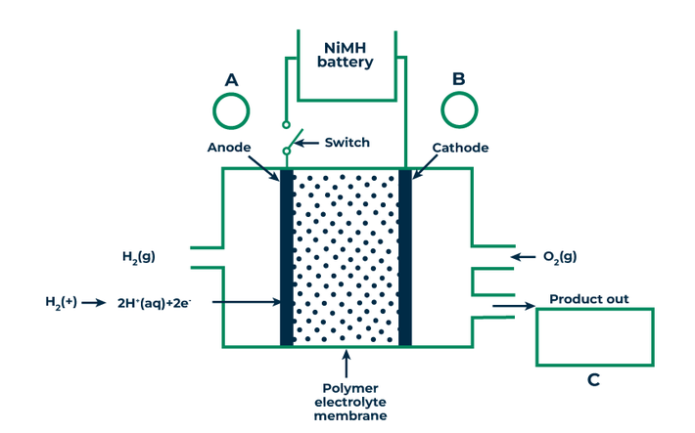
Nickel-Metal Hydride Battery

Slide 17
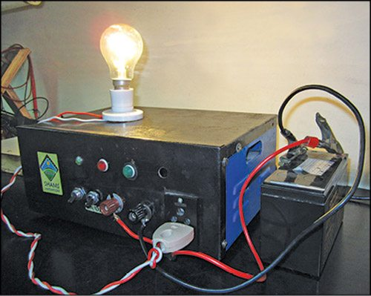
Applications of Electric Battery
Electric Battery like lithium-ion battery used in smartphones.
Electric Battery like lead-acid batteries in automobiles like car engine and power accessories.
Advantages of Electric Battery
Electric Batteries are portable and these can easily supply power to devices without any supply of external power source.
Electric Batteries have generally longer lifespan and these can store energy for extended periods.
Disadvantages of Electric Battery
Electric Battery has very limited energy storage capacity as compared to other power storage sources.
Some Electric Batteries have toxic materials, and if we do not dispose them properly it can harm environment.
DT- Prototype

Slide 18
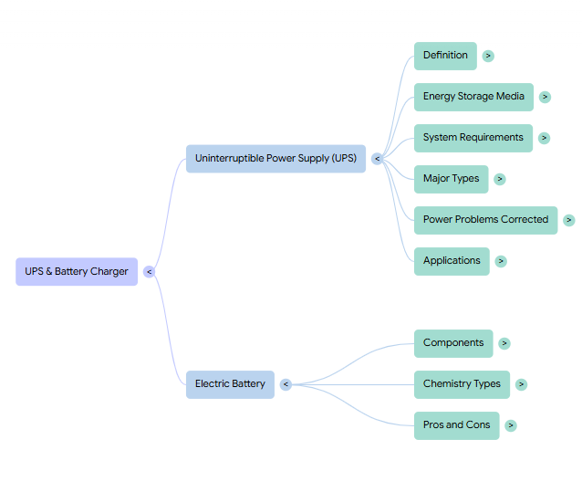
Summary

Slide 19

References
Muthusubramanian R, Salivahanan S, “Basic Electrical and Electronics Engineering”, TataMcGrawHillPublishers,2014.
Kothari DP and I.J Nagrath, “Basic Electrical and Electronics Engineering”, Second Edition, McGraw Hill Education, 2020.
Thank you

