Slide 1

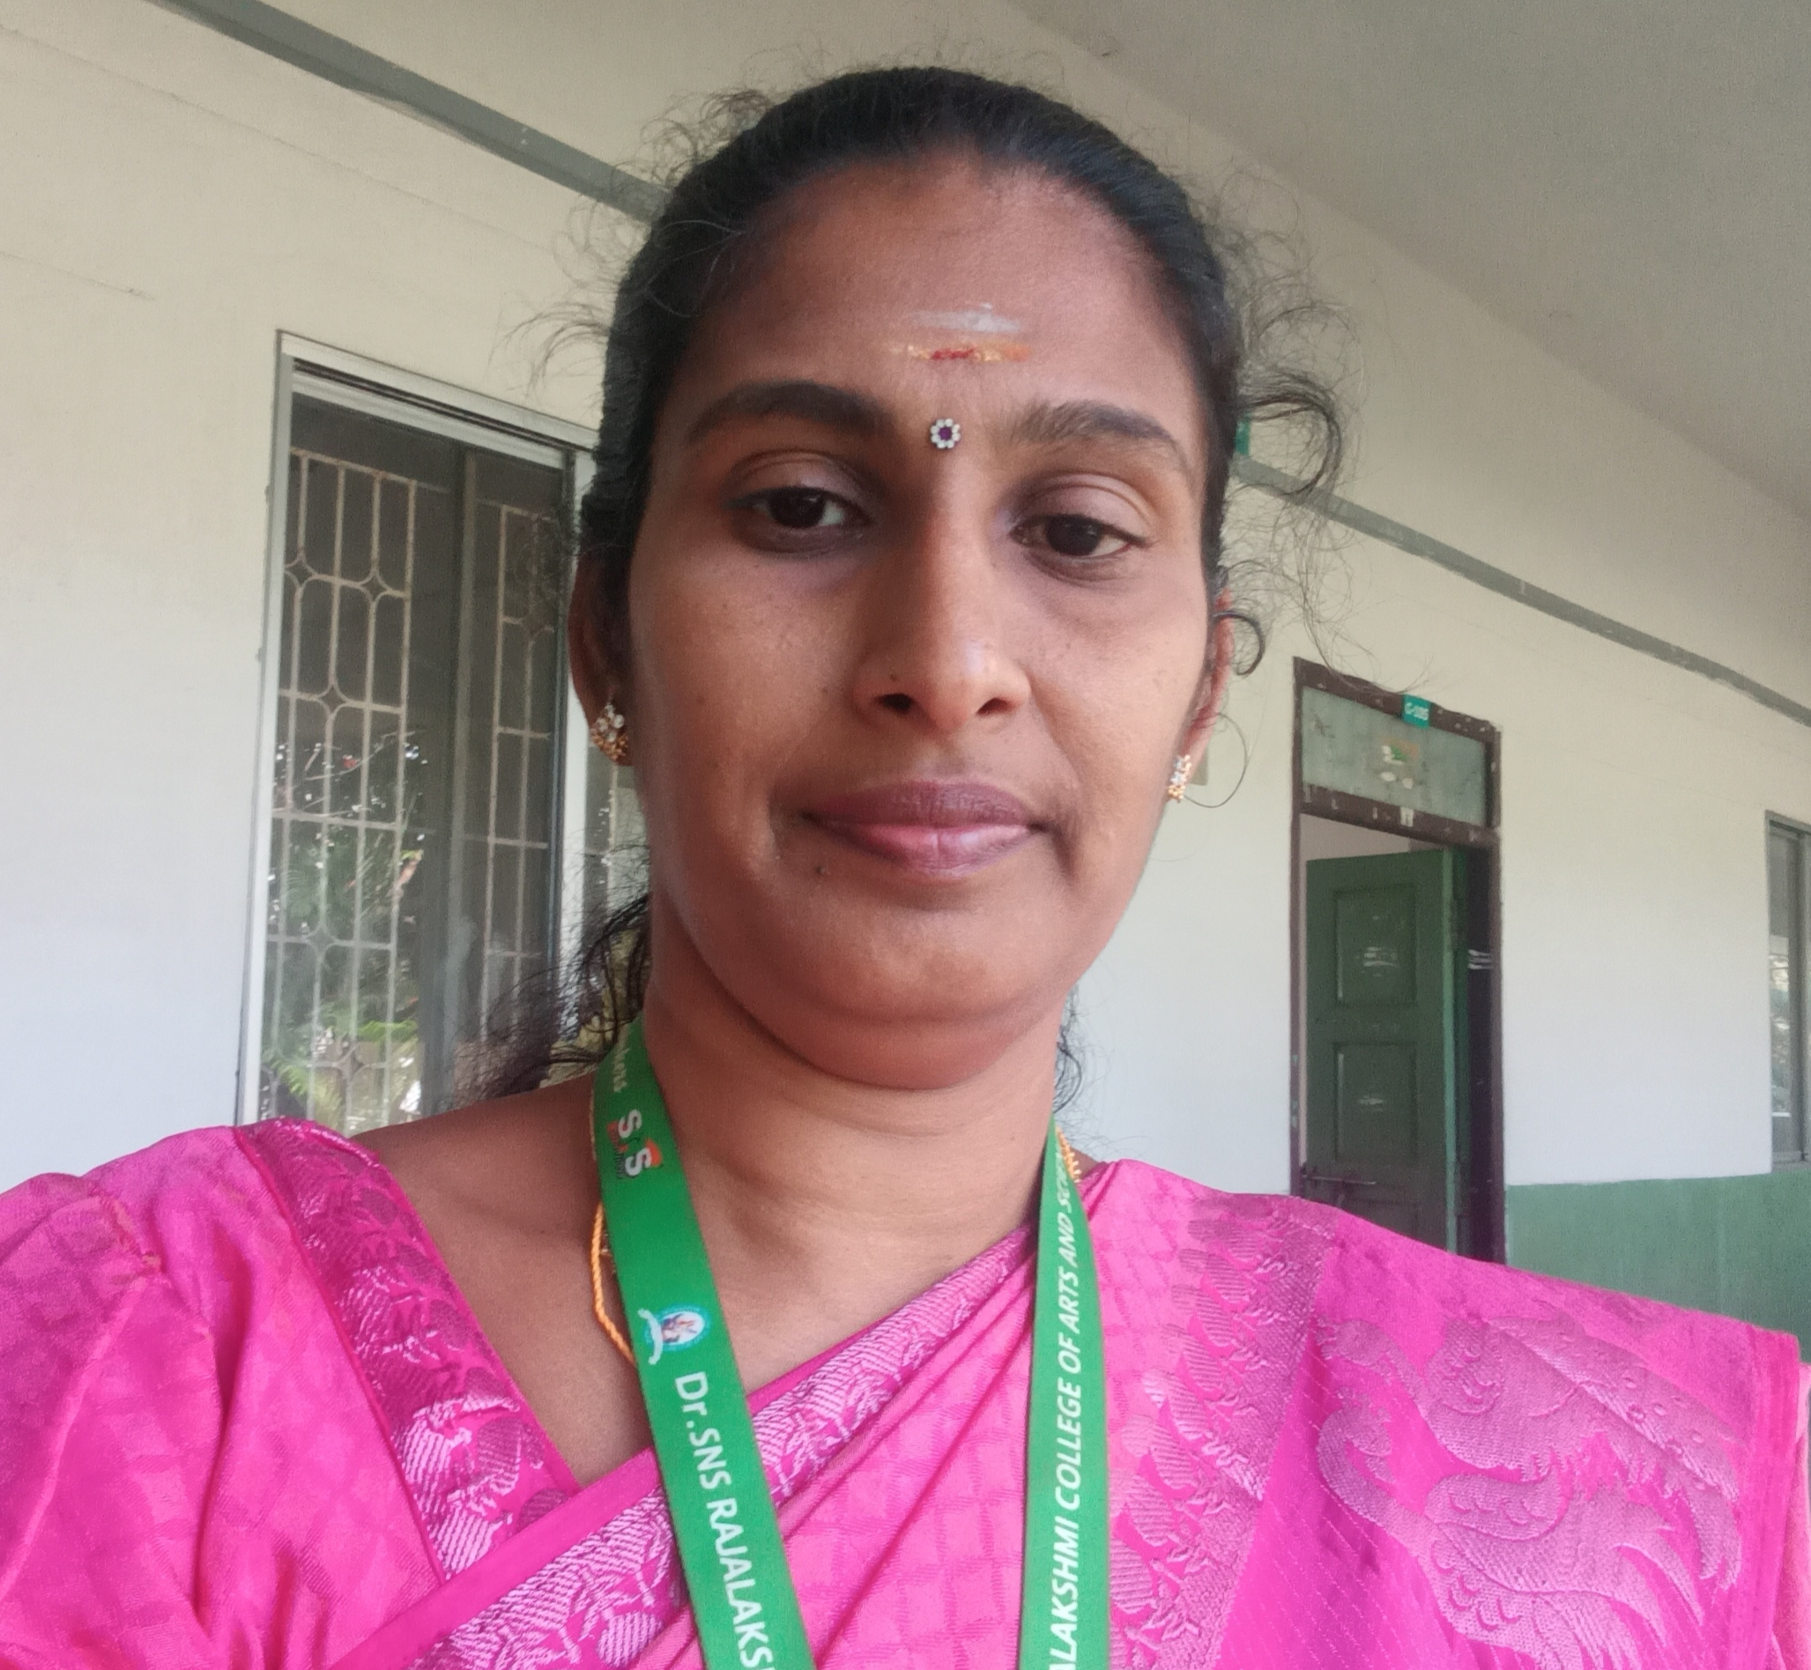
Dr. SNS RAJALAKSHMI COLLEGE OF ARTS & SCIENCE (Autonomous)
Coimbatore -641049
Accredited by NAAC(Cycle–IV) with ‘A+’ Grade
(Recognized by UGC, Approved by AICTE, New Delhi and
Affiliated to Bharathiar University, Coimbatore)
DEPARTMENT OF MATHEMATICS
21UCL302: RESOURCE MANAGEMENT TECHNIQUES
II SEMESTER
TOPIC- ASSIGNMENT PROBLEM
Ms. S.REKHA
ASSISTANT PROFESSOR
DEPARTMENT OF MATHS
Dr.SNSRCAS

Slide 2
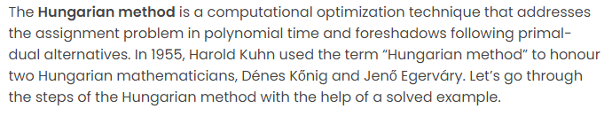
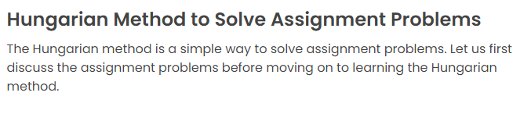

Slide 3
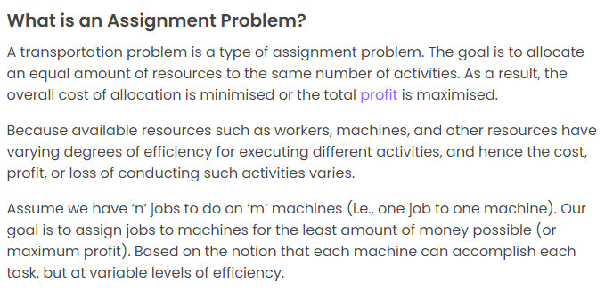

Slide 4
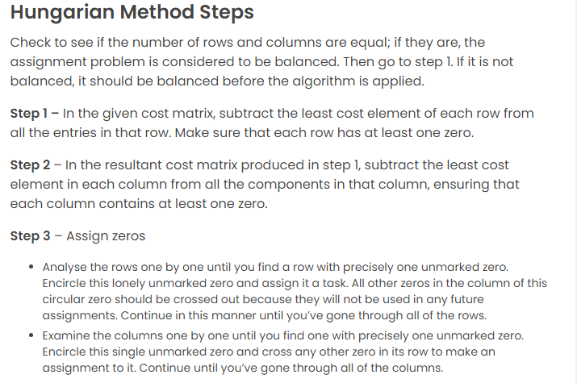
ASSIGENMENT PROBLEM/MATHS/SNSRCAS/S.Rekha
5/12333333

Slide 5
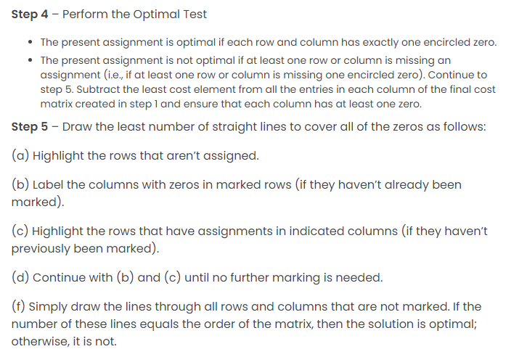

Slide 6
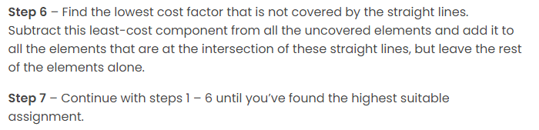

Slide 7
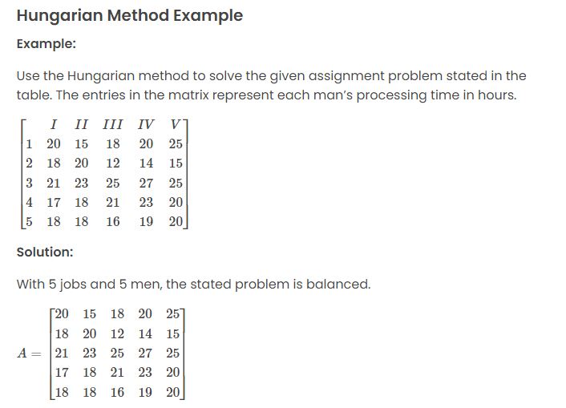

Slide 8
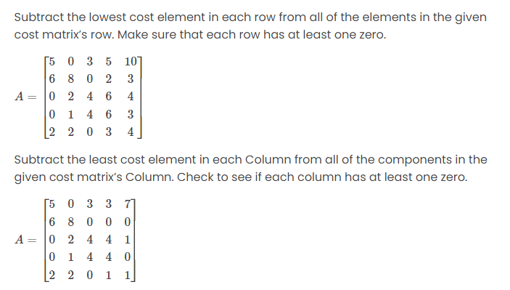

Slide 9
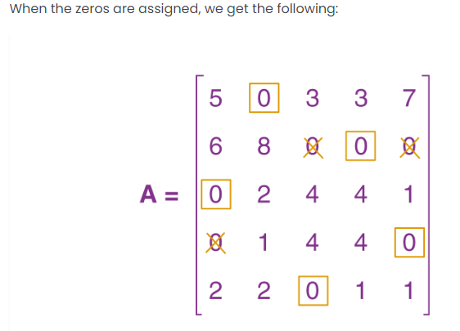

Slide 10
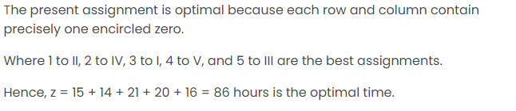

Slide 11
Thank You

