Slide 1

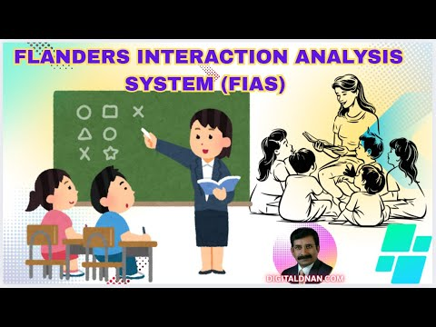
Dr.SNS COLLEGE OF EDUCATION
BD2SM: PEDAGOGY OF
I YEAR/II SEMESTER
UNIT –1 PEDAGOGICAL ANALYSIS
TOPIC : FLANDERS INTERACTION ANALYSIS
Mrs V Rani
Asst.Prof.,
Dr.SNSCE

Slide 2

THINK!!!
Is the teaching one-way or interactive?

Slide 3

EMPATHY
How do students and teachers feel about classroom interaction?

Slide 4

DEFINE
Problem : Lack of systematic observation and analysis of classroom verbal interactions between teachers and students.
Goal : To analyze and improve teacher-student verbal interactions in the classroom using a structured coding system for effective teaching-learning process.
Key Question : How does Flanders' Interaction Analysis (FIAS) help in understanding and improving classroom teaching behavior and student participation?

Slide 5
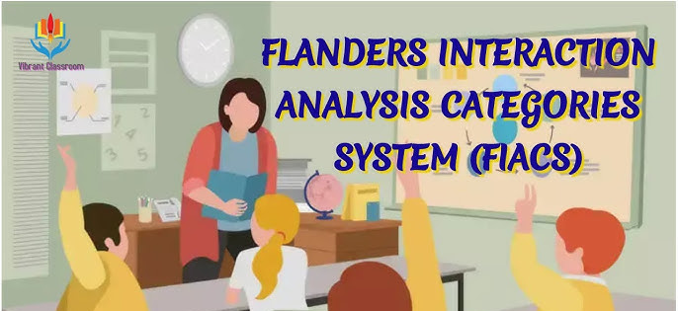
MEANING OF FLANDER INTERACTION ANALYSIS
Flanders Interaction Analysis is a tool to study and improve the quality of verbal interaction in the classroom so that teaching becomes more effective and students become more active.

Slide 6
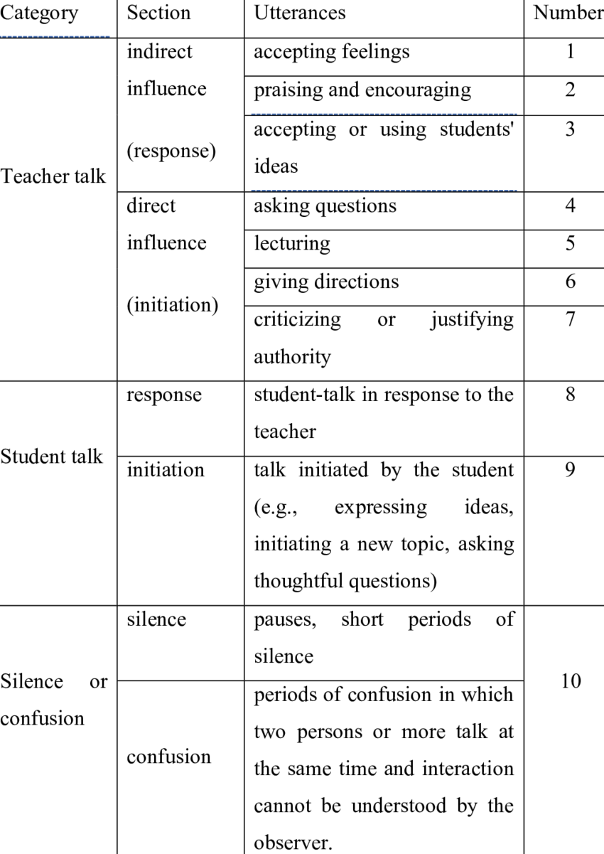
CATEGORIES OF FIAS
TEACHER TALK
Indirect Influence
Direct Influence
STUDENT TALK
Student Talk – Response
Student Talk – Initation
SILENCE

Slide 7

IDEATE
💡 Increase student talk instead of only teacher talk
💡 Encourage student-to-student discussion
💡 Use praise and encouragement to build confidence
💡 Accept and use students’ ideas in teaching
💡 Create a friendly and supportive classroom climate
💡 Balance direct and indirect teacher influence
💡 Allow time for thinking instead of rushing

Slide 8

PROTOTYPE
Prepare a lesson plan incorporating FIAS categories
• Assign roles (Teacher, Observer, Students)
• Observe and record classroom interaction (teacher talk & student talk)
• Classify interaction using 10 FIAS categories (1–10)
• Identify indirect teacher talk (encouraging, questioning)
• Identify direct teacher talk (lecturing, directing, criticizing)
• Analyze student talk (response and initiation)
• Note silence or confusion periods
• Demonstrate a classroom using different interaction patterns
• Apply suitable strategies to increase student participation

Slide 9
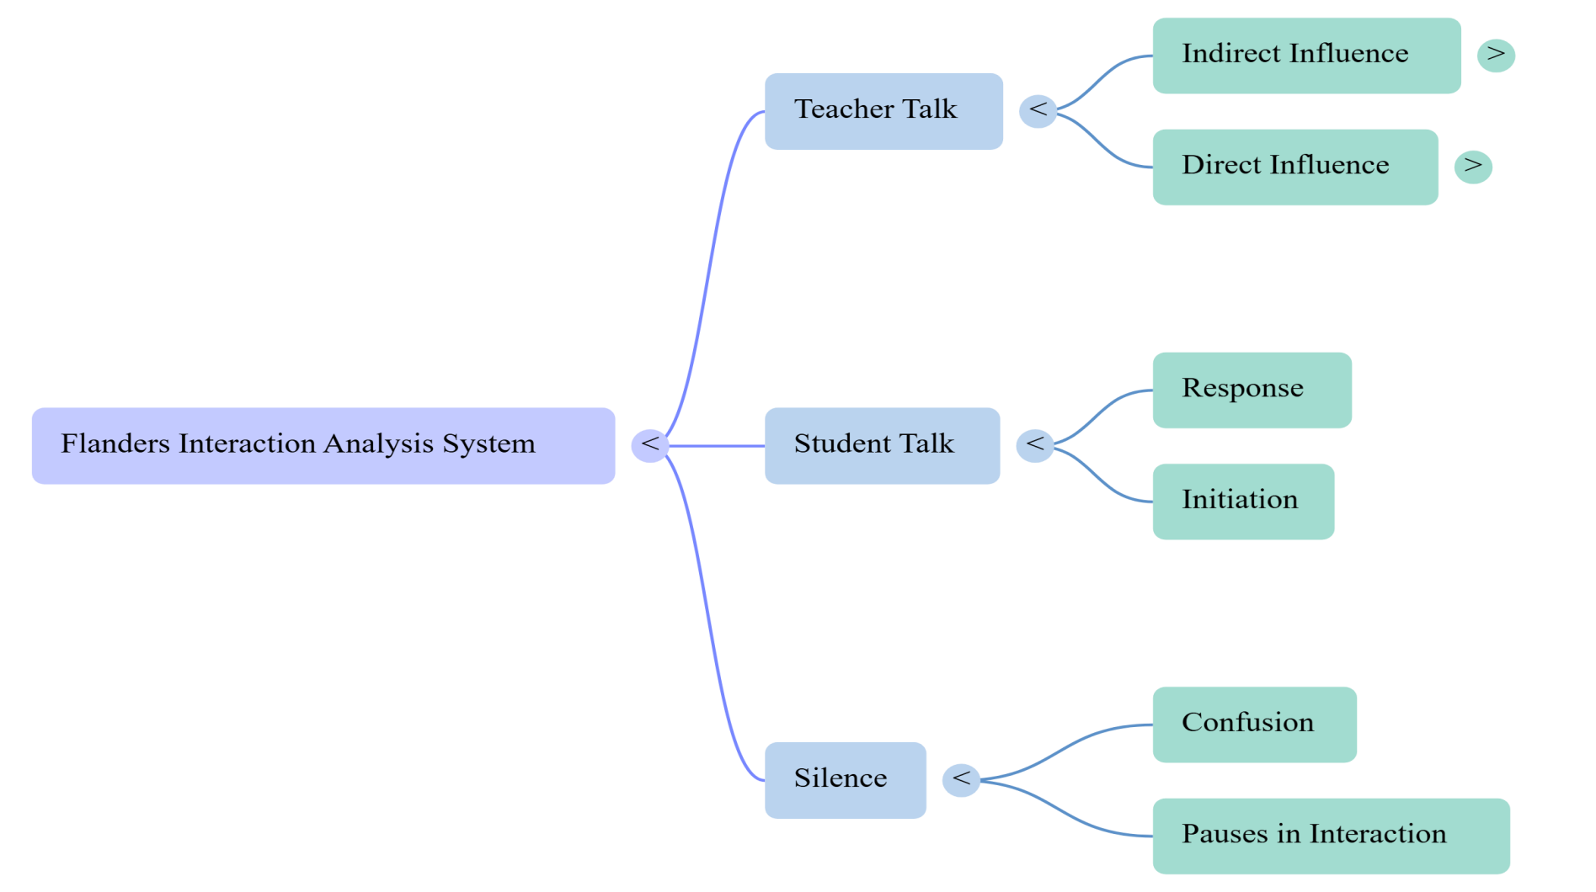
MIND MAP

Slide 10

Test (Reflection & Improvement)
Test (Stage 5):
• Do learners actively participate in classroom interaction?
• Can students differentiate between teacher talk and student talk?
• Are students showing better understanding through interaction?

Slide 11

CASE STUDY
Scenario:
A classroom applies FIAS to analyze and improve interaction between teacher and students
Teacher Talk:
Teacher uses questioning, explaining, and giving directions
Balances direct (lecture) and indirect (encouragement) talk
Student Talk:
Students respond to teacher questions
Interaction Process:
Classroom communication recorded and observed
Result:
• Improved teacher–student interaction • Increased student participation and confidence • Better understanding through active learning

Slide 12
ASSIGNMENT
TOPIC:
Preparing a FIAS matrix (10×10 grid analysis) and Designing a lesson plan based on FIAS principles

