Slide 1


Dr. SNS RAJALAKSHMI COLLEGE OF ARTS & SCIENCE (Autonomous)
Coimbatore -641049
Accredited by NAAC(Cycle–IV) with ‘A+’ Grade
(Recognized by UGC, Approved by AICTE, New Delhi and
Affiliated to Bharathiar University, Coimbatore)
DEPARTMENT OF MATHEMATICS
21UCL302: RESOURCE MANAGEMENT TECHNIQUES
II SEMESTER
TOPIC- IBFS OF TRANSPORTATION PROBLEM-NWC
Ms. S.REKHA
ASSISTANT PROFESSOR
DEPARTMENT OF MATHS
Dr.SNSRCAS

Slide 2
TRANSPORTATION PROBLEM:
A transportation problem is a specific type of Linear Programming Problem (LPP). In this problem, we are tasked with transporting goods from several sources to various destinations. The goal is to minimize the total cost of transportation, considering the supply and demand at the source and destination points, respectively.
Transportation problems can be of two types:
Balanced Transportation Problems: In these problems, the supply and demand are equal.
Unbalanced Transportation Problems: Here, the supply and demand are not equal. To balance the problem, we might need to add a dummy row or column.

Slide 3
NORTHWEST CORNER METHOD
To find the initial feasible solution for a transportation problem, we can use Northwest corner method.
The following steps will guide you through the process of finding a feasible solution for a transportation problem using the North-West Corner Rule.
Step 1: Start with the top-left cell (the North-West corner cell) of the transportation matrix. Assign it the minimum value of supply or demand, i.e., min(supply, demand).
15/2/2025

Slide 4
Step 2: Subtract the minimum value from the corresponding row and column's supply and demand. This can result in three possible scenarios:
If the supply is zero, cross out that row and move down to the next cell.
If the demand is zero, cross out that column and move right to the next cell.
If both supply and demand are zero, cross out both the row and column and move diagonally to the next cell.
Step 3: Repeat these steps until all supply and demand values are zero.
15/2/2025
5/12333333

Slide 5
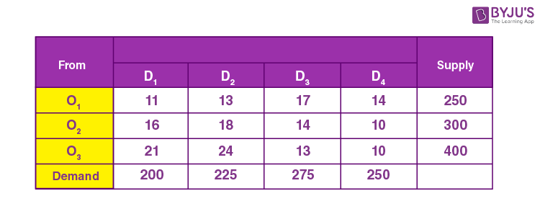
Question 1:
Get an initial basic feasible solution to the given transportation problem using the North-west corner rule.

Slide 6
Solution:
For the given transportation problem, total supply = 950 and total demand = 950.
Thus, the given problem is the balanced transportation problem.
Now, we can proceed with the North-west corner rule to find the initial feasible solution.
Step 1: Consider the upper-left corner cell, which has the value 11. The minimum value of the corresponding cell’s supply and demand is 200.

Slide 7
Step 2: The difference between the corresponding cell’s supply and demand from the minimum value obtained in the previous step is:
Supply = 250 – 200 = 50
Demand = 200 – 200 = 0
As demand is 0, we need to allocate 200 to that cell and strike the corresponding column and then move right to the next cell, i.e., the cell with the value 13

Slide 8
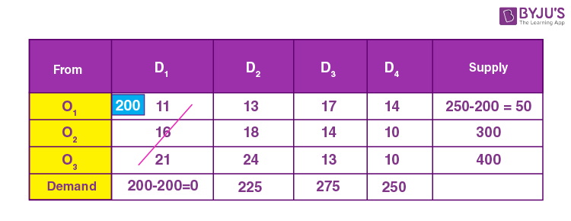
Step 3: For the cell with value 13, the minimum of supply and demand is min(50, 225) = 50.

Slide 9
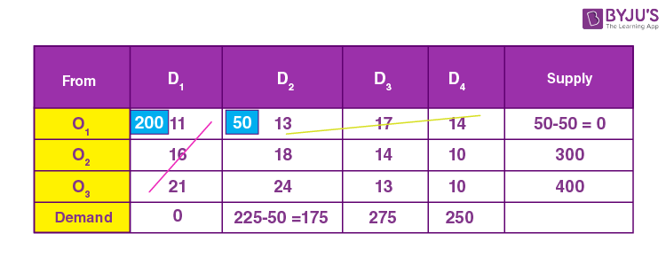
Step 4: The difference between the corresponding cell’s supply and demand from the minimum value obtained in the previous step is:
Supply = 50 – 50 = 0
Demand = 225 – 50 = 175
As the supply is 0, we need to allocate 50 to that cell and strike the corresponding column and then move down to the next cell, i.e., the cell with the value 18.

Slide 10
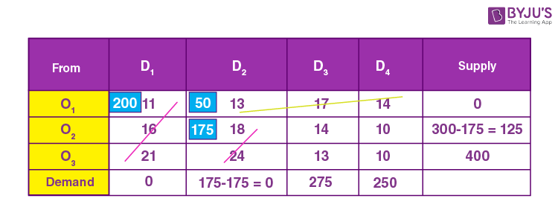
Step 5: For the cell with value 18, the minimum of supply and demand is min(300, 175) = 175.
Step 6: The difference between the corresponding cell’s supply and demand from the minimum value obtained in the previous step is:
Supply = 300 – 175 = 125
Demand = 175 – 175 = 0
As demand is 0, we need to allocate 175 to that cell and strike the corresponding column and then move right to the next cell, i.e., the cell with the value 14.

Slide 11
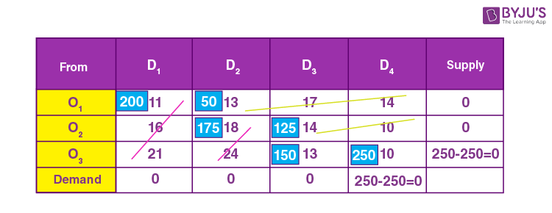
Now, we should calculate the total minimum cost using the allocated values and the corresponding cell values.
Here, the transportation path is:
O1 → D1, O1 ​​→ D2, O2 → D2, O2 → D3, O3 → D3, O3 → D4
Therefore, the total cost = (200 × 11) + (50 × 13) + (175 × 18) + (125 × 14) + (150 × 13) + (250 × 10)
= 2200 + 650 + 3150 + 1750 + 1950 + 2500
= Rs. 12,200

Slide 12
Thank You

