Slide 1


Dr.SNS COLLEGE OF EDUCATION
UNIT –1 PEDAGOGICAL ANALYSIS
Concept and Stages
Mrs V Rani
Asst.Prof.,
Dr.SNSCE

Slide 2

Empathy
Why Do Students Struggle to Learn?

Slide 3
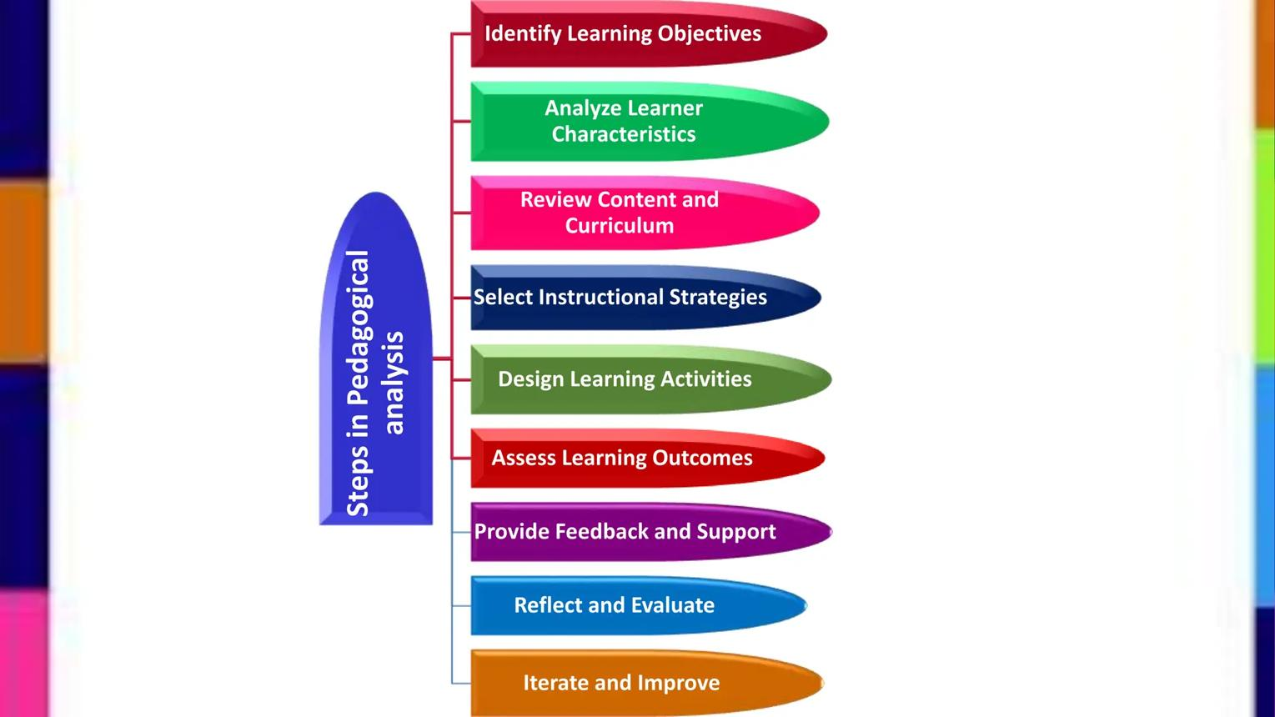
Define
What is Pedagogical Analysis?

Slide 4

Ideate
How Can Teaching Be Made Effective?

Slide 5

Prototype
Designing a Teaching Plan

Slide 6
Puzzle
Puzzle
Title: Match the Following
Content Analysis → (Breaking topic)
Objectives → (Learning goals)
Strategy → (Teaching method)
Evaluation → (Testing learning)

Slide 7
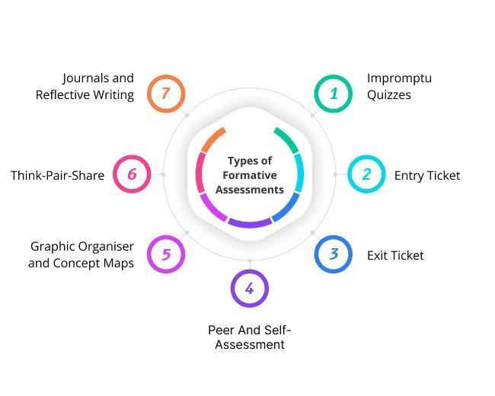
Test
How Do We Check Learning?

Slide 8
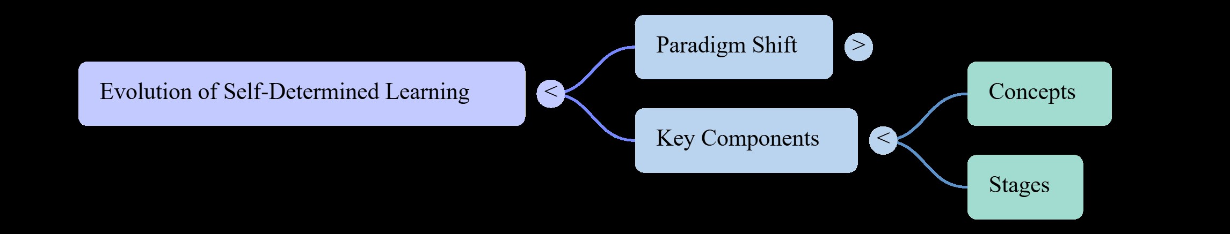
MIND MAP

Slide 9
Assignment
Student Activity
Choose any topic (e.g., Water Cycle / History Lesson)

Slide 10
THANK YOU

