Slide 1

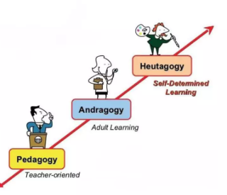
Dr.SNS COLLEGE OF EDUCATION
BD2SM: PEDAGOGY
I YEAR/II SEMESTER
UNIT –1 PEDAGOGICAL ANALYSIS
TOPIC :PARADIGM SHIFT FROM PEDAGOGY TO ANDRAGOGY TO HEUTAGOGY
Mrs V Rani
Asst.Prof.,
Dr.SNSCE

Slide 2

THINK!!!
Why do teaching methods differ for children and adults?

Slide 3

EMPATHY
How would learners feel if the same teaching method is used for all (children, adults, and self-learners) without considering their needs?

Slide 4

DEFINE
Problem:
Lack of appropriate teaching methods based on learner’s age and needs
• Goal:
To apply suitable learning approaches (Pedagogy, Andragogy, Heutagogy) for effective learning
• Key Question:
How do Pedagogy, Andragogy, and Heutagogy improve the learning process?

Slide 5

MEANING OF PEDAGOGICAL ANALYSIS
Pedagogical analysis is the process of breaking down a subject or content into smaller parts to make teaching and learning more effective.

Slide 6
DIFFERENCE BETWEEN
Pedagogy
Andragogy
Heutagogy
Derived from Greek the word pedi means child agogy means leading.
Pedagogy is the art and science of teaching or leading
Teacher-centered approach
Learners are dependent on the teacher
Structured and planned learning
Derived from Greek the word andra means man agogy means leading.
Andragogy is the study of teaching and learning with adults.
Learner-centered approach
Adults are self-directed to some extent
Learning is based on experience
Derived from Greek the word Heauto means self agogy means leading.
Heutagogy is the study of self determined learning.
Fully learner-centered
Learning is flexible and exploratory
High level of independence

Slide 7
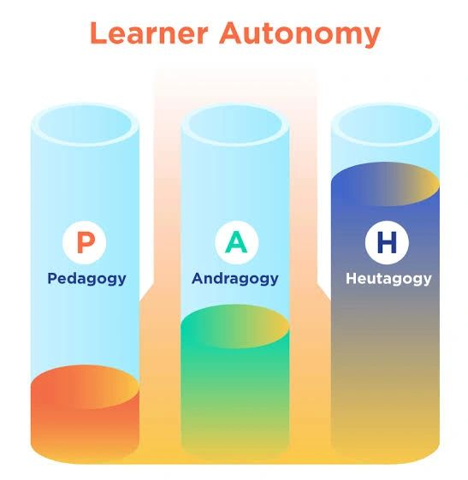
IDEATE
Group discussion: How can Pedagogy, Andragogy, and Heutagogy improve learning?
Compare roles of teacher and learner in different approaches
Role play: Teacher-centered vs learner-centered classroom
Brainstorm real-life examples from school, college, and self-learning
Suggest suitable teaching methods for:
Children
Adults
Independent learners
Create comparison chart (Pedagogy vs Andragogy vs Heutagogy)

Slide 8
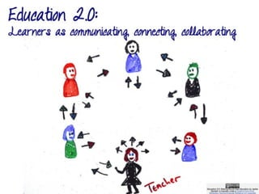
PROTOTYPE
Prepare a lesson plan using Pedagogy, Andragogy, and Heutagogy approaches
Assign roles (Teacher, Adult learner, Self-learner)
Design a model for:
Child-centered learning (Pedagogy)
Experience-based learning (Andragogy)
Self-directed learning (Heutagogy)
Demonstrate a classroom with different teaching methods
Apply suitable strategies based on learner needs
Create a simple framework for effective teaching-learning process

Slide 9
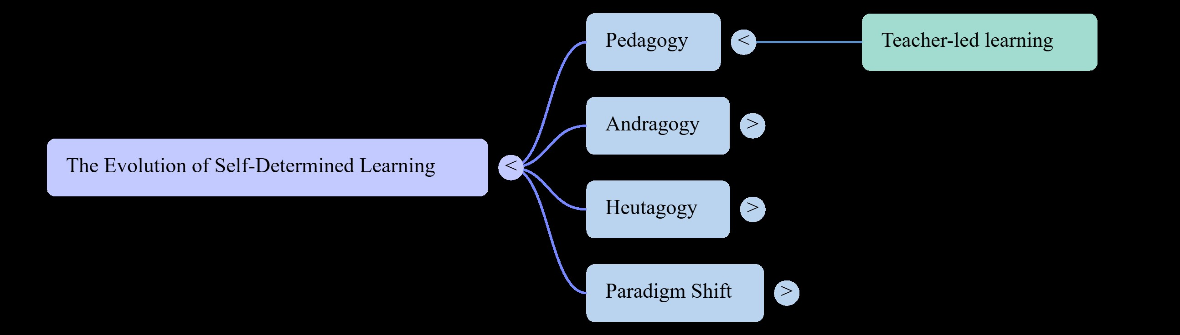
MIND MAP

Slide 10

Test (Reflection & Improvement)
Test (Stage 5):
Do learners understand concepts clearly in different approaches?
Can they differentiate between Pedagogy, Andragogy, and Heutagogy?
Can they apply learning in real-life situations?
Are learners able to learn independently when required?
Tools:
Quiz
Group Discussion
Case-based Questions
Feedback & Reflection

Slide 11

CASE STUDY
Scenario:
A school and training center adopted different teaching approaches for different learners:
Pedagogy:
  Teacher-centered classroom for school children
  Structured lessons and guidance provided
Andragogy:
  Adult learners trained through discussion and experience sharing
  Practical examples used in teaching
Heutagogy:
  Students encouraged for self-learning using digital tools
  Independent projects and research activities
Result:
Improved understanding among all types of learners
Increased learner engagement and participation
Better problem-solving and critical thinking skills

Slide 12
ASSIGNMENT
TOPIC:
Explain the concepts of Pedagogy, Andragogy, and Heutagogy and how they differ in teaching and learning approaches

