Slide 1


Dr.SNS COLLEGE OF EDUCATION
UNIT-1: PEDAGOGICAL ANALYSIS
Critical Pedagogy:
Mrs V Rani
Asst.Prof.,
Dr.SNSCE

Slide 2

Empathy
Why Do We Learn?

Slide 3

Define
What’s is Critical Pedagogy

Slide 4

Ideate
Core Ideas of Critical Pedagogy

Slide 5

Prototype
How is it Practiced?

Slide 6

Test
How Do We Know It Works?

Slide 7
Assignment
Activity Time!
Write a short note on how education can reduce inequality.

Slide 8
Puzzle:
Rearrange the words:
“EDUCATION CHANGE SOCIAL TOOL A IS”

Slide 9
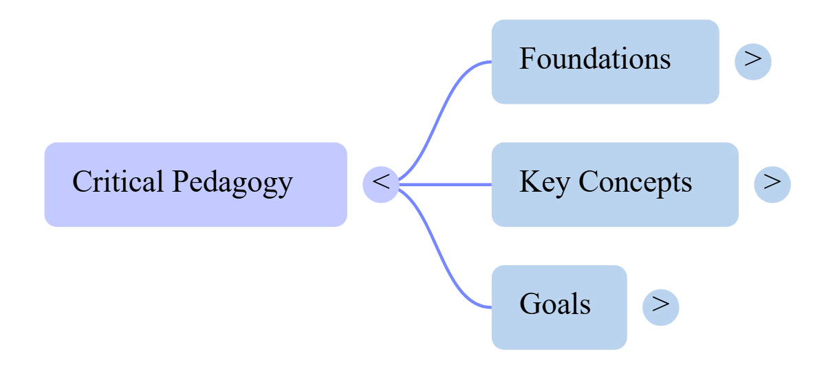
MIND MAP

Slide 10
Case Study
Title: Real-Life Application
Content:
A teacher asks students to discuss gender equality in society

Slide 11
THANK YOU

