Slide 1
ECONOMICS
CH-4 MONEY AND CREDIT

Slide 5
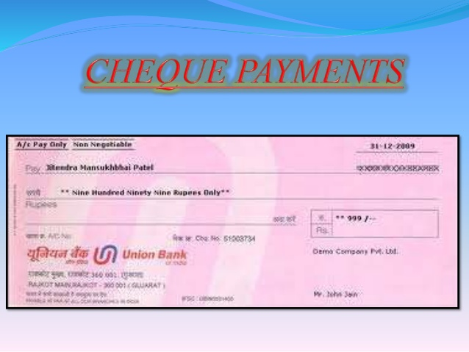

Slide 9
