Slide 1
PART-I

Slide 2
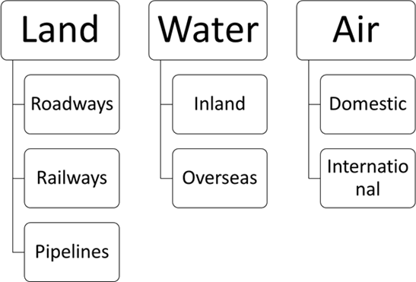

Slide 3
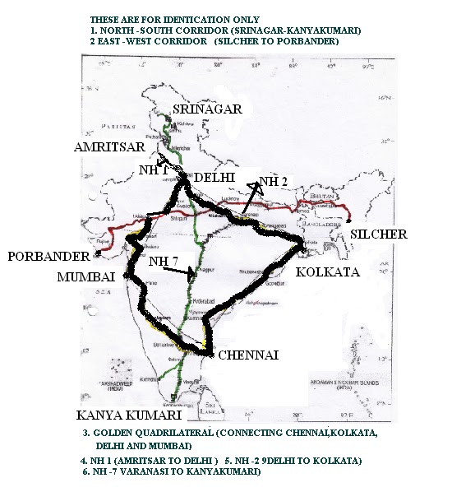

Slide 6
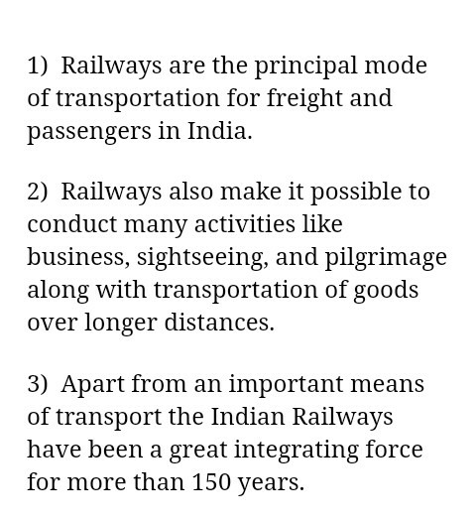

Slide 9
PRESENTED BY KALYANI S
SNS ACADEMY

