Slide 1
Using Python to Retrieve and Visualize Data (part 1 of 2)

Slide 2
Learning Objectives
Create reproducible data visualizations
Write and execute computer code to automate difficult and repetitive data related tasks
Manipulate data and transform it across file systems, flat files, databases, programming languages, etc.

Slide 3
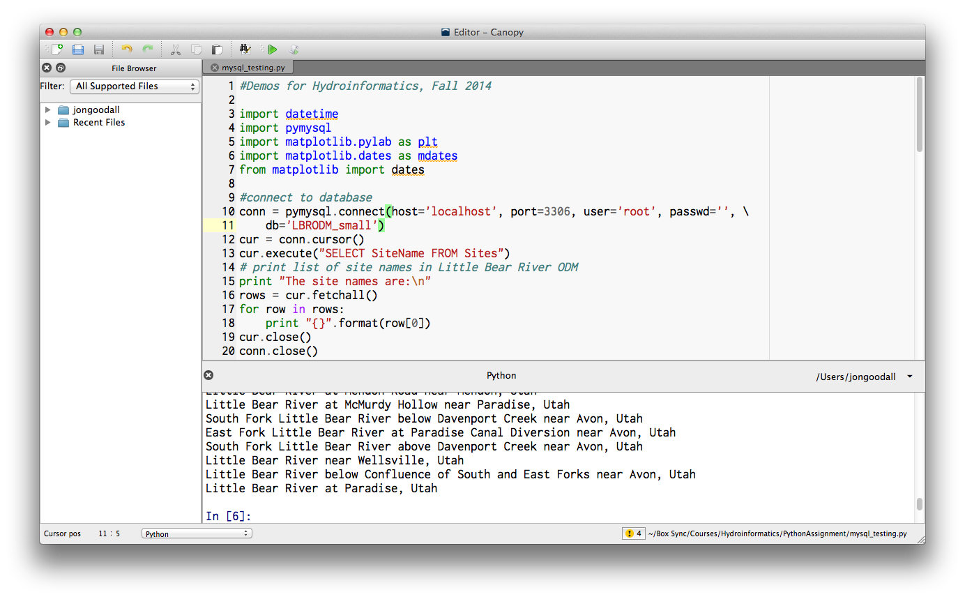
Canopy Editor

Slide 4
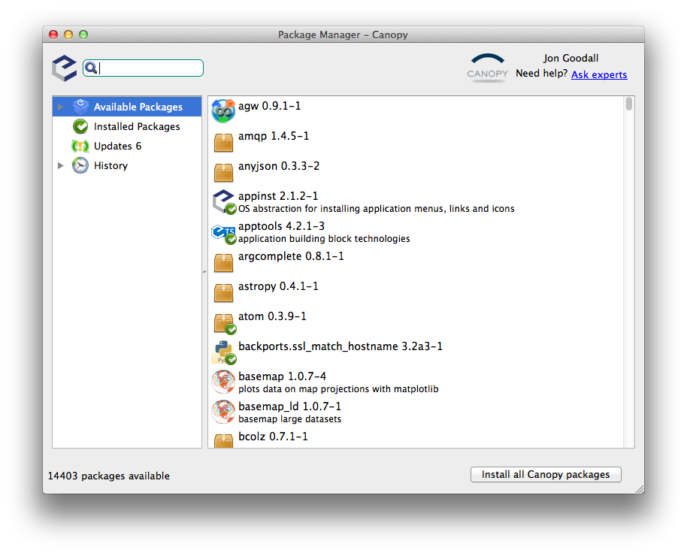
Canopy Package Manager

Slide 5
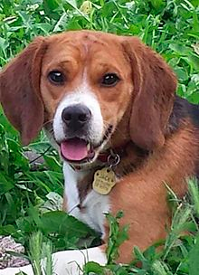
VERY Brief Reminder about Object-Oriented Programming
Class: dog
#Create new instance of dog class
this_dog = dog(‘beagle’,’Rex’,20)
#Get the dog’s name
print this_dog.name
‘Rex’
#Make the dog bark
print this_dog.bark()
‘Ruff!’
Attributes:
Breed
Name
Weight_lbs
Etc.
Sound familiar?
Here’s where it differs from data modeling…
Important: Why ruff and not woof for this dog?
Methods:
Bark
Run
Etc.
Attributes are properties
Methods are actions
Because of its property bread is set to beagle.

Slide 6
Connect to database
Use the PyMySQL package to establish a connection to your database
This uses the connection object in PyMySQL
import pymysql
#connect to database
conn = pymysql.connect(host='localhost', port=3306, user='root', passwd='’, db='LBRODM_small')
Note that I am using the ‘small’ version of the database, which I named LBRODM_small. Your database name may differ.
Your database server must be started for this connection to work.

Slide 7
Determine the SQL statement needed to extract a time series for the ODM database
A time series is a collection of observations made over time at one site and for one variable. We also need to include in the where clause a statement to only include QualityControlLevelID = 1 (quality controlled data).
sql_statement = “SELECT LocalDateTime, DataValue FROM DataValues WHERE SiteID = 2 AND VariableID = 36 AND QualityControlLevelID = 1 ORDER BY LocalDateTime”

Slide 8
Execute the needed SQL statement on the database
Create a cursor object from the connection object you created earlier
cursor = conn.cursor()
Use the cursor object’s execute method to execute the SQL statement
cursor.execute(sql_statement)
Use the cursor object’s fetchall method to get all resulting rows at once
rows = cursor.fetchall()

Slide 9
Restructure the data so that it can be plotted
Use Python’s built-in zip function to transform the result from the query into two lists, one storing the values from the LocalDateTime field and the second storing the values from the DataValue field
localDateTimes, dataValues = zip(*rows)
An explanation of the * before rows is here.

Slide 10
Create a Figure and Subplot
Import matplotlib’s pyplot (MATLAB-like) plotting framework.
import matplotlib.pyplot as plt
Create a figure object, and from the figure object, create a subplot. The response from the add_subplot method is an axes object for that subplot.
fig = plt.figure()
ax = fig.add_subplot(111)

Slide 11
Plot the data
Create a plot of the localDateTimes and dataValues lists. Have a solid grey line with no markers.
ax.plot(localDateTimes, dataValues, color='grey', linestyle='solid', markersize=0)
Show the plot
plt.show()

Slide 12
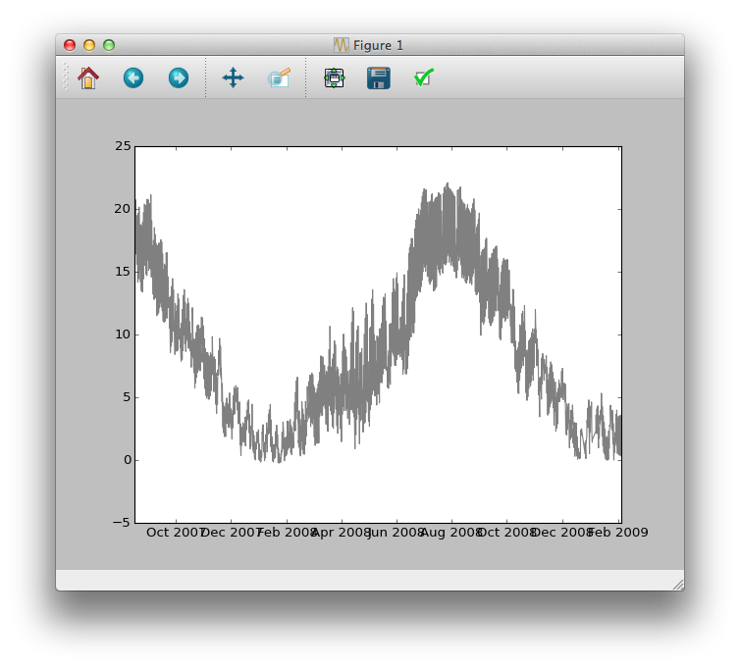
If you execute what we have so far in Canopy, you should see the following
Good start, but we need to clean some things up (axis labels and axis tick labels, for example)

Slide 13
Set properties of the plot (axis labels, title, etc.)
Set the ylabel and xlabel properties
ax.set_ylabel("Temperature ($^\circ$C)")
ax.set_xlabel("Date/Time")
Clean up the xaxis tick mark labels
from matplotlib import dates
import datetime
ax.xaxis.set_minor_locator(dates.MonthLocator())
ax.xaxis.set_minor_formatter(dates.DateFormatter('%b'))
ax.xaxis.set_major_locator(dates.YearLocator())
ax.xaxis.set_major_formatter(dates.DateFormatter('\n%Y'))

Slide 14
Add a grid, title, and change the font size
Add a grid
ax.grid(True)
Set the title
ax.set_title('Water temperature at Little Bear River \n at McMurdy Hollow near Paradise, Utah')
Set the default font size
from matplotlib import rc
font = {'family' : 'normal',
'weight' : 'normal',
'size' : 12}
rc('font', **font)

Slide 15
Clean up the figure spacing, print figure to image file
One quick way to clean up the figure spacing is by using the tight_layout method on the figure object.
fig.tight_layout()
You can save the figure directly to an image file for inclusion in a presentation, report, paper, etc.
fig.savefig(‘plot1.png’)

Slide 16
Setting the Working Directory in Canopy
When saving the figure, if you don’t provide a full path for the figure, then be sure to set the working directory in Canopy as shown below.
Click down arrow to set your
working directory

Slide 17
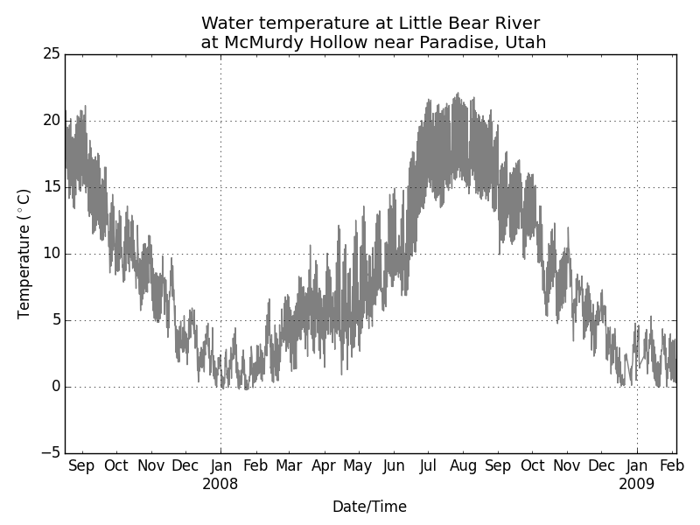
Final Product

Slide 18
Challenge Question 1
Can you modify the code so that a user can set siteID and variableID variables at the bringing of the script and the script produces a plot for the provided siteID and variableID?

Slide 19
Challenge Question 2
Can you modify the code so that the user can set a StartDateTime and EndDateTime at the beginning of the script, and the script produces a plot for just that time range?

