Slide 1
Introduction to Python Programming

Slide 2
Operators
Arithmetic operators we will use:
+ - * / addition, subtraction/negation, multiplication, division
% modulus, a.k.a. remainder
** exponentiation
precedence: Order in which operations are computed.
* / % ** have a higher precedence than + - 1 + 3 * 4 is 13
Parentheses can be used to force a certain order of evaluation. (1 + 3) * 4 is 16

Slide 3
Expressions
When integers and reals are mixed, the result is a real number.
Example: 1 / 2.0 is 0.5
The conversion occurs on a per-operator basis.
7 / 3 * 1.2 + 3 / 2
2 * 1.2 + 3 / 2
2.4 + 3 / 2
2.4 + 1
3.4

Slide 4
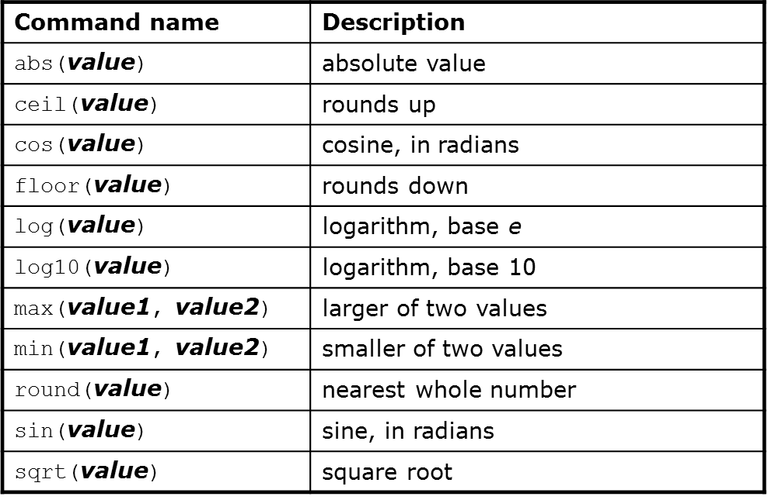
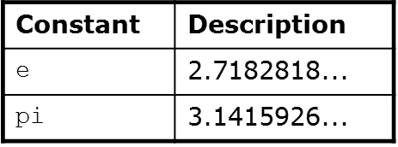
Math Functions
Use this at the top of your program: from math import *

Slide 5
Relational Operators
Many logical expressions use relational operators:

Slide 6
Logical Operators
These operators return true or false

Slide 7
The if Statement
Syntax:
if <condition>:
<statements>
x = 5
if x > 4:
print(“x is greater than 4”)
print(“This is not in the scope of the if”)

Slide 8
The if Statement
The colon is required for the if
Note that all statement indented one level in from the if are within it scope:
x = 5
if x > 4:
print(“x is greater than 4”)
print(“This is also in the scope of the if”)

Slide 9
The if/else Statement
if <condition>:
<statements>
else:
<statements>
Note the colon following the else
This works exactly the way you would expect

Slide 10
The for Loop
This is similar to what you’re used to from C or Java, but not the same
Syntax:
for variableName in groupOfValues:
<statements>
variableName gives a name to each value, so you can refer to it in the statements.
groupOfValues can be a range of integers, specified with the range function.
Example:
for x in range(1, 6):
print x, "squared is", x * x

Slide 11
Range
The range function specifies a range of integers:
range(start, stop) - the integers between start (inclusive)
and stop (exclusive)
It can also accept a third value specifying the change between values.
range(start, stop, step) - the integers between start (inclusive)
and stop (exclusive) by step

Slide 12
The while Loop
Executes a group of statements as long as a condition is True.
Good for indefinite loops (repeat an unknown number of times)
Syntax:
while <condition>:
<statements>
Example:
number = 1
while number < 200:
print number,
number = number * 2

Slide 13
Exercise
Write a Python program to compute and display the first 16 powers of 2, starting with 1
Do this in the Python shell

Slide 14
Strings
String: A sequence of text characters in a program.
Strings start and end with quotation mark " or apostrophe ' characters.
Examples: "hello" "This is a string" "This, too, is a string. It can be very long!"
A string may not span across multiple lines or contain a " character. "This is not a legal String."
"This is not a "legal" String either."

Slide 15
Strings
A string can represent characters by preceding them with a backslash.
\t tab character
\n new line character
\" quotation mark character
\\ backslash character
Example: "Hello\tthere\nHow are you?"

Slide 16
Indexing Strings
As with other languages, you can use square brackets to index a string as if it were an array:
name = “Arpita Nigam”
print(name, “starts with “, name[0])

Slide 17
String Functions
len(string) - number of characters in a string
str.lower(string) - lowercase version of a string
str.upper(string) - uppercase version of a string
str.isalpha(string) - True if the string has only alpha chars
Many others: split, replace, find, format, etc.
Note the “dot” notation: These are static methods.

Slide 18
Byte Arrays and Strings
Strings are Unicode text and not mutable
Byte arrays are mutable and contain raw bytes
For example, reading Internet data from a URL gets bytes
Convert to string:
cmd = response.read()
strCmd = str(cmd)

Slide 19
Other Built-in Types
tuples, lists, sets, and dictionaries
They all allow you to group more than one item of data together under one name
You can also search them

Slide 20
Tuples
Unchanging Sequences of Data
Enclosed in parentheses:
tuple1 = (“This”, “is”, “a”, “tuple”)
print(tuple1)
This prints the tuple exactly as shown
Print(tuple1[1])
Prints “is” (without the quotes)

Slide 21
Lists
Changeable sequences of data
Lists are created by using square brackets:
breakfast = [ “coffee”, “tea”, “toast”, “egg” ]
You can add to a list:
breakfast.append(“waffles”)
breakfast.extend([“cereal”, “juice”])

Slide 22
Dictionaries
Groupings of Data Indexed by Name
Dictionaries are created using braces
sales = {}
sales[“January”] = 10000
sales[“February”] = 17000
sales[“March”] = 16500
The keys method of a dictionary gets you all of the keys as a list

Slide 23
Sets
Sets are similar to dictionaries in Python, except that they consist of only keys with no associated values.
Essentially, they are a collection of data with no duplicates.
They are very useful when it comes to removing duplicate data from data collections.

Slide 24
Writing Programs
Bring up the Idle3 IDE
The first line of your code should be this: #!/usr/bin/env python 3.1
Write the same code you wrote for the exercise of powers of 2 using the IDE’s editor
Press the F5 key to run the program
It will ask you to save the program. Give it a name like PowersOf2.py
The program will run in a Python shell from the IDE
If there are errors, the shell will tell you

Slide 25
Writing Functions
Define a function:
def <function name>(<parameter list>)
The function body is indented one level:
def computeSquare(x)
return x * x
# Anything at this level is not part of the function

