Slide 1
COPOLYMER

Slide 2
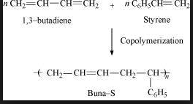
BUNA-S

Slide 3
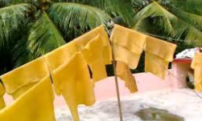
RUBBER

Slide 4
NATURAL RUBBER
Linear polymer of isoprene(2-methyl-1,3-butadiene) also called as cis – 1,4 - polyisoprene

Slide 5
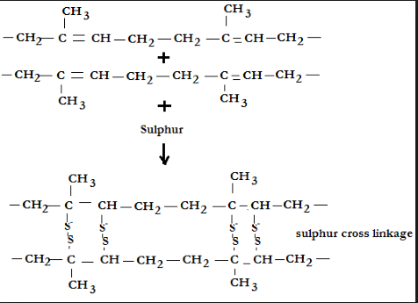
VULCANISATION OF RUBBER

Slide 6
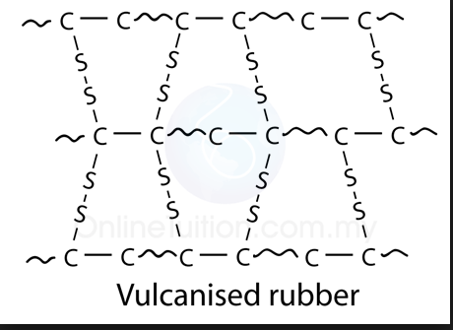
VULCANISED RUBBER

Slide 7
SYNTHETIC RUBBER
Synthetic rubber is a man-made rubber which is produced in manufacturing plants by synthesizing it from petroleum and other minerals. Synthetic rubber is basically a polymer or an artificial polymer.

Slide 8
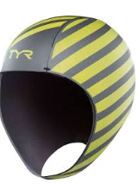
NEOPRENE

Slide 9
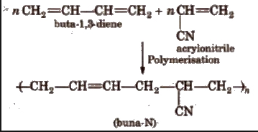
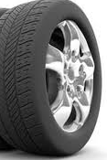
BUNA-N

Slide 10
MOLECULAR MASS OF POLYMER
Properties of polymer depend on its molecular mass, size and structure. The growth of the polymer depends on the availability of the monomer.
A High molecular weight increases the chemical resistance - to a point. It takes more damage to the main chains of the molecules before it will affect the strength of the material. A High molecular weight increases the viscosity of the material – makes it harder to process the material using conventional methods.

Slide 11
BIODEGRADABLE POLYMER
Biodegradable polymers are a specific type of polymer that breaks down after its intended purpose to result in natural by products such as gases (CO₂, N₂), water, biomass, and inorganic salts.

Slide 12
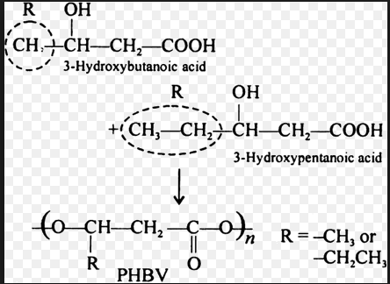
POLY β-HYDROXYBUT YRATE

Slide 13
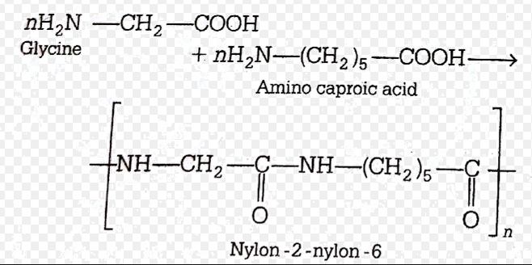
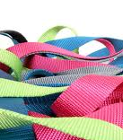
NYLON2-NYLON 6

