Slide 1
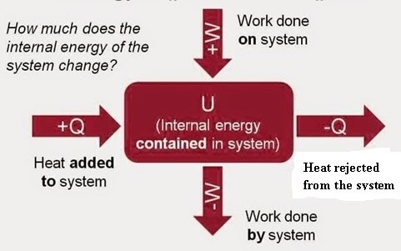

Slide 2
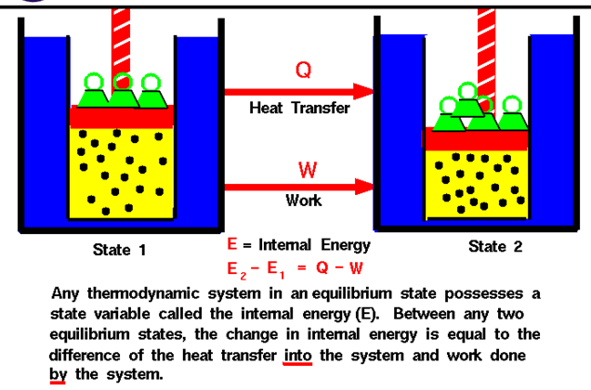
FIRST LAW THERMODYNAMICS

Slide 4
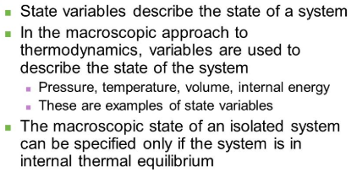
STATE VARIABLES

Slide 5
PATH FUNCTION

