Slide 1
BIOTECHNOLOGY: PRINCIPLES AND PROCESSES

Slide 2
Introduction
Father of biotechnology – Paul berg
Biotechnology is a process of using living organisms or their enzymes or their molecules to obtain products or to develop processes for the welfare of mankind.

Slide 3
Difference between plasmid DNA and chromosomal DNA
Plasmid DNA | Chromosomal DNA
A circular, extra chromosomal DNA | Generally linear
Not associated with histone proteins | associated with histone proteins
Contains very few genes but may not be necessary for the cell | Consists of complete genome vital for the cellular functions
Replicates independently | Replicates with genome

Slide 4
BIOTECHNOLOGY: PRINCIPLES AND PROCESSES
Two core techniques that enabled birth of modern biotechnology:
Genetic engineering:Techniques to alter the chemistry of genetic material (DNA and RNA) to introduce into host organisms and thus change the phenotype of the host organism.
Maintenance of sterile (microbial contamination-free) ambient chemical engineering processes to enable growth of only the desired microbe/eukaryotic cell in large quantities

Slide 5
Conceptual development of the principle of genetic engineering
Asexual reproduction preserves the genetic identity of species.
Sexual reproduction creates variation and creates unique combinations of
genetic makeup.
Traditional hybridization procedures used in plant and animal breeding lead to inclusion of undesirable genes along with desired genes.
The techniques of genetic engineering which includes creation
of recombinant DNA, use of gene cloningand gene transfer, overcome this limitation and allows us to isolate and introduce only one or a set of desirable genes without introducing undesirable genes into target organism
Three basic steps in genetically modifying an organism –
Identification of DNA with desirable gene
Introduction of the identified DNA into the host.
Maintenance of introduced DNA in the host and transfer of the
DNA to its progeny.

Slide 6
TOOLS OF RECOMBINANT DNA TECHNOLOGY
Restriction Enzymes
Cloning vectors
Competent Host (for transformation with recombinant DNA)

Slide 7
Restriction Enzymes
In the year 1963 two enzymes discovered from Escherichia coli which restrict the growth of bacteriophagein it.
One of these added methyl groups to DNA.
Other cut the phage DNA. (restriction endonuclease)

The first restriction endonuclease discovered is Hind II.
Hind II always cut DNA molecule at particular point by recognizing a specific sequence of six base pairs.This is called recognition sequence for Hind II.
Till date around 900 restriction enzymes isolated from 200 strains of bacteria each of which recognize different recognition sequences.

Slide 8
Restriction enzyme belongs to nucleases.
There are two kind of nucleases:
Exonuclease
Endonuclease

Exonuclease removes nucleotides from the free ends of the DNA.
Endonucleases make cuts at specific positions within the DNA.
Each restriction endonuclease recognizes a specific palindromic nucleotide sequences in the DNA.
Palindromes are the group of letters that read same both forward and backward, e.g. “MALAYALAM”.
The palindrome in DNA is a sequence of base pairs that reads same on the two strands when orientation of reading is kept same.


Slide 10
The restriction enzyme cut the strand of DNA little away from the centre of the palindrome sites, but between the same two bases on the opposite strand.This leaves single stranded portions at the ends.There are overhanging stretches called sticky
ends on each strand.
This stickiness of the ends facilitates the action of the enzyme DNA ligases.
The foreign DNA and the host DNA cut by the same restriction endonuclease, the resultant DNA fragments have the same kind of „sticky-ends‟ and these can be joined together using DNA ligases.

Slide 11
Convention for naming restriction endonuclease
The first letter of the name comes from the genus.
Second two letters come from the species of the prokaryotic cell from which the enzyme isolated
The fourth letter is in capital form derived from the Strain of microbes.
The Roman letter followed is the order of discovery
Best example: EcoRI comes from Escherichia coli RY 13

Slide 12
Separation and isolation of DNA fragments
The cutting of DNA by restriction endonucleases results in the fragments of DNA.
These fragments are separated by a technique
called gel electrophoresis.
Since the DNA fragments are negatively charged, they can be separated by forcing them to move towardsanode under an electric field through a medium/matrix.
Most commonly used matrix is agarose, a natural
polymer extracted from sea weed.
DNA fragments separate according to their size through sieving effect provided by the agarose gel. Hence the smaller the fragment size, farther it moves.
The separated fragments are visualized by staining them with Ethidium bromide followed by exposure to UV radiation.
The separated bands of DNA are cut out from the agarose gel and extracted from the gel piece.This step is called elution.

Slide 13
Cloning vectors:
The plasmid and bacteriophages have the ability to replicate within bacterial cells independent of the control of chromosomal DNA.
Alien DNA linked with the vector multiply its number equal to the copy number of the plasmid or bacteriophage.
Features of cloning vector: Origin of replication:
This is the sequence where the replication starts called ori gene.
The alien DNA linked with vector also
replicates.
Controls the copy number of the linked DNA.

Slide 15
Selectable marker
It is required to identify recombinant from the non- recombinant.
Helps in identifying and eliminating non-transformants and selectively permitting the growth of the transformants.
Transformation is a procedure through which a piece of foreign DNA is introduced in a host bacterium.
Normally, the gene coding resistance to antibiotics such as ampicilin.Tetracycline, chloramphenicol or kanamycins etc are considered as useful selectable markers for E.coli.
Thr normal E.coli cells do not carry resistance against any of antibiotics.

Slide 16
Cloning sites
In order to link the alien DNA, the vector needs to have very few, preferably single, recognition sites (palindromic site)for the commonly used restriction endonuclease.
Commonly used vector is pBR322, for E.coli.
It contain 4361 base pairs in its structure
The ligation of foreign DNA is carried out at a restriction site present in one of the two antibiotic resistance genes.
If a foreign DNA ligated or inserted at the Bam H I site of tetracycline resistance gene in the vector pBR322, the recombinant plasmid will lose tetracycline resistance. (insertional inactivation)

The recombinant can be identified from the non-recombinant in following steps:
All are grown in ampicilin medium
One replica of above plate grown in ampicilin medium (control)
Other replica grown in the medium containing both tetracycline and ampicilin.
The colonies grows in plate-I but failed to grow in plate-II are identified as recombinants

Slide 17
Alternative selectable marker
In E.coli a plasmid called PUK-18 is used as selectable marker, which is better than pBR322.
The foreign DNA is introduced within the coding sequence of an enzyme β-galactosidase, which convert X-Gal (chromatogenic substrate) into Galactose and 5-bromo+4 chloro indigo (blue color)
The non-recombinant produce enzyme and give blue colored colonies.
The recombinant unable to produce β-galactosidase and does not produce blue colored colonies after addition of chromatogenic substrate i.e. X-Gal.
This inactivation of insertion of foreign DNA called insertional
inactivation

Slide 18
Vectors for cloning genes in plants and animals
Agrobacterium tumefaciens, a pathogenic bacterium of several dicot plants.
This bacterium contains a plasmid called Ti-plasmid.(tumor
inducing)
In natural condition the A.tumifaciens transfer the T-DNA into the plant which transform normal plant cells into a tumor and direct these tumor cells to produce the chemical required by the pathogen.
Retroviruses in animals have the ability to transform normal cells
into cancerous cells.
The dis-armed retroviruses are being used to transfer gene into animals.
In Ti-plasmid the T-DNA is replaced by the gene of interest, still A.tumifaciens able to transfer the gene into the plant without causing tumor in plants.

Slide 19
Competent Host (for transformation with recombinant DNA)
DNA is a hydrophilic molecule; it cannot pass through cell membranes.
In order to force bacteria to take-up the plasmid, the bacterial cells must first be made „competent‟ to take up DNA.
The bacterial cell is treated with divalent cations such as calcium, which increases the efficiency of DNA up take by the bacteria.
Recombinant DNA and the bacterial cells are incubated in ice, followed by placing them briefly at 42ºC (heat shock) and then putting them back in ice.
By microinjection the recombinant DNA directly injected into the nucleus of the animal cell.
Plant cells are bombarded with high velocity micro-particles of gold or tungsten coated with DNA in a method known as biolistics or gene gun.
The disarmed pathogen vectors which when allowed infecting the cell transfer the recombinant DNA into the host.

Slide 20
PROCESS OF RECOMBINANT TECHNOLOGY:
Isolation of DNA ,
Fragmentation of DNA by restriction endonuclease.
Isolation of desired DNA fragment by gel electrophoresis.
Ligation of DNA fragment with a vector by DNA ligase
Transferring the recombinant DNA into the host
Culturing the host cells in a medium at large scale in a bioreactor.
Extraction of desired product by downstream processing.

Slide 21
Isolation of the Genetic material (DNA):
Bacterial cell wall digested by Lysozyme.
Plant cell wall is digested by cellulase and pectinase.
Fungal cell wall is digested by chitinase.
RNA of the cellular content is digested by ribonuclease.
Proteins are removed by Proteases.
Purified DNA ultimately precipitated out after addition of chilled ethanol.
The precipitated DNA is separated and removed by spooling.

Slide 22
Amplification of Gene of Interest using PCR
PCR stands for Polymerase chain reaction:
Multiple copy of gene of interest can be synthesized in vitro.
PCR includes following steps:
Denaturation
Double stranded DNA made single stranded.
It is done by heating the DNA at 94ºC.
Each single stranded DNA is called Template strand

Slide 24
Annealing
Two sets of primer (small oligonucleotide chain that are
complementary to the DNA at 3‟ end of the DNA template)
added to the medium.
This is done at around 50ºC.
Extension
Deoxyribonucleotides triphosphates are added in the medium.
Taq polymerase catalyses the polymerization reaction using nucleotides extending from the primer towards 5‟ end of the template.
Taq polymerase is a thermostable polymerase isolated from a bacterium called Thermus aquaticus.
It catalyses polymerization reaction at 74ºC.

Slide 25
Obtaining the Foreign Gene product or Recombinant product:
The protein encoding gene is expressed in
a heterogeneous host is called a recombinant protein.
The host is cultured in a continuous culture system provided in bioreactor.
A bioreactor provides optimum growth conditions (temperature, pH, substrate, salts, vitamins, oxygen)
Bioreactor covert the raw materials into specific product, specific enzyme.

Slide 26
Downstream processing
After biosynthesis inside the bioreactor, the product has to be subjected through a series of processes before it is ready for marketing.
The process includes separation and purification, which are collectively referred as downstream processing.
The product has to be formulated in suitable preservatives.
Such formulation has to undergo through clinical trials as in case of drugs.

Slide 27
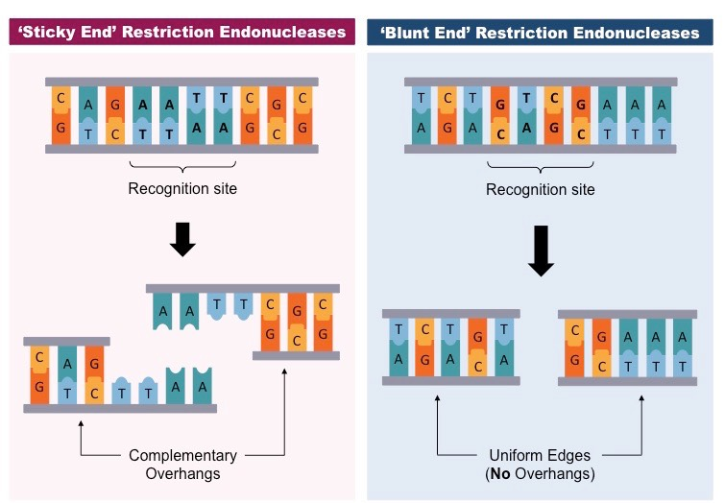

Slide 28
Difference between endonuclease and exo nuclease
Exonuclease | Endonuclease
These nucleases cleave base pairs of DNA at their terminal ends | They cleave DNA at specific point except the terminal end.
They act on single strand or gap in double stranded DNA. | They cleave one strand or both strands of double stranded DNA
They do not cut RNA | They may cut RNA

