Slide 1

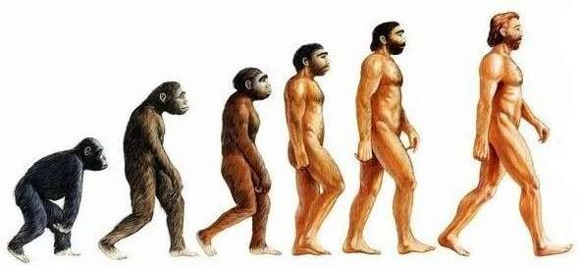
EVOLUTION

Slide 2
ORIGIN OF LIFE:
Stellar distances are measured in light years.
The universe is very old – almost 20 billion years old.
The Big Bang theory attempts to explain to us the origin of
universe.
The Big Bang theory:
A singular huge explosion unimaginable in physical term.
The universe expanded and hence the temperature came down.
Hydrogen and Helium formed sometime later.
The gases condensed under gravitation and formed the galaxies of the present day universe.
In the solar system of the Milky Way galaxy, earth was supposed to have been formed about 4.5 billion years back.

Slide 3
Condition of early earth:
Earth formed 4.5 billion years back.
There was no atmosphere on early earth.
Water vapor, methane, carbon dioxide and ammonia released from
molten mass covered the surface.
The UV rays from the sun broke up water into Hydrogen and oxygen and lighter H₂ escaped.
Oxygen combined with ammonia and methane to form water, CO₂ and others.
The ozone layer was formed.
As it cooled, the water vapor fell as rain, to fill all the depressions and form oceans.
Life appeared 500 Million years after the formation of
earth.

Slide 4
Origin of life:
Early Greek thinkers thought units of life called spores were transferred to different planets including earth.
‘Panspermia’ is still a favorite idea for some astronomers.
For a long time it was also believed that life came out of decaying and rotting matter like straw, mud etc.This was the theory of spontaneous generation.
Louis Pasteur experiment:
Careful experimentation demonstrated that life comes only from
pre-existing life.
He showed that in pre-sterilized flasks, life did not come from killed yeast while in another flask open to air, new living organism arose from ‘killed yeast’.
This disproved the theory of spontaneous generation.

Slide 5
Oparin – Haldane theory of origin of life:
Oparin of Russia and Haldane of England proposed that the first form of life could have come from pre- existing non-living organic molecule (e.g. RNA, protein etc.).
Formation of life was preceded by chemical evolution i.e. formation of diverse
organic molecule from inorganic constituents.
Urey and Miller experiment:
The conditions on earth were –
  High temperature.
  Volcanic storms.
  Reducing atmosphere containing CH₄, NH₃ etc.

In 1953, S.L. Miller an American Scientist created similar conditions in a laboratory scale.
  He created electric discharge in a closed flask to raise temperature upto 800oC as
it was in primitive earth.
  Used CH₄ H₂, NH₃ and water vapor inside the flask.
  He observed the formation of amino acids.

Slide 6
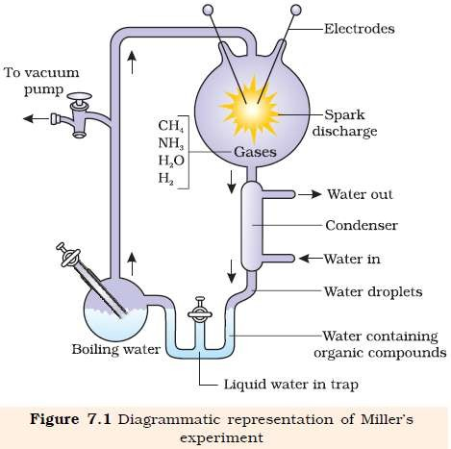

Slide 7
Acceptance of chemical evolution theory: (evidences)
Miller observed the synthesis of amino acids from simple inorganic chemicals in simulated condition in the laboratory.
In similar experiments others observed, formation of sugars, nitrogen bases, pigment and fats.
Analysis of meteorite content also revealed similar compounds indicating that similar processes are occurring elsewhere in space.

Slide 8
Theory of biogenesis:
The first non-cellular forms of life could have originated 3 billion years back.
They would have been giant molecules (RNA, proteins,
Polysaccharides, etc).
These capsules reproduced their molecules perhaps, named as coaservates.
The first cellular form of life did not possibly originate till about
2000 millions years ago.
The first cellular forms of life were probably unicellular.
All life forms were in water environment only.
This theory of biogenesis from non-living molecules was
accepted by majority.

Slide 9
EVOLUTION OF LIFE FORMS – A THEORY:
Conventional religious literature tells us about the theory of special creation.
The theory of special creation has three connotations:-
  All the living organisms (species types) that we see today were created as such.
  The diversity was always the same since creation and will be same in future.
  Earth is about 4000 years old.

Slide 10
Challenge to special creation theory:
Observation made during a sea voyage in a sail ship called H.M.S. Beagle round the world. Charles Darwin concluded that existing life forms share similarities to varying degrees not only among themselves but also with life forms that millions of years ago.
Many such life forms exist any more.There had been extinctions of different life forms in the years gone by just as new forms of life arose at different periods of history of earth.
There has been gradual evolution of life forms.
Any population has built in variation in characteristics.
Those characteristics which enable some to survive better in natural conditions (climate, food, physical factors, etc) would outbreed others that are less-endowed to survive under such natural condition.
Survival of the fittest. The fitness according to Darwin refers ultimately and only leaves more progeny than others.
These, therefore, will survive more and hence are selected by nature. He called it as natural selection.
Alfred Wallace, a naturalist who worked in Malay Archipelago had also come to
similar conclusions around the same time.
The geological history of earth closely correlates with the biological history of earth.

Slide 11
WHAT ARE EVIDENCES FOR EVOLUTION?
Paleontological evidence:
Fossils are remained of hard parts of life-forms found in rocks.
Different-aged rock sediments contain fossils of different life- forms who probably died during the formation of the particular sediment.
They represent the extinct organisms (e.g. Dinosaurs).
A study of fossils in different sedimentary layers indicates the geological period in which they existed.
The study showed that life-forms varied over time and certain life forms are restricted to certain geological time-span.
Hence new lives have arisen at different times in the history of earth.
All this called Paleontological evidence.

Slide 12
Comparative anatomy and morphological evidence:
Comparative anatomy and morphology shows similarities and differences among organisms of today and those that existed years ago.
Divergent evolution:
Whale, bats, cheetah and human share similarities in the pattern of bones of forelimbs.
These forelimbs perform different functions in these animals, they have similar anatomical structure – all of them have humerus, radius, ulna, carpals, metacarpals and phalanges in their forelimbs.
Hence in these animals, the same structure developed along different directions
due to adaptation to different needs.
This is divergent evolution and these structures are homologous.
Homology indicates common ancestry.
Other examples of homologous organ are vertebrate hearts and brains.
Thorn of Bougainvilleaand tendrils of Cucurbitarepresent homology.

Slide 13
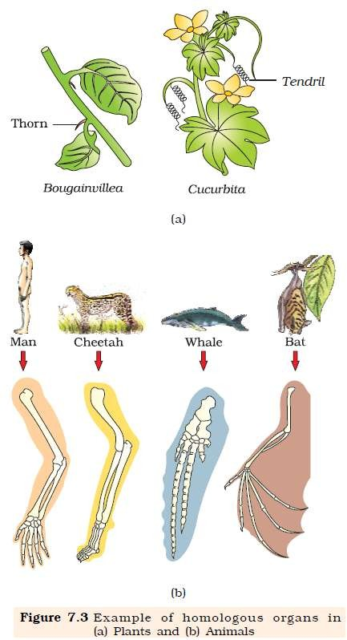
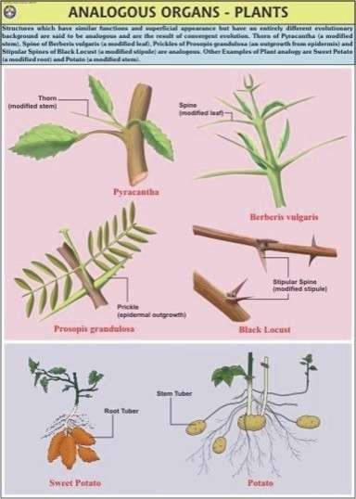

Slide 14
Convergent evolution:
Wings of butterfly and of birds look alike.
They are anatomically similar structure though they perform similar function.
Hence analogous structures are a result of convergent evolution.
Eye of octopus and eye of mammals.
Flippers of Penguins and Dolphins.
Sweat potato (root modification) and potato (stem modification).

Slide 15
Biochemical evidences:
Similarities in proteins and genes performing a given function among diverse organisms give clues to common ancestry.
Embryological support for evolution:
Proposed by Ernst Heckel based upon observation of certain features during embryonic stage common to all vertebrates that are absent in adult.
The embryos of all vertebrates including human develop a row of vestigial gill slits just behind the head but it is a functional organ only in fish and not found in any other adult vertebrates.
This is disproved on careful study performed by Karl Ernst von Baer. He noted that embryos never pass through the adult stages of other animals.

Slide 16
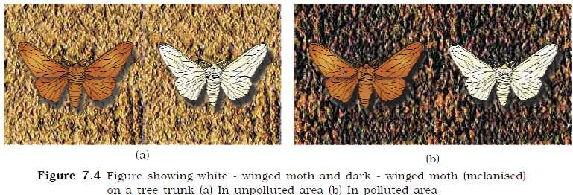
Evolution by natural selection:
Based on observation of moth population in England made in 1850.
Before industrialization set in, it was observed that there were more white-winged moths on trees than dark-winged or melanised moths.
After industrialization i.e. 1920 there were more dark-winged moths in the same area i.e. the proportion was reversed.

Slide 17
Evolution by anthropogenic action:
Excess use of herbicides, pesticides etc., has only resulted in selection of resistant varieties in a much lesser time scale.
This is also true for microbes against which we employ antibiotics or drugs against eukaryotic organisms/cell.
Hence resistance organisms/cells are appearing in a time scale of months or years and not in centuries.
These are the examples of evolution by anthropogenic action.
Evolution is a stochastic process based on chance events in nature and chance mutation in the organisms.

Slide 18
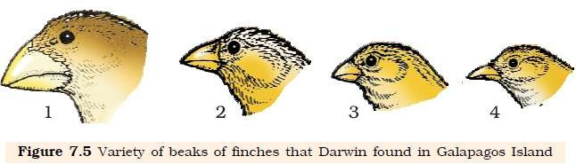
WHAT IS ADAPTIVE RADIATION?
Darwin’s Finches:
In Galapagos Islands Darwin observed small black birds later called Darwin’s Finches.
He realized that there were many varieties of finches in the same island.
All the varieties, he came across, evolved on the island itself.
Form the original seed-eating features, many other forms with altered beaks
arose, enabling them to become insectivorous and vegetarian finches
This process of evolution of different species in a given geographical area starting from a point and literally radiating to other areas of geography (ha
bitats) is called adaptive radiation.

Slide 19
Australian marsupial:
A number of marsupials each different from the other evolved from an ancestral stock. But all within the Australian island continent.
When more than one adaptive radiation appeared to have occurred in an isolated geographical area (representing different habitats), one can call this convergent evolution.
Placental mammals in Australia also exhibit adaptive radiation in evolving into varieties of such placental mammals each of which appears to be ‘similar’ to a
corresponding marsupial (e.g. placental wolf and Tasmanian
wolf-marsupial).

Slide 20
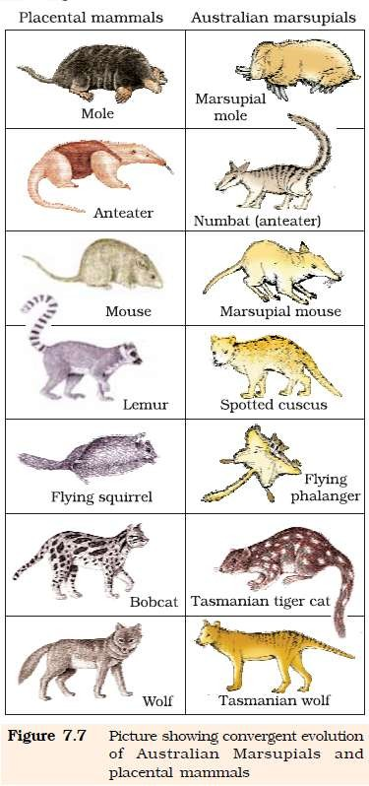
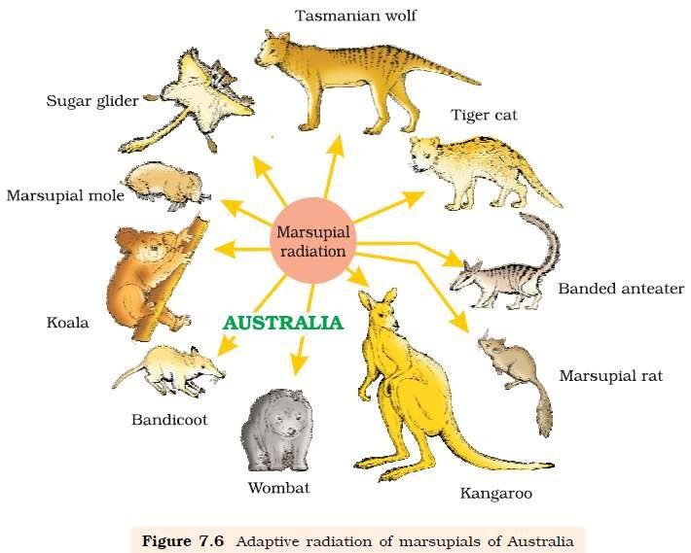

Slide 21
BIOLOGICAL EVOLUTION:
The essence of Darwinian Theory about evolution is natural selection.
The rate of appearance of new forms is linked to the life cycle or
the life span.
There must be a genetic basis for getting selected and to evolve.
Some organisms are better adapted to survive in an otherwise hostile environment.
Adaptive ability is inherited.
It has genetic basis.
Fitness is the end result of the ability to adapt and get selected by nature.
Branching descent and natural selection are the two key
concepts of Darwinian Theory of Evolution.

Slide 22
Lamark theory of evolution: (theory of inheritance of acquired characters)
French Naturalist Lamark had said that evolution of life forms had occurred but driven by use and disuse of organs.
He gave the example of Giraffes who in an attempt to forage leaves on tall trees had to adapt by elongation of their necks.
They passed on this acquired character of elongated neck to succeeding generations.
Giraffes, slowly over the years, came to acquire long necks.

Slide 23
MECHANISM OF EVOLUTION:
In the first decade of twentieth century, Hugo deVries based on his work on evening primrose brought fourth the idea ofmutations.
Mutation is the large difference arising suddenly in a population.
How deVries theory of mutation differs from Darwin’s theory of natural selection?
It is the mutation which causes evolution and not the minor variations that Darwin talked about.
Mutations are random and directionless while Darwinian variations are small and directional.
Evolution for Darwin was gradual while deVries believed mutation caused speciation and hence called itsaltation (single step large mutation).

Slide 24
HARDY – WEINBERG PRINCIPLE:
In a given population one can find out the frequency of occurrence of alleles of a gene on a locus.
This frequency is supposed to remain fixed and even remain the same through generations.
Hardy-Weinberg principle stated it using algebraic equations.
The principle states that allele frequencies in a population are stable and is constant from generation to generation.
The gene pool (total genes and their alleles in a population) remains a constant.
This is called genetic equilibrium:
Sum total of all the allelic frequencies is 1.
(p + q)² = p² + 2pq + q² = 1.
When frequency measured, differs from expected values, the difference (direction) indicates the extent of evolutionary change.
Disturbance in genetic equilibrium, or i.e. change of frequency of alleles in a population would then be interpreted as resulting in evolution.

Slide 25
Five factors are known to affect Hardy-Weinberg equilibrium:
Gene migration or gene flow.
Genetic drift.
Mutation.
Genetic recombination.
Natural selection.

Gene migration: When migrations of a section of population to another place occur, gene frequencies change in the original as well as in the new population. New genes /alleles are added to the new population and these are lost from the old population.
Gene flow: Gene migration occurs many time is termed as gene flow.
Genetic drift: change in gene frequency takes place by chance.
Founder effect: sometimes the change in allelic frequency is so different in the new sample of population that they became a different species. The original drifted population becomes founder species and the effect is
called founder effect.

Slide 26
Operation of natural selection on different trait:
Natural selection can lead to :
  Stabilization: in which more individuals acquire mean character value.
  Directional changes i.e. more individuals acquire value other than the mean character value.
  Disruption: more individuals acquire peripheral character value at both ends of the distribution curve.

Slide 27
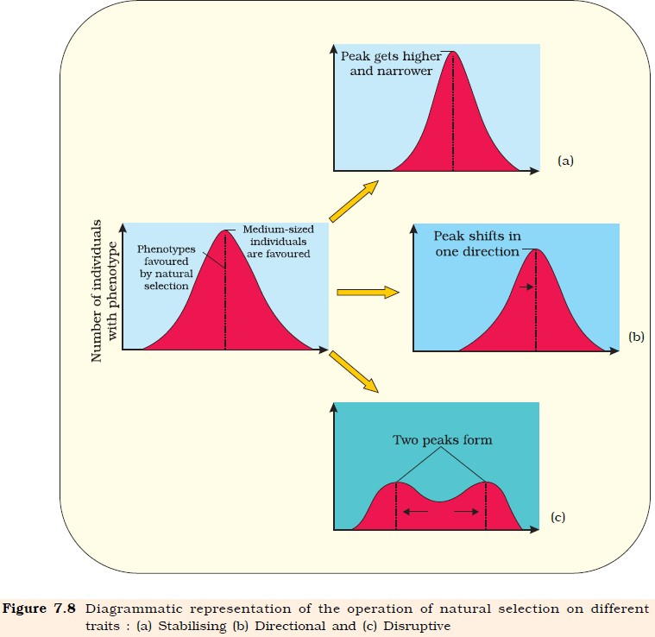

Slide 28
A BRIEF ACCOUNT OF EVOLUTION:
About 2000 million years ago (mya) the first cellular forms of life appeared on earth.
Some cellular form had the ability to release O₂.
Slowly single cell organisms became multi-cellular life forms.
By the time of 500 mya invertebrates were formed and active.
Jawless fish probably evolved around 350 mya.
Sea weeds and few plants existed probably around 320 mya.
Coelacanth a lobe finned fish discovered in South Africa in 1938 evolved into first amphibians that lived on both land and water. These were ancestors of modern day frogs and salamanders.
The amphibian evolved into reptiles.
Reptiles’ lays eggs which don not dry up in sun unlike those of
amphibians.

Slide 29
Giant ferns (pteridophytes) were present but they fell to form coal deposits slowly.
Some of the reptiles went back into water to evolve into fish like reptiles probably 200 mya ( Ichthyosaurs)
The land reptiles were the dinosaurs.
The biggest dinosaurs are Tyrannosaurus rex was about 20 feet in height and had huge fearsome dagger like teeth.
About 65 mya the dinosaurs suddenly disappeared from the earth.
Some of them evolved into birds.
The first mammals were like shrews. Their fossils were small sized.
Mammals were viviparous and protected their unborn young inside the mother’s body.
Due to continental drift, pouched mammals of Australia survived
because of lack of competition from any other mammals.

Slide 30
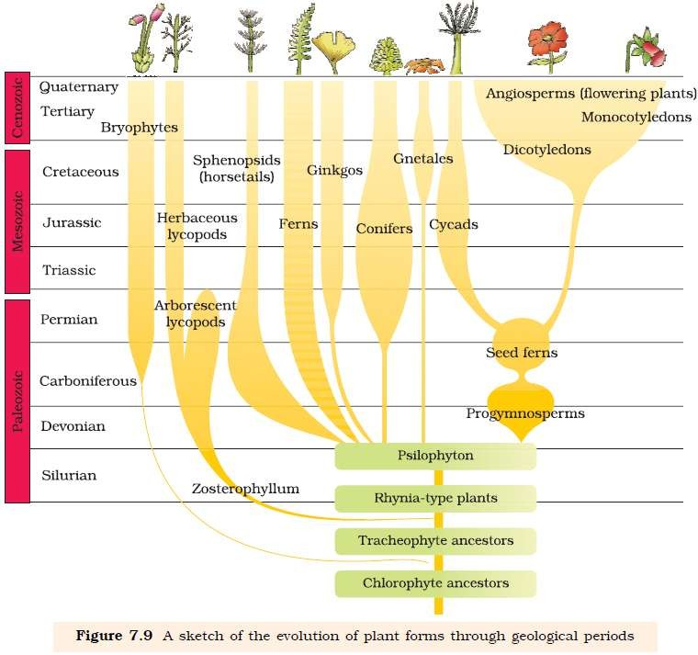

Slide 31
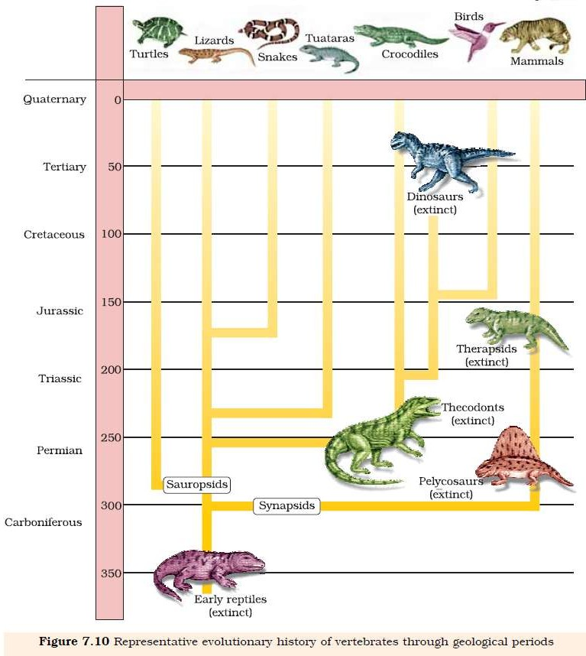

Slide 32
ORIGIN AND EVOLUTION OF MAN:
About 15 mya primates called Dryopithecus and Ramapithecus were existing.
They were hairy and walked like gorillas and chimpanzees.
Ramapithecus was more man like while Dryopithecus was more ape-like.
Few fossils of man-like bones have been discovered in Ethiopia and Tanzania.

Two mya Australopithecines probably lived in East African grasslands.
  They hunted with stone weapons.
  Essentially ate fruit.

The first human-like being the hominid and was called Homo habilis.
  Brain capacity wee between 650 – 800 c.
  They did not eat meat.

Fossils discovered in Java in 1891 revealed the next stage i.e. Homo erectus about 1.5 mya.
  Had large brain around 900 cc.
  Probably ate meat.

Slide 33
Neanderthal man:
  Brain size 1400 cc
  Lived in east and central Asia between 1, 00,000-40,000 years back.
  They used hides to protect their body.
  Buried their dead.

Homo sapiens:
  Arose in Africa and moved across continents and developed distinct races.
  During ice age between 75,000-10,000 years ago modern Homo sapiens arose.
  Pre historic cave art developed about 18,000 years ago.
  Agriculture came around 10,000 years back and human settlement started.


Slide 34
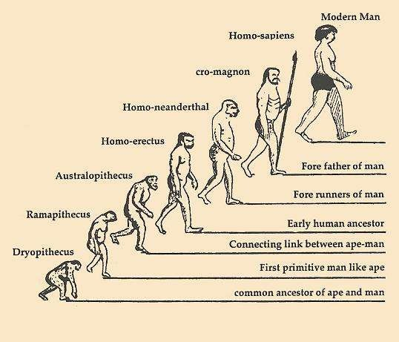

Slide 35
Thanking you

