Slide 1

CONTENTS:
History of PCR
Polymerase Chain reaction
Steps involved
Factors for optimal PCR
Variations of PCR
Comparison PCR & Cloning
Advantages
Limitations

Slide 2
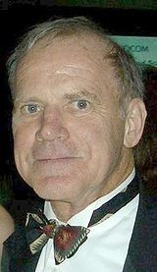
History
OF PCR
As is the photo copier a basic requirement in an office,so is the PCR machine in a molecular biology Laboratory !!!!!!!!!
PCR is DNA replication in a test tube……..

Slide 3
Great mind behind this PCR :Kary Banks Mullis
Developed PCR in 1985 and was awarded nobel prize in 1993.
PCR machine otherwise called Thermocycler.
-1983—Kary Mullis, a scientist working for the Cetus Corporation was driving along US Route 101 in northern California when he came up with the idea for the polymerase chain reaction.
-1985—the polymerase chain reaction was introduced to the scientific community at a conference in October .Cetus rewarded Kary Mullis with a $10,000 bonus for his invention
-Later, during a corporate reorganization, Cetus sold the patent for the PCR process to a pharmaceutical company Hoffmann-LaRoche for $300 million.
4

Slide 4
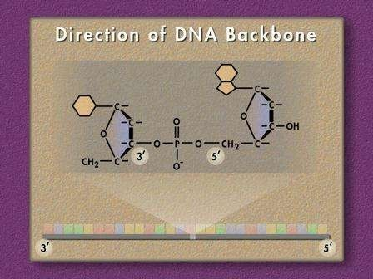
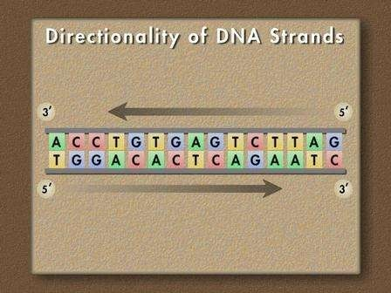
DNA ?

Slide 5
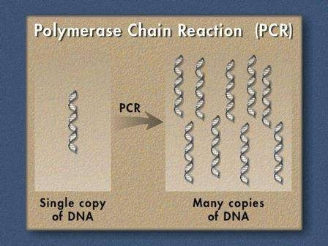
Polymerase Chain Reaction(PCR)
PCR targets and amplifies a specific region of a DNA strand.
It is an invitro technique to generate large quantities of a specified DNA.
Often, only a small amount of DNA is available eg.A drop of blood, Semen strains, Single hair, vaginal swabs etc.
Two methods currently exist for amplifying the DNA or making copies
  Cloning—takes a long time for enough clones to reach maturity
  PCR—works on even a single molecule quickly

Slide 6
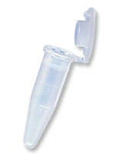
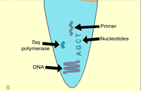
Requirements of PCR
DNA Template
Primers
Taq polymerase
Deoxynucleoside triphosphates(dNTPs)
Buffer solution
Divalent cations(eg.Mg²⁺ )

Slide 7
STEPS INVOLVED:
DENATURATION:
The reaction mixture is heated to a temperature between 90-98° C so that the ds DNA is denatured into single strands by disrupting the hydrogen bonds between complementary bases.
Duration of this step is 1-2 mins.

Slide 8
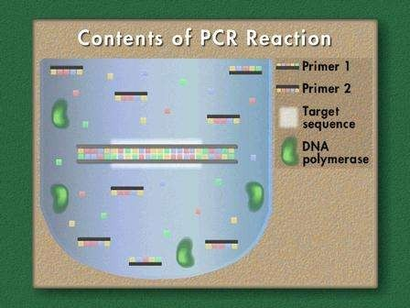

Slide 9
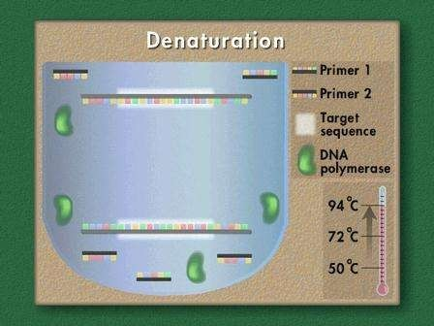

Slide 10
ANNEALING:
Temperature of reaction mixture is cooled to 45-60° C
Primers are jiggling around caused by ???????
Primers base pair with the complementary sequence in the DNA.
Hydrogen bonds reform.
Annealing fancy word for renaturing.

Slide 11
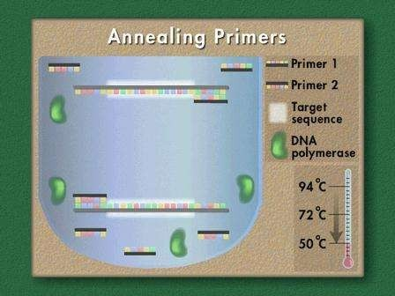

Slide 12
EXTENSION:
The temperature is now shifted to 72° C which is ideal for polymerase.
Primers are extended by joining the bases complementary to DNA strands.
Elongation step continues where the polymerase adds dNTP's from 5' to 3', reading the template from 3' to 5' side, bases are added complementary to the template.
Now first cycle is over and next cycle is continued ,as PCR machine is automated thermocycler the same cycle is repeated upto 30-40 times.

Slide 13
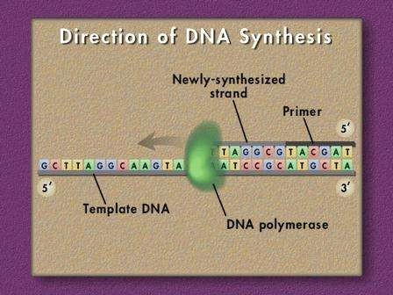

Slide 14
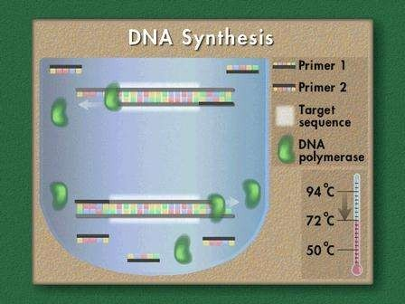

Slide 15
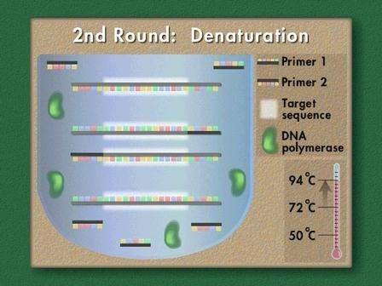
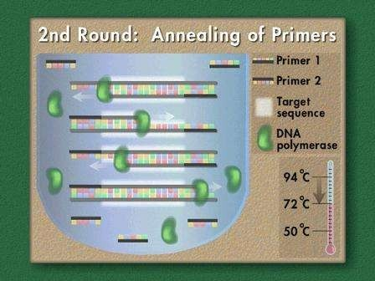

Slide 16
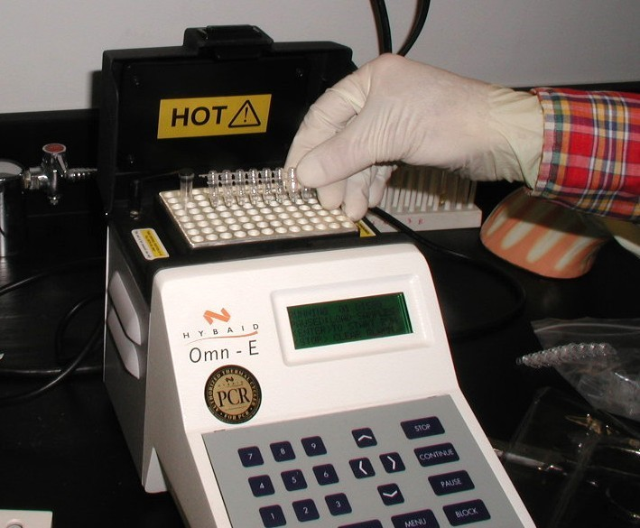
OLD PCR
NEW AUTOMATED PCR

Slide 17
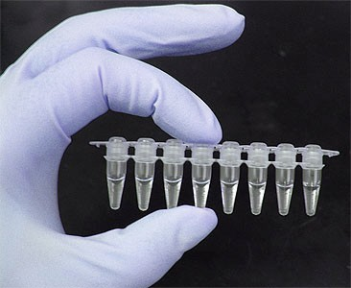
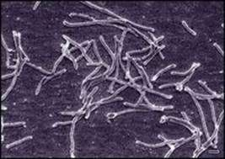
Factors for Optimal PCR:
PCR Primers
-correctly designed pair of primers is required
-primer dimer,hairpin formation should be prevented
-length of primer
DNA Polymerase
-Thermus aquaticus-170° F
-Taq polymerase is heat resistant
-It lacks proof reading exonuclease activity
-Other polymerases can be used .eg:
Tma DNA Polymerase from Thermotoga maritama, Pfu DNA Polymerase from Pyrococcus furiosus.

Slide 18
Annealing Temperature
Very important since the success and specificity of PCR depend on it because DNA-DNA hybridization is a temperature dependent process.
If annealing temperature is too high,pairing between primer and template DNA will not take place then PCR will fail.
Ideal Annealing temperature must be low enough to enable hybridization between primer and template but high enough to prevent amplification of nontarget sites.
Should be usually 1-2° C or 5° C lower than melting temperature of the template-primer duplex

Slide 19

Melting Temperature
- Temperature at which 2 strands of the duplex dissociate.
It can be determined experimentally or calculated from formula
Tm = (4(G+C)) + (2(A+T))
G/C content
ideally a primer should have a near random mix of nucleotides, a 50 GC content
there should be no PolyG or PolyC stretches that can promote non-specific annealing

Slide 20
Variations of PCR:
PCR is highly versatile technique and has been modified in variety of way to suit specific applications.
Inverse PCR
-In this method amplification of DNA of unknown sequence is carried out from known sequence.
- This is especially useful in identifying flanking sequences of various genomic inserts.

Slide 21
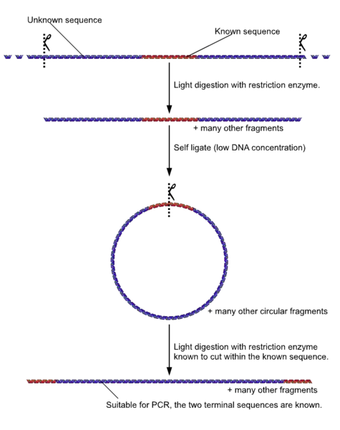

Slide 22
Anchored PCR
-A small sequence of nucleotides can be attached or tagged to target DNA.
- The anchor is frequently a poly G to which a poly C primer is used.

Slide 23
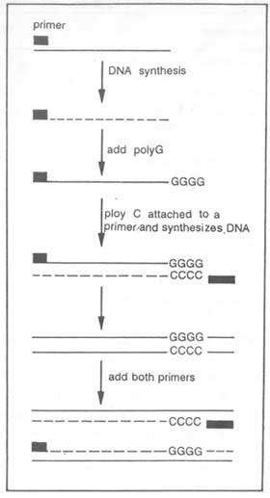

Slide 24
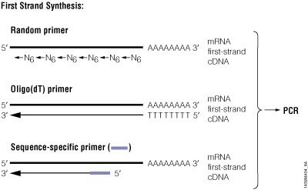
Reverse transcriptase PCR
-It is employed for amplification of RNA molecules .
-RT-PCR is widely used in expression profiling, to determine the expression of a gene or to identify the sequence of an RNA transcript.

Slide 25
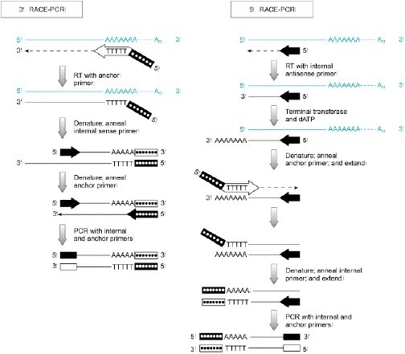
RACE PCR
-Used to obtain 3' and 5' end sequence of cDNA transcripts.

Slide 26
Quantitative real time PCR (Q-RT PCR)
It is used to amplify and also for quantification and detection of DNA sample.
Real time PCR using DNA dyes
Fluorescent reporter probe method
-Detection and quantitation of fluorescent reporter the signal of which increases in direct proportion to the amount of PCR product in a reaction
-Does not measure the amount of end product but its production in real time

Slide 27
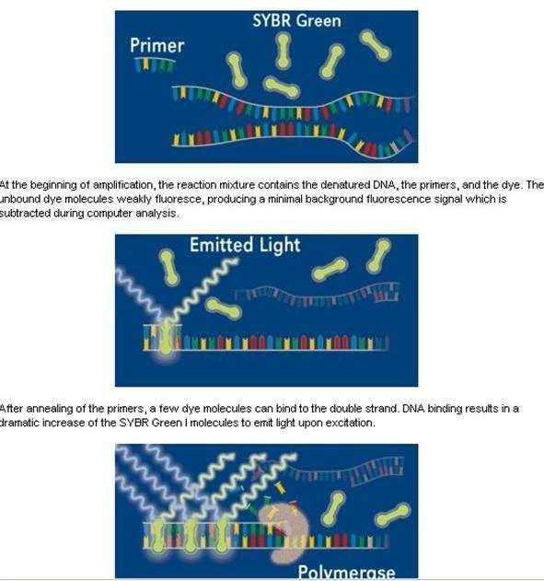

Slide 28
-TaqMan probes are designed such that they anneal within a DNA region amplified by a specific set of primers.
-As the Taq polymerase extends the prime rand synthesizes the nascent strand, the 5' to 3‘ exonulease activity of the polymerase degrades the probe that has annealed to the template.
- Degradation of the probe releases the fluorophore from it and breaks the close proximity to the quencher, thus relieving the quenching effect and allowing fluorescence of the fluorophore.
-Fluorescence detected in the real-time PCR thermal is directly proportional to the fluorophore released and the amount of DNA template present in the PCR.

Slide 29
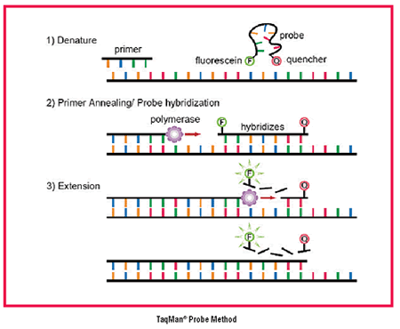

Slide 30
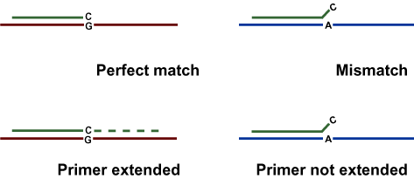
Asymmetric PCR
-It is used for synthesis of Single stranded DNA molecules useful for DNA sequencing
-The two primers are used in the 100:1 ratio so that after 20-25 cycles of amplification one primer is exhausted thus single stranded DNA is produced in the next 5-10 cycles.
  Allele- Specific PCR
-Selective PCR amplification of the alleles to detect single nucleotide polymorphism (SNP)
-Selective amplification is usually achieved by designing a primer such that the primer will match or mismatch one of the alleles at the 3’ end of the primer.

Slide 31
Other types of PCR
Overlap extension PCR
Assemble PCR
Helicase dependent amplication
Intersequence-specific PCR(ISSR)
Ligation-mediated PCR
Methylation –specifin PCR
Miniprimer PCR
Multiplex PCR
Nested PCR
Solid phase PCR
Touch down PCR and so on…………………..

Slide 32
Parameter
PCR
Gene cloning
1.
Final result
Selective amplification specific sequence
Selective amplification of of specific sequence
2.
Manipulation
In vitro
In vitro and in vivo
3.
Selectivity segment DNA
of the specific from complex
First step
Last step
4.
Quantity material
Biological required
of
starting
Nanogram (ng)
Microgram (m)
5.
reagents
DNA polymerase (Taq polymerase)
Restriction Ligase, bacteria
enzymes, vector.
6.
7.
8.
9.
10.
Automation Labour intensive Error probability Applications Cost
Yes No Less More Less
No Yes More Less More
11.
User’s skill
Not required
Required
12.
Time for experiment
a
typical
Four hours
Two to four days

Slide 33
Advantages:
PCR in clinical diagnosis
PCR in DNA sequencing
PCR in Forsenic Medicine
PCR in Gene manipulation and expression studies
PCR in comparative study of genomics
PCR in comparison with gene cloning

Slide 34
Limitations
Sequence Information
Amplicon size
Error rate during amplification
Sensitivity to inhibitors
Contamination
Artefacts

Slide 35


