Slide 1
CH-7 UNTOUCHABILITY A SOCIAL EVIL
CIVICS

Slide 2
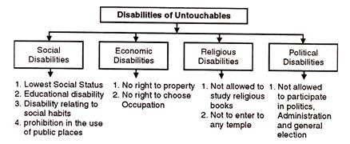
UNTOUCHABILITY

Slide 3
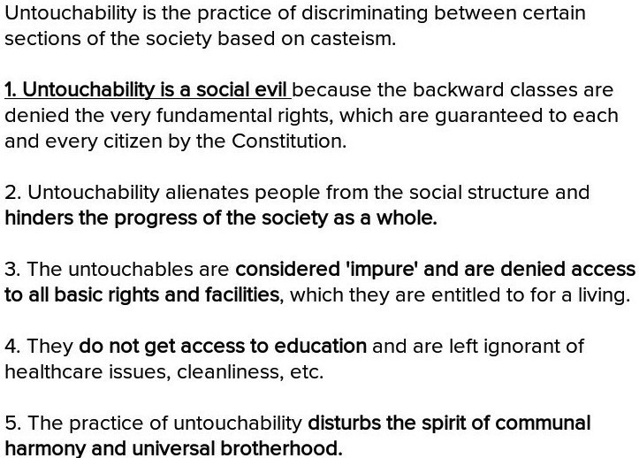

Slide 4
ABOLITION OF UNTOUCHABILITY

Slide 5
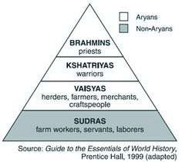
VARNA SYSTEM

Slide 6
CASTE SYSTEM AND ITS EVIL

Slide 8
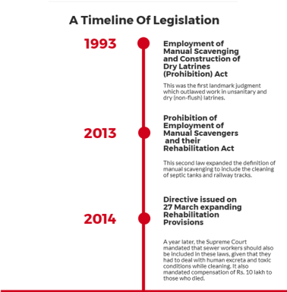
LEGISLATION POLICY

Slide 9
