Slide 1
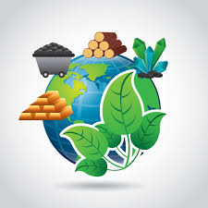
SOCIAL SCIENCE
Natural Resources
land, soil and water
Land resources

Slide 2
Introduction
In this topic we are going to learn about land resources.
Land covers about 29 per cent of the total surface.
It is a gift of nature.
The distribution of population is highly uneven.
About 90 per cent of the worlds population occupies only 30 per cent of the world.
The areas have steep slopes, marshland etc are hot and thick forest are cold.

Slide 3
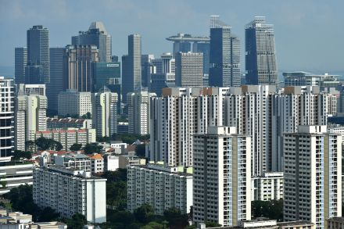
Land Use
We use land for different uses such as cultivating, grazing, mining, setting up of industries, settlements and so on.
It depends upon various physical, economic and human factors.
The amount of land used for a specific purpose varies from place and time.
The slop of the land, climate condition, the quality of soil.
The nature of rocks and minerals and the availability of water.

Slide 4
Owner Ship
Privet owner ship:
Land use of privet holdings is according to the land owner.
Community owner ship or Common property resources:
Community land is mostly used for the purpose of the community such as grazing cattle.

Slide 5
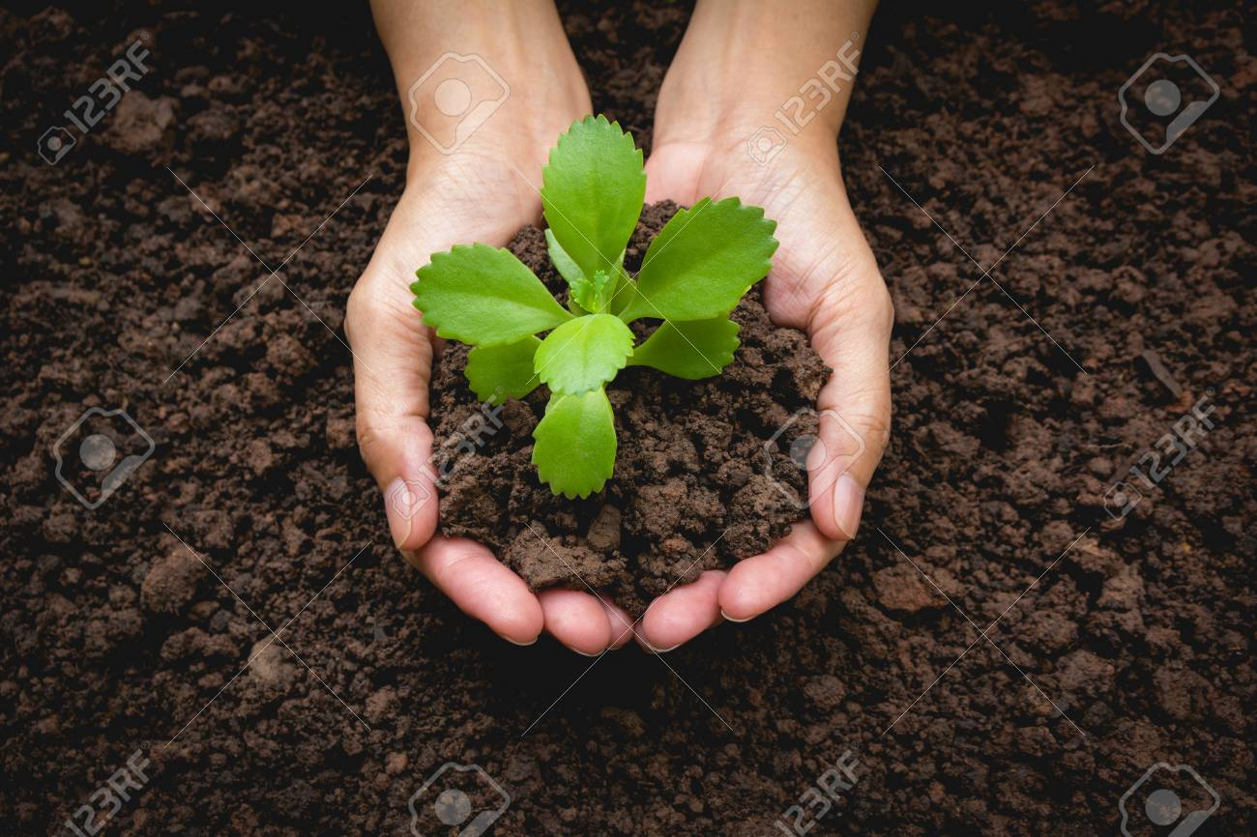
Conservation of land resources
Checking further spread of deserts.
Adopting scientific techniques.
Conserving soil and forest.
Providing irrigation facilities.
Increasing the use of manure and chemical fertilizers.
Afforestation and land reclamation.
Checking overgrazing.

Slide 6
Questions
1. Land covers about
per cent of earth surface.
2. Land uses depends upon , ,
.
3. Common land used for grazing cattle by every member of a community is called.
4. List any 4 methods of land conservation.
5. The area which has high level of population .
6. The cultivation of land depends upon
, , ,

Slide 7
Group Members
BY:
ABINANTHAN.A.K
JAI SURIYA.V.A
JUDHA ABIB EBENEZER
SADHANA.M
PRIYANKA.R
YOGSEHWARI.A.P

