Slide 1
CH- 8 GOVERNMENT FOR DEVELOPMENT
CIVICS

Slide 2
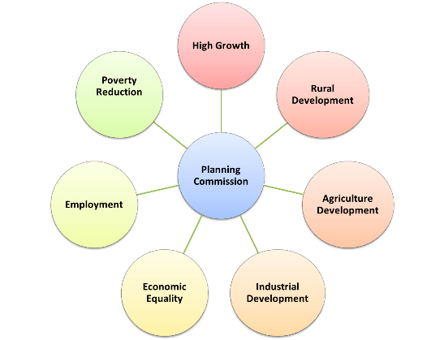
PLANNING COMMISSION

Slide 3
WHAT IS PLAN?

Slide 4
FIVE YEAR PLAN

Slide 5
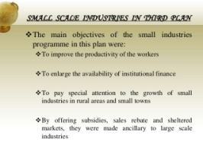
INDUSTRIAL DEVELOPMENT

Slide 6
INDUSTRIAL DEVELOPMENT

Slide 7
RURAL DEVELOPMENT
Education – Sarva Shiksha Abhiyan
Sanitation – Nirmal Gram Puraskar and Swachh Bharath
Health – National Rural Health Mission and National Urban Health Mission
Employment – MNREGA – 2005
Housing – Basic Services to the Urban Poor and Integrated Housing and Slum Development Programme.

Slide 8
RURAL DEVELOPMENT
Rural development:
Provide telephones for communication.
Construction of all-weather roads to connect all villages
Provide clean drinking water.
Provide electricity to rural households
Construction of 60 lakh houses for the poor.
Bringing as much as one crore hectares of land under irrigation.

Slide 9
PREPARED BY
KALYANI S

