Slide 1
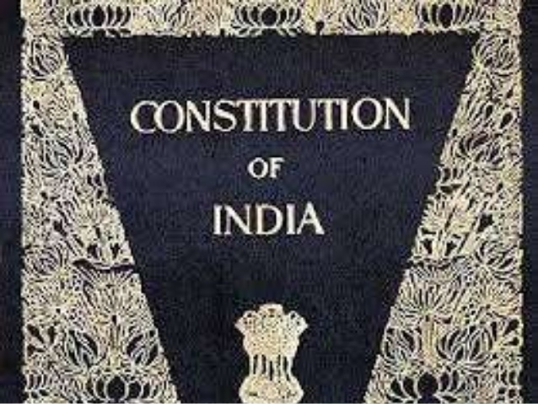
SOCIAL AND POLITICAL LIFE
CH-2 IDEALS OF OUR CONSTITUTION

Slide 2
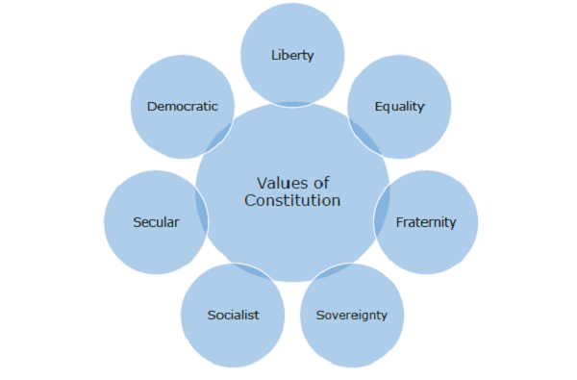

Slide 4
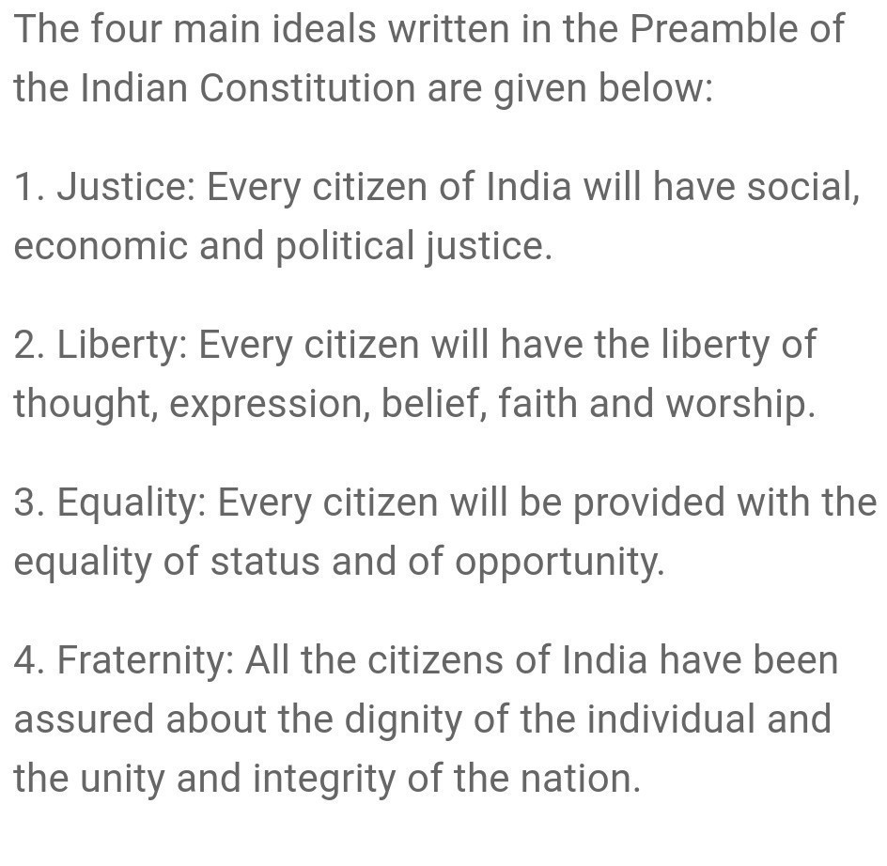

Slide 5
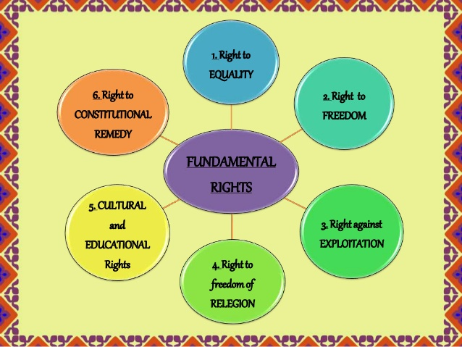

Slide 7
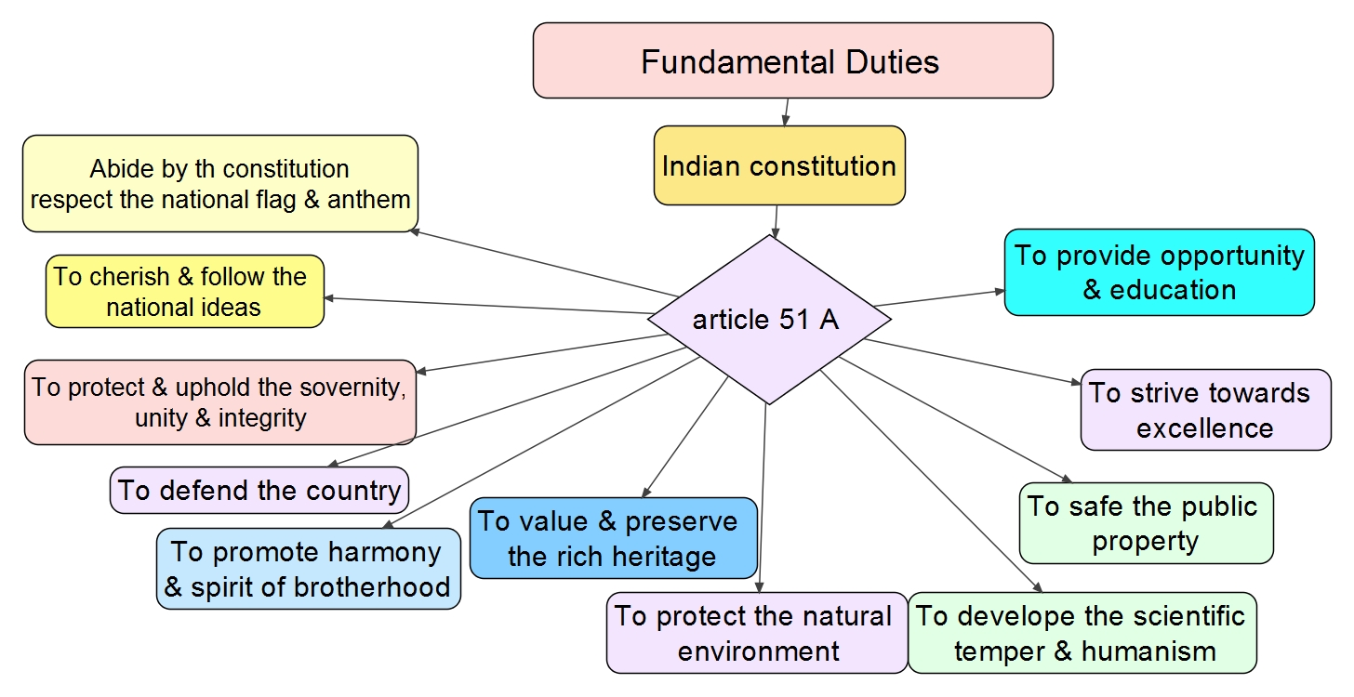

Slide 9
PREPARED BY
KALYANI S

