Slide 1
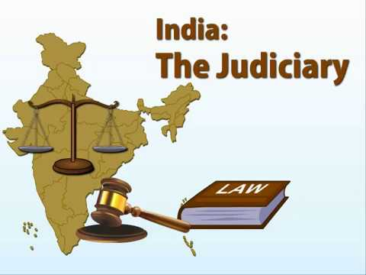

Slide 2
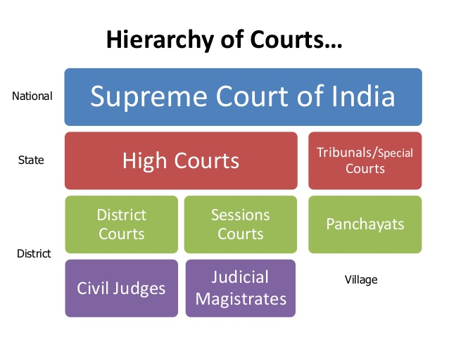

Slide 8
PREPARED BY
KALYANI S

