Slide 1
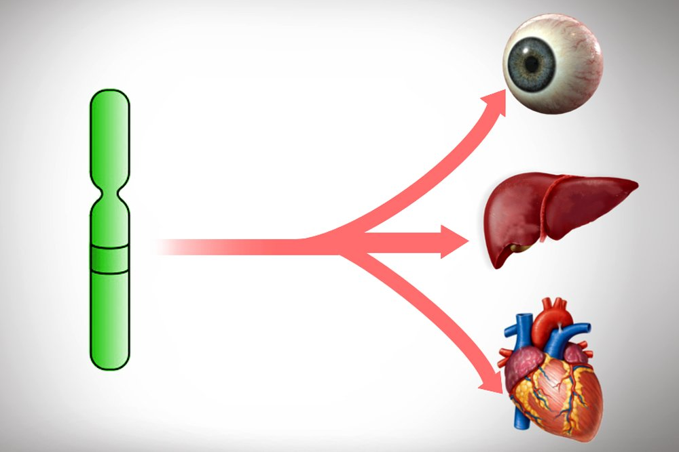
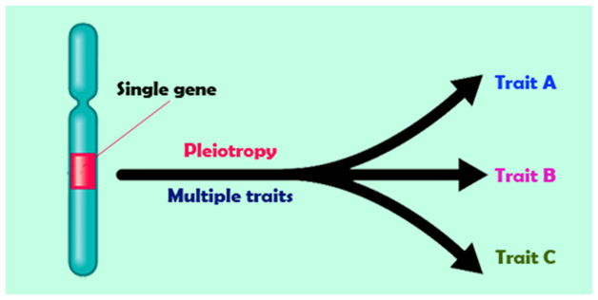
SNS ACADEMY
A fingerprint International School
Affiliated to CBSE New Delhi
Affiliation No :1930610
GRADE XII A (2020-21)
COURSE NAME : BIOLOGY (044)
CHAPTER-5 PRINCIPLES OF INHERITANCE

Slide 2
OBJECTIVE
Learn about genetic defect called Pleotropism.
Acquire knowledge on Pleotropic gene.
Identify various Pleotroic diseases

Slide 3
WHAT IS PLEOTROPISM?
One gene influences multiple unrelated phenotypic traits.
Example:
sickle cell anemia,
phenyl keto uria (PKU)

Slide 4
HISTORY
The term ‘’ pleiotropie’’ was coined in a 1910 by Festschrift
Greek term
Pleion more
Trops character

Slide 5
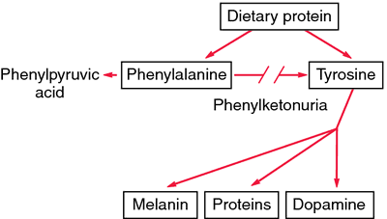
Phenylketouria (PKU)
Rare genetic condition
Inborn error of metabolism
Amino acid phenyl analine

Slide 6
Symptoms of phenylketonuria
Seizures
Tremors, or trembling and shaking
Stunted growth
Hyperactivity
Skin conditions such as eczema
A musty odor of their breath, skin, or urine

Slide 7
Thank you

