Slide 1
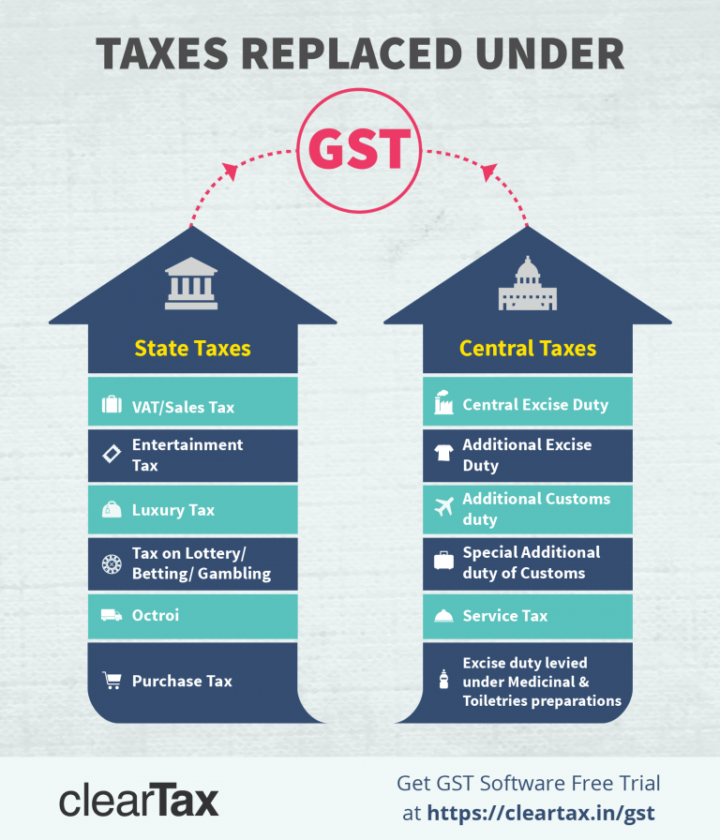
GST

Slide 2
What determines if CGST, SGST or IGST is applicable?
To determine whether Central Goods & Services Tax (CGST), State Goods & Services Tax (SGST) or Integrated Goods & Services Tax (IGST) will be applicable in a taxable transaction, it is important to first know if the transaction is an Intra State or an Inter-State supply.
Intra-State supply of goods or services is when the location of the supplier and the place of supply i.e., location of the buyer are in the same state. In Intra-State transactions, a seller has to collect both CGST and SGST from the buyer. The CGST gets deposited with Central Government and SGST gets deposited with State Government.

Slide 3
Inter-State supply of goods or services is when the location of the supplier and the place of supply are in different states. Also, in cases of export or import of goods or services or when the supply of goods or services is made to or by a SEZ unit, the transaction is assumed to be Inter-State. In an Inter-State transaction, a seller has to collect IGST from the buyer.

Slide 4
What is Central Goods and Services Tax (CGST)?
Under GST, CGST is a tax levied on Intra State supplies of both goods and services by the Central Government and will be governed by the CGST Act. SGST will also be levied on the same Intra State supply but will be governed by the State Government.
This implies that both the Central and the State governments will agree on combining their levies with an appropriate proportion for revenue sharing between them. However, it is clearly mentioned in Section 8 of the GST Act that the taxes be levied on all Intra-State supplies of goods and/or services but the rate of tax shall not be exceeding 14%, each.

Slide 5
What is State Goods and Services Tax (SGST)?
Under GST, SGST is a tax levied on Intra State supplies of both goods and services by the State Government and will be governed by the SGST Act. As explained above, CGST will also be levied on the same Intra State supply but will be governed by the Central Government.
Note: Any tax liability obtained under SGST can be set off against SGST or IGST input tax credit only.
An example for CGST and SGST:

Slide 6
Why the split into SGST, CGST, and IGST?
India is a federal country where both the Centre and the States have been assigned the powers to levy and collect taxes. Both the Governments have distinct responsibilities to perform, as per the Constitution, for which they need to raise tax revenue.
The Centre and States are simultaneously levying GST.
The three types tax structure is implemented to help taxpayers take the credit against each other, thus ensuring “One Nation, One Tax”.

