Slide 5
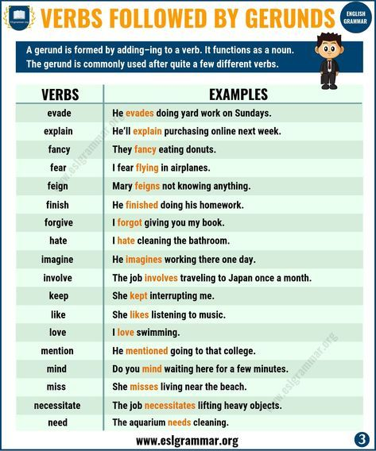

Slide 9
GOEBBELS

Slide 12
REFERENCES & THANKING SLIDE

