Slide 1
an International CBSE Finger Print School
Coimbatore
SUBJECT NAME-Computer Science
GRADE-XII
UNIT –Data Structures with Stack

Slide 2
CONSIDER AN EXAMPLE
Data structure refers to a data collection with well defined operations and behaviour or properties.
A stack is a linear data structure implemented in LIFO(Last In First Out) where insertions and deletions are restricted to occur only at one end.
LIFO means element last inserted would be the first one to be deleted.
The stack is also a dynamic data structure

Slide 3
A Queue is also a linear dynamic structure implemented in FIFO(First In First Out) manner where insertions can occur at the rear end and deletions can occur only at front end.FIFO means elements are deleted in the same order as they are inserted into.

Slide 4
A stack is a linear data structure implemented in LIFO(Last In First Out) where insertions and deletions are restricted to occur only at one end.
LIFO means element last element last inserted would be the first one to be deleted.
1.Data can only be removed from the top(pop).The element at the top of the stack.The removal of element from a stack is technically called POP operation.

Slide 5
A new data element can only be added to the top of the stack(Push).The insertion of element in a stack is technically called PUSH operation. A stack is a dynamic data structure as it can grow(with increase in number of elements) or shrink(with decrease in number of elements). A static data structure,on the other hand, is the one that has fixed size.

Slide 6
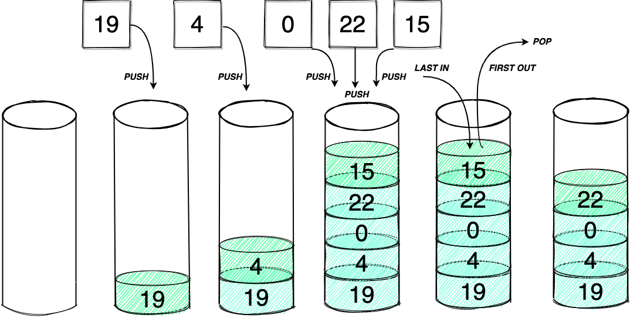

Slide 7
Peek: Refers to inspecting the value at the stack’s top without removing it.It is also called as inspection. Overflow: When one tries to push an item in stack that is full.This situation occurs when the size of the stack is fixed and cannot grow further or there is no memory left to accommodate new item.

Slide 8
Underflow: When one tries to pop/delete an item from an empty stack.That is,stack is currently having no item and still one tries to pop an item. The technical terms for insertion and deletion from stack are push and pop respectively.

Slide 10
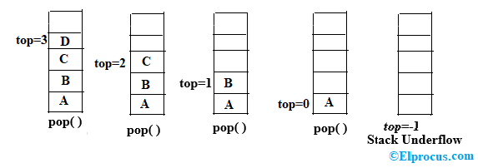

Slide 11
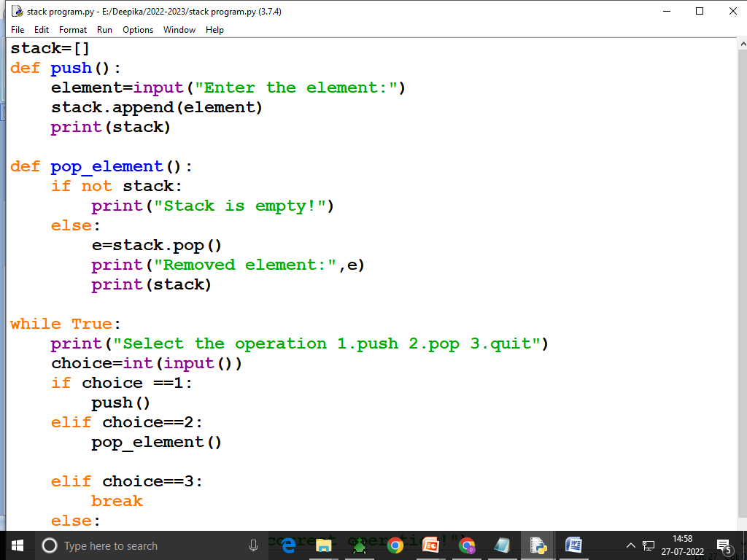

Slide 12
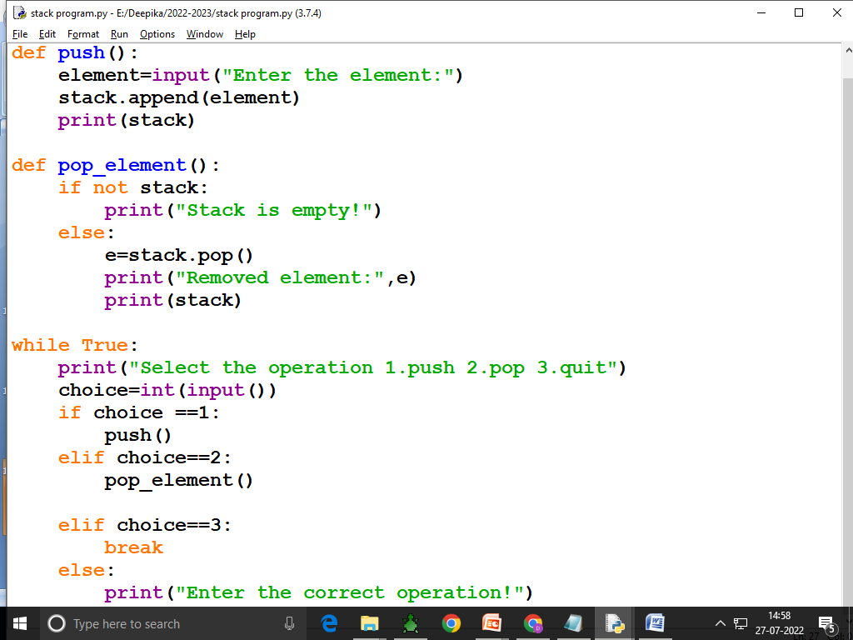

Slide 13
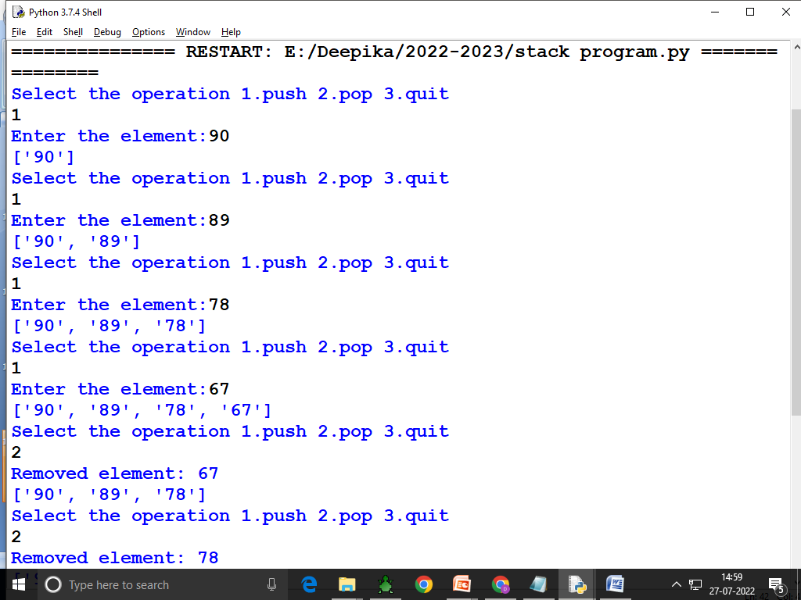

Slide 14
