Slide 1
COMPUTER HARDWARE AND SOFTWARE

Slide 2
What is computer ?
Computer is an electronic machine.
It runs on electricity. It takes inputs from you.
It uses some program (set of instructions) to process these inputs.
Finally it delivers output as per your requirement.

Slide 3
What is computer hardware?
Computer Hardware- Physical parts of a computer which you touch and see is called as hardware.
Example:
monitor, keyboard, hard disk, CPU
chip etc.

Slide 4
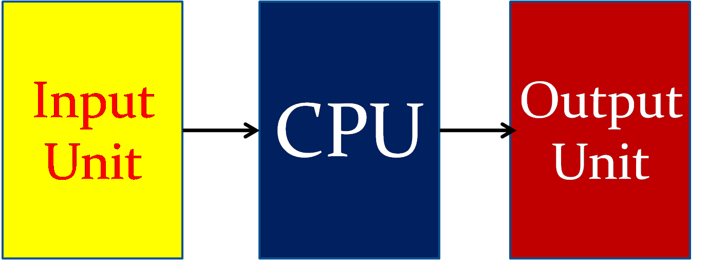

Slide 5
