Slide 1
an International CBSE Finger Print School
Coimbatore
SUBJECT NAME - 041 MATHEMATICS
GRADE-XII
UNIT – 4
TOPIC – DETERMINATES

Slide 2
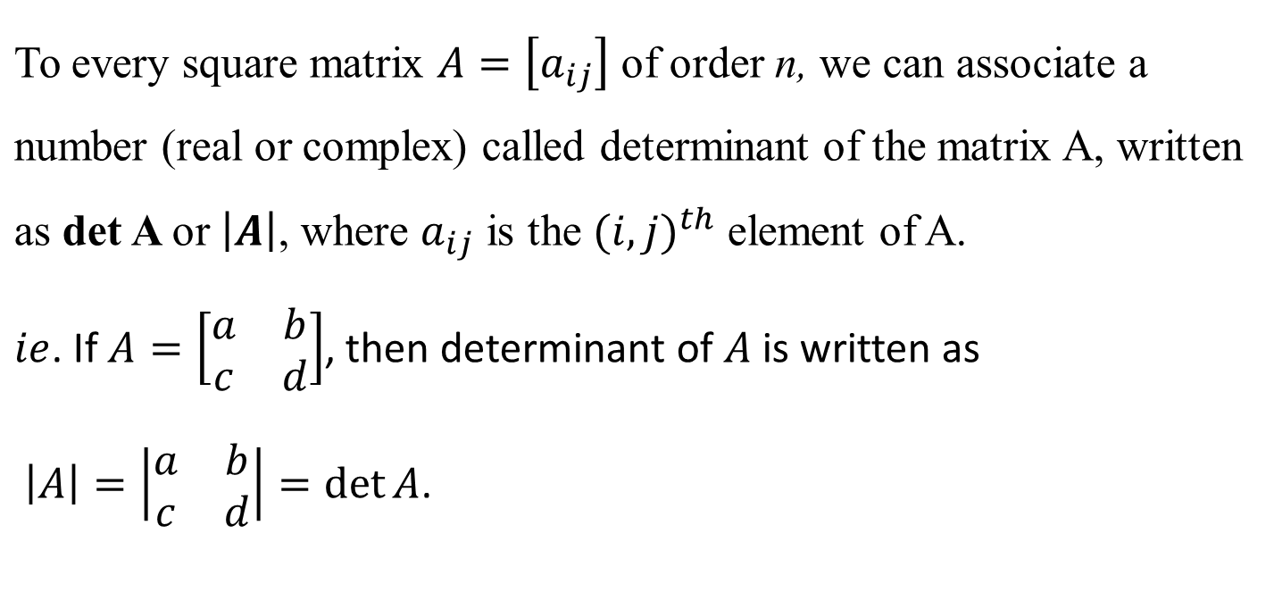
DETERMINANTS
Only square matrices have determinants.

Slide 3
Determinant of a matrix of order one
Let A = [a] be the matrix of order 1, then determinant of A is defined to be equal to a.

Slide 4
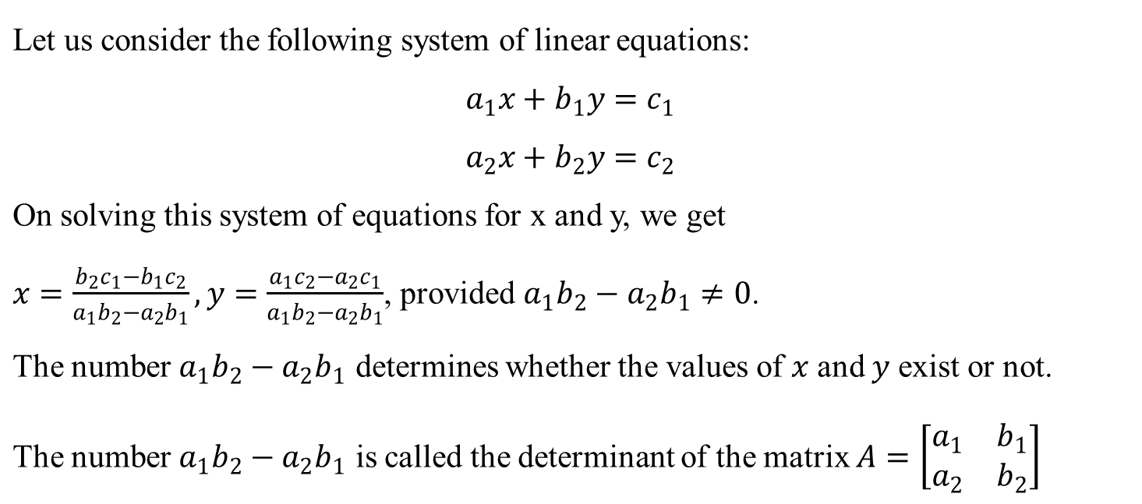
Determinant of a matrix of order two

Slide 5
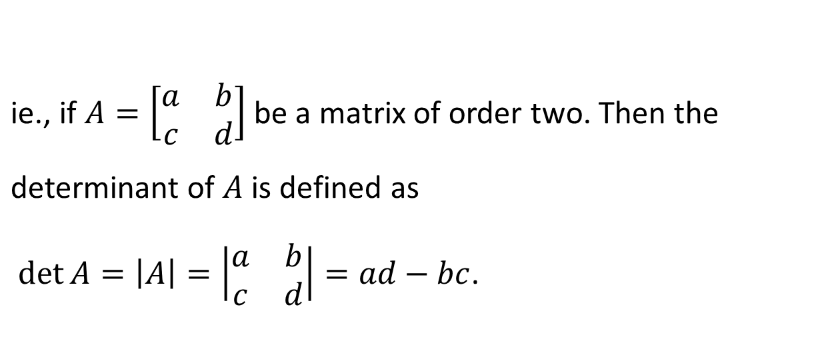
Determinant of a matrix of order two

Slide 6
Determinant of a matrix of order 3
Determinant of a matrix of order three can be determined by expressing it in terms of second order determinants. This is known as expansion of a determinant along a row (or a column).

Slide 7
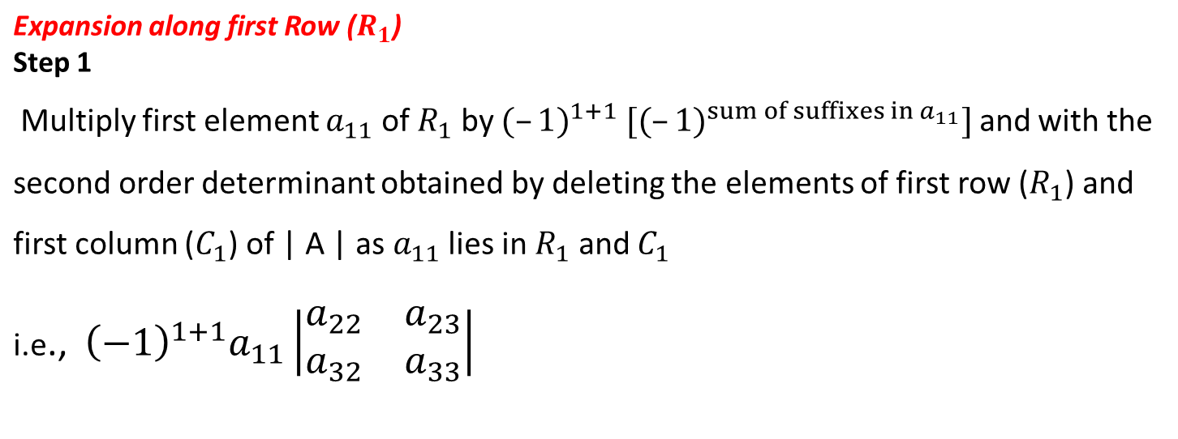

Slide 8
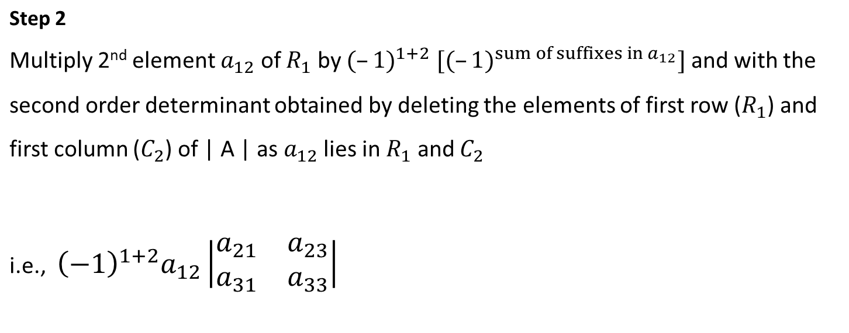
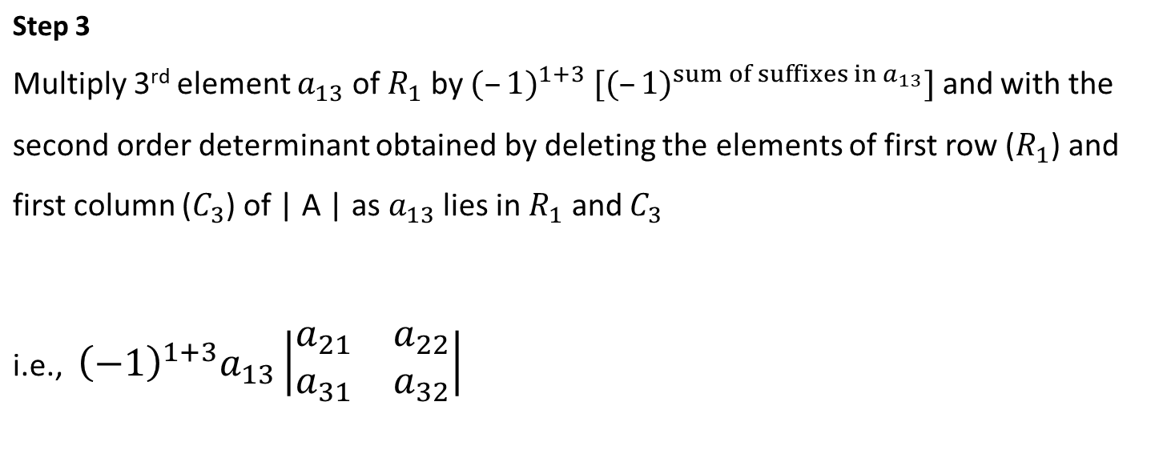

Slide 9
Step 4
Now the expansion of determinant of A, that is, | A | written as sum of all three terms obtained in steps 1, 2 and 3 above is given by

Slide 10
MINORS AND COFACTORS
Minor of an element
To each element of a matrix, a number called its minor is associated.
The minor of an element is the value of the determinant obtained by deleting the row and column containing the element.
Remark Minor of an element of a matrix of order n (n ≥ 2) is a determinant of order n – 1.

Slide 11
Cofactor of an element
Minors and Cofactors

Slide 12
If elements of a row (or column) are multiplied with cofactors of any other row (or column), then their sum is zero.

Slide 13
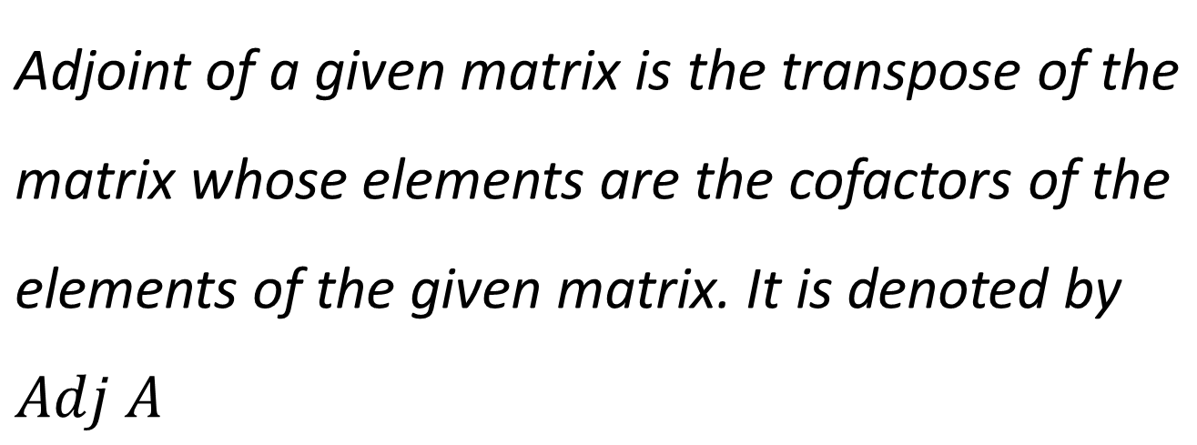
ADJOINT OF A SQUARE MATRIX
Adjoint of a Square matrix of Order 2
Adjoint of a Square matrix of Order 3

Slide 14
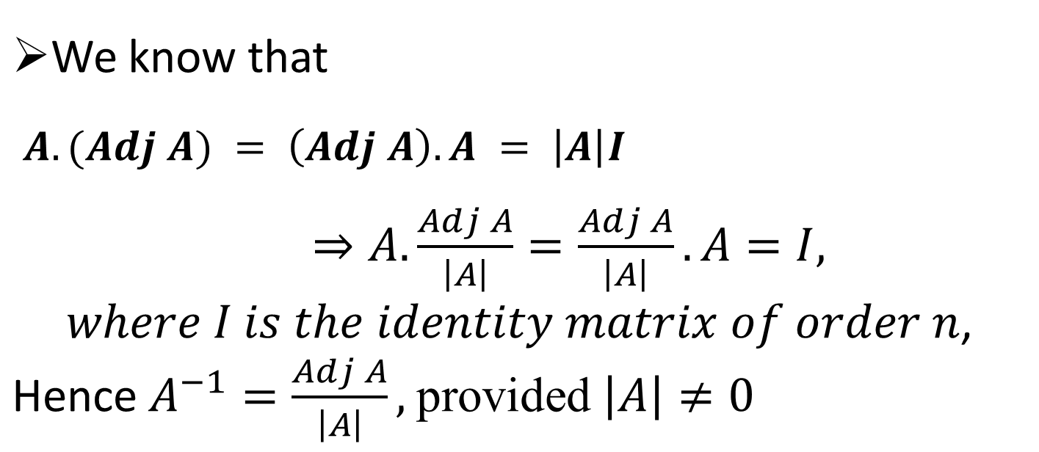
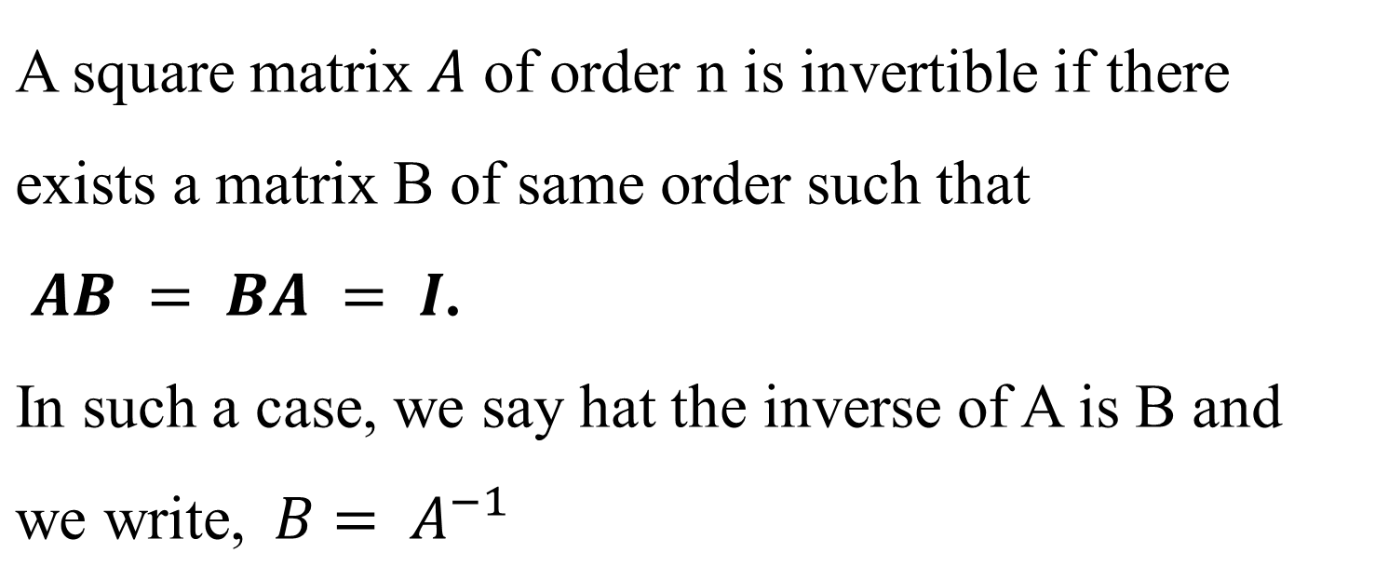
INVERSE OF A MATRIX
Properties of Inverse
Hence a square matrix A is invertible if and only if A is non-singular.

Slide 15
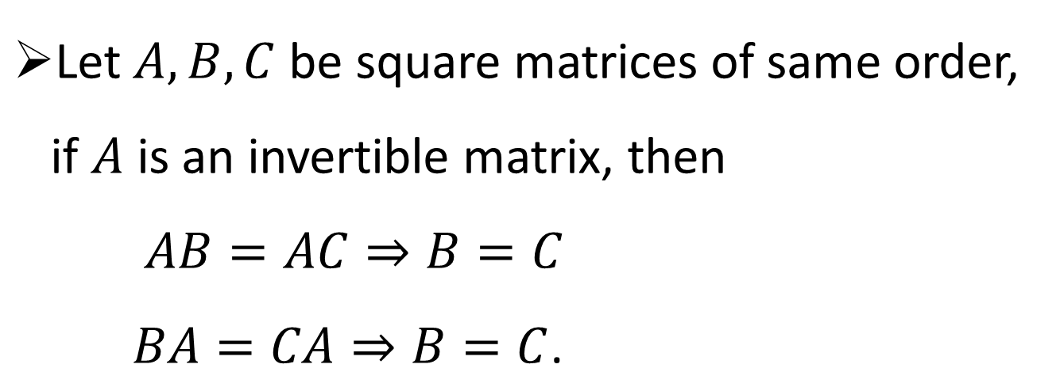
Every invertible matrix possesses a unique inverse

Slide 16
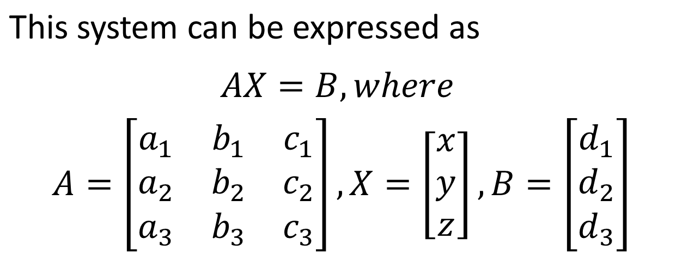
SOLUTION OF A SIMULTANEOUS LINEAR EQUATIONS

Slide 17
Questions:
Evaluate the determinants
Find the area of the triangle whose vertices are (3, 8), (– 4, 2) and (5, 1).
Solve the following system of equations by matrix method. 3x – 2y + 3z = 8 2x + y – z = 1 4x – 3y + 2z = 4

Slide 18
References
https://d2cyt36b7wnvt9.cloudfront.net/exams/wp-content/uploads/2019/12/06154041/Maths_Ch-041.pdf
https://www.selfstudys.com/books/ncert-new-book/english/12th/mathematics-part-i/4-determinants/143831
https://www.slideshare.net/SeyidKadher1/determinants-68070113
https://www.rcboe.org/cms/lib/GA01903614/Centricity/Domain/2819/determinants.ppt

