Slide 1
an International CBSE Finger Print School
Coimbatore
SUBJECT NAME - 041 MATHEMATICS
GRADE-XII
UNIT – 5
TOPIC – CONTINUITY AND DIFFERENTIABILITY

Slide 2
CONTINUITY AND DIFFERENTIABILITY
DERIVATIVES
Derivatives are met in many engineering and science problems, especially when modelling the behaviour of moving objects.
We use the derivative to determine the maximum and minimum values of particular functions (e.g. cost, strength, amount of material used in a building, profit, loss, etc.).
After studying this lesson, you will be able to :
Define and interpret geometrically the derivative of the function y= f(x) at x = c;
Find the derivatives of the function of the form cf(x) , (f(x) ± g(x)) and polynomial functions;
State and apply the results concerning derivatives of the product and quotient of two functions;

Slide 3
state and apply the chain rule for the derivative of a function;
find the derivative of algebraic functions (including rational functions); and
find second order derivative of a function.
Differentiability at a point.

Slide 4
Geometrical meaning:

Slide 5
Derivative of a function:
This definition of derivative is also called the first principle of derivative.

Slide 6
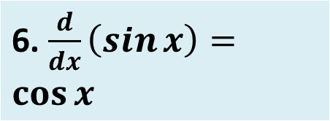
Theorem:
Derivative of some standard functions:

Slide 8
Theorem:

Slide 9
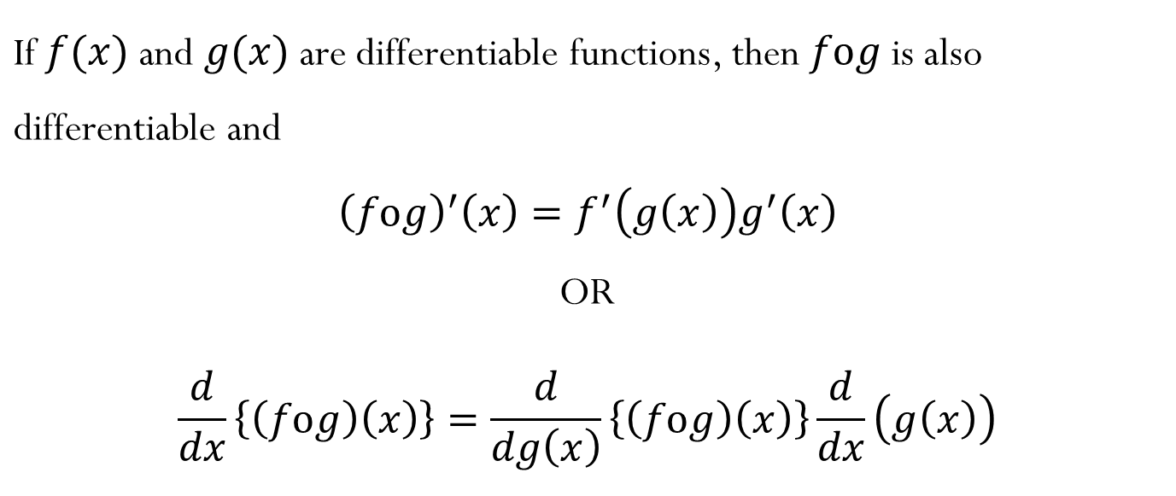
DIFFERENTIATION OF A FUNCTION OF A FUNCTION
Chain Rule for Differentiation:

Slide 10
Differentiation of Implicit Functions:
LOGARITHMIC DIFFERENTIATION

Slide 11
Alternatively, we may write
Differentiating with respect to x, we get

Slide 12
DIFFERENTIATION OF PARAMETRIC FUNCTIONS
DIFFERENTIATION OF A FUNCTION with respect to ANOTHER FUNCTION

Slide 13
Second Order Derivative

Slide 14
MEAN VALUE THEOREMS
ROLLE’S THEOREM

Slide 15
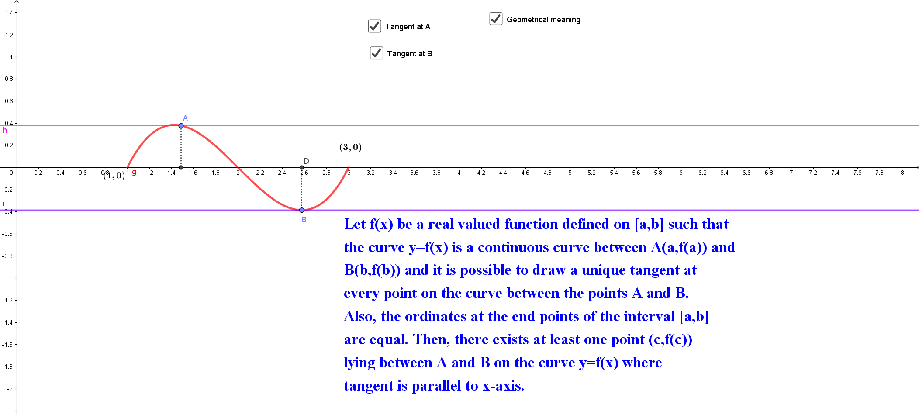
Geometrical Interpretation of Rolle’s Theorem

Slide 16
LAGRANGE’S MEAN VALUE THEOREM

Slide 17
Questions:
Examine whether the function f given by f (x) = x² is continuous at x = 0.
Discuss the continuity of the function f given by f (x) = x³ + x² – 1.
For what value of λ is the function defined by
continuous at x = 0? What about continuity at x = 1?

Slide 18
References
https://www.slideshare.net/SeyidKadher1/continuity-and-differentiability
https://www.aees.gov.in/htmldocs/downloads/XII_Class_Content/20200831/20200831-XII-Maths-Differentiability-2%20of%204-Ppt.pptx
https://www.cyut.edu.tw/~fmchang/docs/chapter2.ppt
https://d2cyt36b7wnvt9.cloudfront.net/exams/wp-content/uploads/2019/12/06154044/Maths_Ch-052.pdf
https://www.vedantu.com/ncert-solutions/ncert-solutions-class-12-maths-chapter-5

