Slide 1


Ch 3 – Current Electricity

Slide 2
Current Electricity:
Study of electric charges in motion[motion- change in position w.r.to object]
Branch of physics which deals with dynamic state of charge
Examples:
When charge flows through a filament of a light bulb, it glows
When charge flows through the circuit of a computer, it works
Television, torch, fan and all other appliances work when charge flows through them.

Slide 3
Electric Current:
Flow of charge in a conductor under a potential difference maintained between the ends of a conductor constitutes an electric current.
When a charge flows in a conductor from one place to the other in a particular direction, then this flow of charge is called ‘electric current’.
It is measured by the rate of flow of charge I = Q / t.
SI Unit: ampere (A)

Slide 4
Electric Current:
By convention, electric current flows from positive to negative
Electronic or electric current flows from negative to positive side.
Electric current is a scalar quantity:
Though it has both magnitude and direction, yet it is a scalar quantity. This is because the laws of ordinary algebra are used to add electric currents and the laws of vector addition are not applicable to the addition of electric currents.

Slide 5
Numericals:
In a circuit, charge Q = (3t² + 5t)c. Find average current from 0 to 4s.
Also find the instantaneous current at t = 2s.
In a circuit, I = (2t² + 3)A. Find the number of electrons that flow between 0 to 10s.

Slide 6
Free electrons:
Free electrons are valence electrons that hop from one atom to another.
Metals have 10²⁸ electrons /
In the absence of external electric field, electrons move in random direction(due to thermal energy) and no flow in a particular direction.
Average velocity will be zero and no net electric current.
Speed of electrons = 10 ⁵ m/s

Slide 7
In the presence of electric field:
When you apply voltage, there will be an electric field from +ve to
–ve.
Force on each electron will be F = qE [since electric field is force per unit charge]
F = -eE (-e represents charge of an electron = 1.6 X 10-¹⁹C)
Mass of electron = 9.1 X 10-³¹ C
The electron experiences a force(from negative to positive) in the direction opposite to the electric field(from positive to negative).

Slide 8
In the presence of electric field:
a= F / m = -eE / m
But this acceleration is only for a short time. It moves, collides with copper atom, it moves, collides with copper atom…..Because of this continuous collisions, they move slowly across the wire.
Note:
1 coulomb of charge = 1 / 1.6 X 10-¹⁹ = 6.25 X 10 ¹⁸ electrons per second.

Slide 9
Ohm’s Law:
The potential difference across the ends of a conductor in an electric circuit is directly proportional to the current flowing through it, provided its temperature remains same.
V is proportional to I. If V is doubled, I will be doubled. If V is halved, I also will be halved.

Slide 10
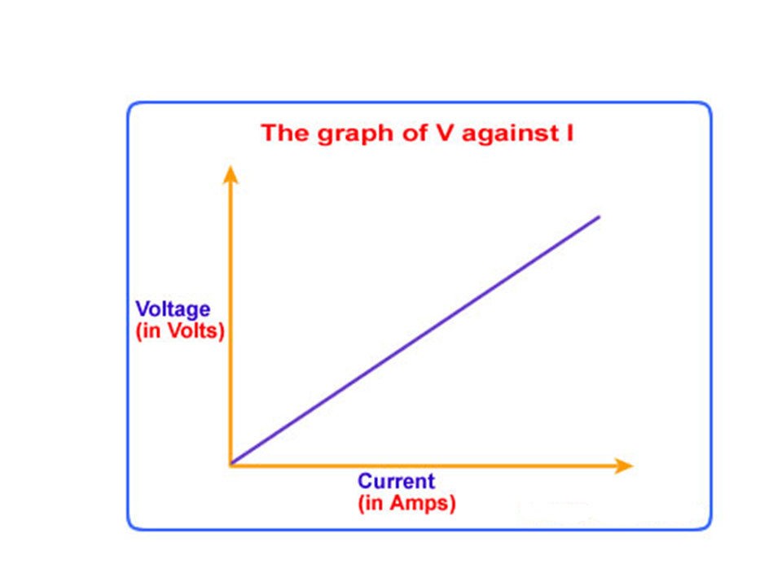
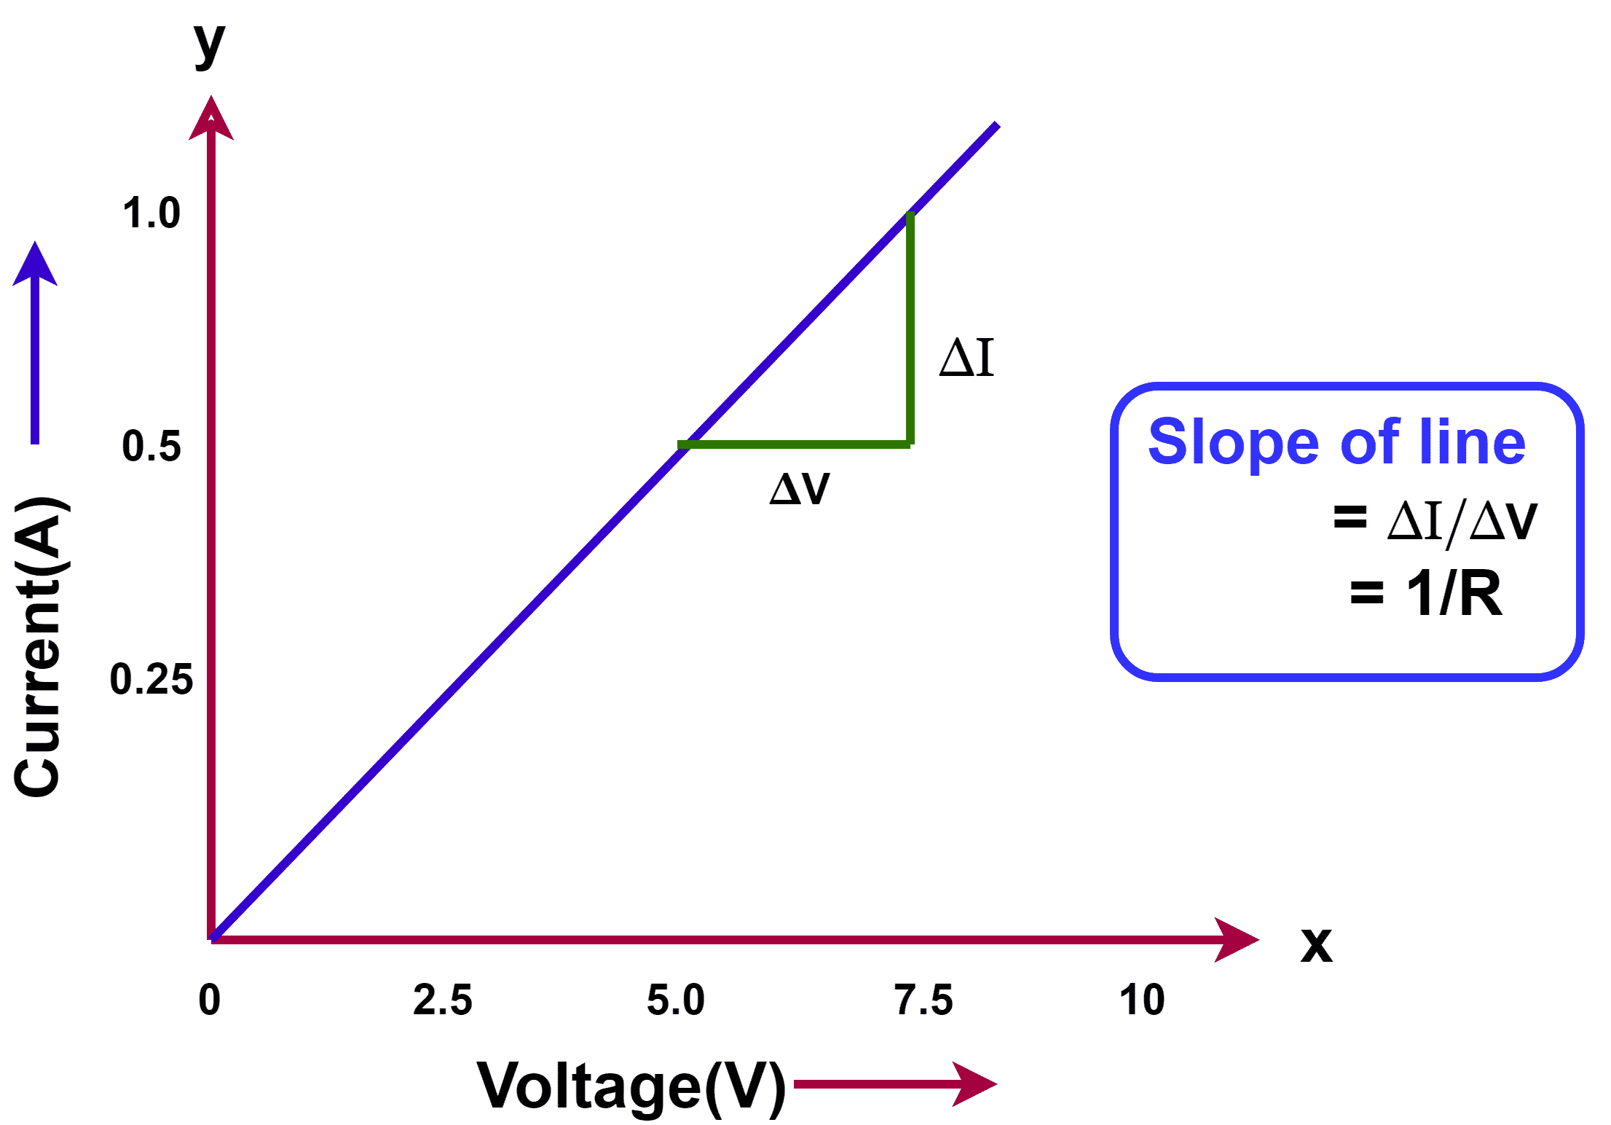
Graph(Ohm’s Law): Straight line passing through the origin

Slide 11
Resistance and cause of resistance:
The obstruction offered to the flow of current by the conductor.
The wire is not hollow but filled with atoms. The negatively charged electrons were obstructed by copper ions.
The material itself is offering resistance and the copper atoms present in the material is offering resistance to the flow of electrons and therefore we can conclude these copper atoms are the cause for the resistance and hence the velocity is slow. So, we are naming it as drift velocity.

Slide 12
Resistance by ohm’s law:
Resistance of a conductor is numerically equal to the potential difference across its ends divided by the current through conductor.
R = V / I
I = V /R
If you increase the voltage, the factor R's relationship with I is higher the R, smaller the current, and vice versa.

Slide 13
Conductance(G):
The reciprocal of resistance
symbol G
where G = 1 / R,
unit 1 / ꭥ = ꭥ-1 or mho, or Siemens(S)

Slide 14
Factors affecting the resistance of a conductor:
Nature of conductor :(like aluminum, iron, and copper)
Length of the conductor: Longer the wire, more copper atoms will be there to obstruct the flow of electrons. Therefore, it will offer more resistance. So, R is directly proportional to L.
Thickness of the wire: If area is more, there will be more space for the electrons to move. So, R is inversely proportional to 1 by a.
Temperature of the conductor:

Slide 15
Relationship with temperature and Resistance of a material:
Material Type | Temperature ↑ → Resistance | Proportionality
Metals (Conductors) | Increases | Direct
Semiconductors | Decreases | Inverse
Insulators | Usually constant/high | Not clearly defined

Slide 16
Mobility(μ):
Defined as the magnitude of drift velocity per unit electric field.
μ = | Vd |/ E
Vd = eEτ/m
μ = eτ/m
SI Unit: m²/ Vs

Slide 17
Limitations Of Ohm’s Law:

Slide 18
Effect of temperature on Resistance and Resistivity:
The difference between resistors and resistivity is that no dimensional factor l/A in resistivity formula.
R = ml / ne²τA
ρ = m / ne²τ
Mass of an electron have no connection with temperature as it is a constant.
Length of the wire ‘l’ will change on heating(raising the temperature). We can ignore that, since the change is very small.
n -> electron density will start to increase since more number of free electrons were getting energy. As temp. inc, n increases.

Slide 19
Effect of temperature on Resistance and Resistivity:
Charge of an electron remains constant.
τ, the average relaxation time will start to decrease, as increase in temperature provides more heat energy to the electrons and therefore more collisions(hits). Time for relaxation will get reduced.
There will be a small change in area of cross section A and it can be ignored.
Since we are ignoring the factors l and A, both R and ρ are same.

Slide 20
Effect of temperature in conductors:
For conductors, n is approximately equal to 10²⁸.
Temperature increase won't make much increase in electron density n. If you heat up the wire by some temperature, there is no significant increase in n.
Already there are so many electrons, 10²⁸ a huge value. If you increase the temperature, only few electrons will add up.
But τ is the dominating factor. Since there were more collisions and therefore a decrease in time for relaxation. As temperature increases, resistance, resistivity increases since τ decreases. As temperature increases, collision becomes more and n have no significance change, therefore ρ increases.

Slide 21
Effect of temperature in Semiconductors:
Semiconductors were neither good conductors nor insulators. Example: silicon, germanium.
As we heat up semiconductors, while we are increasing the temperature, typically l and A were ignored and n and τ are the critical factors.
As the temperature increases, huge increase in n, since semiconductors do not have huge number of electrons at room temperature. When we raise the temperature, there will be a huge increase in electrons and collisions will be more, so τ will get decreased.

Slide 22
Effect of temperature in Semiconductors:
ρ = m / ne²τ
As n increases, resistivity falls.
Hence, as temp. increases, ρ decreases.

Slide 23
Effect of temperature in Semiconductors:
Alloys are homogeneous mixture of metals like nichrome, constantan, and manganin. For certain alloys like nichrome, constantan and manganin, there for a small increase in temperature, there is hardly much change in ρ.

