Slide 1
Magnetism and Matter
An Introduction to Magnetic Phenomena
Drawing on Chapters 4 & 5 of Physics Text

Slide 2
Introduction to Magnetism
Magnetic phenomena are universal in nature.
Earth's magnetism predates humans.
"Magnet" comes from Magnesia, Greece (600 BC).
Early 19th-century discovery: Moving charges produce magnetic fields (Oersted, Ampere, Biot, Savart).

Slide 3
Common Ideas Regarding Magnetism
Earth behaves like a magnet.
Bar magnets align in north-south direction.
Like poles repel, unlike poles attract.

Slide 4
Non-Existence of Magnetic Monopoles
Isolated magnetic poles don't exist.
Breaking a magnet gives two smaller magnets.
Unlike electric charges, magnetic monopoles are not found.

Slide 5
Making Magnets & Chapter Overview
Iron and its alloys can become magnets.
Topics: Bar magnets, Gauss’s law of magnetism, types of magnetism (para-, dia-, ferro-).

Slide 6
The Bar Magnet & Magnetic Field Lines
Iron filings show field lines around magnets.
Similar pattern seen around current-carrying solenoids.
Magnetic field lines are intuitive tools.

Slide 7
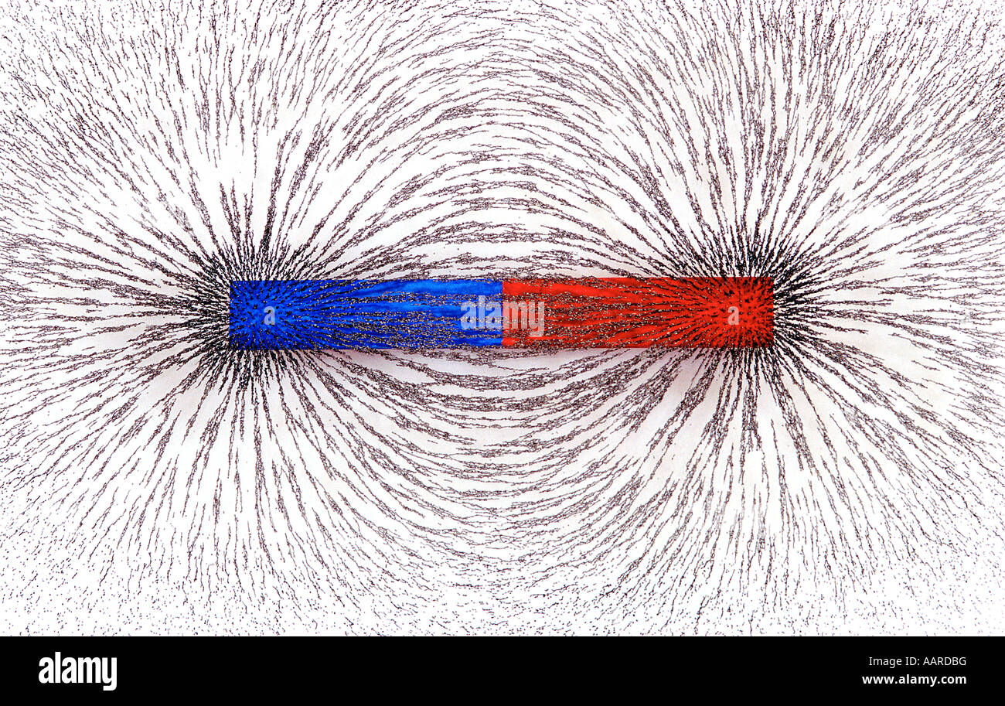

Slide 8
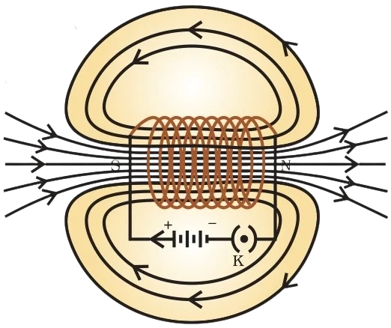

Slide 9
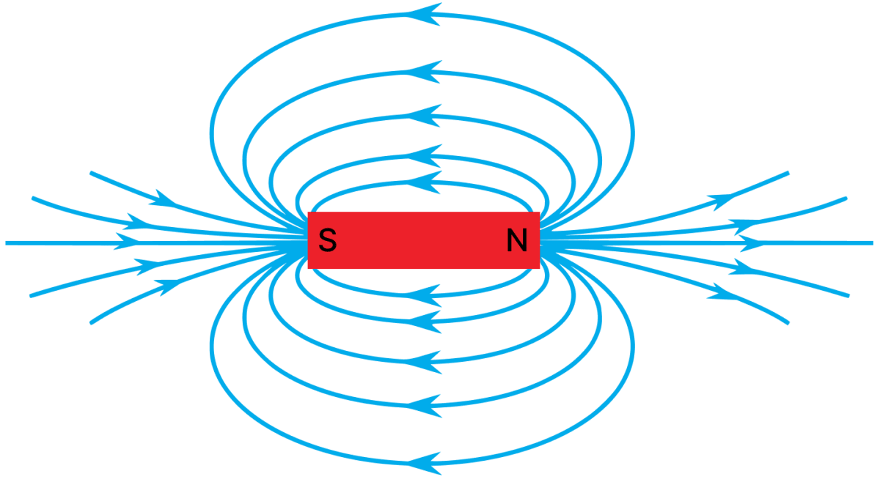

Slide 10
Properties of Magnetic Field Lines
Form continuous closed loops.
Direction: Tangent represents magnetic field direction.
Density: More lines = stronger field.
Do not intersect.

Slide 11
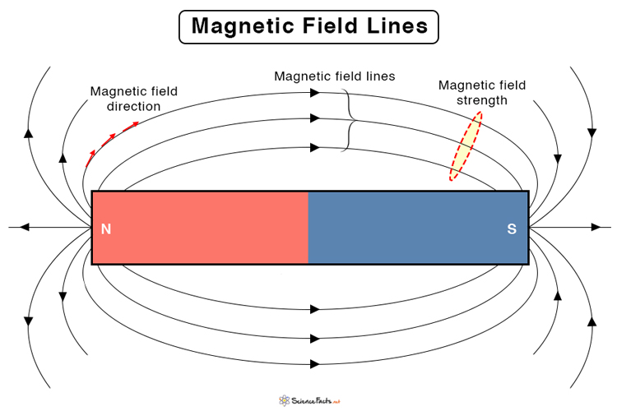

Slide 12
Do not intersect
Magnetic field lines are a visual representation of the direction and strength of a magnetic field. At any given point in space, the magnetic field can have only one direction. If two magnetic field lines were to cross, that would mean the field has two directions at the same point, which contradicts the definition of a vector field.

Slide 13
Bar Magnet as an Equivalent Solenoid
Ampere: All magnetic phenomena are due to circulating currents.
Bar magnet resembles solenoid.
Field: B = (μ₀/4π) * (2m/r³).
Magnetic moment equivalence with solenoid.

Slide 14
Dipole in a Uniform Magnetic Field
• Compass in field experiences torque: τ = m x B; magnitude = mB sinθ.
• Potential Energy: Um = –m.B
• Stable: m ∥ B
• Unstable: m anti-parallel to B
Studied already under the topic, torque on a rectangular current carrying coil

Slide 15
Example 5.1 Insights
Cutting a magnet yields two poles each.
Uniform fields: torque but no net force.
Non-uniform fields: force + torque.
Not all configurations need poles.

Slide 16
Identifying Magnetized Bars
• Repulsive force proves both are magnetized.
• Force at ends vs. middle helps identify which bar is magnetized.

Slide 17
Electrostatic Analogy
• E ↔ B; p ↔ m; 1/ε₀ ↔ μ₀
• Equatorial Field: –p/4πε₀r³, –μ₀m/4πr³
• Axial Field: 2p/4πε₀r³, μ₀2m/4πr³
• Torque: p x E ↔ m x B
• Energy: –p.E ↔ –m.B

Slide 18
Gauss's Law for Magnetism
• Electrostatics: Flux depends on net charge.
• Magnetic: Flux through closed surface = 0.
• Field lines form closed loops.
• Φ_B = ∫ B ⋅ dS = 0
• Implies no magnetic monopoles.

