Slide 1
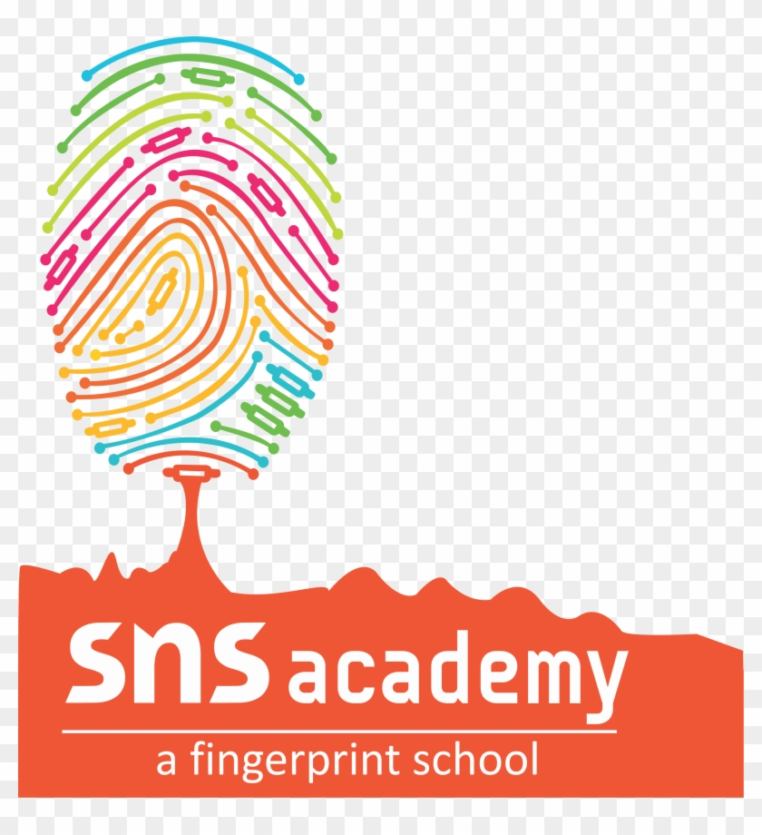

Understanding Computer Languages
How Do We Talk to Computers?

Slide 2
What are Computer Languages?
A computer needs very specific instructions to do a task or function.
Imagine trying to talk to someone who speaks a completely different language – it would be hard to communicate.
Computers don't understand human languages directly.
So, we use special languages called programming languages to tell computers what to do.
These are like a set of instructions.

Slide 3
Types of Computer Languages
Programming languages are grouped into five categories, or 'generations,' based on how they developed.
These are:
1. First Generation Language (Machine Language)
2. Second Generation Language (Assembly Language)
3. Third Generation Language (High-level Languages)
4. Fourth Generation Language (Very High-level Languages)
5. Fifth Generation Language (Advanced High-level Languages)

Slide 4
First Generation Language (1GL): Machine Language
This is also known as Low-level Language (LLL).
Machine language is the only language a computer understands directly.
Instructions in 1GL are made up of binary numbers, which are just combinations of 0s and 1s.
0 represents the OFF state.
1 represents the ON state.
Advantages: Machine code runs very fast and efficiently.
Disadvantages: It's very difficult to write and find errors in programs written in machine language. It's also machine-dependent.

Slide 5
Second Generation Language (2GL): Assembly Language
This language is also considered a Low-level Language.
Instead of binary digits (0s and 1s), Assembly Language uses mnemonic codes.
Mnemonic codes are like abbreviations that help us remember original words or concepts.
ADD for Addition
MUL for Multiplication
SUB for Subtraction
DIV for Division
Advantages: It's easier for humans to understand than machine language.
Disadvantages: It's still machine-dependent. You need a special program called an Assembler to convert it into machine language.

Slide 6
Third Generation Language (3GL): High-level Languages (HLL)
These languages are designed to be more like human languages (English) and use mathematical symbols.
This means they are easier for us to understand and write.
Examples: FORTRAN, COBOL, BASIC, Pascal, C, C++, Java.
Advantages: These languages are machine-independent, meaning programs can run on different computers.
Disadvantages: Computers don't understand these languages directly. They need a translator to convert them into machine language.

Slide 7
Fourth Generation Language (4GL): Very High-level Languages
These languages are even closer to human language and are designed for faster development.
They are 'programmer-friendly' and very versatile.
4GLs help improve programming efficiency by using English-like words and phrases.
They also reduce the overall time, effort, and cost involved in program development.
Examples: SQL, Focus, Postscript, WAVE, Python, Ruby, Perl.

Slide 8
Fifth Generation Language (5GL): Advanced High-level Languages
These languages are primarily used in Artificial Intelligence (AI) research.
The goal is to allow computers to solve problems without explicit programming steps.
They focus on letting the computer specify the problem and find the solution itself.
The ultimate aim is for computers to behave, think, and react like humans.
Examples: Prolog, OPSS, Mercury.

Slide 9
What are Translators?
Since computers only understand machine language, other languages need special programs to convert them. These are called translators.
There are three main types of translators:
1. Assembler: Converts Assembly Language programs into machine language.
2. Compiler: Converts an entire high-level language program into machine language at once.
3. Interpreter: Converts a high-level language program line-by-line and executes each line immediately.

Slide 10
Recap!
Computers understand instructions through programming languages.
There are five generations of computer languages, from low-level to high-level.
Machine language (1GL) is the computer's native language (0s and 1s).
Assembly language (2GL) uses mnemonic codes (like ADD, SUB).
High-level languages (3GL, 4GL, 5GL) are closer to human language.
Translators (Assemblers, Compilers, Interpreters) convert programs into machine language so computers can understand them.

