Slide 1




"A Hero" by R.K. Narayan: A Grade 7 Lesson
This lesson explores R.K. Narayan's short story, "A Hero." We will analyze themes of courage, fear, and perception. Get ready to delve into a classic tale from Malgudi.
by Praveena Ramesh

Slide 2

R.K. Narayan: Author and Context
Born in Madras, India (1906-2001); wrote in English.
Known for fictional South Indian town, Malgudi.
Themes: ordinary people, Indian middle class life, humor, simplicity.
Awards: Sahitya Akademi Award, Padma Vibhushan.

Slide 3

"A Hero": Story Overview
Swami's Challenge
Unexpected Encounter
A young boy named Swami is forced to sleep alone by his father.
He confronts a burglar in the dark and becomes a local hero.
Core Themes
Part of "Malgudi Days"
Explores courage, fear, and societal expectations.
Published in a collection of short stories.

Slide 4
Before the Incident: Fear and Forced Bravery
Comfort in Granny's Presence
Father's Challenge
Swami's Deep-Seated Fear
Swami habitually sleeps next to his granny, relying on her.
His father challenges his courage, insisting he sleep alone.
He fears darkness, strange sounds, and loneliness.
He feels safe and protected by her closeness.
An argument ensues, and Swami reluctantly agrees to the office.
The thought of sleeping alone fills him with dread.

Slide 5
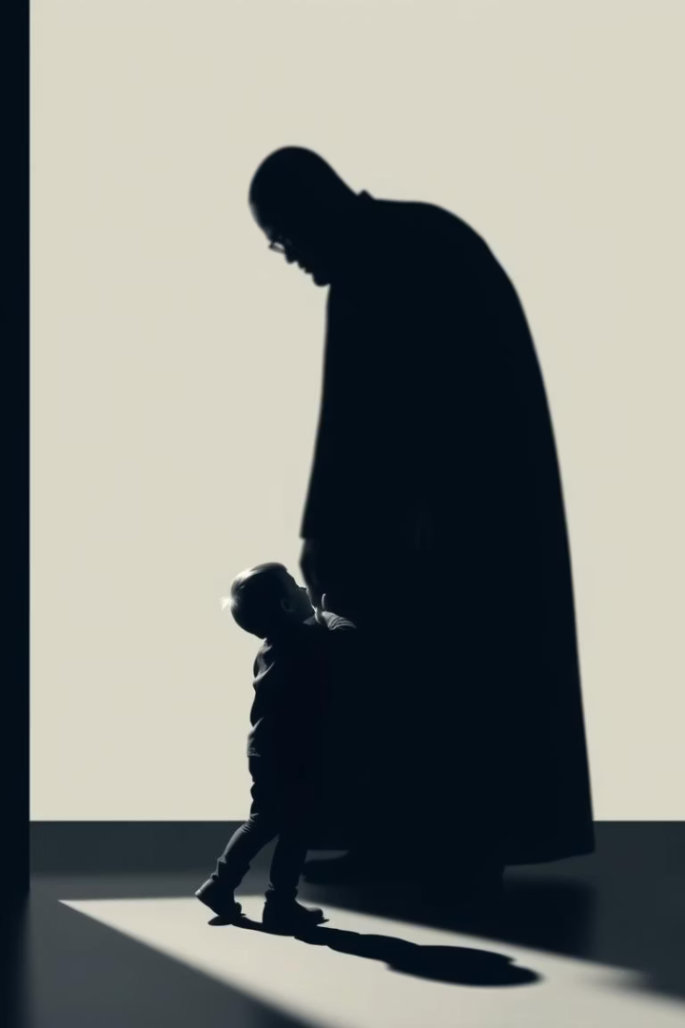




The Incident: Confrontation in the Dark
Disturbed Sleep
Swami drifts into sleep, then awakens by unsettling sounds.
Burglar's Entry
A shadowy figure, a burglar, quietly enters the room.
Instinctive Action
In sheer terror, Swami instinctively bites the burglar's leg.
Capture
The burglar cries out; servants quickly rush in and capture him.

Slide 6

The Aftermath: Acclaim and Reality
Overnight Hero
Swami receives widespread praise as a local hero.
Public Recognition
Police commend him, and his story appears in newspapers.
Father's Pride
His father proudly showcases Swami's "courageous" act.
Internal Truth
Swami privately knows he acted from fear, not bravery.

Slide 7





Exploring Heroism
What is a Hero?
Swami's Actions
Societal Perception
Is it intentional action or an accidental outcome?
Were they fear-driven or truly courageous?
Heroic acts versus genuine bravery.
Anyone a Hero?
Can ordinary people rise to heroism?

Slide 8

Themes: Courage and Fear
Courage Defined
It's not absence of fear, but triumph over it.
Fear's Influence
Fear can drive unexpected, powerful actions.
Societal Pressures
Society shapes how we understand and value courage.
Internal vs. External
Distinguish between inner bravery and outward acts.

Slide 9




Themes: Perception vs. Reality
Surface vs. Truth
1
How society views events differs from what happened.
Swami's Conflict
2
He is a public hero but a fearful boy inside.
Narayan's Message
3
Question surface appearances and dig deeper.
Role of Irony
4
Irony highlights the gap between perception and reality.

Slide 10

Discussion and Analysis
1
Swami's Character
Analyze his development throughout the story.
2
Family Expectations
Discuss their role in shaping Swami's actions.
3
Personal Connection
Relate the story to your own experiences.
4
Story's Lesson
What does "A Hero" teach us about ourselves?

