Slide 1
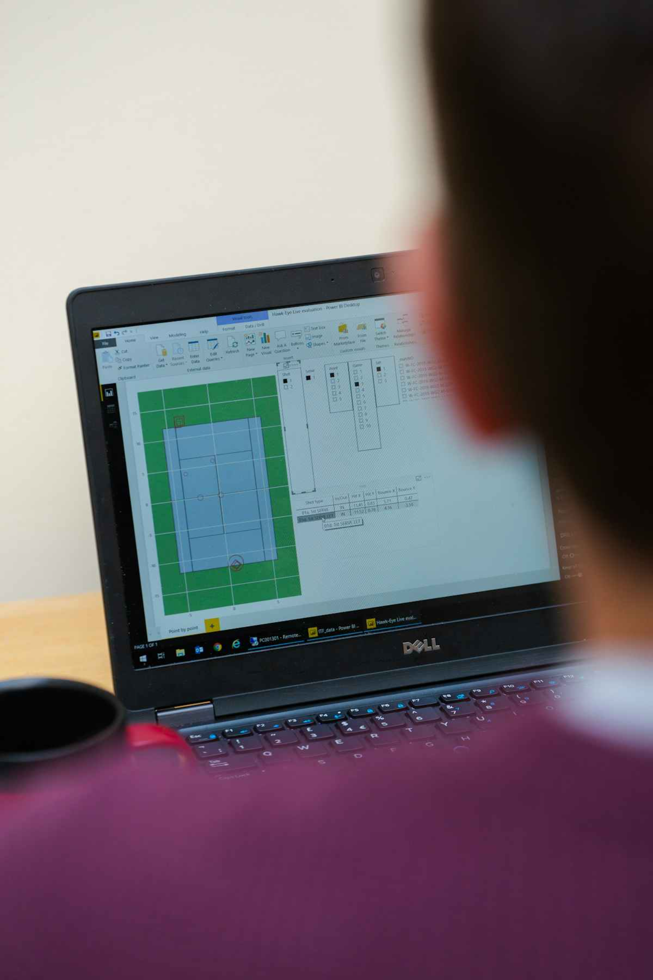
Data Handling for Grade 7 Maths
Data handling is about understanding, organizing, and interpreting information. It helps us make sense of the world around us, from tracking daily temperatures to monitoring student attendance.

Slide 2
What is Data?
Definition
Numerical Data
Categorical Data
Facts, figures, or information collected for analysis.
Measured or counted quantities, such as students' heights or test scores. For example, collecting the "number of siblings" for 25 students.
Groups or labels, like favorite colors or types of pets. This helps us classify information.

Slide 3
Collecting Data
Surveys
Primary Data
Asking questions, like "What's your favorite subject?", to gather opinions and preferences directly.
Collected firsthand for a specific purpose, like conducting a class poll on lunch choices.
Secondary Data
Observations
Data collected by others, found in reports, books, or online, like population statistics from a government website.
Watching and recording events or behaviors, such as counting cars passing by a school.

Slide 4
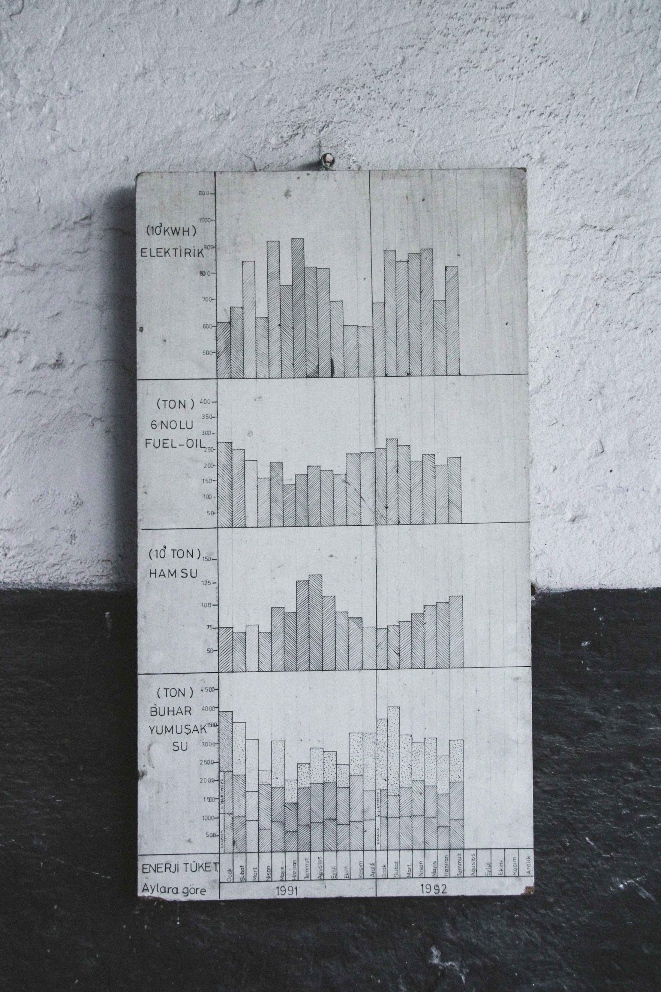
Organizing Data
Organizing raw data makes it easier to read, interpret, and analyze. It's the crucial step before representing data visually.
Tally Charts
Use tally marks (|||| |) to count frequencies for each category or value. Each fifth mark crosses the previous four for easy counting.
Frequency Tables
List categories or values alongside their corresponding counts or frequencies. For example, organizing 30 student responses on "Favorite Fruit" into a concise table.

Slide 5
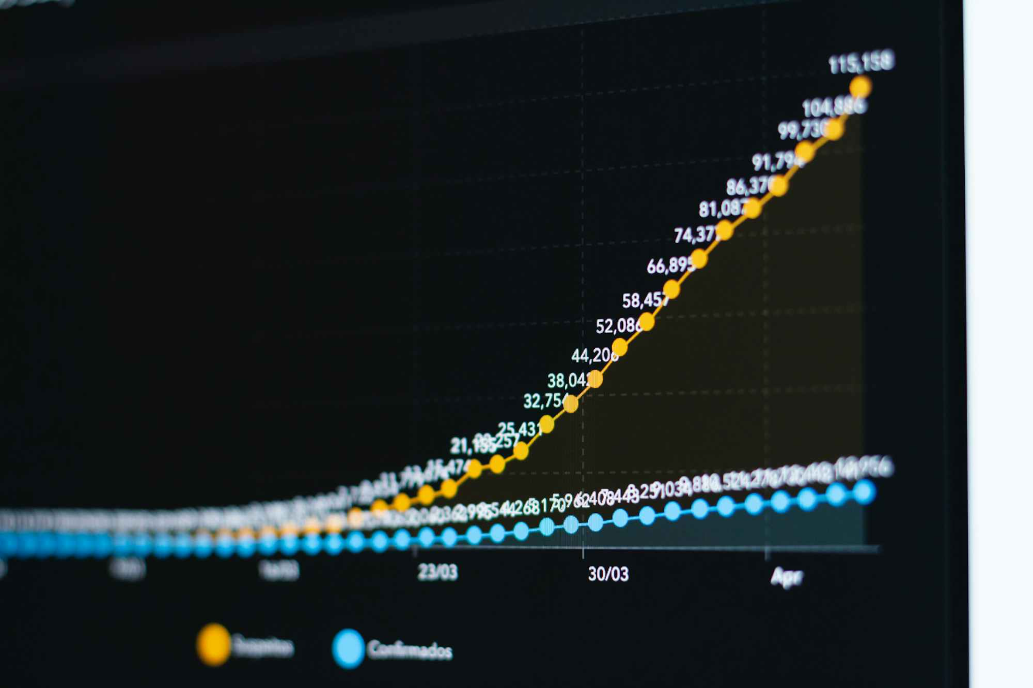

Representing Data - Part 1
Bar Graphs & Pictographs
Bar Graphs
Pictographs
Use rectangular bars to compare different categories or values. Essential elements include a clear title, labeled axes (x and y), and a consistent scale.
Represent data using symbols or pictures, where each symbol stands for a certain quantity. Always include a key to explain what each picture represents.

Slide 6
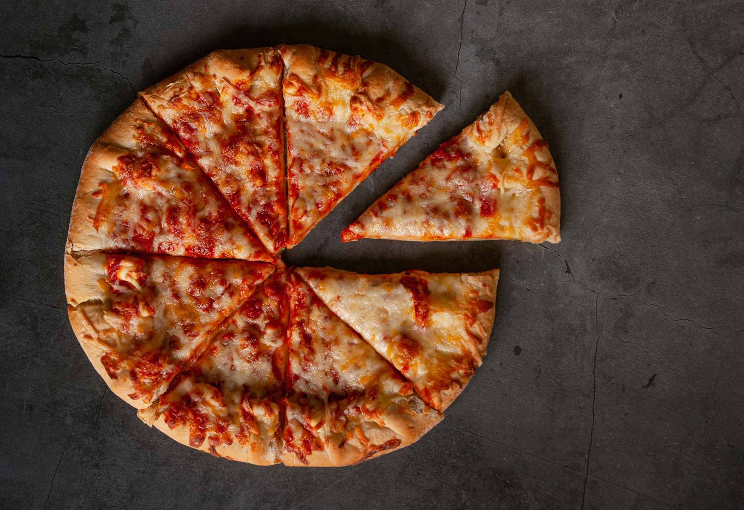
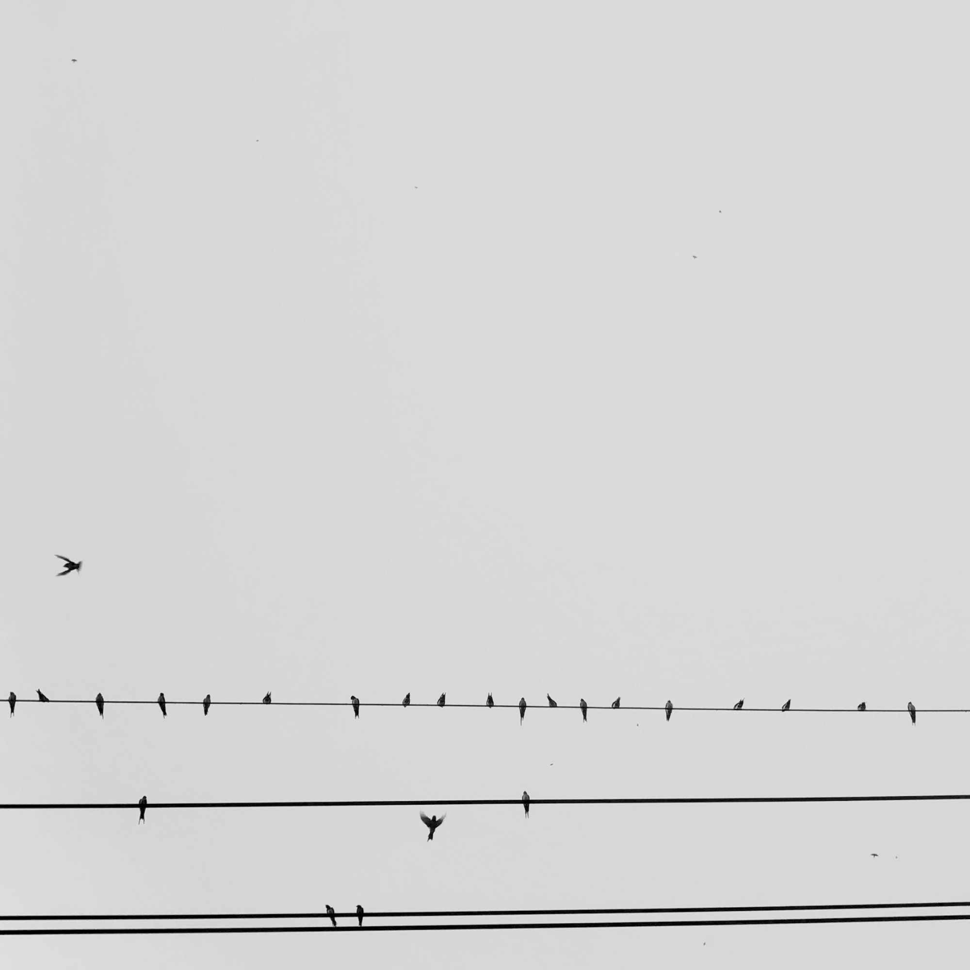
Representing Data - Part 2
Line Plots & Circle Graphs
Line Plots
Circle Graphs (Pie Charts)
Show the frequency of data along a number line, using "X" marks to represent each data point. Ideal for showing the distribution of small datasets. For example, a line plot of scores on a 10-point quiz for 20 students.
Illustrate parts of a whole as percentages or fractions, showing the proportion of each category. For instance, a pie chart representing budget allocation for a school trip (e.g., 40% transport, 30% food).

Slide 7
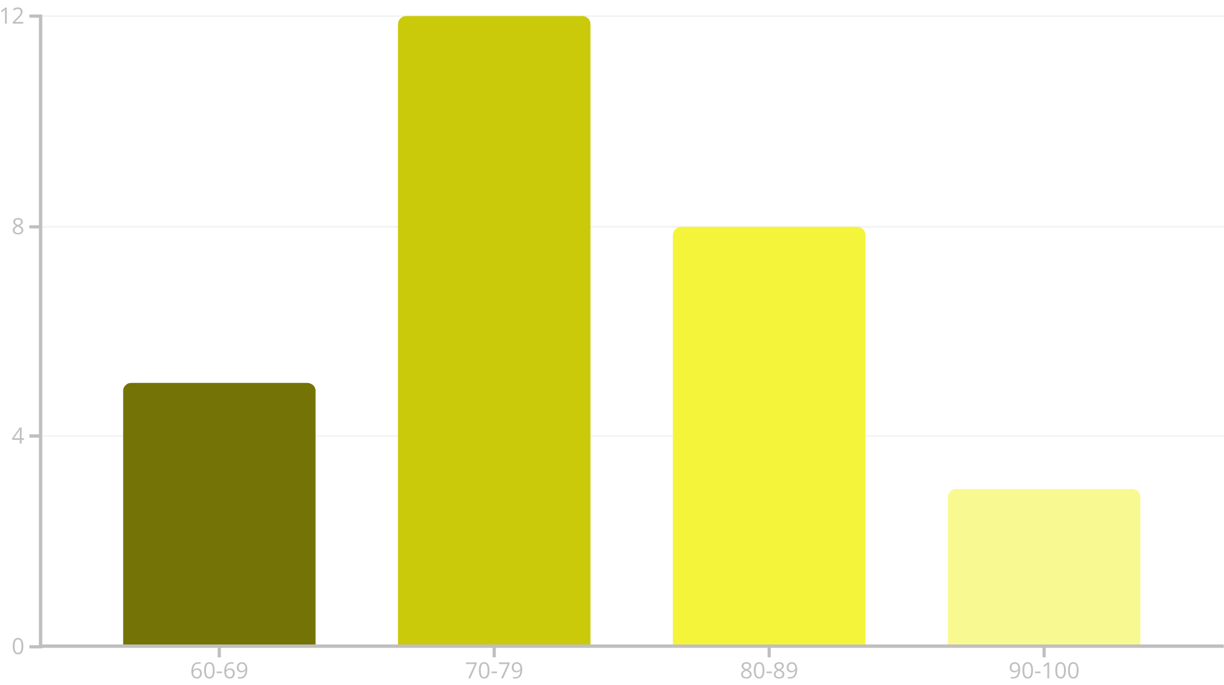
Representing Data - Part 3
Histograms
Histograms are powerful tools for visualizing the distribution of continuous numerical data. Unlike bar graphs, their bars touch, indicating continuous intervals.
Each bar in a histogram represents a range or interval of numbers (e.g., 0-9, 10-19). This allows us to see patterns and frequencies within data bins. For example, a histogram showing the distribution of student test scores.

Slide 8
Analyzing Data - Measures of Central Tendency
1
2
3
Mean (Average)
Median
Mode
The sum of all values divided by the number of values in the dataset.
The middle value when the data is ordered from least to greatest. If there's an even number of values, it's the average of the two middle numbers.
The value that appears most frequently in a dataset.
Example: For {2, 3, 5, 5, 8}, Mode = 5
Example: For {2, 3, 5, 5, 8}, Mean = (2+3+5+5+8)/5 = 4.6
Example: For {2, 3, 5, 5, 8}, Median = 5

Slide 9
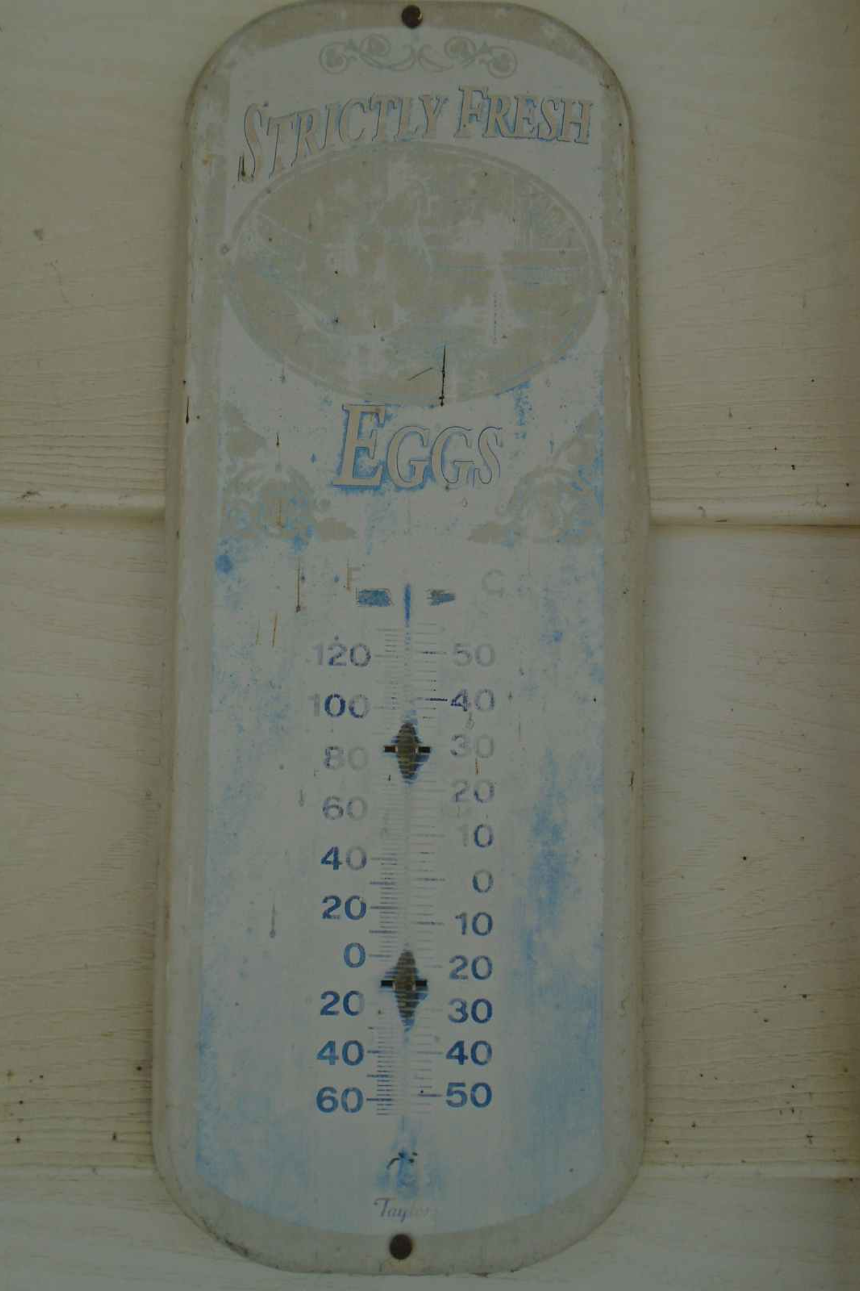

Analyzing Data - Measures of Spread
Range
Example:
The simplest measure of spread, calculated as the difference between the highest and lowest values in a dataset.
Consider daily temperatures in a week: {15°F, 20°F, 22°F, 25°F, 30°F}.
It provides a quick indication of how spread out or varied the data is. A larger range suggests greater variability within the dataset.
Highest Value: 30°F Lowest Value: 15°F
Range = 30°F - 15°F = 15°F

Slide 10





Conclusion: Why Data Handling Matters
Recap
Importance
We've learned to collect, organize, represent, and analyze data effectively.
Data helps us understand trends, make informed decisions, and solve real-world problems.
Applications
Challenge
From sports statistics to weather forecasts, data handling is everywhere.
Look for data in your daily life and try to interpret it!

