Slide 1

Simple Equations: Unlocking the Power of Algebra!
Welcome to Grade 7 Maths! Prepare to dive into the exciting world of equations, fundamental tools for problem-solving in mathematics and beyond. Today, our focus will be on understanding and solving one-variable linear equations.

Slide 2




What is an Equation?
Definition
The Equals Sign
An equation is a mathematical statement that shows two expressions are equal in value.
Every equation always contains an "equals" sign (=), indicating balance between both sides.
Example 1
Example 2
5 + 3 = 8. Both sides of the equation simplify to the same value, 8, confirming their equality.
x + 7 = 10. This equation includes an unknown value, 'x', which we need to determine.

Slide 3
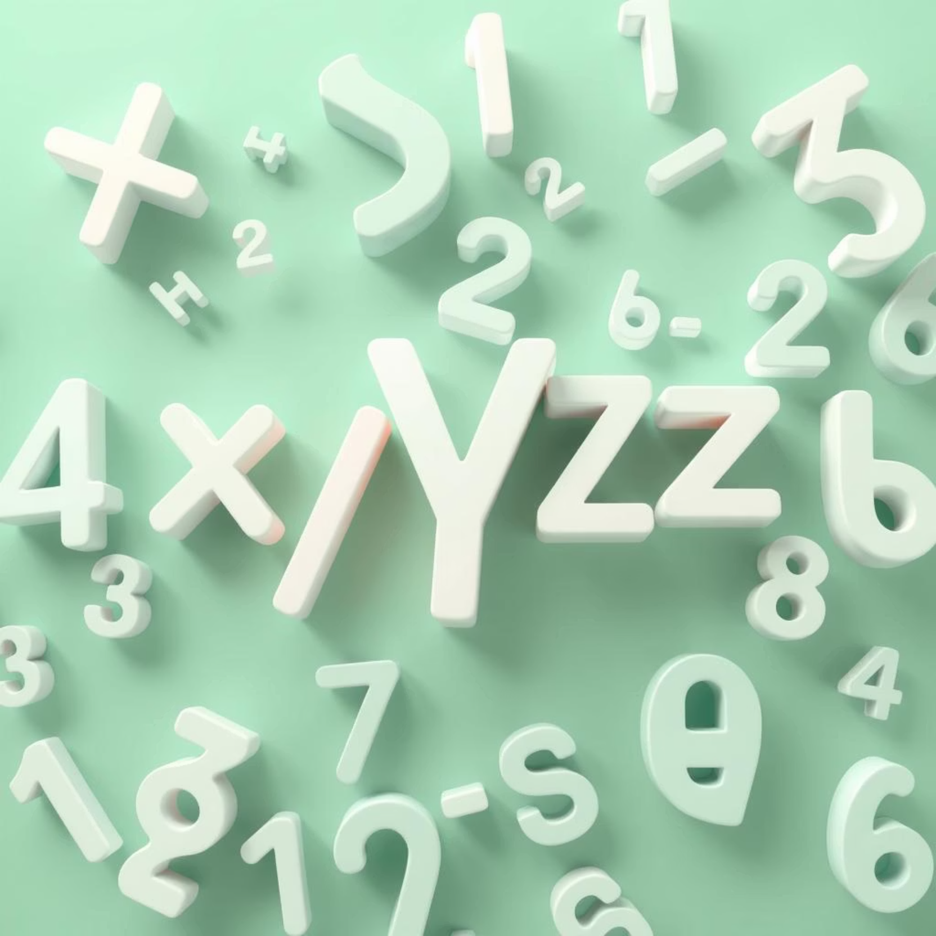
Meet the Variables!
Definition: A variable is typically a letter (like x, y, a, b) that represents an unknown numerical value in an equation.
Purpose: Variables are used when we don't know the exact quantity or value, making the equation a puzzle to solve.
Goal: The primary goal when solving an equation is to find the specific value of the variable that makes the equation true and balanced.
In Action: In the equation "x + 7 = 10", 'x' is our variable, waiting for us to uncover its true value.

Slide 4




The Balancing Act: Keeping Equations Equal
Maintain Equality
1
Whatever operation you perform on one side, you must replicate on the other.
Balance Scale
2
Visualize an equation as a balance scale; both sides must always weigh equally.
True Equations
3
This fundamental rule ensures the equation remains balanced and true throughout the solving process.
Crucial Rule
4
Mastering this principle is crucial for solving equations accurately and confidently.

Slide 5



Solving Equations: Addition & Subtraction
Inverse Operations
Undoing Addition
Undoing Subtraction
To isolate the variable, we use inverse (opposite) operations.
If a number is added (+), subtract the same number from both sides.
If a number is subtracted (-), add the same number to both sides.
Example: x + 5 = 12(Subtract 5 from both sides); x = 7
Example: y - 3 = 9(Add 3 to both sides); y = 12

Slide 6

Solving Equations: Multiplication & Division
Just like with addition and subtraction, we apply inverse operations to tackle multiplication and division in equations. This strategy helps us efficiently isolate the variable and find its value.
Practice Examples
Multiplication:3x = 15Divide by 3 on both sides:x = 5
Undoing Multiplication: To reverse a multiplication (*), divide both sides of the equation by the same number. This cancels out the multiplication, leaving the variable alone.
Division:y / 4 = 2Multiply by 4 on both sides:y = 8
Undoing Division: To counteract a division (/), multiply both sides of the equation by the same number. This effectively removes the division, revealing the variable's value.

Slide 7
Tackling Two-Step Equations
Two-step equations involve two different operations, such as multiplication and addition. You'll need to apply two inverse operations to solve them.
Practice Problem
Step 2: Undo Multiplication/Division
Equation: 5y - 7 = 18
Step 1: Undo Addition/Subtraction
Solution: (Add 7 to both sides, then divide by 5); y = 5
Next, undo any multiplication or division to isolate the variable completely.
Always start by undoing any addition or subtraction. This is the opposite order of operations (PEMDAS/BODMAS) when solving.
Example: 2x = 8 (Divide both sides by 2)Solution: x = 4
Example: 2x + 3 = 11 (Subtract 3 from both sides)

Slide 8

Equations in the Real World
Equations aren't just for textbooks; they help us solve everyday puzzles. Learning to translate word problems into mathematical equations is a valuable skill.
Scenario 1: Pencil CostYou bought 3 pencils and a $2 eraser for a total of $8. To find the cost of each pencil, the equation is: 3p + 2 = 8
Scenario 2: Remaining CookiesAfter eating 5 cookies, you have 7 left. How many cookies did you start with? The equation is: c - 5 = 7

Slide 9
Always Check Your Work!
Checking your solution is a crucial step that ensures accuracy and builds confidence in your math skills. It's like double-checking your answers on a test!
Substitute Your Answer
Verify Equality
Example Walkthrough
After solving an equation, take the value you found for the variable and substitute it back into the original equation.
Calculate both sides of the equation. If the values on both sides are equal, then your solution is correct!
Equation: 2x + 3 = 11
Your Solution: x = 4
Check: 2(4) + 3 = 8 + 3 = 11
Result: Since 11 = 11, your solution is correct!

Slide 10
Conclusion: Your Equation Toolkit
You've now equipped yourself with the fundamental tools for solving simple equations! Remember these key takeaways:
Equations Defined: They help us find unknown values by establishing balanced mathematical statements.
Key Concepts: Always recall the role of variables, the power of inverse operations, and the critical balancing rule.
Practice Makes Perfect: Regularly practice solving both one-step and two-step problems to solidify your understanding.
Next steps in your algebra journey will include exploring more complex equations, understanding inequalities, and even graphing equations!

