Slide 1

Visualizing Solids: Understanding 3D Shapes in Math
Welcome to our journey into the fascinating world of three-dimensional objects. We'll explore how to recognize, describe, and represent solids, building crucial spatial reasoning skills along the way.

Slide 2

What Are Solids? Beyond Flat Shapes
Solids are three-dimensional objects possessing length, width, and height. Unlike flat 2D shapes such as squares or circles, solids occupy space.
Think of real-world examples: A book, a dice, a soda can, or even an ice cream cone. These all have volume, which is the amount of space an object takes up.

Slide 3



Anatomy of a Solid: Faces, Edges, Vertices
Faces
Edges
Vertices
Flat surfaces that make up the exterior of a solid. A standard cube has 6 faces.
Line segments where two faces meet. A cube features 12 distinct edges.
The points where multiple edges converge, also known as corners. A cube typically has 8 vertices.
Remember Euler's Formula for Polyhedra: V - E + F = 2 (Vertices - Edges + Faces = 2).

Slide 4
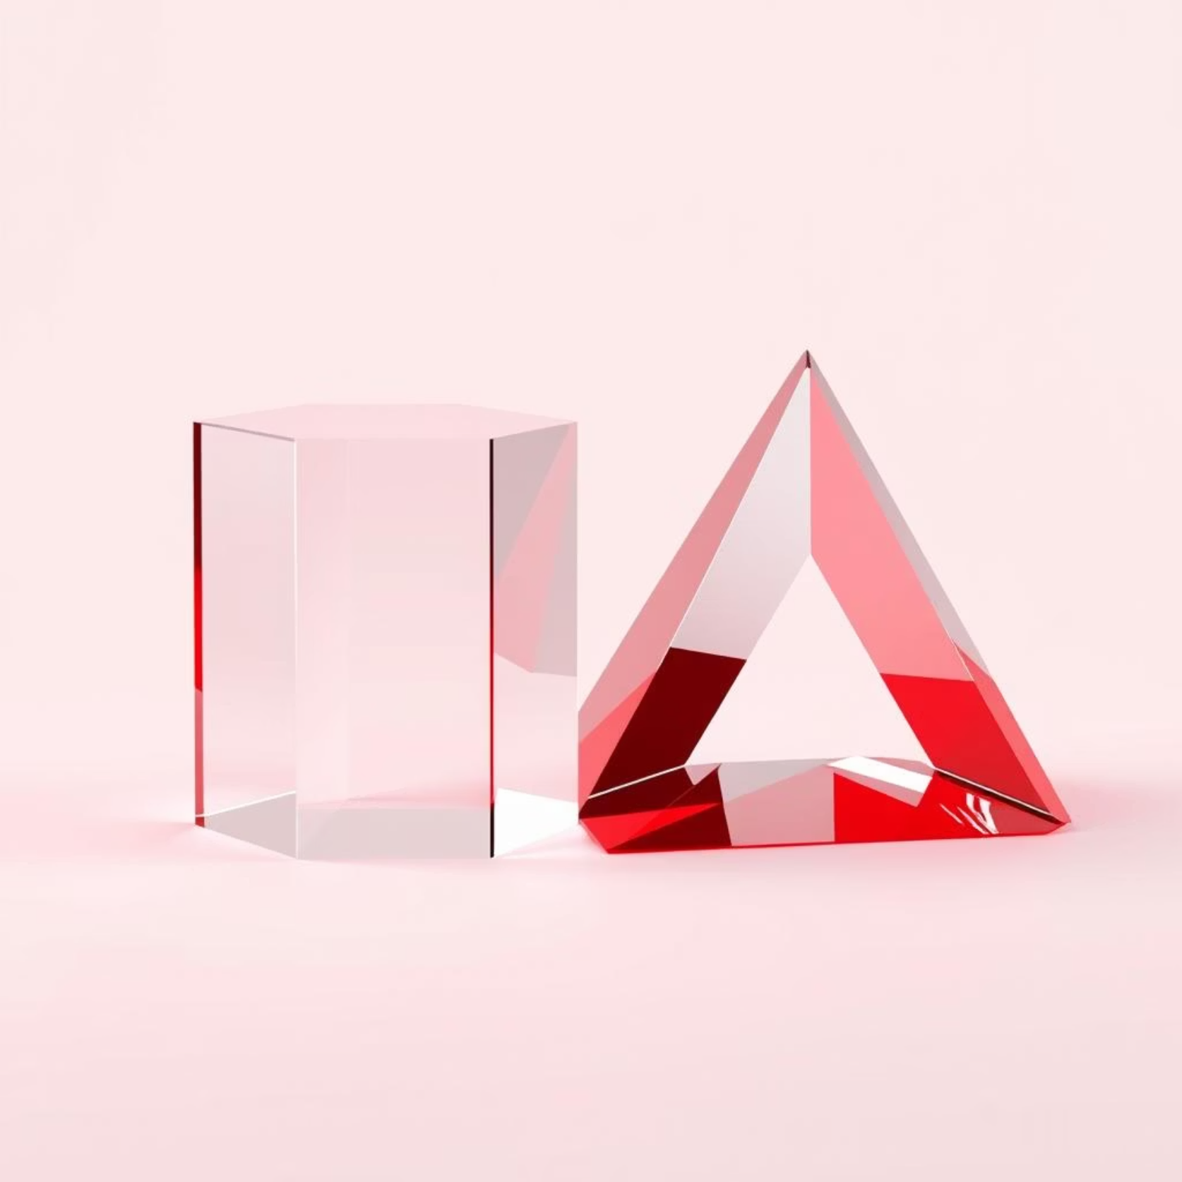
Common Solids: Prisms
What is a Prism?
A prism is a solid characterized by two identical, parallel bases connected by rectangular faces. They are named according to the shape of their bases.
Examples:
Rectangular Prism: Like a brick or a cereal box, it has 6 faces, 12 edges, and 8 vertices.
Triangular Prism: Resembling a Toblerone bar, it has 5 faces, 9 edges, and 6 vertices.
Cylinders are considered a special type of prism with circular bases.

Slide 5
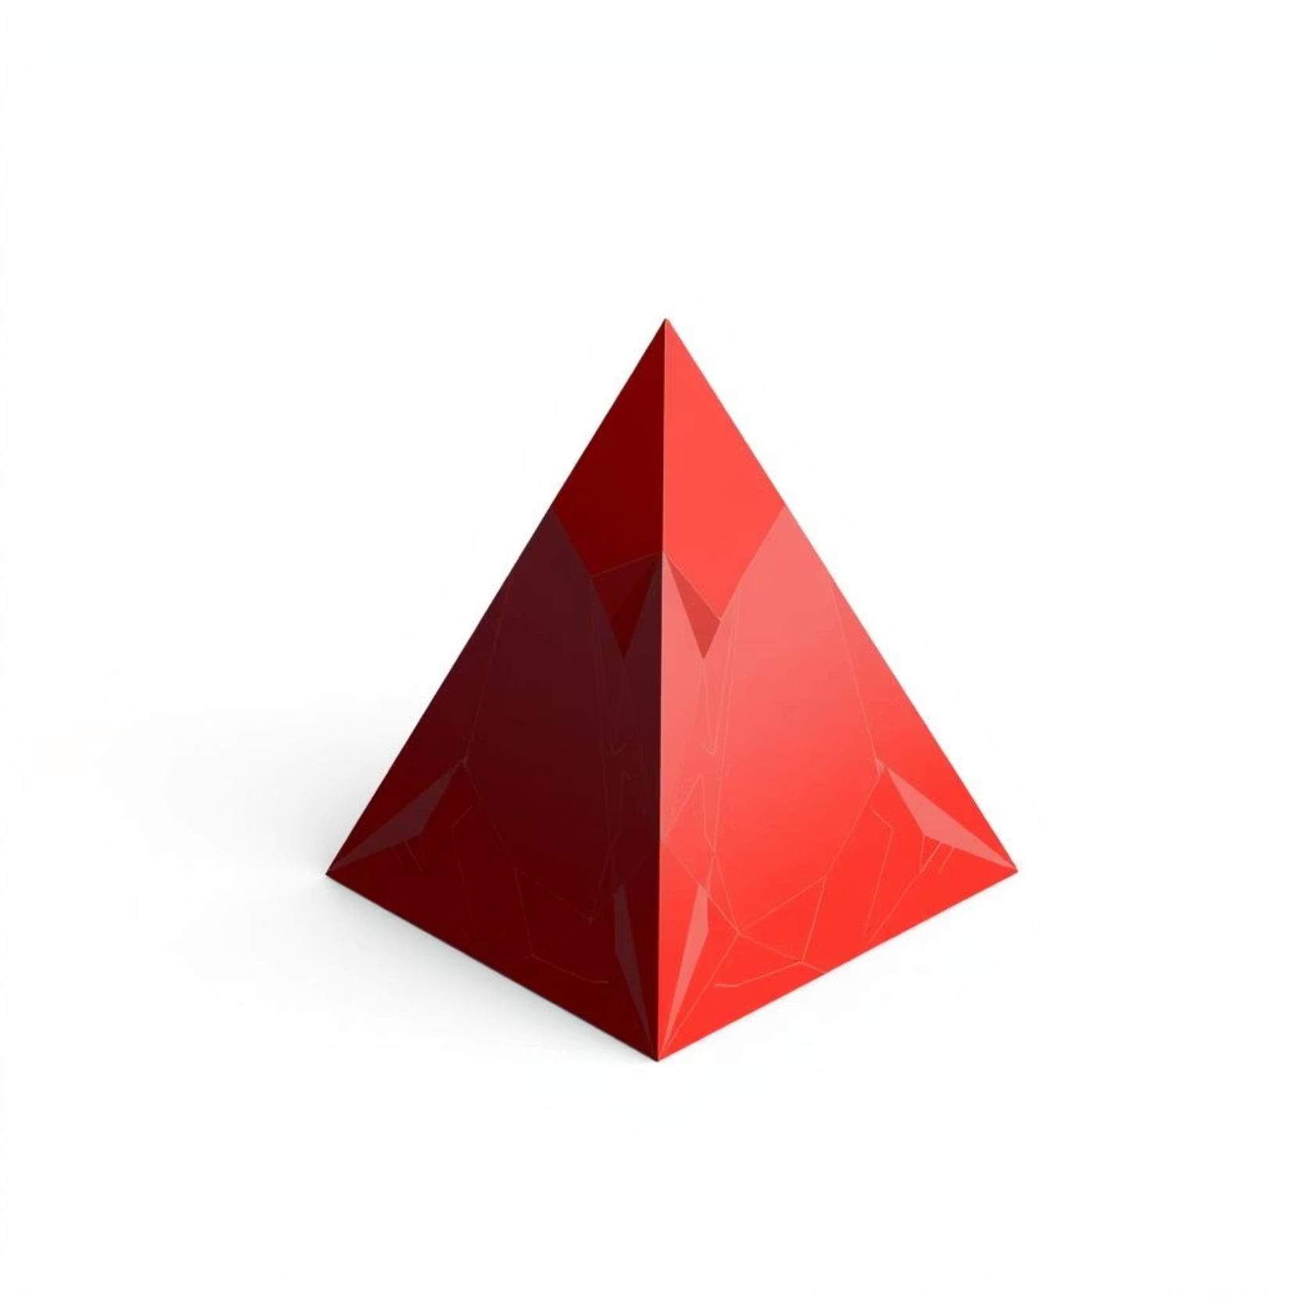
Common Solids: Pyramids
What is a Pyramid?
A pyramid consists of a base and triangular faces that all converge at a single point called the apex. Like prisms, they are named based on the shape of their base.
Examples:
Square Pyramid: Think of the ancient Egyptian pyramids, with 5 faces, 8 edges, and 5 vertices.
Triangular Pyramid (Tetrahedron): This solid has 4 faces, 6 edges, and 4 vertices.
Cones are a special form of pyramid with a circular base.

Slide 6



Other Important Solids
Sphere
Cylinder
Cone
A perfectly round 3D object where all points on its surface are equidistant from its center. Examples include a basketball or a globe. Spheres have no faces, edges, or vertices.
Defined by two parallel circular bases connected by a curved surface. Common examples are a soup can or a battery.
Features a circular base and a curved surface that tapers to a single vertex (apex). Think of an ice cream cone or a party hat.

Slide 7
Visualizing Solids: Different Views
Orthographic projections allow us to draw 3D objects from various perspectives, helping us understand their full form.
Top View
Front View
Side View
What you would see if you looked straight down from above the object.
The appearance of the object when viewed directly from the front.
How the object appears when viewed directly from either its left or right side.
For example, a simple house might appear as a rectangle from the top, a square from the front, and a triangle from the side.

Slide 8
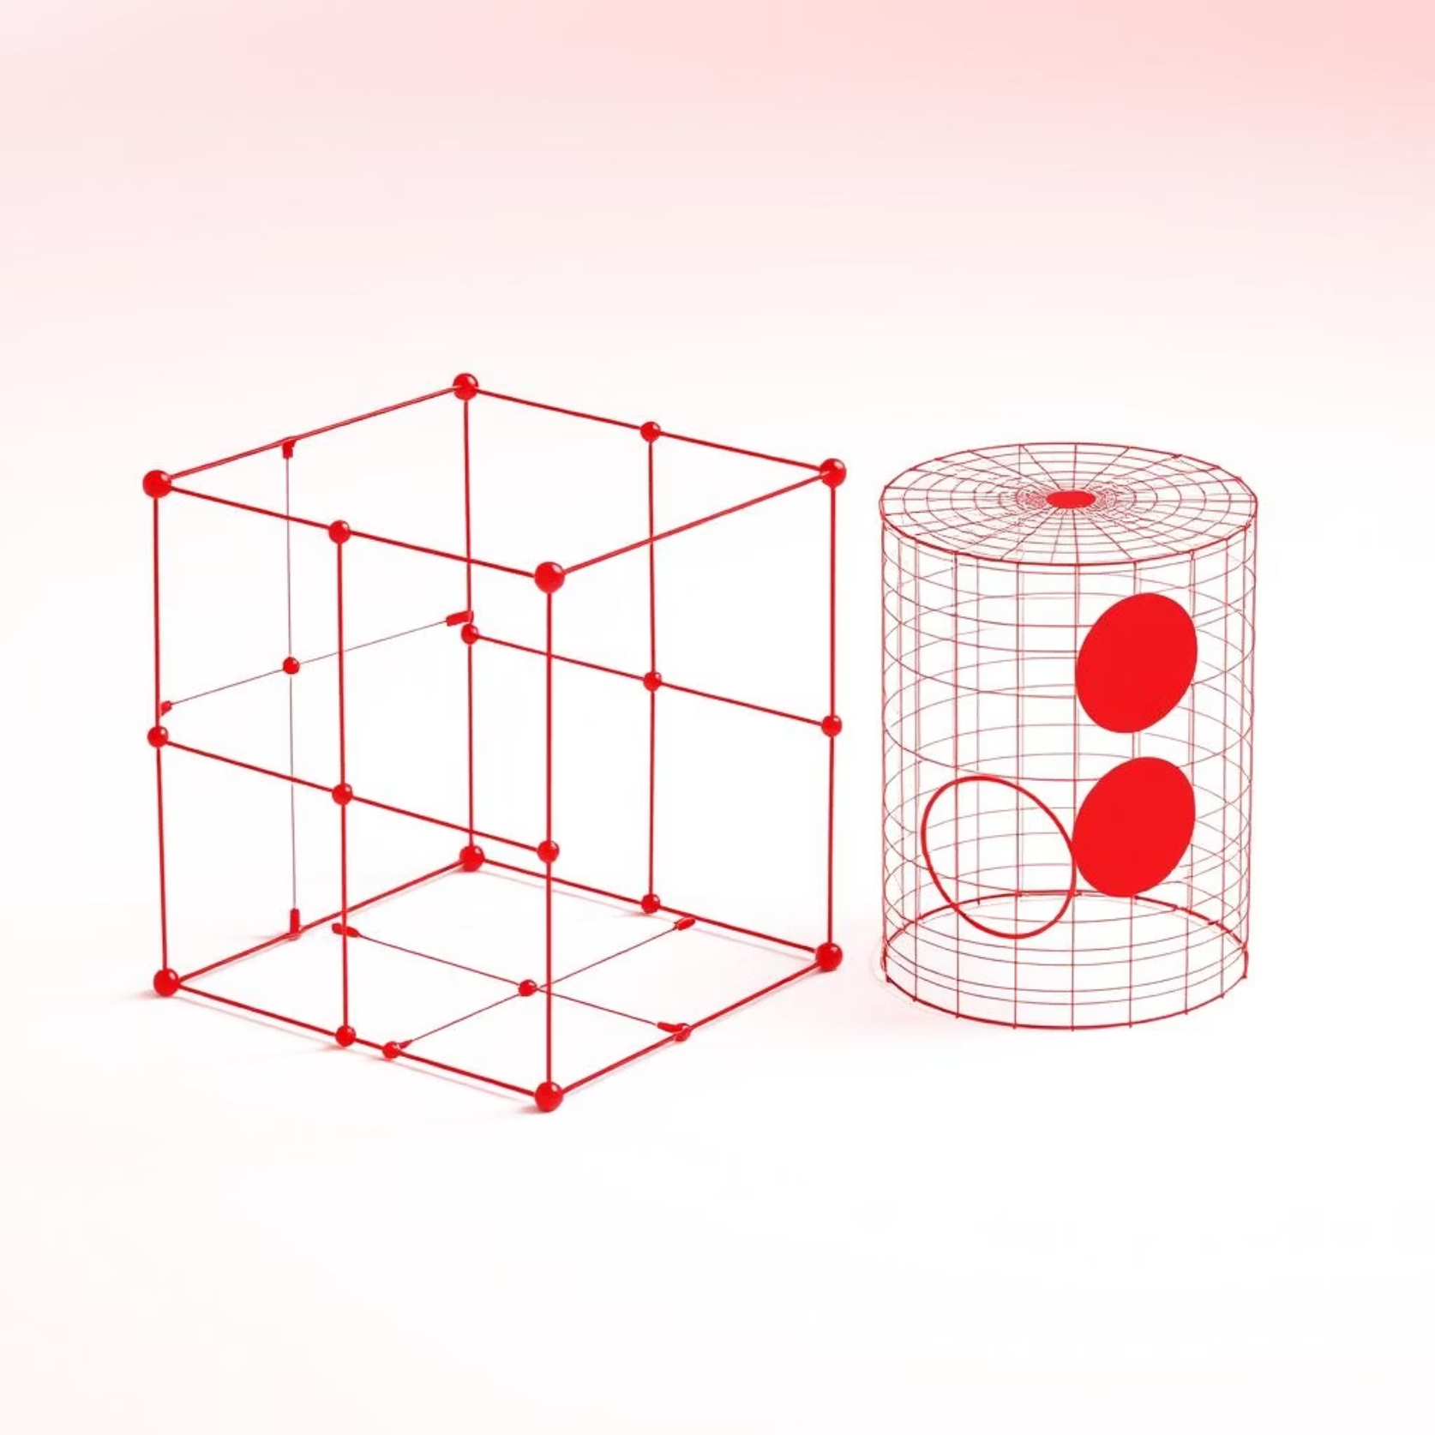
Nets of Solids: Unfolding 3D Shapes
A net is a 2D pattern that can be folded along its edges to construct a 3D solid. Understanding nets is essential for calculating the surface area of a solid.
A cube's net is composed of 6 squares, often arranged in a 'T' or cross shape.
A cylinder's net typically consists of two circles (the bases) and one rectangle (the curved surface).
Nets provide a clear visualization of all the faces of a solid and how they connect to form the 3D shape.

Slide 9
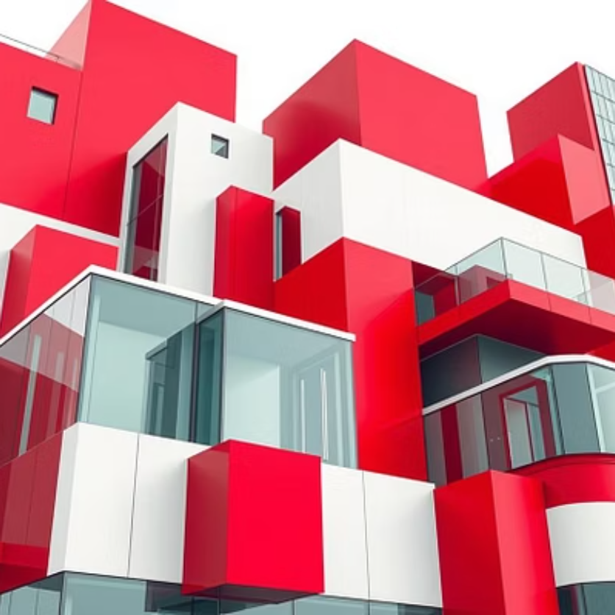


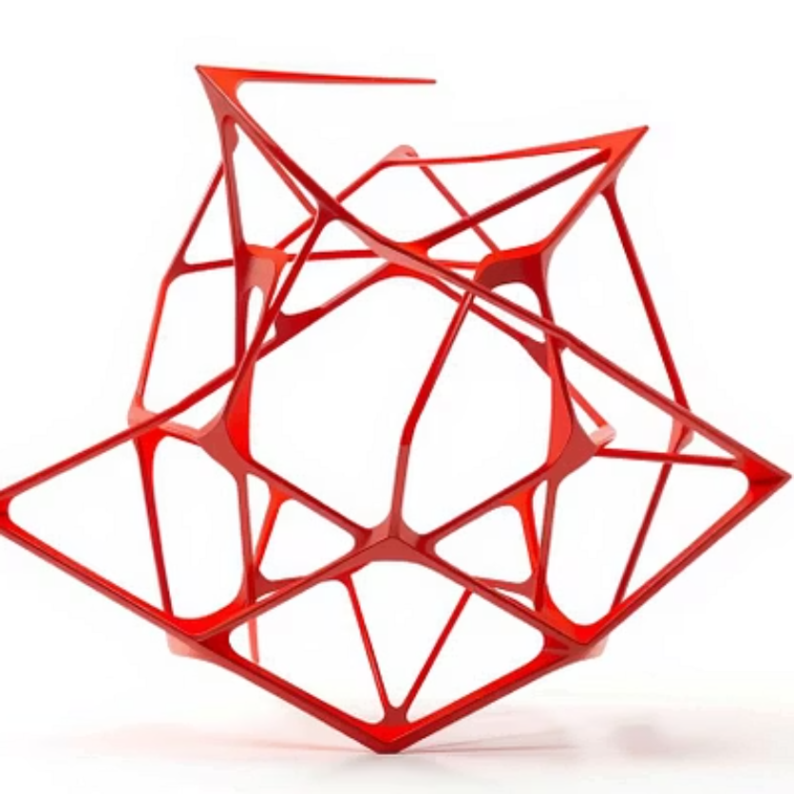
Solids in the Real World: Beyond the Classroom
Solid shapes are everywhere around us!
Architecture: Buildings often take the form of prisms, pyramids, or spherical domes.
Engineering: Bridges, car parts, and machinery all incorporate various solid geometries.
Packaging: From cereal boxes to soda cans and gift boxes, solids are fundamental to product packaging.
Art & Design: Sculptures, product designs, and animations frequently utilize 3D forms.

Slide 10
Conclusion: The Power of 3D Thinking
Spatial Reasoning
1
Understanding solids is crucial for developing strong spatial reasoning skills, a foundation for future learning.
Key Concepts Mastered
2
You've learned about faces, edges, vertices, and their properties, unlocking the anatomy of 3D shapes.
Visualize & Analyze
3
Using different views and nets helps you analyze and understand complex 3D structures.
Future Foundations
4
This knowledge is foundational for advanced math, science, and engineering fields. Keep observing 3D shapes in your world!

