Slide 1
Bhuj earthquake of 2001
R.P.Srisharan
7A

Slide 2
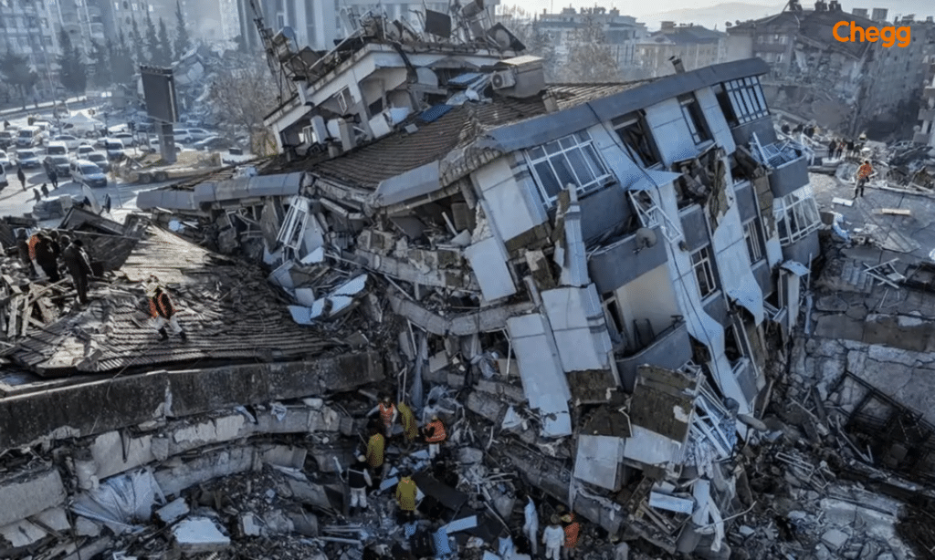
A serve earthquake struck the Kachchh region of Gujarat at 8.45 a.m. on 26 January 2001.It lasted for almost a minute.

Slide 3
Due to the earthquake, high-rise buildings collapsed, communication and power lines were completely disrupted, the transport system was thrown out of gear, and settlements became heaps of debris

Slide 4
The epicenter was near the town of Bhuj. The intensity of this earthquake was measured at 8.1 on the Richter scale by the Indian Meteorological Department.

Slide 5
About 50,000 people were killed and more than 5,00,000were adversely affected. There was large scale destruction of property in Bhuj, Rajkot and Ahmedabad.
(A)Seafloor spreading of the Indian Ocean at the rate of 5 cm per year.
(b)Gradual northward movement of the Indian plate.
(c)The reactivated faults below the surface in the Kachchh region.

Slide 6
THANK YOU

